Slide 2
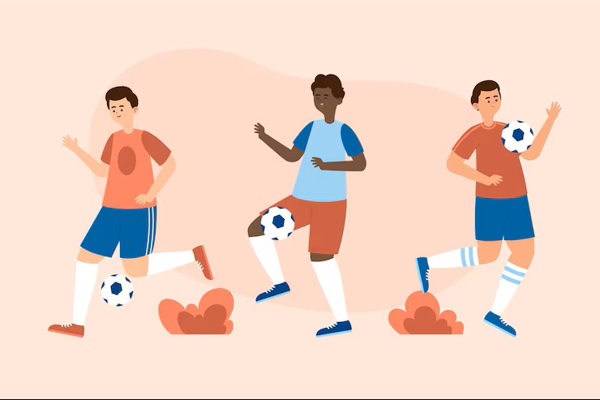

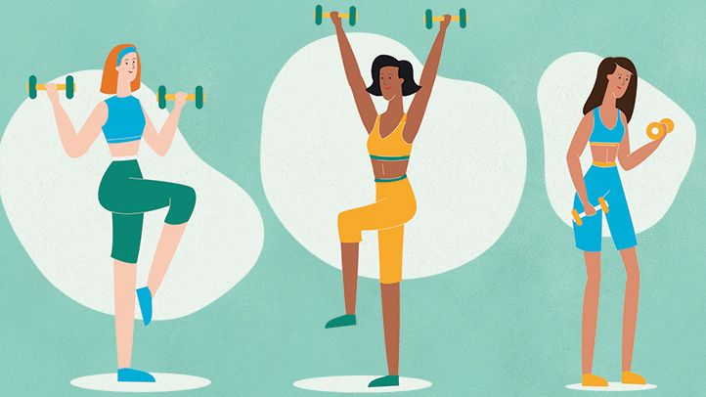
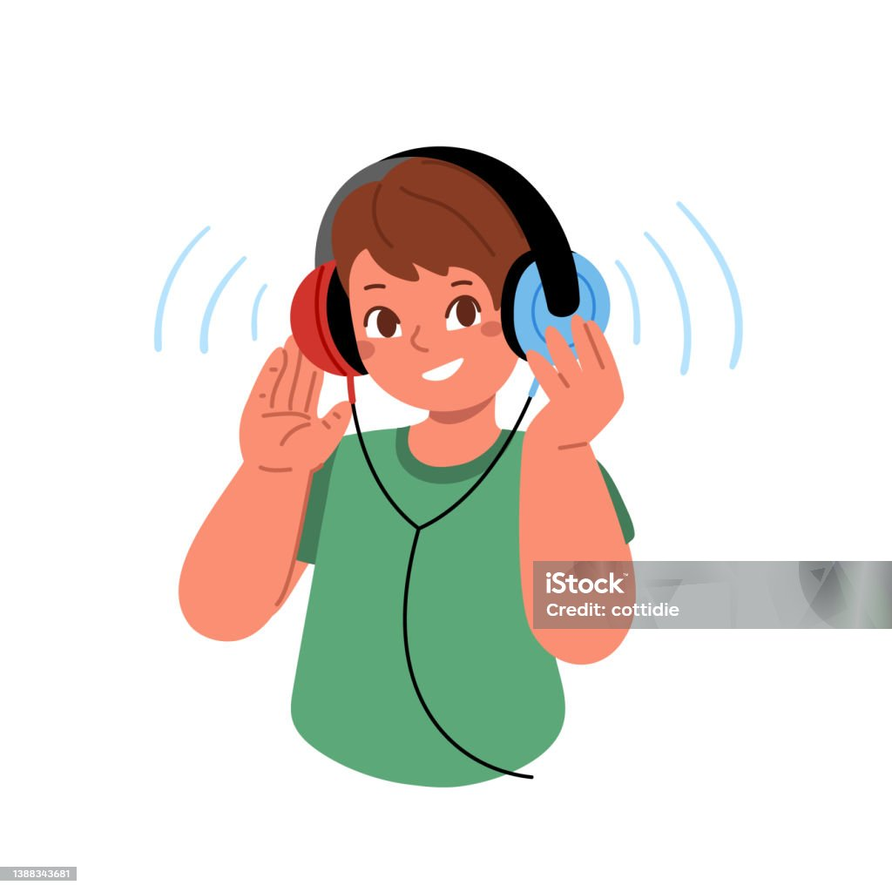
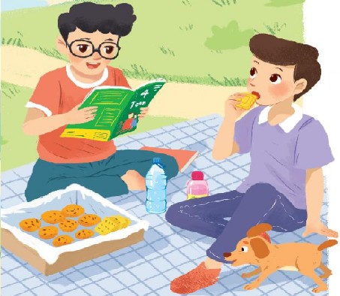
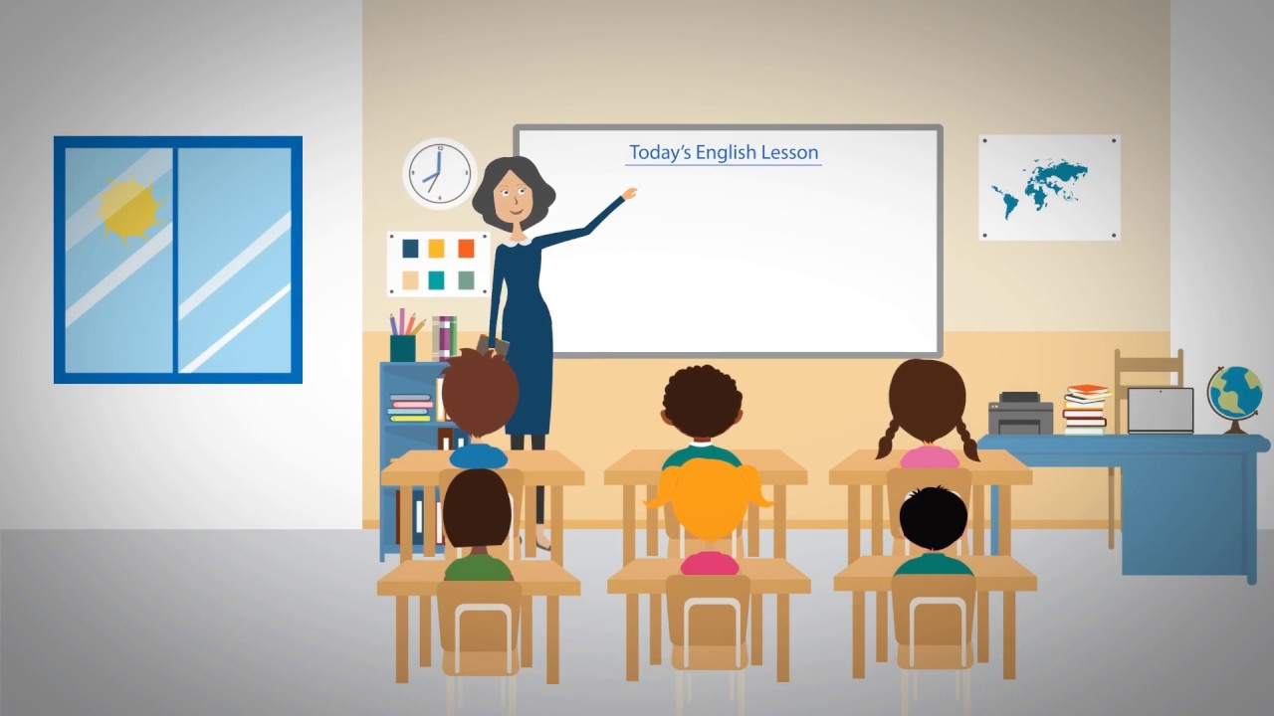
Do you have many friends at new school?
WARM-UP
Match the phrases with correct pictures
LESSON 1: GETTING STARTED
have a picnic
listen to music
play football
do exercise
read books
learn many subjects
1

Slide 3


Unit
3
MY FRIENDS
LESSON 1: GETTING STARTED
A surprise guest

Slide 4


New words
pass (v)
/pɑːs/
Chuyền, đưa

Slide 5
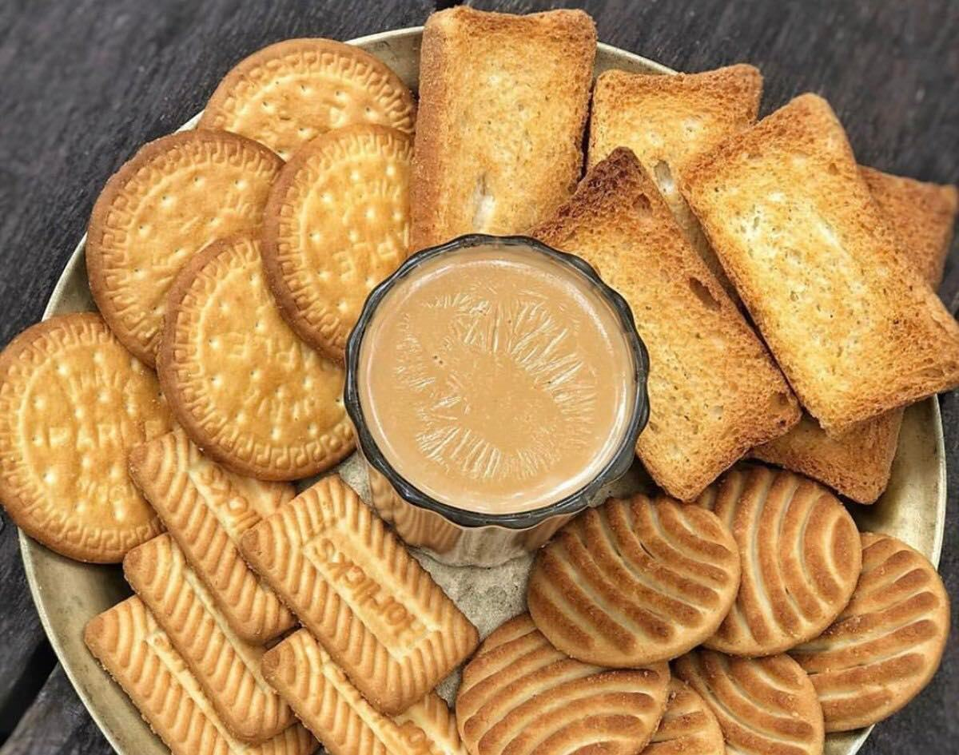
New words
biscuits (n)
/ˈbɪs.kɪt/
Bánh quy

Slide 6

New words
magazine (n)
/mæɡ.əˈziːn/
Tạp chí

Slide 7
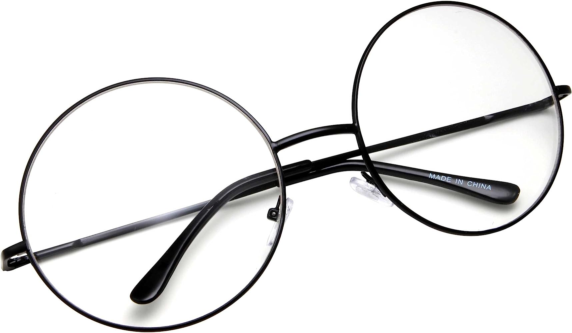
New words
glasses (n)
/ˈɡlɑːsɪz/
mắt kính

Slide 8

New words
cheek (n)
/tʃiːk/
má

Slide 9

New words
bookshop (n)
/ˈbʊk.ʃɒp/
Cửa hàng sách

Slide 10
New words
New words | Pronunciation | Meaning
pass (v) | /pɑːs/ | Đưa, chuyền
2. biscuits (n) | /ˈbɪs.kɪt/ | Bánh quy
3. magazine (n) | /mæɡ.əˈziːn/ | Tạp chí
4. glasses (n) | /ʌnˈjuːʒuəl/ | Mắt kính
5. cheek (n) | /tʃiːk/ | má
6. bookshop (n) | /ˈbʊk.ʃɒp/ | cửa hàng sách

Slide 11
CHECKING New words
cheeks
magazine
pass
glasses
biscuits
bookshop
1. Would you like some tea and _______?
2. Hoa Hoc Tro is my sister’s favourite _________?
3. Can you _____ me that book, please?
4. I often go to the ________ to buy English books.
5. The baby has round face and chubby _______.
6. My father wears _______ when he reads books

Slide 12

PRACTICE
1
Listen and read.
Phong: That was a great idea, Nam. I love picnics!
Nam: Please pass me the biscuits.
Phong: Sure. Here you are.
Nam: Thanks. What are you reading, Phong?
Phong: 4Teen. It’s my favourite magazine!
Nam: Look! It’s Mai. And she is with someone.
Phong: Oh, who’s that? She has glasses and long black hair.
Nam: I don’t know. They’re coming over.
Mai: Hi there. This is my friend Chau.
Phong & Nam: Hi, Chau. Nice to meet you.
Chau: Nice to meet you, too.
Nam: Would you like to sit down? We have lots of food.
Mai: Oh, sorry, we can’t. We’re going to the bookshop.
Chau: Bye for now.
Phong & Nam : Bye bye.

Slide 13

Read the conversation again and choose T/ F
LESSON 1: GETTING STARTED
Phong: That was a great idea, Nam. I love picnics!
Nam: Please pass me the biscuits.
Phong: Sure. Here you are.
Nam: Thanks. What are you reading, Phong?
Phong: 4Teen. It’s my favourite magazine!
Nam: Look! It’s Mai. And she is with someone.
Phong: Oh, who’s that? She has glasses and
long black hair.
Nam: I don’t know. They’re coming over.
Mai: Hi there. This is my friend Chau.
Phong & Nam: Hi, Chau. Nice to meet you.
Chau: Nice to meet you, too.
Nam: Would you like to sit down? We have lots of food.
Mai: Oh, sorry, we can’t. We’re going to the bookshop.
Chau: Bye for now.
Phong & Nam : Bye bye.
Statements | True | False
1. Phong and Nam are having a party
2. Phong is reading 4Teen
3. Phong and Nam see Mai and Chau
4. Chau has glasses and short black hair
5. Mai and Chau are going to the class

Slide 14
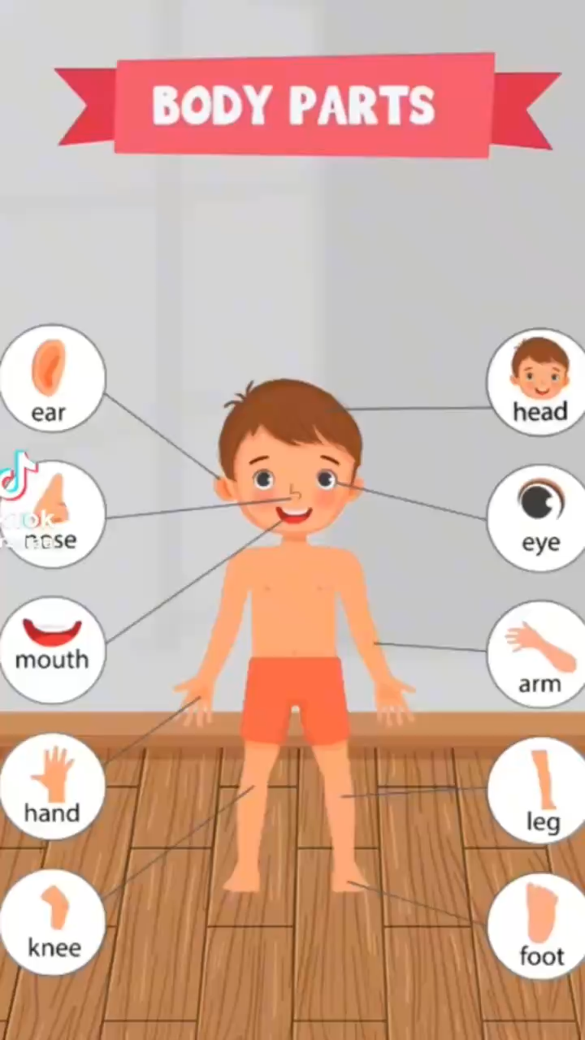
The body part song
Notes:
Teacher plays the song on speakers.
Teacher and students sing along and point at the mentioned body parts in the song lyrics. Do 2-3 times and make it faster each time.
Link: https://www.youtube.com/watch?v=YGi3f_fHIzg

Slide 15
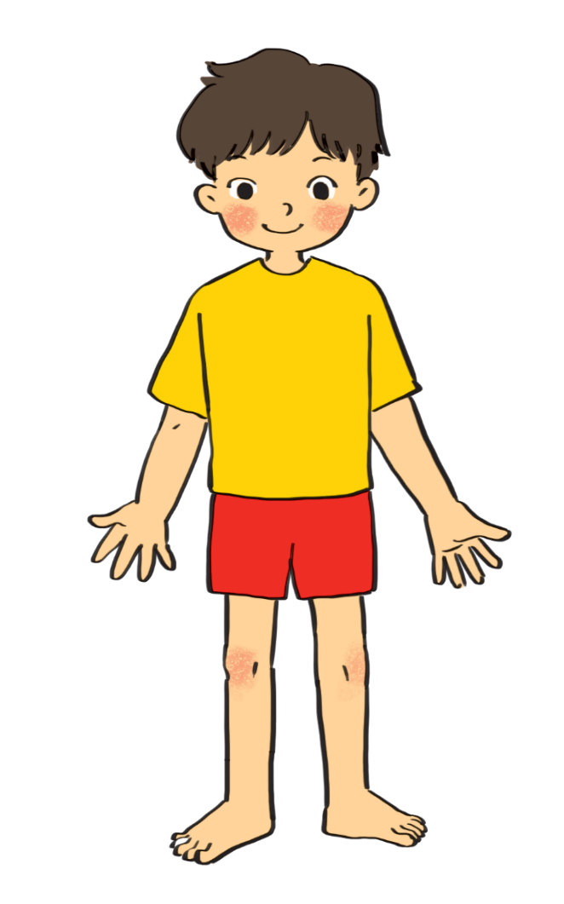
PRACTICE
Label the body parts with the words in the box.
3
cheek
eye
hand
arm
mouth
cheek
eye
hand
arm
mouth
leg
nose
hair
shoulder
foot
leg
nose
hair
shoulder
foot
eye
hair
1.
10.
2.
nose
9.
cheek
shoulder
8.
mouth
3.
7.
arm
4.
hand
5.
leg
foot
6.

Slide 16

Simon says:
He has curly hair and big nose
Who is Phong?

Slide 17
PRACTICE
4
Work in groups. Complete the word webs.
arms
hair
nose
eyes
Example:
long / short
big / small
leg
fingers
blonde
curly
hair

Slide 18
PRACTICE
4
Work in groups. Complete the word webs.
Example:
nose
eyes
big / small
head
foot
hand
ears

Slide 19


PRACTICE
4
Work in groups. Complete the word webs.
Example:
long/ short
blonde
curly
hair
straight
black

Slide 20


PRODUCTION
5
Guessing
Work in groups. Take turns to describe a friend. Other group members guess who he / she is.
Example:
A: She has long black hair and big eyes.
B: Is that Lan?
A: That’s right.

Slide 21

CONSOLIDATION
1
Wrap-up
What have we learnt in this lesson?
identify the topic of the unit
use lexical items related to friends
identify the language features that are covered in the unit

Slide 22

CONSOLIDATION
2
Homework
- Write some sentences to describe at least 3 classmates.
- Do exercises in the workbook.
- Start preparing for the Project of the unit.

Slide 23






Website: hoclieu.vn
Fanpage: facebook.com/www.tienganhglobalsuccess.vn/

