Slide 1
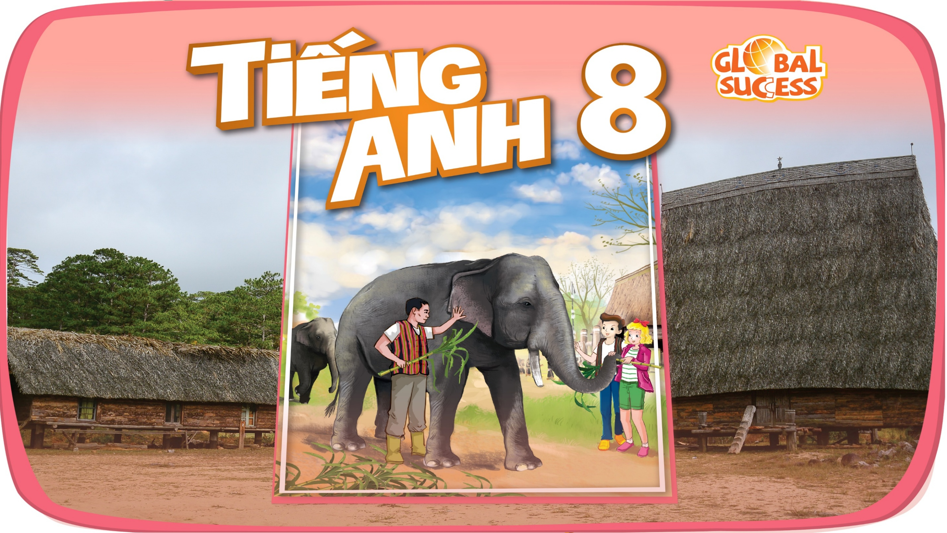

Slide 2

Unit
2
LIFE IN THE COUNTRYSIDE
LESSON 5: SKILLS 1

Slide 3
LESSON 5: SKILLS 1
WARM-UP
Task 1: Work in pairs. Look at the picture and discuss the questions.
Vocabulary
Task 2: Read the text and match the highlighted words in the text with their meanings.
Task 3: Read the text again and tick T (True) or F (False) for each sentence.
READING
Task 4: Make notes about the village or town where you live or which you know.
Task 5: Work in groups. Take turns to talk about the village or town where you live or which you know. Use the information in 4.
SPEAKING
Wrap-up
Homework
CONSOLIDATION

Slide 4
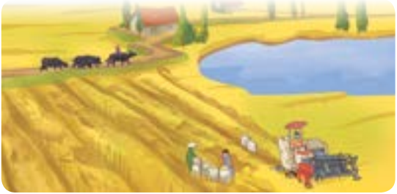

WARM-UP
1
Work in pairs. Look at the picture and discuss the following questions.
1. What can you see in it?
2. Which of the following adjectives describe the picture?
- The buffalos are riding on the field.
People are harvesting the crop by combine harvester.
There is a lake and a house. There are many tall
trees.
Peaceful, vast, picturesque

Slide 5
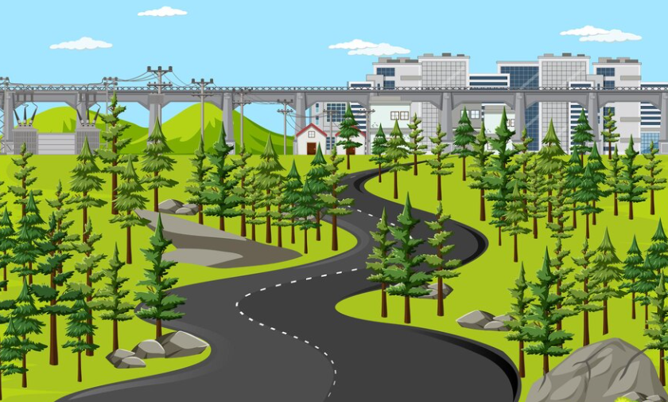

READING
* New vocabulary
stretch (v)
/stretʃ/
trải dài

Slide 6
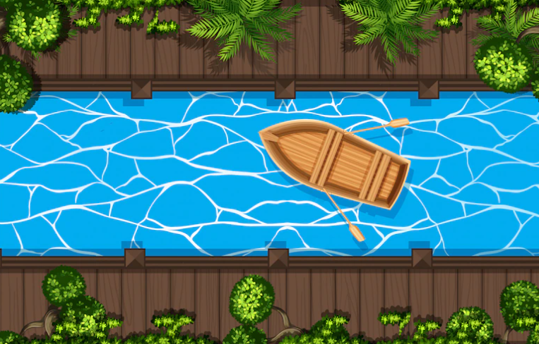
READING
* New vocabulary
canal (n)
/kəˈnæl/
kênh đào

Slide 7
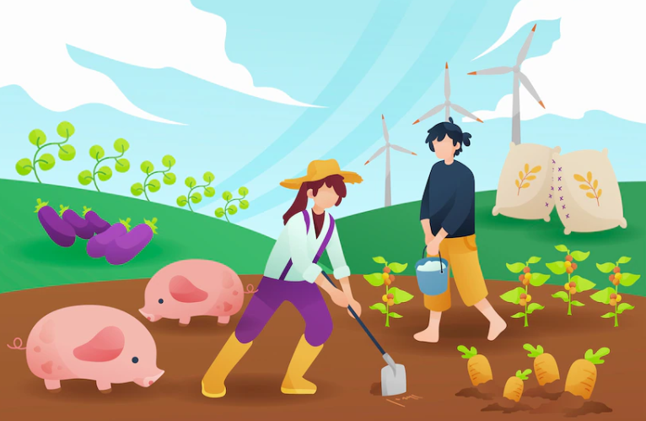
READING
* New vocabulary
cultivate (v)
/ˈkʌltɪveɪt/
canh tác

Slide 8
READING
* New vocabulary
New words | Pronunciation | Vietnamese equivalent
1. stretch (v) | /stretʃ/ | trải dài
2. canal (n) | /kəˈnæl/ | kênh đào
3. cultivate (v) | /ˈkʌltɪveɪt/ | canh tác

Slide 9
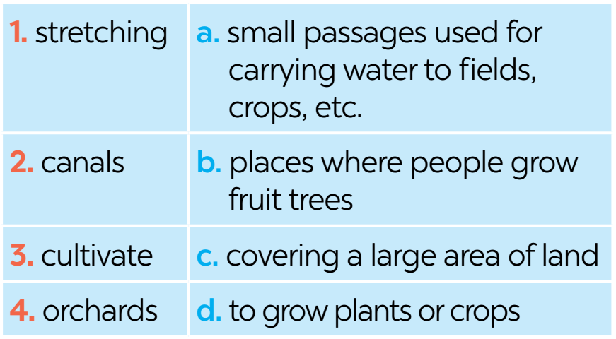
READING
2
Read the text about life in a village in Viet Nam. Match the highlighted words in the text with their meanings (Read the text in Hoclieu.vn)

Slide 10

READING
3
Read the text again and tick T (True) or F (False) for each sentence. (T uses hoclieu.vn)
 | T | F
1. Life in the author’s village is very peaceful.
2. The people in the village work very hard.
3. Villagers live only by catching fish in lakes, ponds, and canals.
4. The children are always busy helping their parents.
5. The villagers get along well.

Slide 11
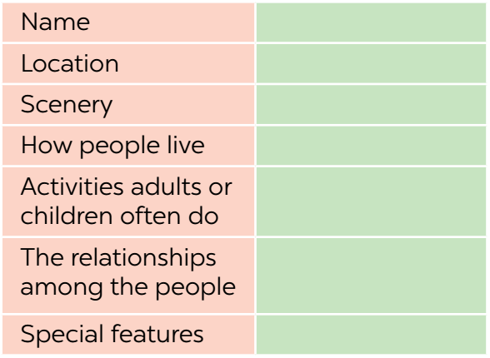
SPEAKING
4
Make notes about the village or town where you live or which you know.
Keo Quan
Located in Quoc Khanh
Beautiful, there are tall trees
work hard, grow vegetables, cultivate rice, raise cattles
children play mobile games, help their parents
Know each other well
People meet in the evening, eat fruit, sing folk sóng

Slide 12
SPEAKING
5
Work in groups. Take turns to talk about the village or town where you live or which you know. Use the information in 4.
Keo Quan
I live in Keo Quan. It’s an old village located in ……... The scenery is..….....People work ……Children play…….and ……. They know…………People meet…….
Located in Quoc Khanh
Beautiful, there are tall trees
work hard, grow vegetables, cultivate rice, raise cattles
children play mobile games, help their parents
Know each other well
People meet in the evening, eat fruit, sing folk sóng

Slide 13

CONSOLIDATION
1
Wrap-up
What have we learnt in this lesson?
read about different aspects of a Vietnamese village;
talk about a village or town where one lives or which one knows;

Slide 14

CONSOLIDATION
2
Homework
Do exercises in the workbook.

Slide 15

Website: hoclieu.vn
Fanpage: facebook.com/www.tienganhglobalsuccess.vn/

