Slide 1
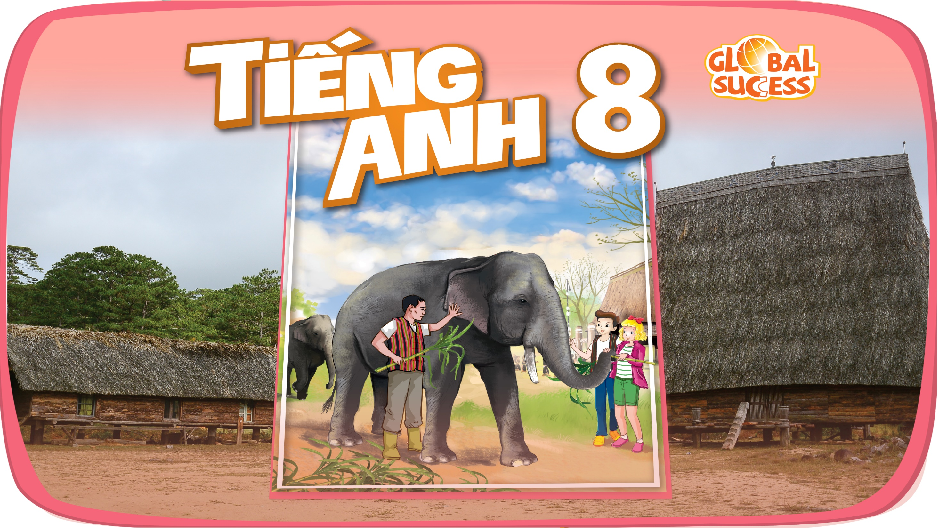

Slide 2

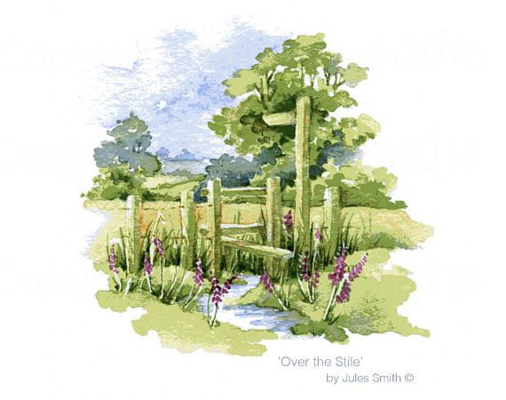
Unit
2
LIFE IN THE COUNTRYSIDE
LESSON 4: COMMUNICATION

Slide 3
WARM-UP
1. Thank you. Yours’ re, too.
2. Happy birthday. Wow you’re wearing such a beautiful dress
3. Here is your present. I hope you like it.
JUMBLED
CONVERSATION
4. I’m glad you like it.
5. This is the best gift I have ever had. I love it.

Slide 4

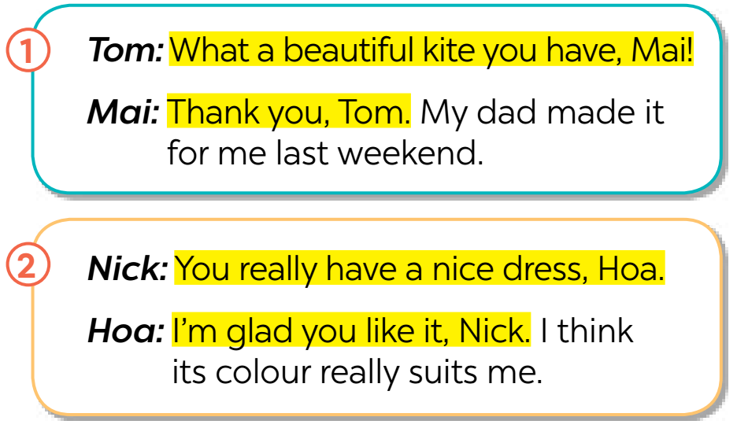
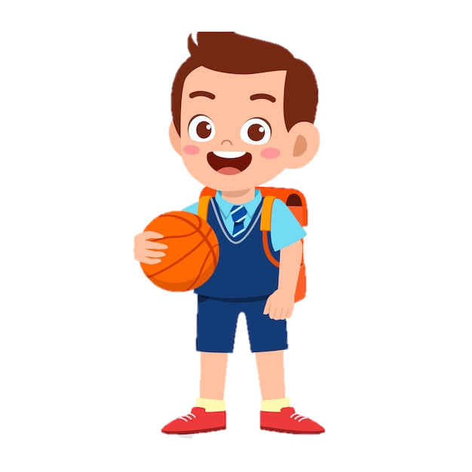

EVERYDAY ENGLISH
1
Listen and read the conversations. Pay attention to the highlighted sentences.
Giving compliments | Responding to compliments
- What a beautiful kite you have! - You really have a nice dress. | - Thank you. - I’m glad you like it.

Slide 5

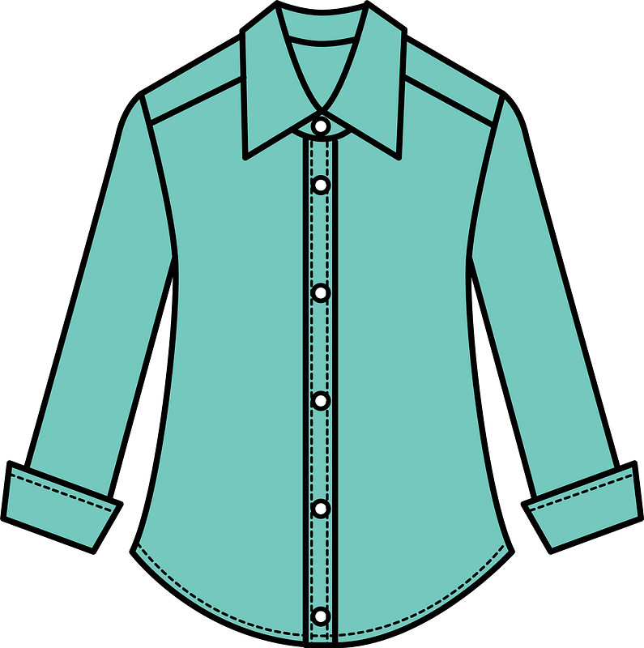
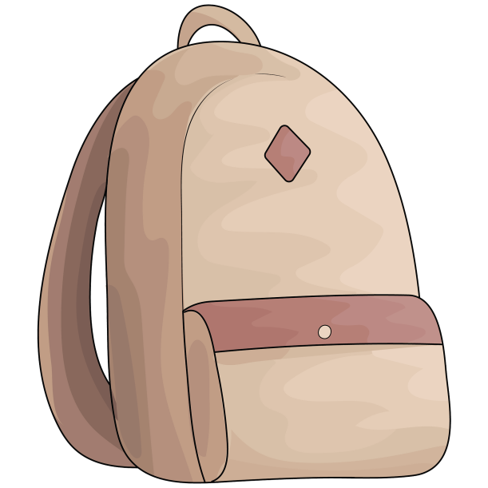
EVERYDAY ENGLISH
2
Work in pairs. Make similar conversations to practise giving and responding to compliments, using the cues below.
– a shirt
– a bicycle
– a school bag

Slide 6


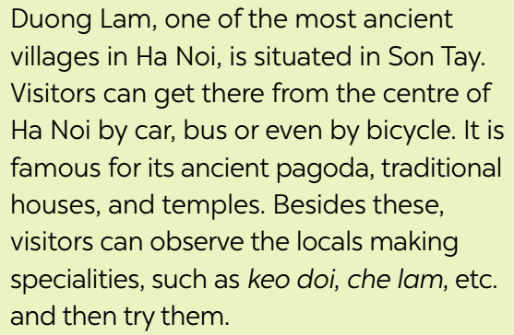
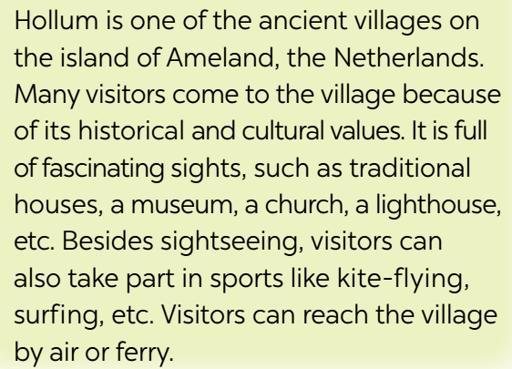
ADVERTS FOR BEAUTIFUL VILLAGES
Read the adverts for the two beautiful villages. tick the boxes to show which village the statements describe. Sometimes both boxes need to be ticked.
3
Duong Lam and Hollum are both ancient villages, …

Slide 7
ADVERTS FOR BEAUTIFUL VILLAGES
3
Read the adverts for the two beautiful villages. tick the boxes to show which village the statements describe. Sometimes both boxes need to be ticked.
Statements | Duong Lam | Hollum
1. It’s an ancient village.
2. We can visit an ancient pagoda, traditional houses, and temples in this village.
3. We can get there by plane or ferry.
4. We can go there by car, bus, or bike.
5. It has a lighthouse.

Slide 8
ADVERTS FOR BEAUTIFUL VILLAGES
4
Work in groups. take turns to talk about the similarities and differences between Duong Lam and Hollum
Duong Lam and Hollum are both ancient villages, …

Slide 9
ADVERTS FOR BEAUTIFUL VILLAGES
4
Work in groups. take turns to talk about the similarities and differences between Duong Lam and Hollum
the similarities : Duong Lam and Hollum are both ancient villages, …
The differences : Duong Lam is situated in Son Tay, Ha Noi
in Viet Nam,
- get there by car, bus or even by bicycle
- places to visit: traditional houses, and temples
Hollum is located on the island of Ameland, New Zealand.
- get there by plane or ferry
- places to visit: traditional houses, a museum, a church, a lighthouse

Slide 10

ADVERTS FOR BEAUTIFUL VILLAGES
5
Work in pairs. Which village in 3 would you like to visit for a holiday? Explain your choice to your partner.
Example:
A: Which village would you like to visit for a holiday?
B: Duong Lam, of course!
A: Why?
B: Because I love watching the locals making specialities and …

Slide 11
Exercise 1: Choose the correct answer (adjective or adverb) to complete the sentences.
1. Horses, mountain bikes and feet work ________ on grasslands. (good/ well)
2. Agriculture is still based on _____ methods in some countries. (traditional/ traditionally)
3. The _ populated provinces present a different economic picture.(dense/ densely) dày đặc
4. He is very ________ . He often buys things for other people. (generous/ generously)
5. The village is ________ situated in a quiet spot near the river. (beautiful/ beautifully)
6. Our house is very central, so we can ______ get to theatres and cinemas. (easy/ easily)
7. Children in the countryside play (more freely / freely) than those in the city.
8. She ________ ran down the stairs to greet her cousins. (excited/ excitedly)
9. The Thompson left their homeland and looked for a ________ place to stay. (permanent/ permanently)lâu dài
10. Some reporters spoke ________ about rural development. (optimistic/ optimistically) lạc quan

Slide 12
Exercise 1 : Choose the correct answer (adjective or adverb) to complete the sentences.
Horses, mountain bikes and feet work on grasslands. (good/ well)
Agriculture is still based on methods in some countries. (traditional/ traditionally)
The populated provinces present a different economic picture. (dense/ densely)
He is very . He often buys things for other people. (generous/ generously)
The village is situated in a quiet spot near the river. (beautiful/ beautifully)
Our house is very central, so we can get to theatres and cinemas. (easy/ easily)
Children in the countryside play (more freely / freely) than those in the city.
She ran down the stairs to greet her cousins. (excited/ excitedly)
The Thompson left their homeland and looked for a place to stay. (permanent/ permanently)
Some reporters spoke about rural development. (optimistic/ optimistically)

Slide 13
Exercise 2 :. Complete the sentences with suitable forms of the adverbs given in the brackets.
→ My mother can cook _________________________________________ .
5 . Phong is a faster swimmer than Phuc. (fast)
→ Phong swims _____________________________________________ .
6. Nick is a careful writer than Phuc. (carefully)
→ Nick writes essays ____________________________________________ .
7. Tom works hard, but Mi didn’t .Therefore, he got better results in the exams. (hard)
→ Tom works ________________________________ .
8. Living in the countryside is not as convenient as living in the city.(than)
→ Living in the city is __________________________________ .
9. My English is more fluent than my sister’s. (fluently)
→ I speak English ___________________________________________ .
10.My cousin is a better singer than I am. (well)
→ My cousin sings _________________________________________

Slide 14
b. Complete the sentences using the words and phrases below to help you
1. my cousin / crazy about / play / computer / games
…………………..………………
2. they / interested / play / badminton / after school?
..............................................................................................
3. I / not fond / make models / because / I / not patient
…………………………………………………………….
4. - why / you / not into / cook?- because / often / burn myself
……………………………………………………
5. my friends / keen / do judo / and / they / go / judo club / every Sunday.
……………………………………………………………………………………………

Slide 15
Exercise 2: Complete the sentences with suitable forms of the adverbs given in the brackets.
1.I am faster worker than Tom is. (fast)
I work faster than Tom..
2.Jack’s car cannot run as fast as Tom’s car. (faster)
→Tom’s car can run faster than Jack’s car..
3.Mai’s singing is more beautiful than Mi’s. (beautifully)
→Mai sing more beautifully than Mi.
4.I can’t cook as well as my mother .
→My mother can cook better than me/ I can.
5.Phong is a faster swimmer than Phuc. (fast)
→Phong swims faster than Phuc (does).
6.Nick is a careful writer than Phuc. (carefully)
→Nick writes essays more carefully than Bill (does).
7.Tom works hard, but Mi didn’t . Therefore, he got better results in the exams. (hard)
→Tom works harder than Mi.Therefore, he got better results in the exams.
8.Living in the countryside is not as convenient as living in the city.(than)
→Living in the city is more convenient than living in the countryside.
9.My English is more fluent than my sister’s. (fluently)
→I speak English more fluently than my sister’s.
10.My cousin is a better singer than I am. (well)
→My cousin sings better than I do/ me.

Slide 16

CONSOLIDATION
1
Wrap-up
What have we learnt in this lesson?
How to give and respond to compliments

Slide 17

CONSOLIDATION
2
Homework
Do exercises in the workbook.

Slide 18

Website: hoclieu.vn
Fanpage: facebook.com/www.tienganhglobalsuccess.vn/

