Slide 1


Slide 2
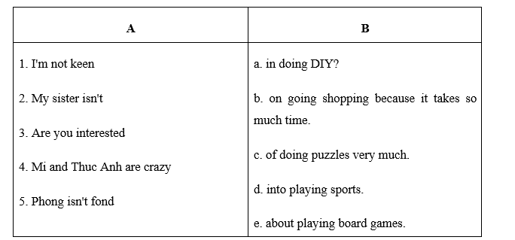
2. Match the sentence half in A with the other half in B to make a complete sentence.

Slide 3
3. Fill in each blank with a suitable word. 1. Mark is ________ about sport, and he can play basketball, football, table tennis, and golf. 2. Are you keen ________ gardening or going shopping? 3. Many girls are interested in ________ DIY. 4. My mum and I love ________, so we can spend hours in the kitchen. 5. Is your grandfather ________ of collecting stamps and coins? - Yes, he is. 6. What does your brother do in his free time? - He usually ________ the net.
crazy
on
doing
cooking
fond
surfs

Slide 4
Rewrite the sentences 1. I like reading books, listening to music, and drawing in my free time. I like………………………… 2. My brother is interested in doing puzzles. My brother likes……………………………….. 3. My favourite leisure activity is doing DIY. I like……………………………. 4. They are crazy about cooking. They like…………………………… 5. Phong detests playing computer games. Phong hates…………………………………..
books, music, and pictures.
doing puzzles.
doing DIY the most.
cooking very much.
playing computer games very much.

Slide 5


Unit
1
LEISURE TIME
LESSON 4: COMMUNICATION
1

Slide 6
LESSON 4: COMMUNICATION
WARM-UP
Asking questions
Task 1: Listen and read the conversations. Pay attention to the highlighted sentences
Task 2: Work in pairs. Practise inviting and accepting invitations in situations.
EVERYDAY ENGLISH
Task 3: Work in pairs. Answer the question.
Task 4: Read and complete the table with the information from the text.
Task 5: Work in groups. Ask and answer the questions.
TEENS’ LEISURE ACTIVITIES AROUND THE WORLD
CONSOLIDATION
Wrap-up
Homework

Slide 7
WARM-UP
Answer the questions:
1. What do you like doing in your free time?
2. What do your friends like doing in their free time?
3. What do young people in Viet Nam often do in their free time?
LEISURE ACTIVITIES

Slide 8

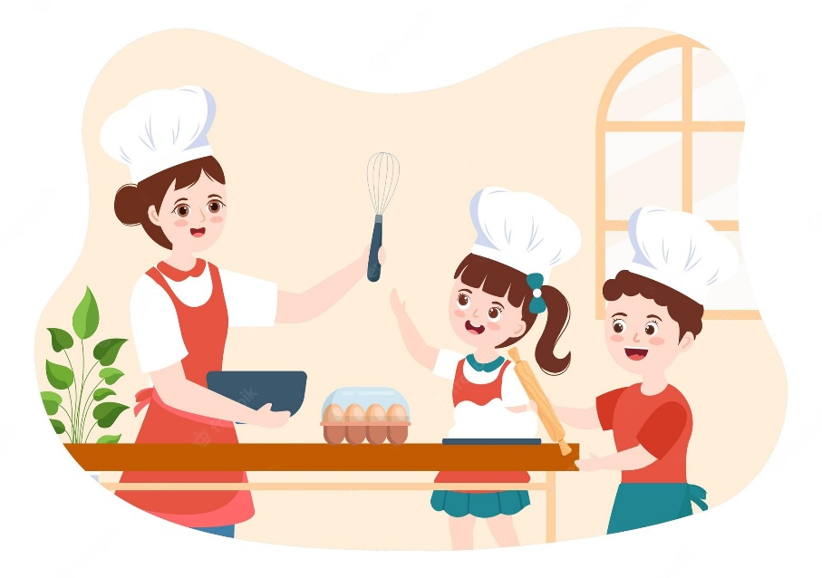
EVERYDAY ENGLISH
1
Listen and read the conversations. Pay attention to the highlighted sentences.
Trang: Would you like to go to the cooking club with me this Sunday?
Ann: I’d love to. Thanks.
1
Tom: Do you fancy going for a walk?
Mark: That’s great. Thanks.
2
Structures | Examples
How to invite | Would you like to… Do you fancy…
How to accept invitations | I’d love to. That’s great.

Slide 9
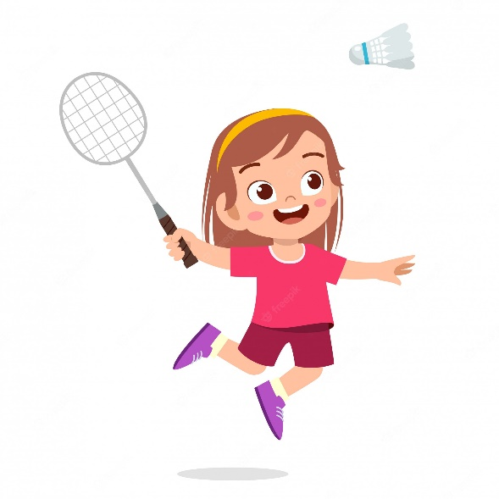

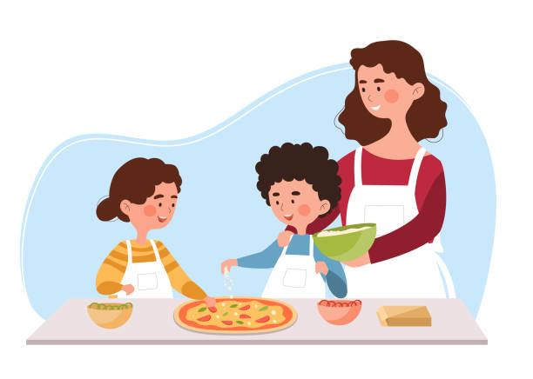
PRACTICE
2
Work in pairs. Practise inviting and accepting invitations in the following situations. Remember to use the highlighted language in 1.
You invite your friend to play badminton.
You invite your friend to make paper flowers with you.
You invite your friend to try your home-made pizza.

Slide 10
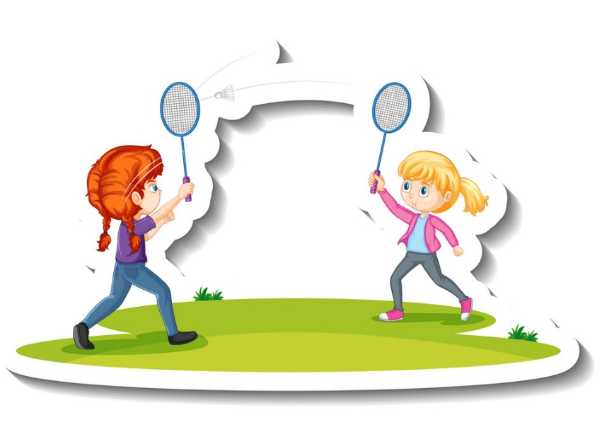
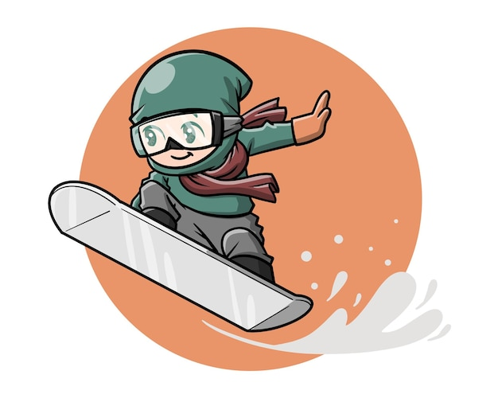
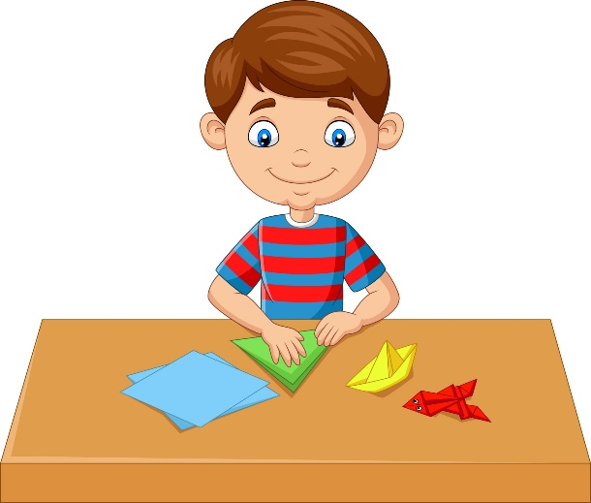
TEEN’S LEISURE ACTIVITIES AROUND THE WORLD
3
Work in pairs. Answer the question.
What is the activity in each picture?
doing origami
playing badminton
snowboarding

Slide 11
TEEN’S LEISURE ACTIVITIES AROUND THE WORLD
4
Read what three teenagers say about their leisure activities. Complete the table with the information from the text.
Name | Country | Leisure activity | Person / People to do the activity with | Benefits of the activity
Sakura | Japan
Eric | Switzerland
Lan | Viet Nam
doing origami
no one
helps her to relax
snowboarding
parents
improves his overall health and balance
playing badminton
best friend
- improves her muscle strength
- reduces stress

Slide 12
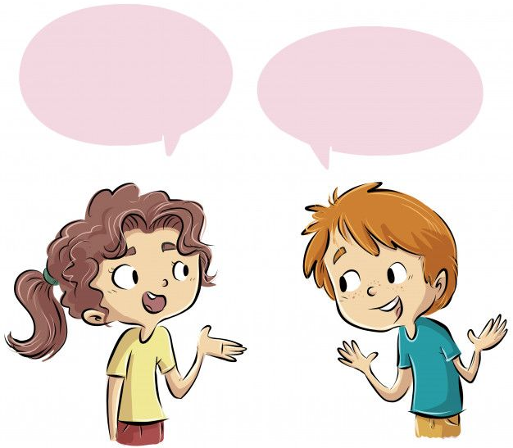
TEEN’S LEISURE ACTIVITIES AROUND THE WORLD
5
Work in groups. Ask and answer the questions.
Which of the activities in 4 do you want to try?
Why do you want to try it?

Slide 13

CONSOLIDATION
1
Wrap-up
What have we learnt in this lesson?
How to invite and accept invitations

Slide 14

CONSOLIDATION
2
Homework
Do exercises in the workbook.

Slide 15

Website: hoclieu.vn
Fanpage: facebook.com/www.tienganhglobalsuccess.vn/

