Slide 1
Find 6 meaningful words in the puzzle.
WARM-UP
A | N | C | H | E | C | K | E
P | P | O | S | T | O | S | E
I | E | N | A | C | U | U | B
C | O | N | M | U | A | T | E
T | W | E | B | S | I | T | E
U | A | C | L | I | P | D | I
R | S | T | D | Y | F | K | L
E | R | P | Q | E | A | O | V

Slide 2


Unit
3
TEENAGERS
LESSON 2: A CLOSER LOOK 1

Slide 3
LESSON 2: A CLOSER LOOK 1
WARM-UP
Game: Word puzzles
Task 1: Circle the correct options to complete the phrases.
Task 2: Use the correct form of the verbs in 1 to complete the sentences.
Task 3: Choose the correct answer A, B, or C.
VOCABULARY
Task 4: Listen and repeat the words. Pay attention to the sounds /ʊə/ and /ɔɪ/.
Task 5: Listen and practise the sentences. Underline the words with /ʊə/ and circle the words with /ɔɪ/.
PRONUNCIATION
FURTHER PRACTICE
Game: Kim’s game
CONSOLIDATION
Wrap-up
Homework

Slide 4


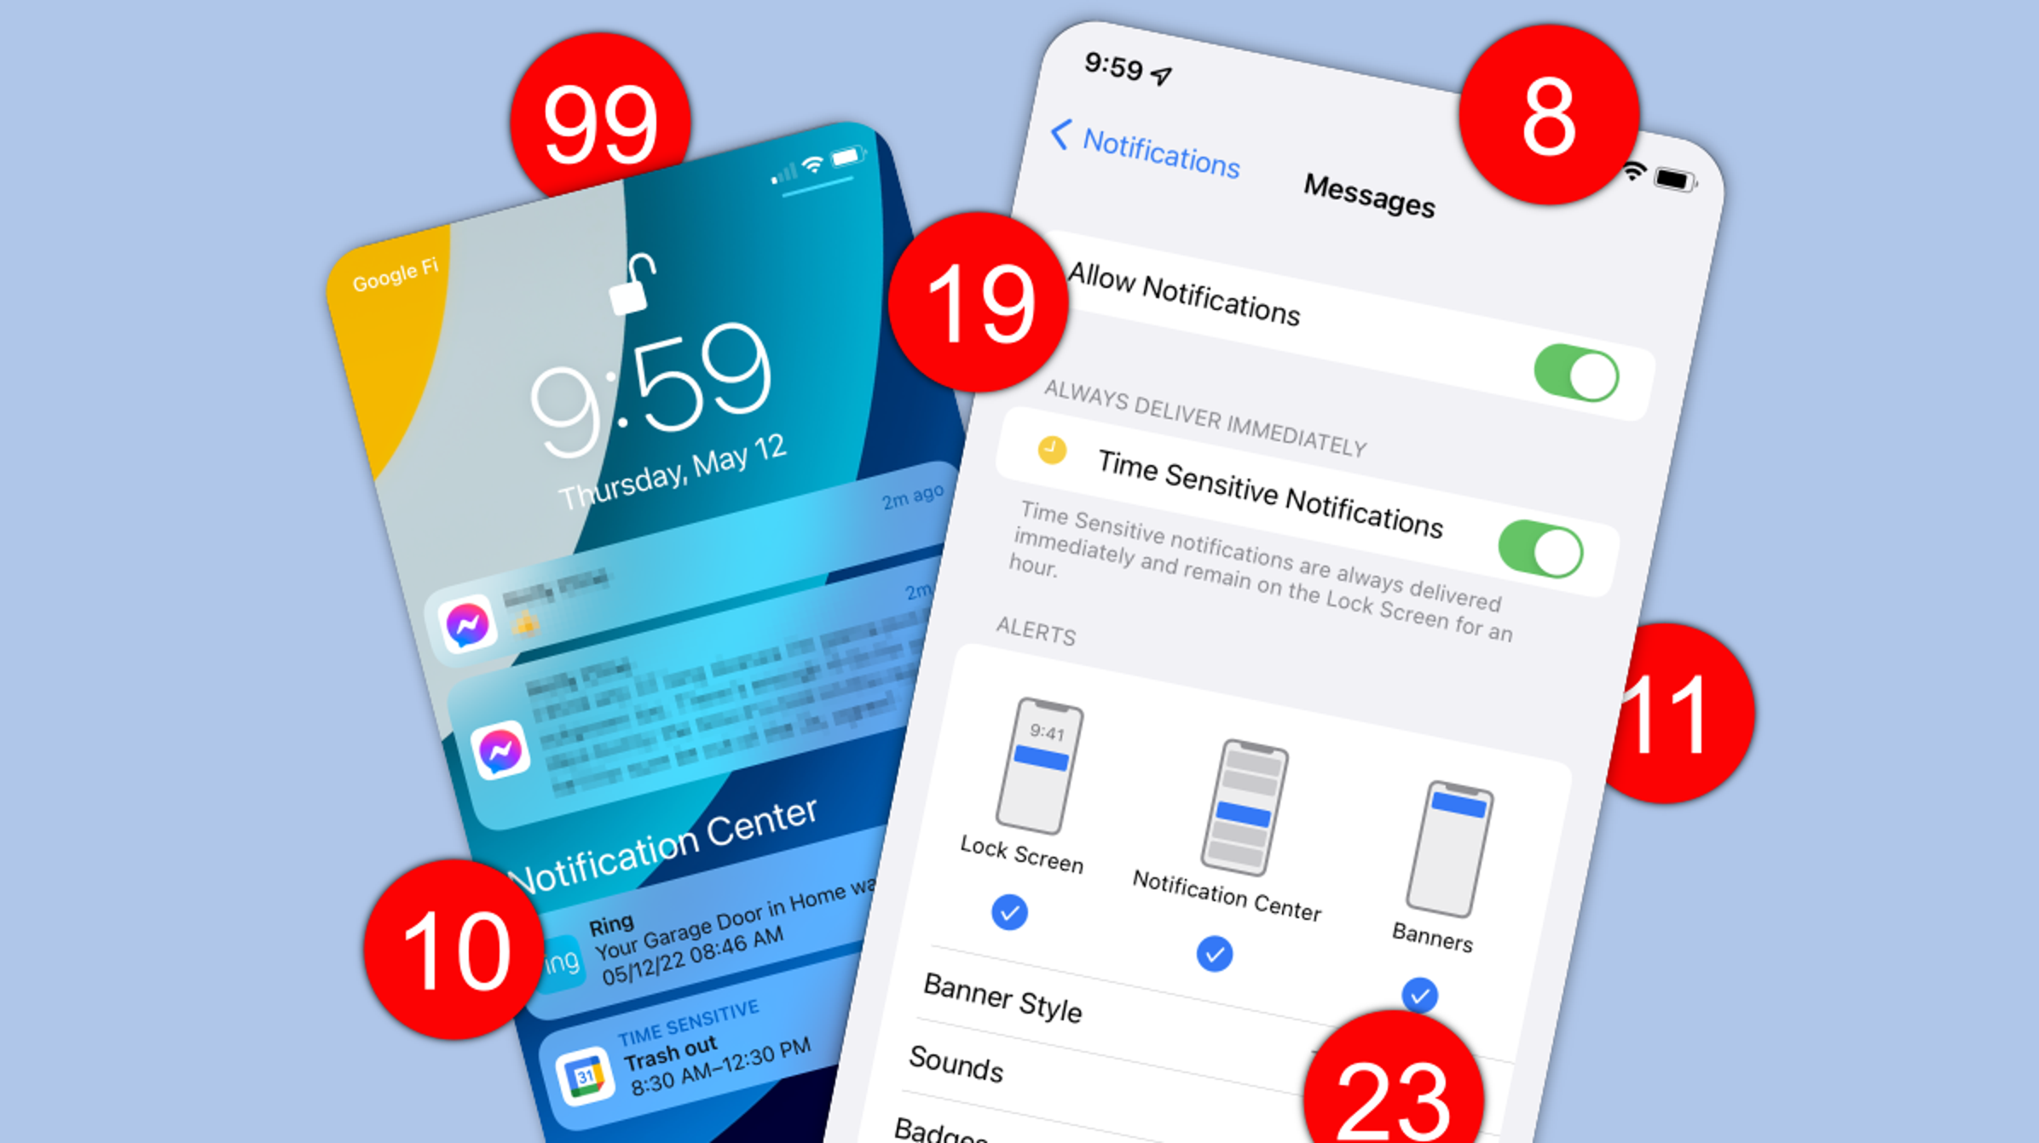
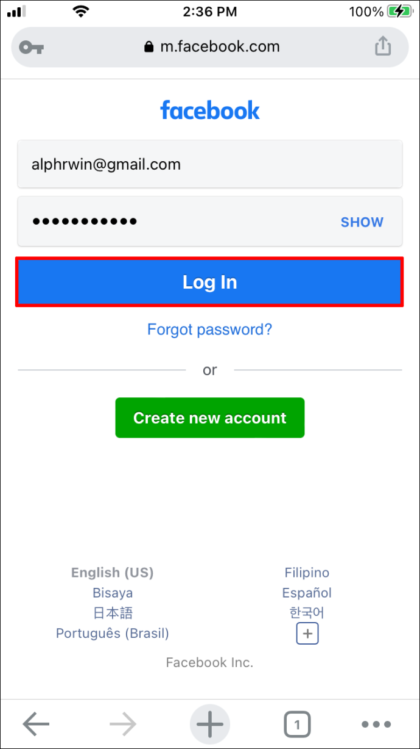
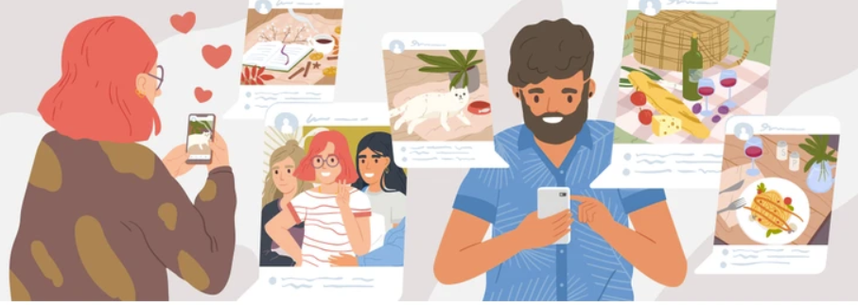
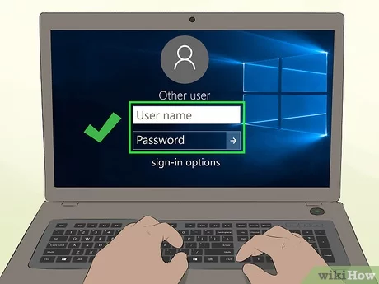
VOCABULARY:
upload (v)
/ˌʌpˈləʊd/:
tải lên
browse (v)
/braʊz/:
đọc lướt, tìm (trên mạng)
notification (n)
/ˌnəʊtɪfɪˈkeɪʃn/:
thông báo
log on to (v)
/lɒɡ ɒn tə/:
đăng nhập
check (v)
/tʃek/:
kiểm tra
account (n)
/əˈkaʊnt/:
tài khoản

Slide 5
VOCABULARY
New words | Pronunciation | Meaning
1. upload (v) | /ˌʌpˈləʊd/ | tải lên
2. browse (v) | /braʊz/ | đọc lướt, tìm (trên mạng)
3. notification (n) | /ˌnəʊtɪfɪˈkeɪʃn/ | thông báo
4. log on to (v) | /lɒɡ ɒn tə/ | đăng nhập
5. check (v) | /tʃek/ | kiểm tra
6. account (n) | /əˈkaʊnt/ | tài khoản

Slide 6



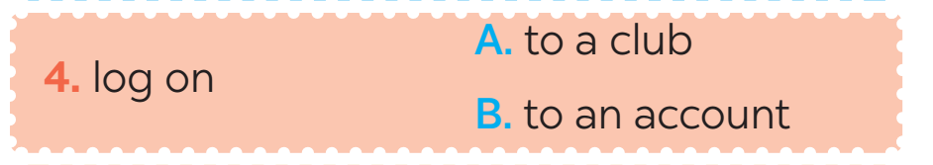

VOCABULARY:
1. Circle the correct options to complete the phrases.
1

Slide 7
VOCABULARY
2
Use the correct forms of the verbs in 1 to complete the sentences.
1. I________ the school website and found pictures of school activities.
2. Our teacher ________ a video of our last meeting in our forum for everyone to see.
3. She ________ with some old friends at the English club.
4. Tom ________ the notifications and saw some new posts.
5. Mi often ________ to her Instagram account to chat with her friends.
browsed
uploaded
connects
checked
logs on

Slide 8
VOCABULARY:
3. Choose the correct answer A, B, or C.
1. Our class has a(n)______, and we often post questions there to discuss.
A. office B. forum C. club
2. We try to meet our parents’ ______, but it is hard.
A. dreams B. interests C. expectations(kì vọng)
3. He is a big ______ and scares his weaker classmates.
A. bully(người hay bắt nạt người khác) B. forum C. pressure
4. She was chatting with her friends, so she couldn’t ______ on the lesson.
A. concentrate(tập trung)B. coach(huấn luyện) C. advise
5. We have ______ from our exams, peers, and parents. This makes us feel very stressed.
A. interests B. pressure C. friends

Slide 9


Slide 10
PRONUNCIATION
4
Listen and repeat the words. Pay attention to the sound /ʊə/ and /ɔɪ/. Then put the words into the correct columns
boy tourist toy ensure
avoid choice sure tournament
/ʊə/ | /ɔɪ/
tourist
boy
ensure
toy
sure
avoid
tournament
choice

Slide 11
PRONUNCIATION
5
Listen and practice the sentences. Underline the words with /ʊə/ and circle the words /ɔɪ/.
She is a noisy and curious girl.
They joined a full-day city tour.
I found it enjoyable to watch the tournament.
She’ll record our voices during the interview.
He is not acting very mature and is starting to annoy me.

Slide 12
FURTHER PRACTICE
RULE:
Work in 2 teams.
Students look closely and memorize the words in 1 minutes. Then rewrite those words in 5 minutes.
The team with more correct words will be the winner.

Slide 13
FURTHER PRACTICE: Kim’s Game
harvest
stress
cattle
upload
friendly
enjoy
noisy
toy
account
Keep in touch
crop
check
paddy field
avoid
Message friends
dislike
Notes:
* Teacher should prepare these words to stick on the board.

Slide 14

CONSOLIDATION
2
Homework
Do exercises in the workbook.
Learn by heart New words
Prepare: Lesson 3: Unit 2 A closer look 2

Slide 15

Website: hoclieu.vn
Fanpage: facebook.com/www.tienganhglobalsuccess.vn/

