Slide 1

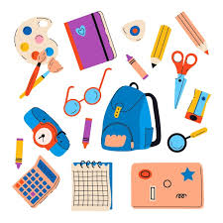

WELCOME TO CLASS 6A2
TEACHER: PHAN VAN DIEN

Slide 2


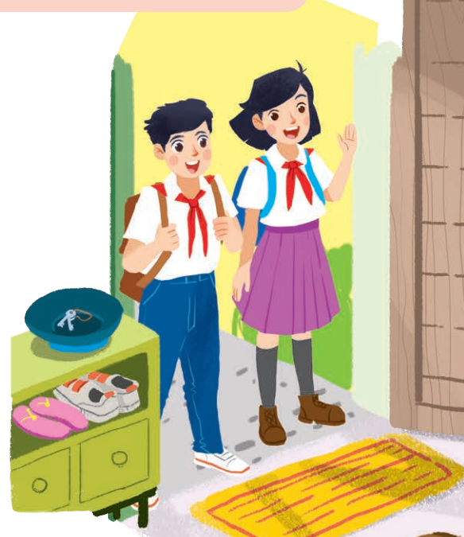
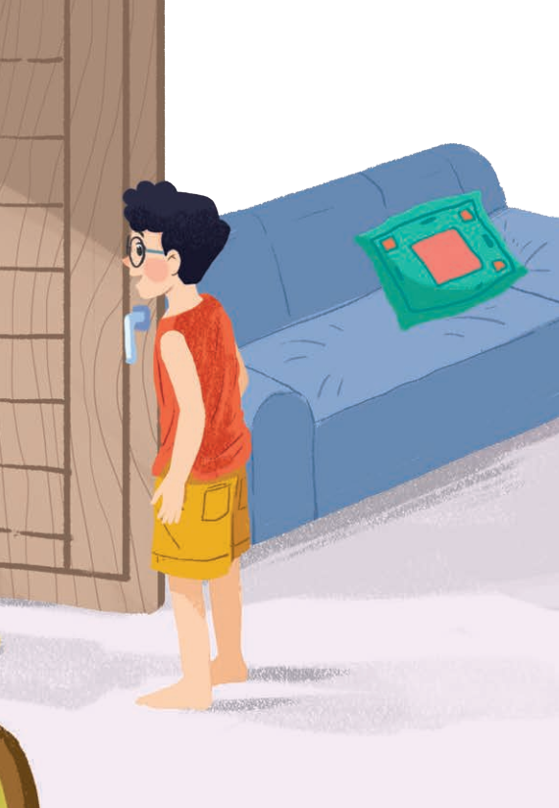
Unit
1
MY NEW SCHOOL
LESSON 1: GETTING STARTED
A special day
1

Slide 3
WARM-UP
Instructions
2 teams
Close your books.
Look at the picture.
WHAT CAN YOU REMEMBER?
Remember every detail in the picture in 1 minute.
Try to answer the questions.

Slide 4
WARM-UP

Slide 5
WARM-UP
Answer the questions:
1. How many people can you see in the picture?
2. Who are they?
3. Where are they?
4. What are the two students carrying on their backs?
5. Where are they going to?
→ I can see three people.
→ They are students.
→ They are at one of the boys’ homes.
→ They are carrying school bags/ backpacks.
→ They are going to school.

Slide 6


PRESENTATION
subject (n)
/ˈsʌbdʒekt/
môn học

Slide 7
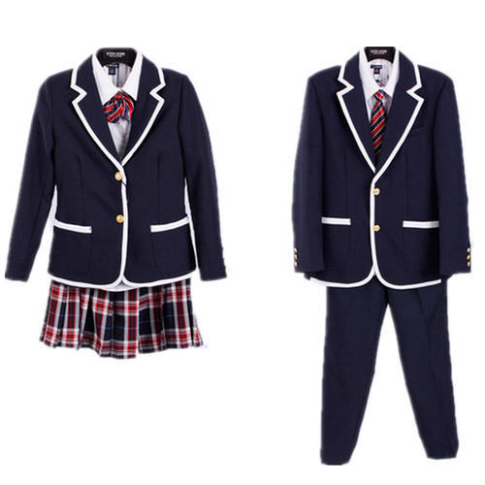
PRESENTATION
uniform (n)
/ˈjuːnɪfɔːm/
đồng phục

Slide 8
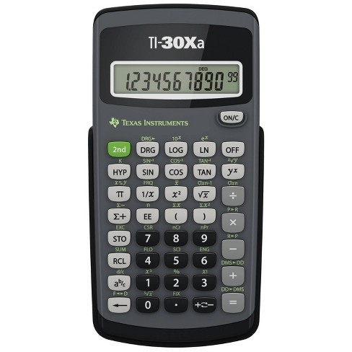
PRESENTATION
calculator (n)
/ˈkælkjəleɪtə(r)/
máy tính

Slide 9
PRESENTATION
New words | Pronunciation | Meaning
1. subject (n) | /ˈsʌbdʒekt/ | môn học
2. uniform (n) | /ˈjuːnɪfɔːm/ | đồng phục
3. calculator (n) | /ˈkælkjəleɪtə(r)/ | máy tính

Slide 10
PRACTICE
1
Listen and read.
Phong: Hi, Vy.
Vy: Hi, Phong! Are you ready?
Phong: Just a minute.
Vy: Oh, this is Duy, my new friend.
Phong: Hi, Duy. Nice to meet you.
Duy: Hi, Phong. I live near here, and we go to the same school!
Phong: Good. Hmm, your school bag looks heavy.
Duy: Yes! I have new books, and we have new subjects to study.
Phong: And a new uniform, Duy! You look smart!
Duy: Thanks, Phong. We always look smart in our uniforms.
Phong: Let me put on my uniform. Then we can go.

Slide 11

PRACTICE
2
Read the conversation again and tick T (True) or F (False).
 | T | F
1. Vy, Phong, and Duy go to the same school.
2. Duy is Phong's friend.
3. Phong says Duy looks smart in his uniform.
4. They have new subjects to study.
5. Phong is wearing a school uniform.

Slide 12
PRACTICE
3
Write ONE word from the box in each gap.
go subjects has wear uniforms
1. Students ________ their uniforms on Monday.
2. Vy ______ a new friend, Duy.
3. – Do Phong, Vy, and Duy ______ to the same school?
– Yes, they do.
4. Students always look smart in their _________.
5. – What _________ do you like to study?
– I like to study English and history.
wear
has
go
uniforms
subjects

Slide 13
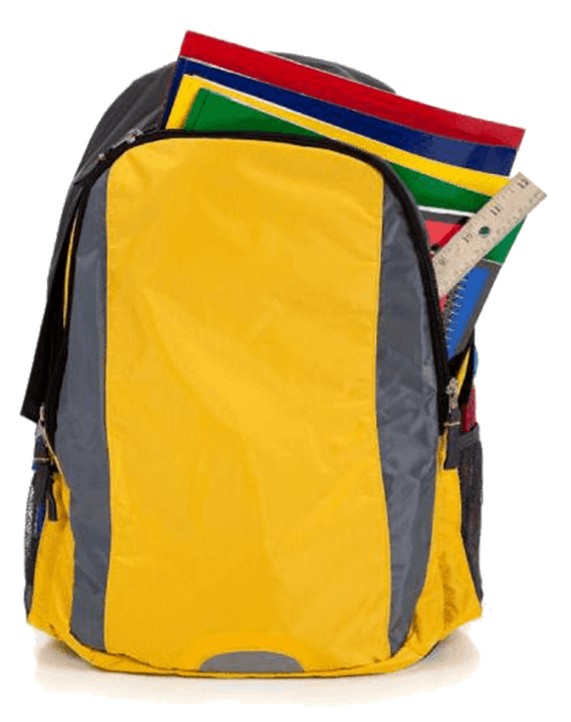
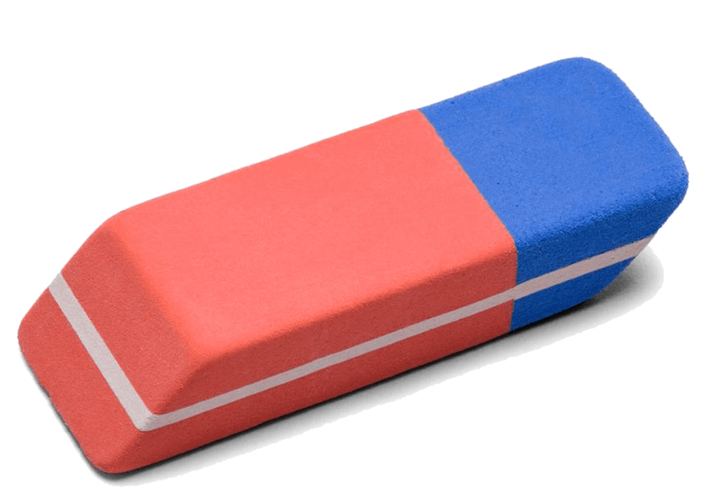


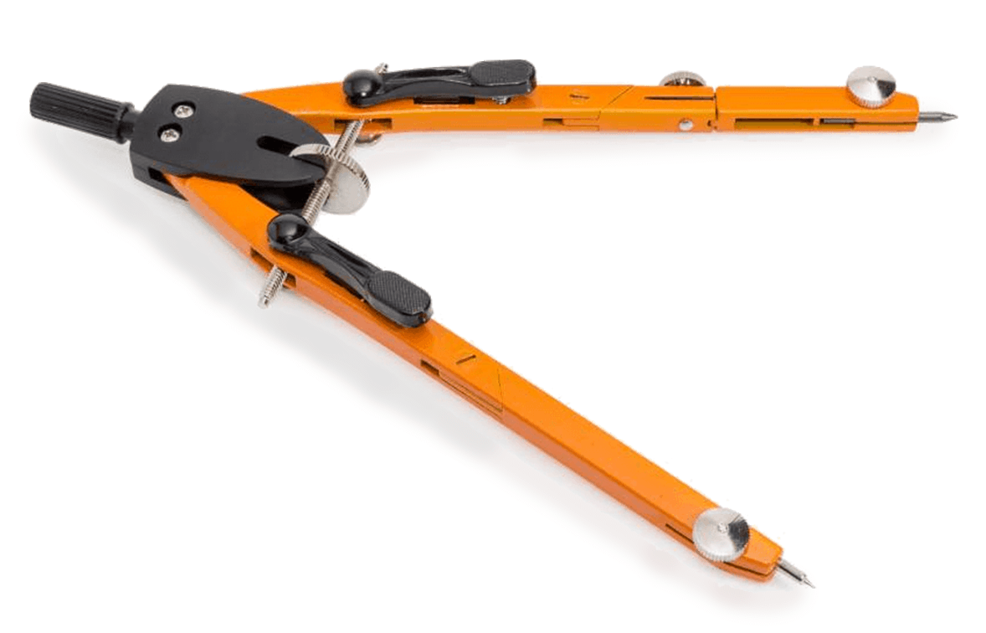
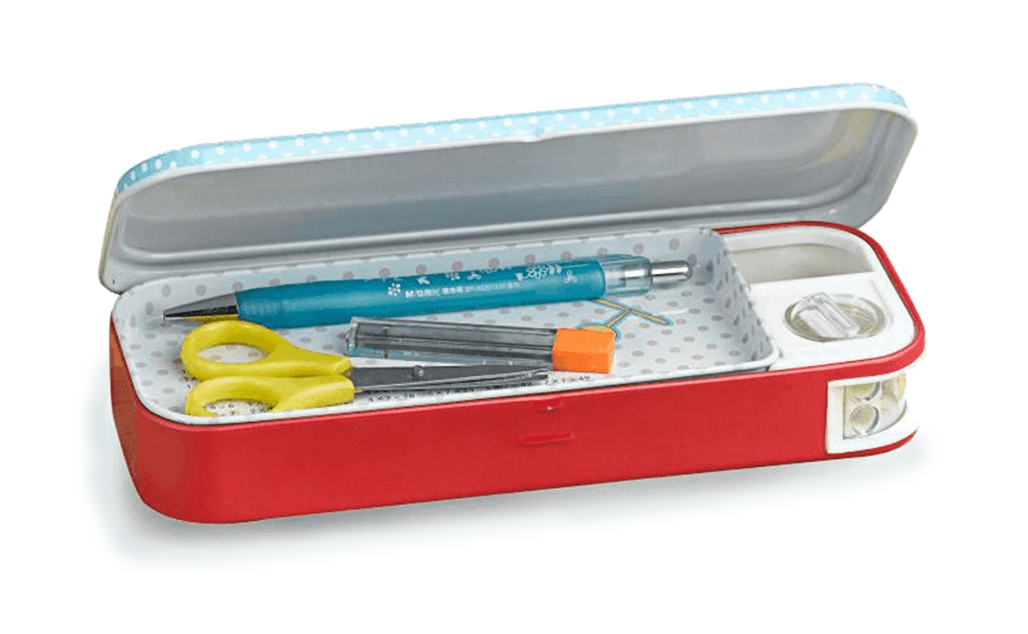


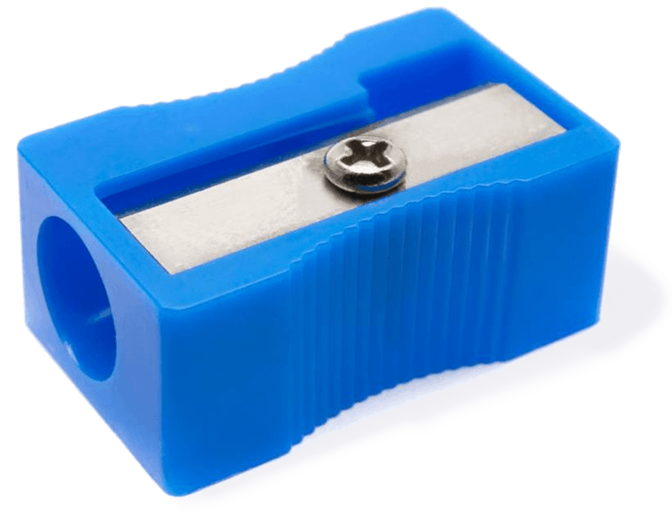
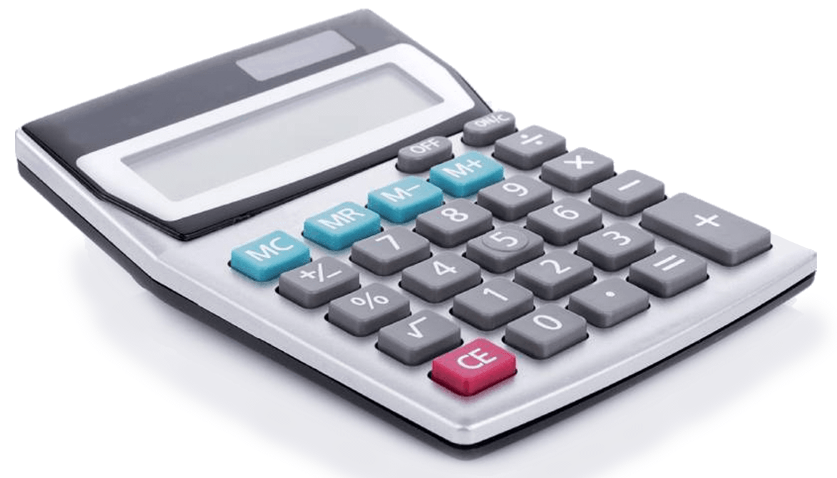


PRACTICE
4
Match the words with the school things. Then listen and repeat.
pencil sharpener
compass
school bag
calculator
rubber
pencil case

Slide 14

PRODUCTION
5
Write names of the things you can see around the class in your notebook.
Work in groups of 4
Look around the class
Write down things you can see in the class
Each group shares with the whole class

Slide 15

CONSOLIDATION
1
Wrap-up
What have we learnt in this lesson?
Topic of the unit
New words of school things

Slide 16

CONSOLIDATION
2
Homework
- Do exercises in the workbook.
- Think of activities students can do at school.
- Start preparing for the Project of the unit.

Slide 17






Website: hoclieu.vn
Fanpage: facebook.com/www.tienganhglobalsuccess.vn/

