Slide 1
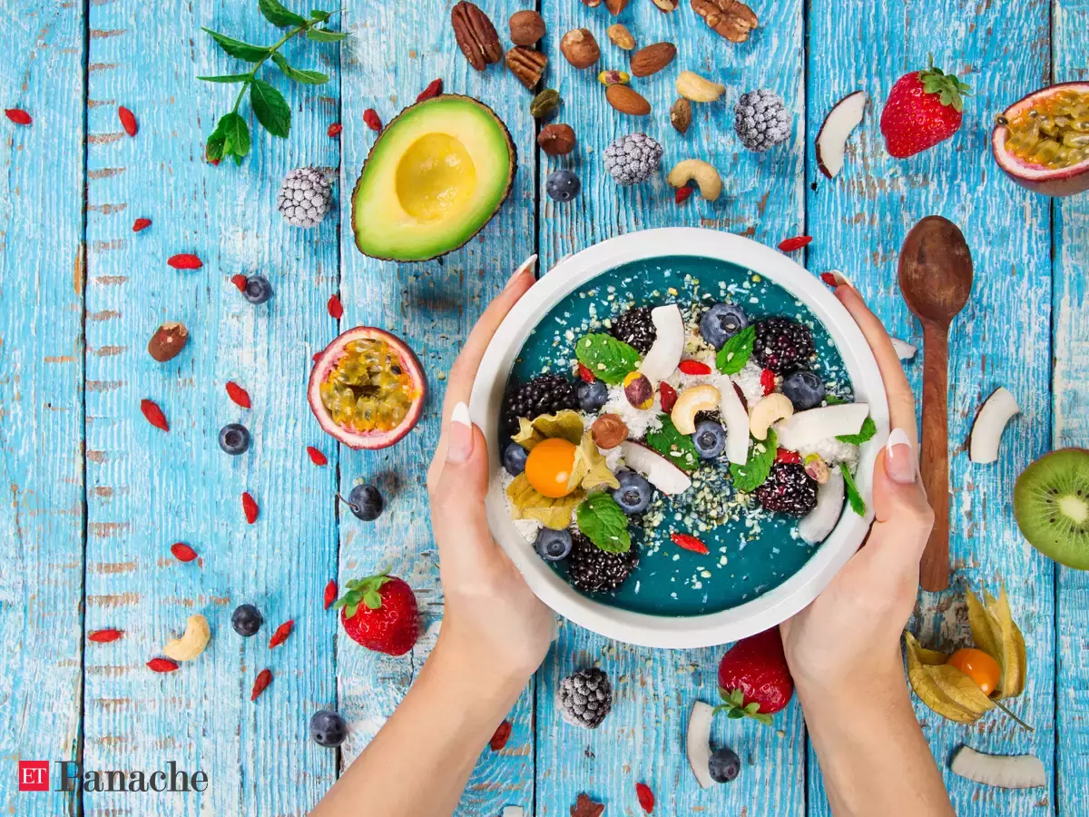
Unit
5
FOOD AND DRINK
Lesson 6: SKILLS 2

Slide 2
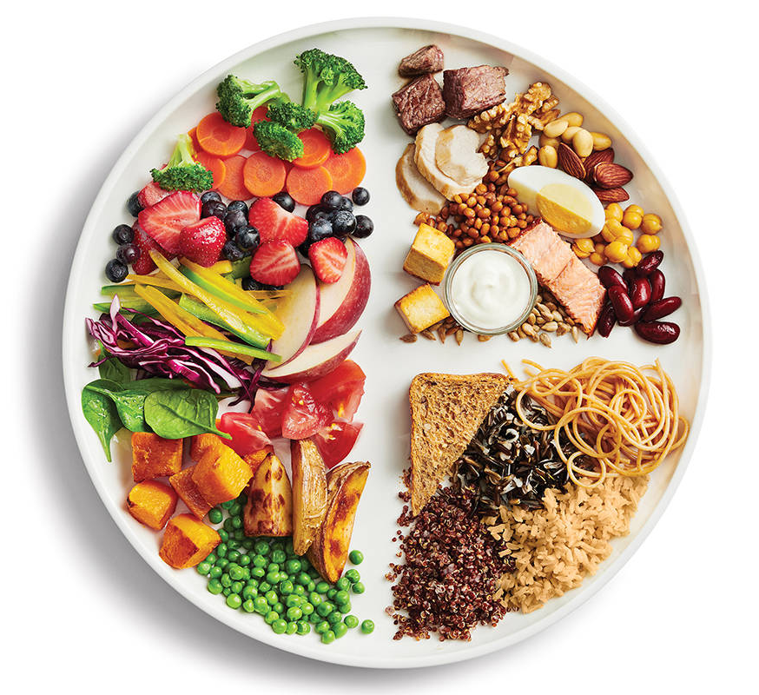
MINI GAME
Our eating habits
In your groups, talk about:
What you ate and drank yesterday
Who had healthy diets

Slide 3
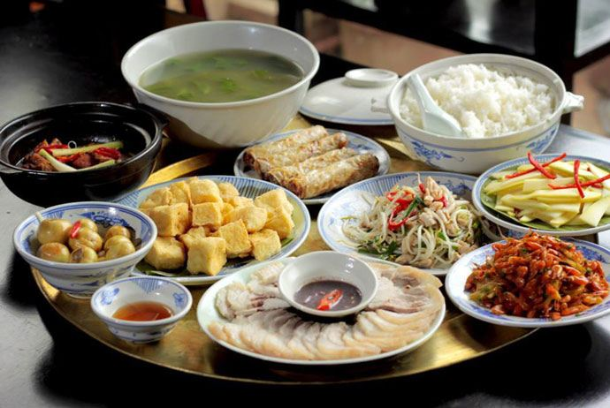
Vocabulary
meal
/mɪəl/
bữa ăn

Slide 4
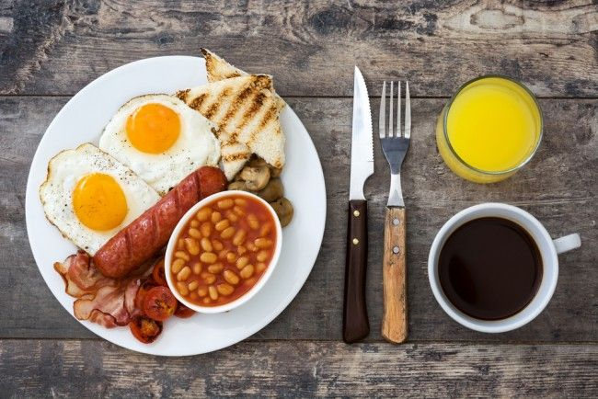
Vocabulary
breakfast
/ˈbrek.fəst/
bữa sáng

Slide 5
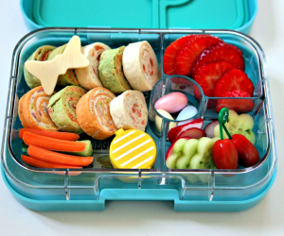
Vocabulary
lunch
/lʌntʃ/
bữa trưa

Slide 6
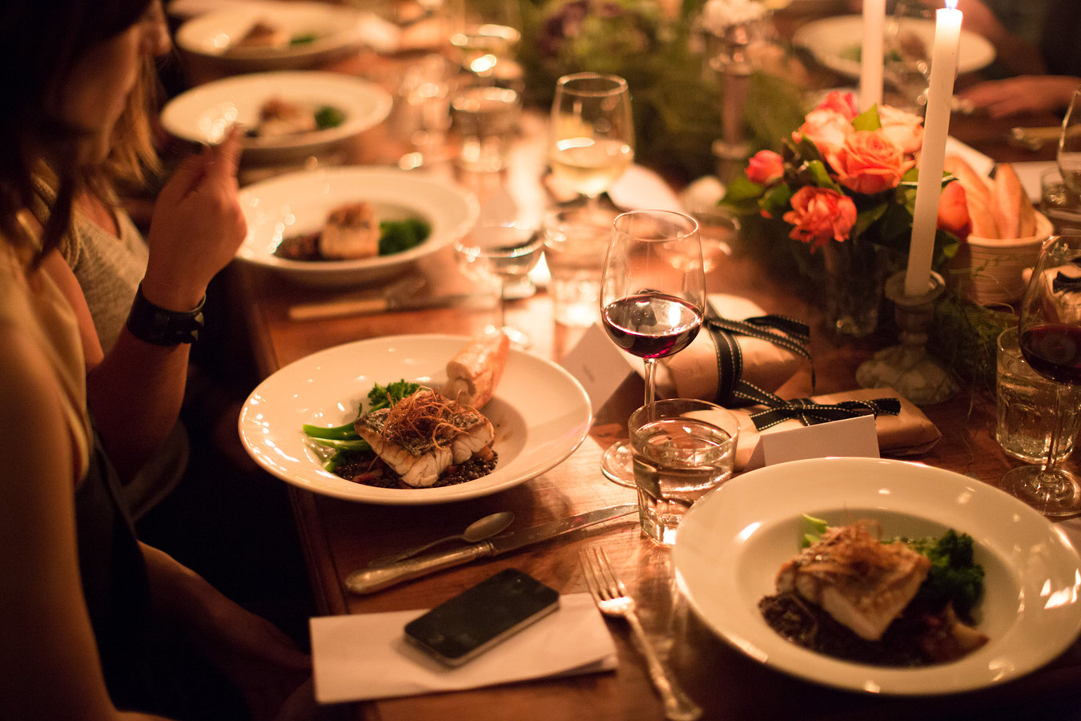
Vocabulary
dinner
/ˈdɪnər/
bữa tối

Slide 7
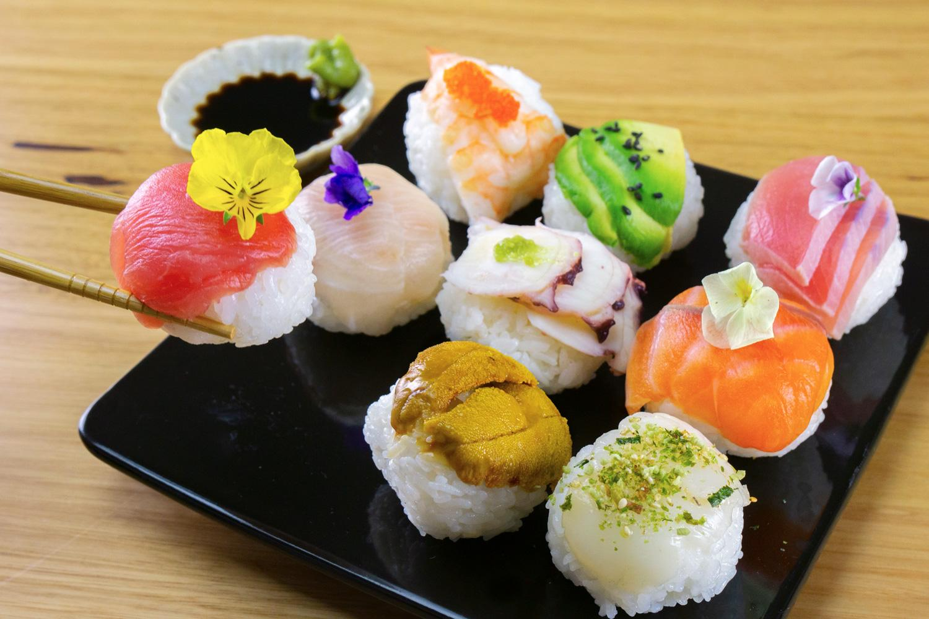
Vocabulary
fabulous
/ˈfæbjələs/
rất tuyệt vời

Slide 8
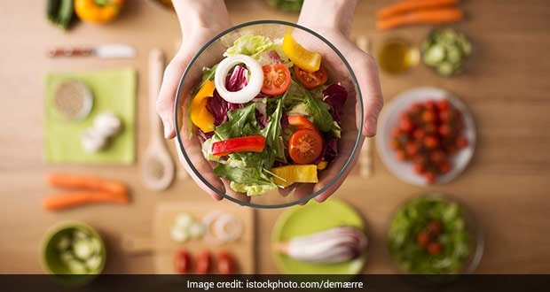
Vocabulary
healthy
/ˈhelθi/
tốt cho
sức khoẻ

Slide 9
LISTENING
1
Work in groups. Discuss the following questions.
1. What time do people in your area often have breakfast, lunch, and dinner?
2. What do they often have for breakfast, lunch, and dinner?

Slide 10
LISTENING
2
Listen to Minh talking about the eating habits in his area. Circle the food and drink you hear.
eel soup | cakes | green tea
coffee | toast

Slide 11
LISTENING
3
Listen again and tick True (T) or False (F).
 | T | F
1. People in Minh's area often have four meals a day.
2. Most of them have lunch at home.
3. Lunch is the main meal of the day in his area.
4. People in his neighborhood often have rice, fresh vegetables, and seafood or meat for dinner.
5. After dinner, they often have some fruit and green tea.
F
T
F
T
T

Slide 12
People in my area often have three meals a day: breakfast, lunch and dinner. For breakfast, we usually have pho or eel soup with bread. Sometimes we have instant noodles or xoi (sticky rice). Lunch often starts at 11:30 a.m. Most of us have lunch at home. We often have rice, fish, meat, and vegetables. Dinner is the main meal of the day. It's also the time when family members gather at home, so it takes a bit longer than the other meals. It often starts at around 7:30 p.m. We usually have rice with a lot of fresh vegetables and seafood or meat. We normally talk about everyday activities during the meal. Then we have some fruit and green tea. I think the food in my area is fabulous. It's very healthy and delicious.

Slide 13
WRITING
4
Make notes about the eating habits in your area.
 | Time | Food and drink
Breakfast
Lunch
Dinner

Slide 14
WRITING
4
Write a paragraph of about 70 words about the eating habits in your area. Use the information in 4 to help you.
People in my city love delicious food and they usually eat three meals a day including breakfast, lunch, and dinner. At around 6.30 a.m a.m., they usually have a light breakfast with a bowl of pho or bread. Some people eat a bowl of instant noodles and drink a cup of coffee before going to work. Lunch usually starts around 11.30 a.m. They usually have a plate of fried rice and drink juice for lunch. Dinner usually starts at 18:00 with rice, lots of vegetables, some meat and fish. Then they usually have some fruit and some tea.

Slide 15
CONSOLIDATION
1
WRAP-UP
In this lesson, we have learnt to:
listen for specific information about eating habits
write a paragraph about eating habits in the area.

Slide 16
CONSOLIDATION
2
HOMEWORK
Write a paragraph about your eating habits and upload on the drive link given.
Prepare for the project.

