Slide 2


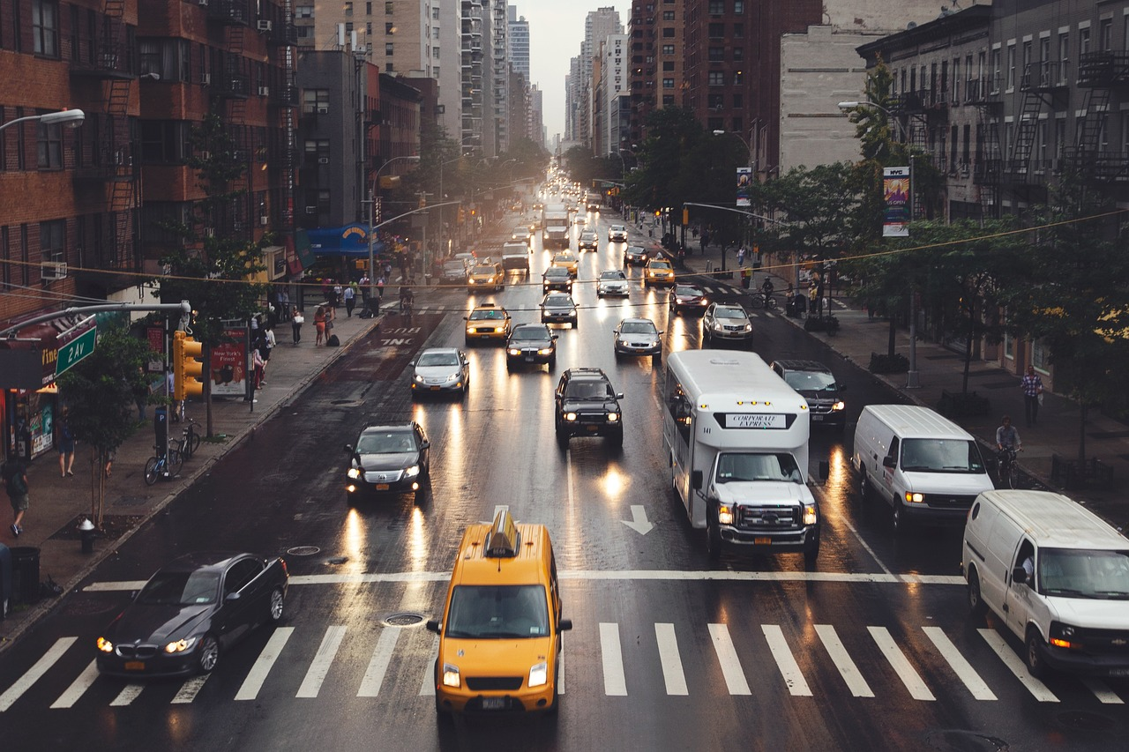
---------------
Unit
2
CITY LIFE
LESSON 1: GETTING STARTED
How is your city?

Slide 3
WARM-UP
OPTION 1
Answer the questions:
1/ Can you name some big cities in Viet Nam and in the world?
2/ Can you describe something you know about these cities?
(population, traffic, tourist attractions, ….)
THINK!

Slide 4
WARM-UP
OPTION 1
Answer the questions:
3/ Do you want to live there?
4/ Can you describe where you live? Is it a city or town?
5/ Do you like living there?
THINK!

Slide 5

WARM-UP
OPTION 2
- Work in teams.
- You have 2 minutes think about City advantages and disadvantages.
DEBATE
Advantages team | Disadvantages team

Slide 6
WARM-UP
OPTION 2
DEBATE TIME (2 minutes)
Advantages team | Disadvantages team

Slide 7

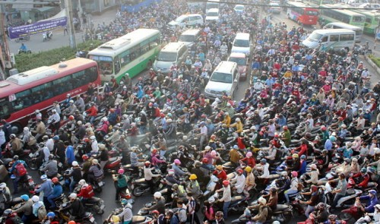
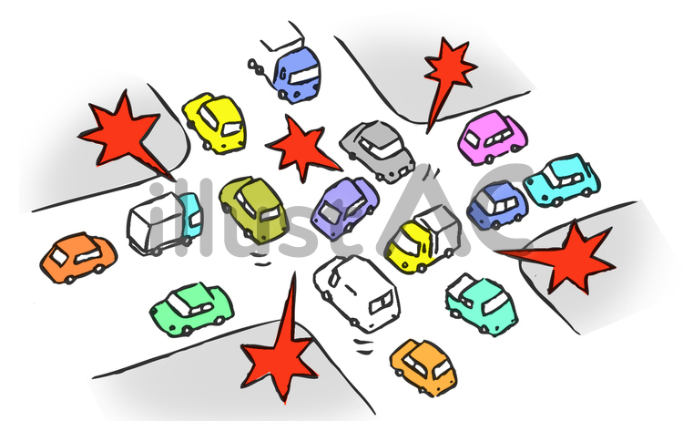
PRESENTATION
a large number of vehicles close together and unable to move or moving very slowly.
traffic jam (n)
/ˈtræf.ɪk ˌdʒæm/
kẹt xe

Slide 8

PRESENTATION
a situation in which a place is too blocked or crowded, causing difficulties.
congested (adj)
/kənˈdʒes.tɪd/
tắc nghẽn (giao thông

Slide 9
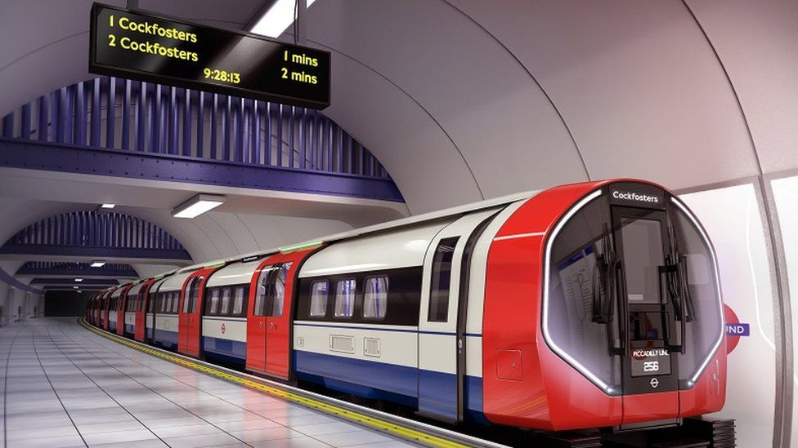
PRESENTATION
an area or piece of land where construction work is taking place
construction site (n)
/kənˈstrʌkʃn saɪt/
công trường xây dựng

Slide 10
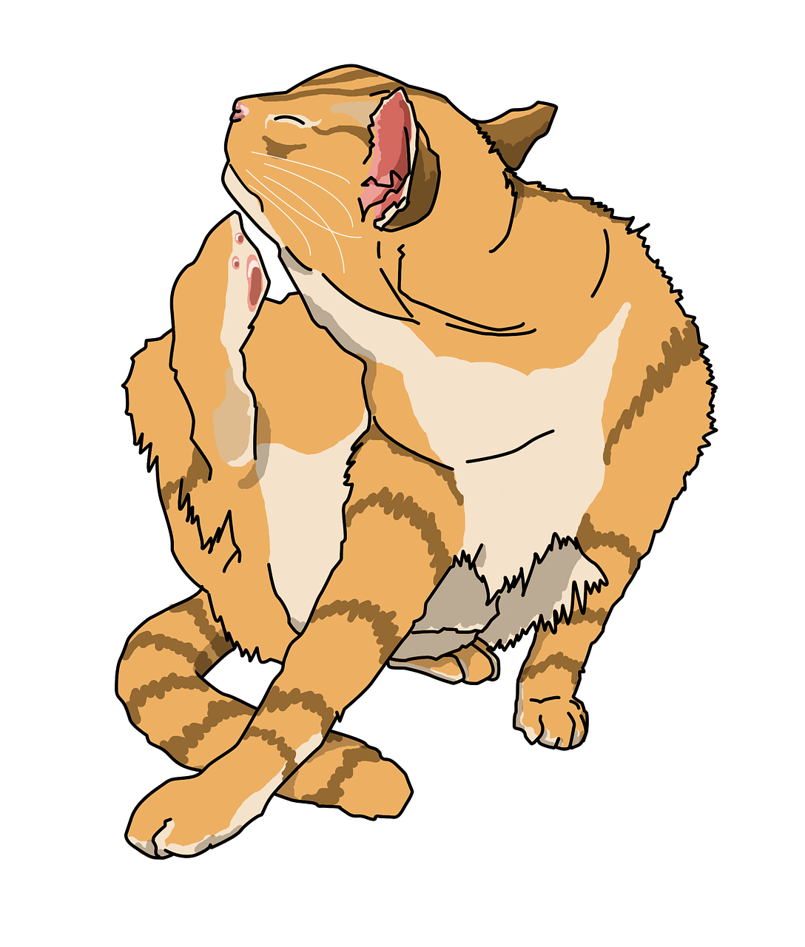
PRESENTATION
A railway system in which electric trains travel through tunnels below ground.
underground (n)
/ˌʌndəˈɡraʊnd/
hệ thống tàu điện ngầm

Slide 11
PRESENTATION
having or causing an itch
itchy (adj)
/ˈɪtʃi/
ngứa, gây ngứa

Slide 12
PRESENTATION
downtown (n)
/ˌdaʊnˈtaʊn/
in or to the central part of a city
khu trung tâm tp, thị trấn

Slide 13
PRESENTATION
unreliable (adj)
not able to be trusted
/ˌʌn.rɪˈlaɪə.bəl/
không đáng tin

Slide 14
PRESENTATION
grand (adj)
important and large in degree
/ɡrænd/
hoành tráng

Slide 15
PRESENTATION
pricey (adj)
expensive
/ˈpraɪ.si/
đắt đỏ

Slide 16
PRESENTATION
New words | Pronunciation | Meaning
1. traffic jam (n) | /ˈtræf.ɪk ˌdʒæm/ | kẹt xe
2. congested (adj) | /kənˈdʒes.tɪd/ | tắc nghẽn (giao thông)
3. construction site (n) | /kənˈstrʌkʃn saɪt/ | công trường xây dựng
4. underground (n) | /ˌʌndəˈɡraʊnd/ | hệ thống tàu điện ngầm

Slide 17
PRESENTATION
New words | Pronunciation | Meaning
5. downtown (n) | /ˌdaʊnˈtaʊn/ | khu trung tâm tp, thị trấn
6. unreliable (adj) | /ˌʌn.rɪˈlaɪə.bəl/ | không đáng tin
7. grand (adj) | /ɡrænd/ | hoành tráng
8. pricey (adj) | /ˈpraɪ.si/ | đắt đỏ

Slide 18
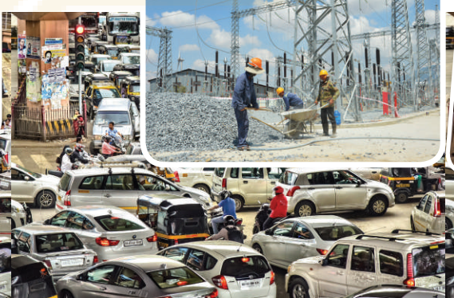
PRACTICE
Look at pictures on p.28
1. What do you see in each picture?
traffic jam /
traffic congestion, …..
2. Are the things in the pictures common in your home town?

Slide 19
PRACTICE
1
Listen and read.
Trang: Hi, Ben. Sorry I couldn’t get online earlier. I got stuck in a traffic jam and came home late.
Ben: No problem, Trang. Did you go by bus?
Trang: No. My dad picked me up. I rarely use the bus. It’s slow and packed with people.
Ben: I mostly get around by underground. It’s more reliable than the bus.
Trang: That’s great.
Ben: But traffic congestion is terrible in London. You know, the more crowded the city gets, the more congested the streets are.

Slide 20
PRACTICE
1
Listen and read.
Trang: Yeah … and the more polluted they may become. There’s a construction site in my neighbourhood. It’s dusty, so people easily get itchy eyes.
Ben: It must be noisy, too. The noise probably makes people feel stressed sometimes.
Trang: That’s right. But new buildings make the city look modern and attractive. Do you remember the grand building downtown?
Ben: Of course. How’s it now? When I left Viet Nam, they nearly finished it.

Slide 21
PRACTICE
1
Listen and read.
Trang: Well, it’s now a shopping mall. Teens like it because it’s modern and fun.
Ben: Do you often go there?
Trang: Sometimes. I watch movies there with my sister. I want to go there more often, but it’s a bit pricey.
Ben: It’s expensive here in London, too …
Say the words in the text that you think are related to the topic City life.

Slide 22
PRACTICE
1
Listen and read.
Underline the words in the text that you think are related to the topic City life.

Slide 23
PRACTICE
2
Read the conversation again and tick T (true) or F (False).
 | T | F
1. The bus in Trang’s city is slow and crowded.
2. The underground system in Ben’s city is unreliable.
3. There is a dusty and noisy construction site near Trang’s house.
√
√
“get around by underground. It’s more reliable than the bus.”
√

Slide 24
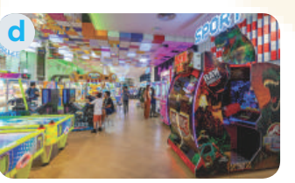
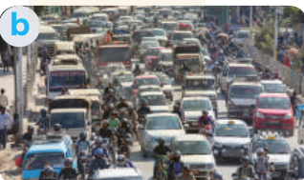
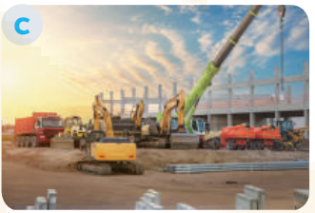

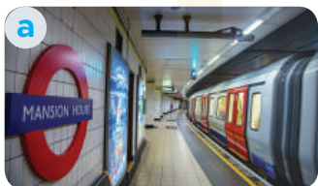
PRACTICE
2
Read the conversation again and tick T (true) or F (False).
 | T | F
4. Trang thinks new buildings make the city look ugly.
5. . Both Trang and Ben find shopping malls expensive.
“ But new buildings make the city look modern and attractive”
√
√

Slide 25
PRACTICE
3
Match the words/phrases with their pictures.
1. congested road
2. construction site
3. the underground
4. itchy eyes
5. entertainment centre

Slide 26
PRACTICE
3
Match the words/phrases with their pictures
1. congested road
2. construction site
3. the underground
4. itchy eyes
5. entertainment centre

Slide 27
PRACTICE
3
Match the words/phrases with their pictures
1. congested road
2. construction site
3. the underground
4. itchy eyes
5. entertainment centre

Slide 28
PRACTICE
3
Match the words/phrases with their pictures
1. congested road
2. construction site
3. the underground
4. itchy eyes
5. entertainment centre

Slide 29
PRACTICE
3
Match the words/phrases with their pictures
1. congested road
2. construction site
3. the underground
4. itchy eyes
5. entertainment centre

Slide 30
PRACTICE
Extra Activity: Work in groups. Each group makes sentences with the words/phrases.
1. congested road
2. construction site
3. the underground
4. itchy eyes
5. entertainment centre

Slide 31
PRACTICE
4
Choose the correct answer A, B, C, or D
1. I like getting around by ______. I hate the smell of car exhaust.
A. underground | B. private car
C. taxi | D. bus
2. Road dust may badly affect our ______.
A. stomach | B. back
C. eyes | D. leg

Slide 32
PRACTICE
4
Choose the correct answer A, B, C, or D
3. There’s a ______ in my neighbourhood. It’s noisy and dusty.
A. building | B. construction site
C. hospital | D. lake
4. The road is narrow, so ______ often occurs at rush hour.
A. traffic light | B. traffic flow
C. traffic congestion | D. traffic safety

Slide 33
PRACTICE
4
Choose the correct answer A, B, C, or D
3. Many teens fancy spending their weekends in an entertainment ______.
A. industry | B. value
C. business | D. centre

Slide 34
PRODUCTION
5
Quiz: A lifestyle survey: City life or Village life?
Complete the quiz. Then compare your choices with your friends’ and the teacher’s explanation. Which suits you more, life in the city or in a village?
You have 4 minutes to do this activity individually.

Slide 35
Compare your choices with your partner.
PRODUCTION
1. What kind of house do you want to live in? | 2. How do you like to get around?
A. A small and modern apartment. B. A house with a garden | A. By public transport. B. By motorbike or bicycle.
3. Where do you frequently enjoy visiting? | 4. How do you describe your favourite neighbourhood?
A. Shops, restaurants, cinemas, and art galleries. B. Local farmers’ markets. | A. Crowded and busy. B. Quiet and green.
5. How do you like to spend time outdoors?
A. Going for a walk or running in the park. B. Doing gardening or visiting next-door neighbours.

Slide 36
PRODUCTION
Compare your choices with your partner.
If you choose lots of A.
You will fit in the city.
If you choose lots of B.
The village is your better choice.

Slide 37
PRODUCTION
Show me more ideas about:
City Life | Village Life

Slide 38
PRODUCTION
EXTRA ACTIVITY
Work in groups and talk about the differences between living in the city and living in the countryside.

Slide 39

PRODUCTION
EXTRA ACTIVITY
 | LIVING IN THE CITY | LIVING IN THE COUNTRYSIDE
Accommodation
Means of transport
Facilities
Neighbourhood
Outdoor activities

Slide 40

CONSOLIDATION
1
Wrap-up
What have we learnt in this lesson?
Gain an overview about the topic City life
Gain vocabulary to talk about life in the city

Slide 41

CONSOLIDATION
2
Homework
- Do exercises in the workbook.

Slide 42
CONSOLIDATION
2
Homework
- Prepare for the Project of the unit
- Open book p.27
- Work in groups to brainstorm about the features of a city you want to live in the future and draw a picture of it.
- You will show and present in Lesson 7 – Looking back and Project.

Slide 43
CONSOLIDATION
2
Homework
Name of the future city:
The population of the future city:
The type of houses people will live in:
The means of transportation that people will use:
The kinds of school and number of schools in the city:
The kinds and/or places of entertainment in the city:

Slide 44
Website: hoclieu.vn
Fanpage: facebook.com/www.tienganhglobalsuccess.vn/

