Slide 2
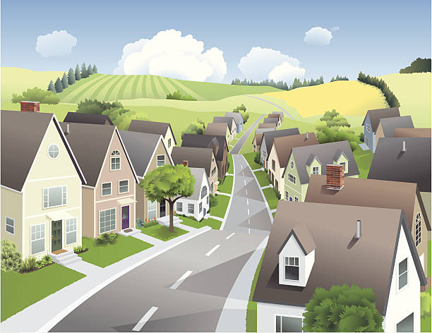
Unit
1
LOCAL COMMUNITY
LESSON 6: SKILLS 2
1

Slide 3
WARM-UP
Who is your favourite community helper?
Why?
BRAINSTORMING

Slide 4
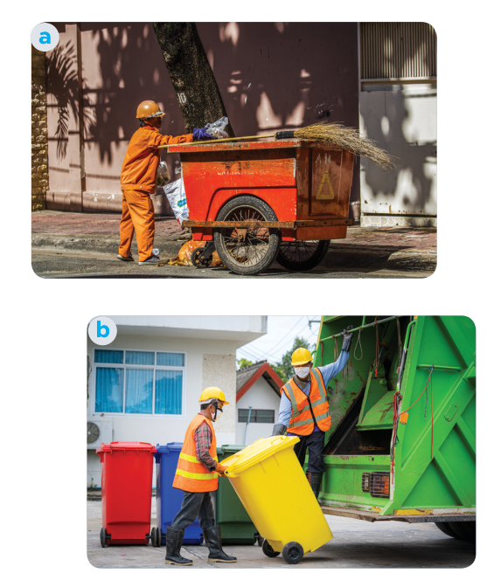
PRE LISTENING
1
Work in pairs. Discuss the questions.
1. Who can you see in the pictures?
2. What are they doing?
We can see garbage collectors.
They are taking the garbage away.

Slide 5
WHILE LISTENING
2
Listen and fill in each blank with no more than two words.
1. The name of the writing contest is “My Favourite _____________”. 2. Mr Vinh is a __________________. 3. He is tall and __________________. 4. He is hard-working, responsible, and _______________.
Community Helper
garbage collector
slim
friendly

Slide 6
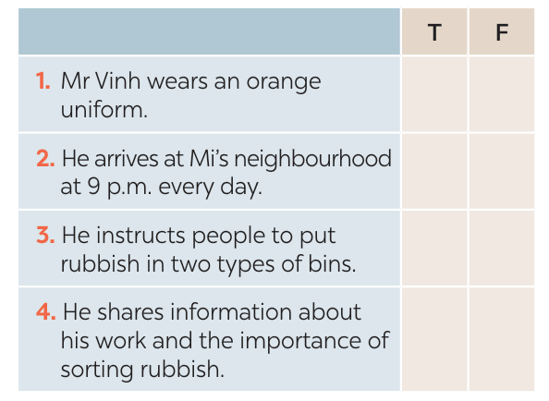
WHILE LISTENING
3
Listen again and tick T (True) or F (False).
1-F
2-F
3-T
4-T

Slide 7
This is An Binh commune radio station. In today's special programme, we will share with you a piece of writing which won first prize in our writing contest test called “My favourite community helper”. This was written by Mi, a grade nine student. There are many great community helpers in our neighbourhood. But my favourite one is Mr. Vinh, the garbage collector. Mr. Vinh is a tall and slim man. He usually wears a green uniform with reflective stripes. He is hardworking and responsible. Every day he goes to our neighbourhood at 06:00 p.m with a garbage cart. He instructs everyone to put garbage in the correct bin, recyclable and nonrecyclable, and then goes to the next neighbourhood at about 09:00 p.m. He comes back and empties all the bins carefully.

Slide 8
WRITING
4
Work in pairs. Choose a community helper you like and answer the following questions.
- What is his / her job?
– What does he / she look like?
– What is he / she like?
– What does he / she do for the community?
– How do you feel about him / her?

Slide 9
4. Work in pairs. Choose a community helper you like and answer the following questions.
A: What is his job?
B: He is a firefighter. His primary job is to respond to emergencies involving fires and other disasters.
A: What does he look like?
B: He typically wears distinctive uniforms that include protective gear.
A: What is he like?
B: He is a dedicated, brave, and quick-thinking individual.
A: What does he do for the community?
B: He responds to fire incidents, accidents, and natural disasters to protect lives and property for the community. He also engages in public programs, educating people on fire safety and prevention.
A: How do you feel about him?
B: I have immense respect and gratitude for him.

Slide 10
WRITING
5
Write a paragraph (about 100 words) about your favourite community helper. Use the answers to the questions in 4 to help you.
My favourite community helper is a firefighter. He typically wears specialized uniforms that include protective gear. He is a dedicated, brave, and quick-thinking individual. He responds to fire incidents, accidents, and natural disasters to protect lives and property for communities. He also engages in public programs, educating people on fire safety and prevention. I have immense respect and gratitude for him. He is a true hero in real life.

Slide 11
WRITING
5
Write a paragraph (about 100 words) about your favourite community helper. Use the answers to the questions in 4 to help you.
My favourite community helper is Mr Nam. He is a delivery person in my neighbourhood. He is a friendly person. Whenever he delivers something to us, he smiles happily. He sometimes asks me about my study. In addition, he is hard-working and responsible. He delivers goods to my family and other families in the neighbourhood despite the weather. Sometimes he has to return twice to deliver us a parcel because we are not at home. I really appreciate his manner. In general, Mr Nam is a very dedicated community helper who makes our life easy and comfortable.

Slide 12
CONSOLIDATION
1
Wrap-up
What have we learnt in this lesson?
Listen for specific information about a community helper.
Write a paragraph about a community helper.

Slide 13
CONSOLIDATION
2
Homework
- Do exercises in the Workbook.

Slide 14
Website: hoclieu.vn
Fanpage: facebook.com/www.tienganhglobalsuccess.vn/

