Slide 2
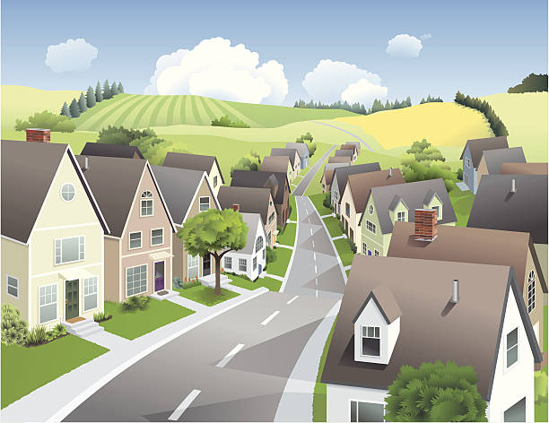
Unit
1
LOCAL COMMUNITY
LESSON 4: COMMUNICATION
1

Slide 3
WARM-UP
Phrasal verbs revision
FIND OUT

Slide 4
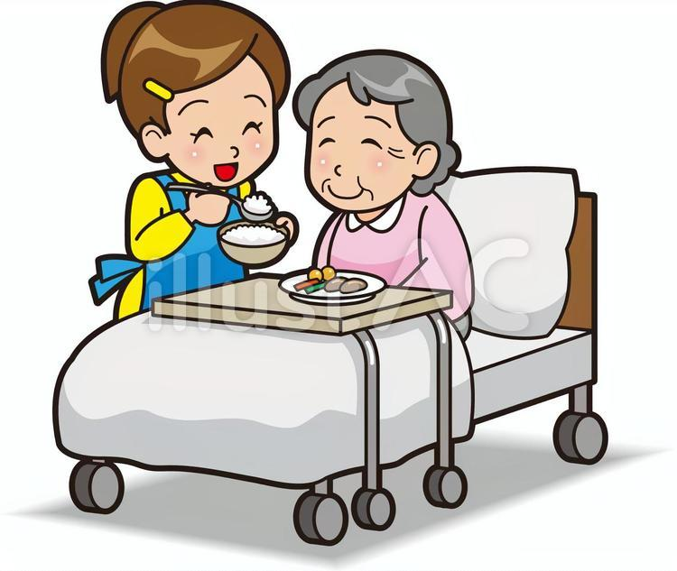
WARM-UP
TAKE CARE OF/
LOOK AFTER
COME BACK

Slide 5
WARM-UP
LOOK FOR
TAKE OFF

Slide 6
WARM-UP
GET OVER

Slide 7
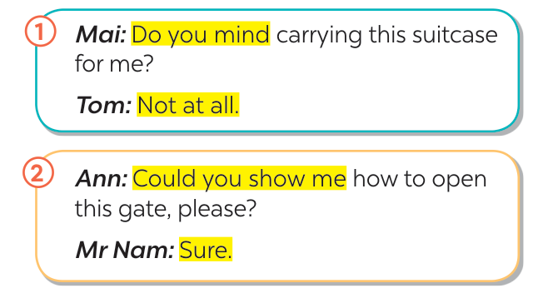
EVERYDAY ENGLISH
1
Listen and read the conversations. Pay attention to the highlighted parts.

Slide 8
EVERYDAY ENGLISH
2
Work in pairs. Ask for help and respond in the following situations.
1. You want your friend to lend you her pen. 2. You want your neighbour to tell you the name of the new garbage collector. 3. You want to ask your neighbour where to buy the best fruits and vegetables.
Example:
1. Do you mind lending me your pen?
- Not at all. Here you are.
2. Could you tell the name of the new garbage collector?
- Sure. His name’s Nam.
3. Could you tell me where to buy the best fruits and vegetables in our area?
- Sure. There’s a shop in Le Lai Street.

Slide 9
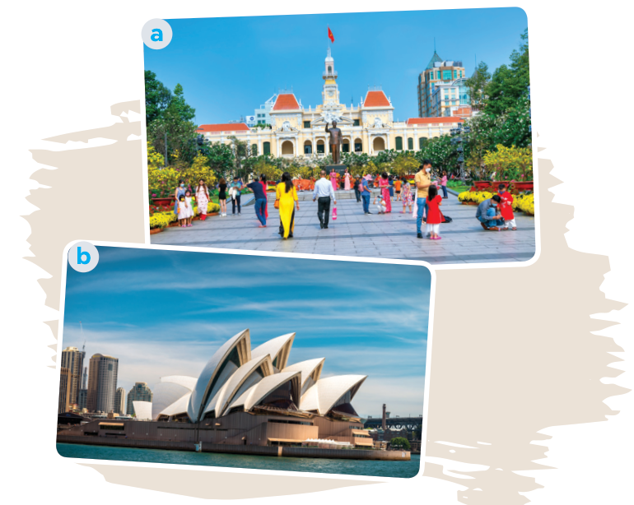
PLACES OF INTEREST
3
Do you know the place in each picture?
- Picture 1: Nguyen Hue Pedestrian Street in Ho Chi Minh City.
- Picture 2: Sydney Opera House in Sydney, Australia.

Slide 10
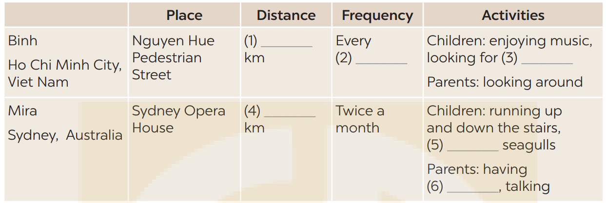
PLACES OF INTEREST
4
Listen to Binh and Mira talking about a place of interest in their community. Fill in each blank with no more than TWO words and / or a number.
one / 1
weekend
favourite books
five / 5
feeding
a drink

Slide 11
PLACES OF INTEREST
5
Work in pairs. Ask and answer about your favourite places of interest. Use the questions below.
– What is your favourite place of interest? – How far is it from your house? – How often do you go to that place? – What do you do there?

Slide 12
PLACES OF INTEREST
5
Work in pairs. Ask and answer about your favourite places of interest. Use the questions below.
Example:
Lan’s favourite place of interest is Tao Dan Park. It’s only one kilometre from her house, so she goes there every weekend with her mother and sister. There they walk, do some exercises and enjoy the fresh air. Sometimes they also cycle around the park.

Slide 13
CONSOLIDATION
1
Wrap-up
What have we learnt in this lesson?
How to seek for help and respond;
Some famous places of interest.

Slide 14
CONSOLIDATION
2
Homework
- Do exercises in the Workbook.

Slide 15
Website: hoclieu.vn
Fanpage: facebook.com/www.tienganhglobalsuccess.vn/

