Slide 2
Unit
1
LOCAL COMMUNITY
LESSON 3: A CLOSER LOOK 2
1

Slide 3
WARM-UP
QUESTION WORDS BEFORE TO-INFINITIVES
What do you do when you don’t know how to get to a place in your neighbourhood?
BRAINSTORMING

Slide 4
PRESENTATION
QUESTION WORDS BEFORE TO-INFINITIVES
– We use a question word such as who, what, where, when, or how before a to-infinitive to express an indirect question about what we should do. – We often use a verb such as ask, wonder, (not) decide, (not) tell, or (not) know before the question word + to-infinitive.
Example:
- We don’t know what to do to help the community.
- She asked how to get to the nearest shopping mall.

Slide 5
PRACTICE
1
Fill in each blank with a suitable question word.
how
1. I don’t know ______ to deal with this problem.
2. My sister wondered ______ to buy the best cakes.
3. Could you tell me ______ to do to get on well with my new neighbours?
4. They asked ______ to take out the rubbish, at 5 or 6 p.m.
5. He can’t decide ______ to give his books to.
where
what
when
who

Slide 6
PRACTICE
2
Rewrite the sentences using question words + to-infinitives.
1. I don’t know how I can get to the swimming pool.
2. They are wondering where they can buy traditional handicrafts.
3. She asked what she should give to her new neighbour at his house-warming party?
I don’t know how to get to the swimming pool.
They are wondering where to buy traditional handicrafts.
She asked what to give to her new neighbour at his house-warming party.

Slide 7
PRACTICE
2
Rewrite the sentences using question words + to-infinitives.
4. I can’t decide who I should ask for advice.
5. Could you tell me when I have to pay the water bill?
I can’t decide who to ask for advice.
Could you tell me when to pay the water bill?

Slide 8
PRESENTATION
PHRASAL VERBS
– A phrasal verb consists of a verb and one or two particles, such as up, down, back, on, round, …
– A phrasal verb usually has a special meaning.
Example:
go out = leave your house to go to a social event
pass down = give or teach something to your children
cut down on = reduce the amount or number of something
run out of = have no more of

Slide 9
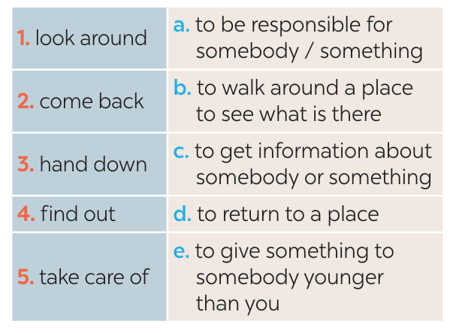
PRACTICE
3
Match each phrasal verb with its meaning.
1-b
2-d
3-e
4-c
5-a

Slide 10
PRACTICE
4
Complete each sentence using the correct form of a phrasal verb in 3.
came back
1. We _______________ from our home town last Saturday.
2. The artisans in my village usually _______________ their skills to their eldest children.
3. If you want to ______________ about our community, you can go to the local museum.
4. When we aren’t at home, our neighbour _____________ our cats.
5. Whenever I go to a new place, I spend time _____________.
hand down
find out
takes care of
looking around

Slide 11
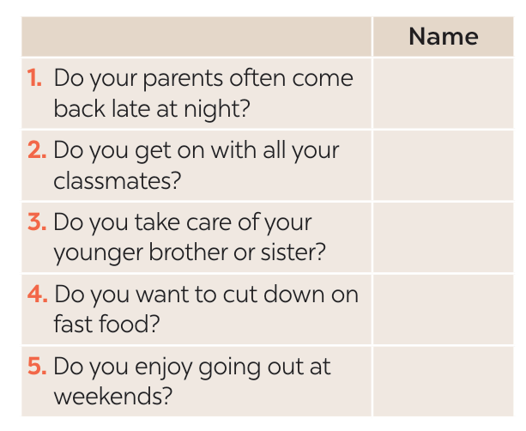
PRACTICE
5
Find someone who … Ask as many friends as you can the following questions. Then write their names in the table if they say “yes”.

Slide 12
CONSOLIDATION
1
Wrap-up
What have we learnt in this lesson?
- Use questions words before to-infinitives and some phrasal verbs.

Slide 13
CONSOLIDATION
2
Homework
- Do exercises in the Workbook.
- Make 5 sentences using phrasal verbs.

Slide 14
Website: hoclieu.vn
Fanpage: facebook.com/www.tienganhglobalsuccess.vn/

