Slide 2
Unit
1
LOCAL COMMUNITY
LESSON 1: GETTING STARTED
I really love where I live now.
1

Slide 3
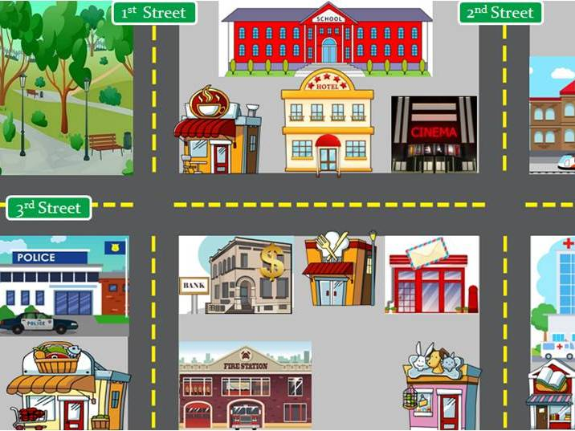
WARM-UP
What can you see in this photo?
BRAINSTORMING

Slide 4
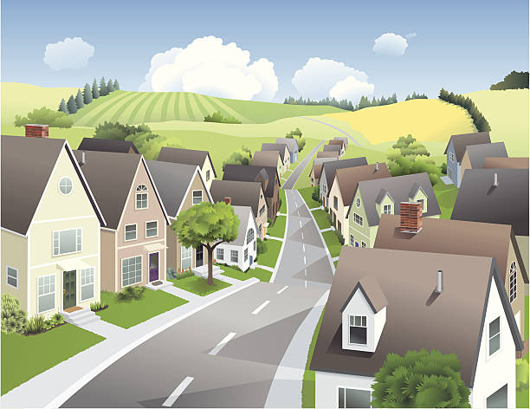
PRESENTATION
suburb (n)
/ˈsʌbɜːb/
vùng ngoại ô

Slide 5
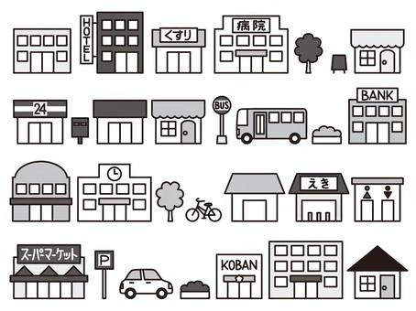
PRESENTATION
facilities (n)
/fəˈsɪlətiz/
cơ sở vật chất

Slide 6
PRESENTATION
New words | Pronunciation | Meaning
1. suburb (n) | /ˈsʌbɜːb/ | vùng ngoại ô
2. facilities (n) | /fəˈsɪlətiz/ | cơ sở vật chất
3.Neighbour(n) |  | Người hàng xóm
4. Neighbourhood(n) |  | vùng hàng xóm
5.Get on with( vp) |  | quan hệ tốt
6. remind…..of(vp) |  | gợi nhớ về

Slide 7
PRACTICE
1
Listen and read.
Ann: Hi, Mi. Long time no see. How’re you doing?
Mi: I’m fine, thanks. By the way, we moved to a new house in a suburb last month.
Ann: Oh, that’s why I haven’t seen you in the Reading Club very often.
Mi: Yes. We’re still busy moving in, you know.
Ann: How’s your new neighbourhood?
Mi: It’s much bigger than our old one. The streets are wider, and there are fewer people.
Ann: What about the facilities?
Mi: It has all the things we need: shopping malls, parks, and hospitals. And there’s a craft village near our house.
Ann: Great! How’re your new neighbours?
Mi: They’re nice. Last Sunday when I was looking for the way to the bus station, a lady came and showed me the way. I think we will get on with them.
Ann: That reminds me of the time our family moved to Viet Nam. We didn’t know where to buy stuff for our
house, and the new neighbours in the community gave us useful advice. I guess you like your new place.
Mi: Sure. I really love where I live now.

Slide 8
PRACTICE
2
Read the conversation again. Fill in each blank with no more than TWO words from the conversation.
1. Mi’s family moved to a new house in a suburb ______.
2. Her new neighbourhood is bigger with wider streets and ______.
3. There is a ____________ near Mi’s house.
4. Mi thinks she will get on with her new ______.
5. People in Ann’s community gave her family ______ on where to buy stuff.
last month
fewer people
craft village
neighbours
useful advices

Slide 9
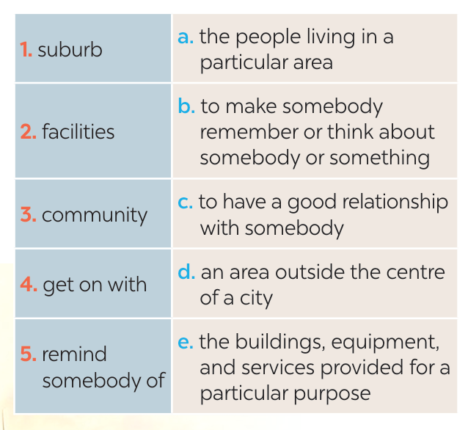
PRACTICE
3
Match each word or phrase with its definition.
1. d
2. e
3. a
4. c
5. b

Slide 10
PRACTICE
4
Complete each sentence with a word or phrase from 3.
suburb
1. They don’t live in the city centre but in a ________ of Ha Noi.
2. I love our new neighbourhood because we _____________ the people here.
3. There are enough sports ____________ for people of all ages in our local park.
4. Souvenirs _________ people ______ a place, an occasion, or a holiday.
5. The local ____________ encourages us to protect the environment and keep our neighbourhood clean.
get on with
facilities
remind of
community

Slide 11
PRODUCTION
5
GAME: What is the place?
DO THE FOLLOWING QUIZ.
1. People watch sports such as football there.
2. People go there for health check-ups.
3. Parents take their children there so that they can have fun.
4. Children learn to read and write there.
5. Visitors see objects from the past there.

Slide 12
CONSOLIDATION
1
Wrap-up
What have we learnt in this lesson?
identify the topic of the unit
use lexical items related to local community
identify the language features that are covered in the unit

Slide 13
CONSOLIDATION
2
Homework
- Do exercises in the Workbook.
- Start preparing for the Project of the unit by working in groups of 5 to brainstorm about your community.

Slide 14
Website: hoclieu.vn
Fanpage: facebook.com/www.tienganhglobalsuccess.vn/

