Slide 2


Unit
3
HEALTHY LIVING FOR TEENS
LESSON 5: SKILLS 1
1

Slide 3
WARM-UP
BRAINSTORM
Take out 1 piece of paper and a pen.
Draw a circle and divide it into four equal parts, like a pizza. Label each section of the circle with 4 different categories:
+ work/school
+ family/friends
+ hobbies/interests
+ self-care
Brainstorm activities that fit into each category and write them in the corresponding section of the circle.

Slide 4
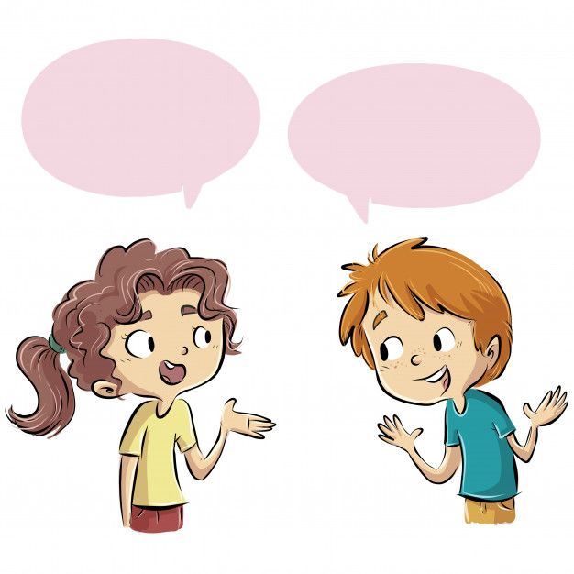
WARM-UP
BRAINSTORM
Share your circle with a partner.
Answer the following questions:
+ Do you have a well-balanced life?
+ Can you make any adjustments to achieve a more well-balanced life?

Slide 5

READING
2
The following text is about how a successful teen celebrity kept
a well-balanced life when he was at school. Read the text and match each highlighted word with its meaning.
When I was at school, I had to learn how to have a well-balanced life in order to reduce stress and anxiety. Below are some of the typical things I did.
Firstly, I managed my time properly. I started to plan my schedule, made a weekly work list and gave priority to some of my work. This helped me concentrate my efforts on my most important tasks.
In addition, I communicated with my family, friends, and teachers about my busy schedule and problems, so they would offer me additional support.
I also took breaks appropriately because they helped me keep away from stress and anxiety, and gave my brain a rest and improved my mood.
Finally, I looked after my physical health. I got at least eight hours of sleep a day. I played football with my classmates twice a week and went for a walk with my grandparents early every morning. Besides, I also tried to follow a healthy diet. I ate a lot of fruit and vegetables. I ate little fattening foods and avoided junk foods like chips, cookies, pizza, etc.

Slide 6

READING
celebrity (n)
.
/səˈleb.rə.ti/
người nổi tiếng
Notes:
celebrity (v): someone who is famous, especially in the entertainment business

Slide 7
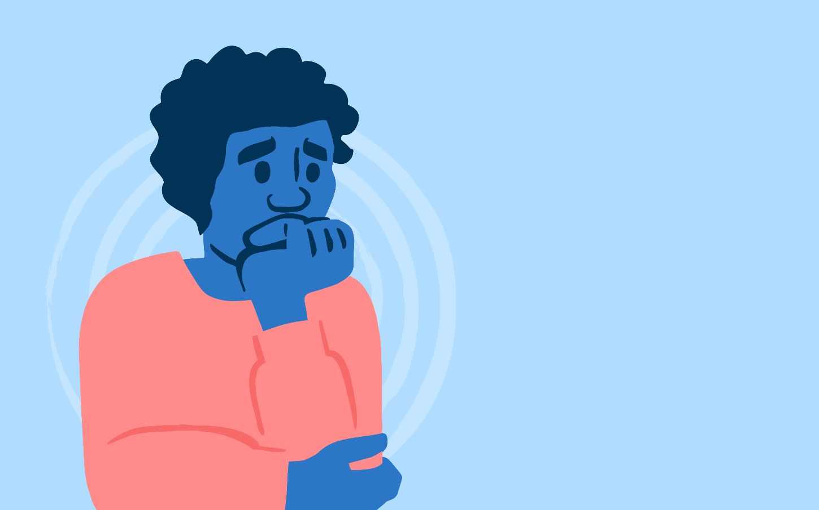
READING
anxiety (n)
.
/æŋˈzaɪ.ə.ti/
sự lo lắng
Notes:
anxiety (n) an uncomfortable feeling of nervousness or worry about something that is happening or might happen in the future

Slide 8
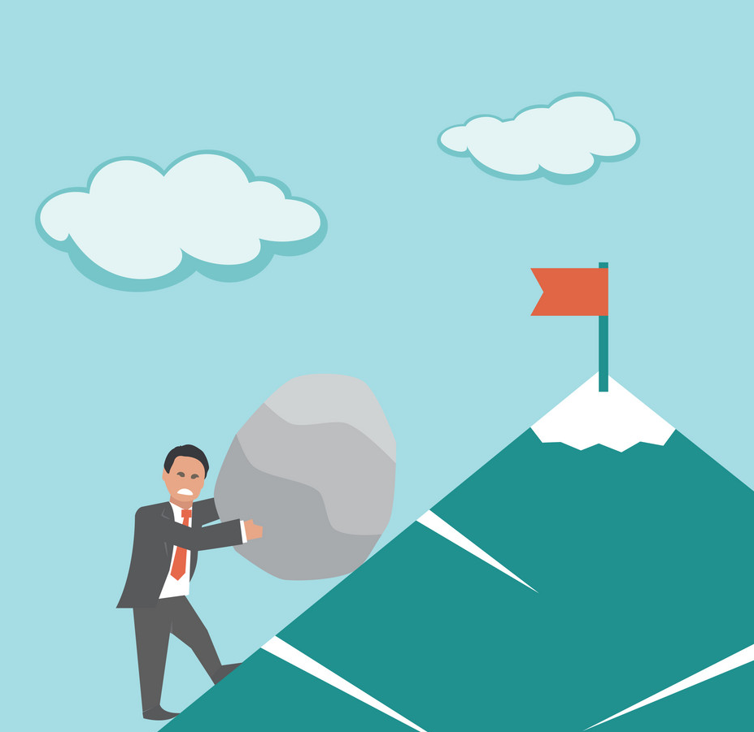
READING
effort (n)
.
/ˈef.ət/
sự cố gắng
Notes:
effort (n) physical or mental activity needed to achieve something:

Slide 9

READING
additional (adj)
.
/əˈdɪʃ.ən.əl/
thêm, bổ sung
Notes:
additional (a) extra

Slide 10
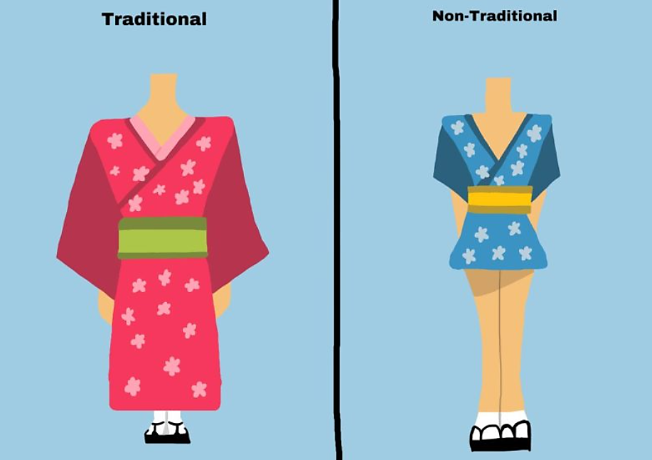

READING
appropriately (adv)
.
/əˈprəʊ.pri.ət.li/
một cách thích hợp
Notes:
appropriately (adv) close to a particular number or time although not exactly that number or time:

Slide 11
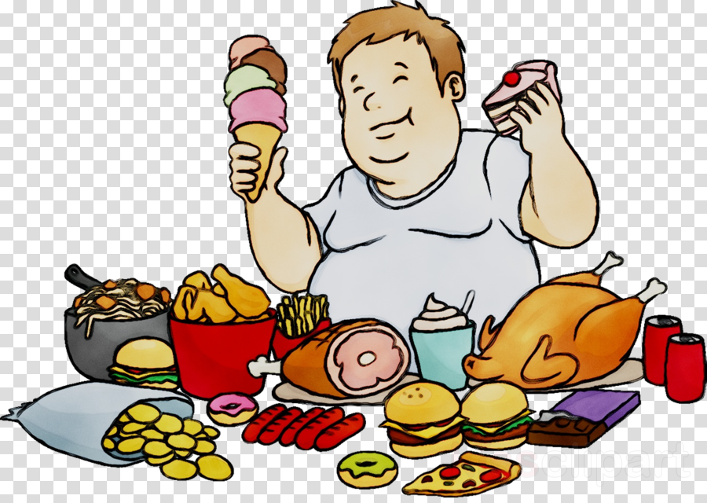
READING
fattening (adj)
.
/ˈfæt.ən.ɪŋ/
gây béo
Notes:
fattening (a) Fattening food contains a lot of fat, sugar, etc. that would quickly make you fatter if you ate a lot of it:

Slide 12
PRESENTATION
New words | Pronunciation | Meaning
1. celebrity (n) | /səˈleb.rə.ti/ | người nổi tiếng
2. anxiety (n) | /æŋˈzaɪ.ə.ti/ | sự lo lắng
3. effort (n) | /ˈef.ət/ | sự cố gắng
4. additional (adj) | /əˈdɪʃ.ən.əl/ | thêm, bổ sung
5. appropriately (adv) | /əˈprəʊ.pri.ət.li/ | một cách thích hợp
6. fattening (adj) | /ˈfæt.ən.ɪŋ/ | gây béo

Slide 13
READING
2
Read the text and match each highlighted word with its meaning.
a. more than the amount you expected or agreed to
b. likely to make you fat
c. the state of feeling nervous or worried that something bad is going to happen
d. in a way that is suitable or right for a particular situation
1. anxiety
2. additional
3. appropriately
4. fattening

Slide 14
READING
2
Read the text and match each highlighted word with its meaning.
a. more than the amount you expected or agreed to
b. likely to make you fat
c. the state of feeling nervous or worried that something bad is going to happen
d. in a way that is suitable or right for a particular situation
1. anxiety
1. c
2. a
3. d
4. b
2. additional
3. appropriately
4. fattening

Slide 15
READING
3
Read the text again and answer the following questions.
1. Why did the teen celebrity have to learn how to have a well-balanced life when he was a student?
2. What did he do to manage his time properly?
3. Why did he communicate with his family, friends, and teachers about his schedules and problems?
4. Why did he take breaks?
5. How did he follow a healthy diet?

Slide 16
READING
2
The following text is about how a successful teen celebrity kept
a well-balanced life when he was at school. Read the text and match each highlighted word with its meaning.
When I was at school, I had to learn how to have a well-balanced life in order to reduce stress and anxiety. Below are some of the typical things I did.
Firstly, I managed my time properly. I started to plan my schedule, made a weekly work list and gave priority to some of my work. This helped me concentrate my efforts on my most important tasks.
In addition, I communicated with my family, friends, and teachers about my busy schedule and problems, so they would offer me additional support.
I also took breaks appropriately because they helped me keep away from stress and anxiety, and gave my brain a rest and improved my mood.
Finally, I looked after my physical health. I got at least eight hours of sleep a day. I played football with my classmates twice a week and went for a walk with my grandparents early every morning. Besides, I also tried to follow a healthy diet. I ate a lot of fruit and vegetables. I ate little fattening foods and avoided junk foods like chips, cookies, pizza, etc.

Slide 17
READING
3
Read the text again and answer the following questions.
1. Why did the teen celebrity have to learn how to have a well-balanced life when he was a student?
2. What did he do to manage his time properly?
Because he wanted to avoid stress and anxiety.
He planned his schedule, made a weekly work list and gave priority to his work, which helped him concentrate his efforts on his most important tasks.
Notes:
1. Because he wanted to avoid stress and anxiety.
2. He planned his schedule, made a weekly task list and gave priority to his work, which helped him concentrate his efforts on his most important tasks.
3. Because they would offer him additional support.
4. Because they helped him avoid stress and anxiety, and gave his brain a rest and improved
his mood.

Slide 18
READING
3
Read the text again and answer the following questions.
3. Why did he communicate with his family, friends, and teachers about his schedules and problems?
4. Why did he take breaks?
5. How did he follow a healthy diet?
Because they would offer him additional support.
Because they helped him keep away from stress and anxiety, and gave his brain a rest and improved his mood.
He ate a lot of fruit and vegetables. He ate little fattening foods and avoided junk foods like chips, cookies, pizza, etc.

Slide 19

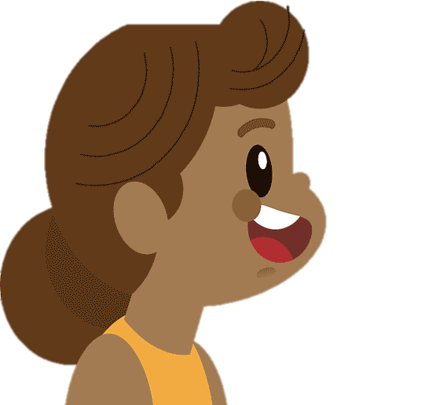
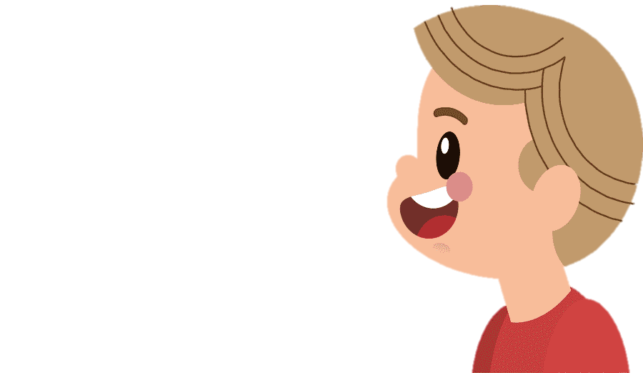
SPEAKING
4
Work in pairs. Ask and answer the following questions about how to
have a well-balanced life. Make notes of your partner’s answers.
1. How can we manage our time properly?
2. How can we spend time with our friends, teachers, and parents?
3. How can we avoid stress and anxiety?
4. How can we take care of our physical
health?

Slide 20
SPEAKING
4
Work in pairs. Ask and answer the following questions about how to
have a well-balanced life. Make notes of your partner’s answers.
How can we manage our time properly?
To effectively manage time, create a daily or weekly to-do list, prioritize tasks based on importance and urgency, and break down large tasks into smaller, manageable goals.
2. How can we spend time with our friends, teachers, and parents?
Foster open communication with friends, teachers, and parents by planning regular meet-ups and setting shared activities for shared bond-building.
3. How can we avoid stress and anxiety?
Maintaining a healthy work-life balance, engaging in relaxation activities like hobbies, meditation, or yoga, and seeking support from friends, family, or counselors can help alleviate stress.
4. How can we take care of our physical health?
Regular exercise, a balanced diet rich in fruits, vegetables, proteins, and adequate sleep are essential for maintaining physical health.

Slide 21
SPEAKING
5
Work in groups. Take turns to talk about your partner’s ideas about how to have a well-balanced life.
Suggested answers:
I talked with An about how she manages a well-balanced life. First, she manages her time properly by creating a to-do list and give priority to her tasks based on their importance and deadlines. Second, she plans regular times to connect with friends, through study groups or social outings. She also maintains open communication with her teachers by asking questions and seeking help when needed. Next, she practises mindfulness techniques such as deep breathing, meditation, or yoga to manage stress and maintain a clear mind. Finally, she engages in regular physical activities that she enjoys like jogging, dancing, swimming, etc to help boost her energy.

Slide 22

CONSOLIDATION
1
Wrap-up
What have we learnt in this lesson?
Vocabulary related to related to students’ life and schoolwork.
Reading for specific information.
Talking about partner’s ideas about how to have a well-balanced life.

Slide 23
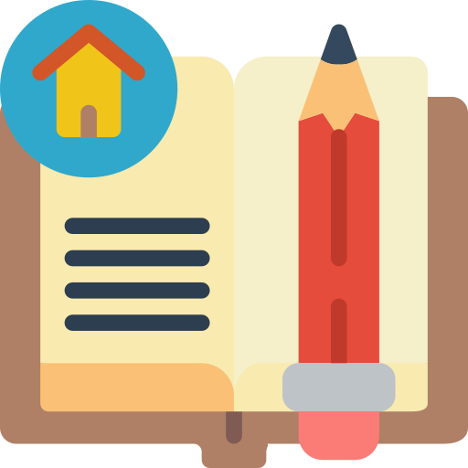
CONSOLIDATION
2
Homework
Do exercises in the workbook.

Slide 24
Website: hoclieu.vn
Fanpage: facebook.com/www.tienganhglobalsuccess.vn/

