Slide 2
Unit
3
HEALTHY LIVING FOR TEENS
LESSON 4: COMMUNICATION
EVERYDAY ENGLISH: Asking for repetition and responding
1

Slide 3
WARM-UP: Watch a video and fill in each blank with ONE word.
1. I'm sorry, I didn't quite _____ that.
2. Could you ____ that again?
3. I'm sorry. I still didn’t ___ that.
4. _____ more time?
5. Look! I can't hear a ____ you're saying.

Slide 4
WARM-UP: Watch a video and fill in each blank with ONE word.
catch
1. I'm sorry, I didn't quite _____________ that.
2. Could you _____________ that again?
3. I'm sorry. I still didn’t _____________ that.
4. _____________ more time?
5. Look! I can't hear a _____________ you're saying.
say
get
One
word

Slide 5
EVERYDAY ENGLISH
1
Listen and read the dialogues below. Pay attention to the highlighted sentences.
Mai: Can you open the door, Tom?
Tom: Sorry?
Mai: Can you open the door, please?
Nick: Excuse me. Would you mind showing me the way to the post office?
Woman: I beg your pardon.
Nick: Would you mind showing me the way to the post office?

Slide 6
EVERYDAY ENGLISH
ASKING FOR REPETITION | RESPONDING
Sorry? | Repeat/Simplify what you have said
I beg your pardon.
I'm sorry, I didn't quite catch that.
Could you say that again?
One more time?
Look! I can't hear a word you're saying.

Slide 7
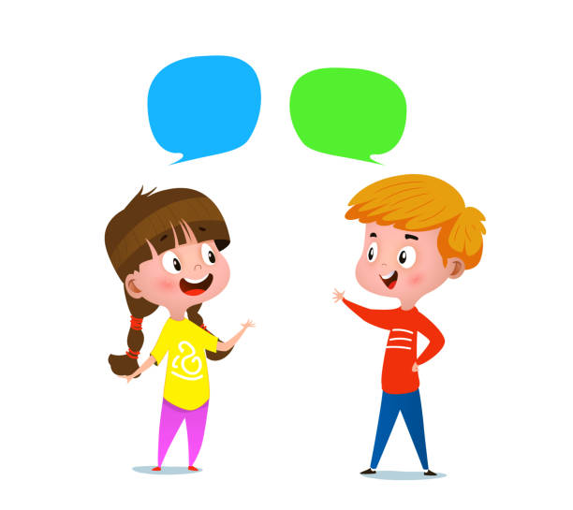
EVERYDAY ENGLISH
2
Work in pairs. Make similar conversations for the following situations.
Situation 1: You ask your friend to pass the book, but he / she can’t hear what you say.
Situation 2: A stranger asks you the way to the nearest bus station, but you can’t hear what he / she says.

Slide 8
EVERYDAY ENGLISH
2
Work in pairs. Make similar conversations for the following situations.
Situation 1: You ask your friend to pass the book, but he / she can’t hear what you say.
Suggested answer:
A: Can you pass me the book?
B: Sorry?
A: Can you pass me the book, please?

Slide 9
EVERYDAY ENGLISH
2
Work in pairs. Make similar conversations for the following situations.
Situation 2: A stranger asks you the way to the nearest bus station, but you can’t hear what he / she says.
Suggested answer:
A: Excuse me. Could you tell me the way to the nearest bus station, please?
B: I beg your pardon.
A: Could you tell me the way to the nearest bus station, please?

Slide 10
EMOTION WORD MATCH
GAME
T writes down a list of emotion words on the board.
Each student receives a small piece of paper and write down an emotion word from the list without showing it to anyone.
Ss write 1-2 short sentences about a school-related experience that made them feel that particular emotion.
Collect the pieces of paper and mix them up. Read each sentence out loud one by one without revealing the emotion word and have Ss try to guess which emotion word matches each sentence.

Slide 11
TIPS FOR BEING HAPPY ON SCHOOL DAYS
praise (v)
.
/preɪz/
khen, ca ngợi
Notes:
Praise (v): to say that you approve of and admire somebody/something

Slide 12
TIPS FOR BEING HAPPY ON SCHOOL DAYS
overcome (v)
/ˌəʊ.vəˈkʌm/
đánh bại, vượt qua
Notes:
Overcome (v): to defeat or succeed in controlling or dealing with something

Slide 13
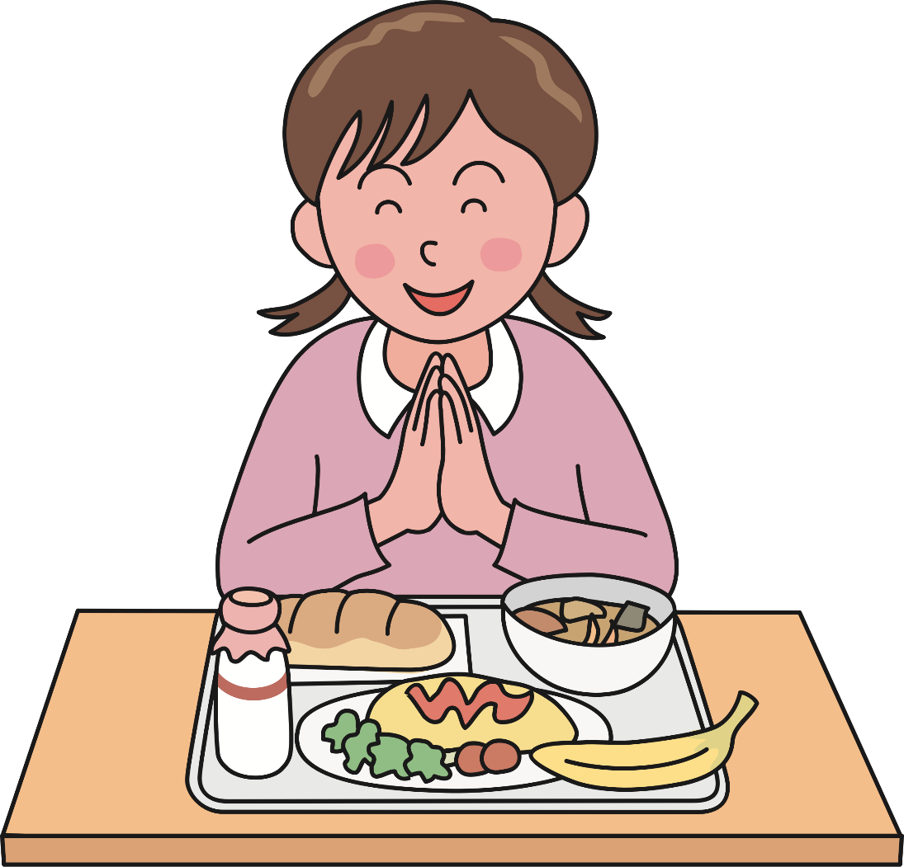
TIPS FOR BEING HAPPY ON SCHOOL DAYS
thankful (adj)
/ˈθæŋk.fəl/
biết ơn
Notes:
Thankful (a): happy or grateful because of something

Slide 14
TIPS FOR BEING HAPPY ON SCHOOL DAYS
New words | Pronunciation | Meaning
1. praise (v) | /preɪz/ | khen, ca ngợi
2. overcome (v) | /ˌəʊ.vəˈkʌm/ | đánh bại, vượt qua
3. thankful (adj) | /ˈθæŋk.fəl/ | biết ơn

Slide 15
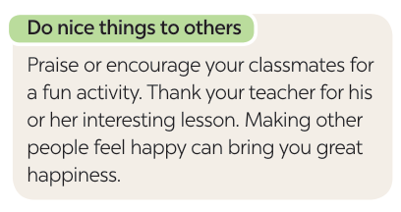
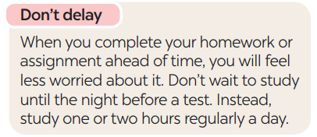
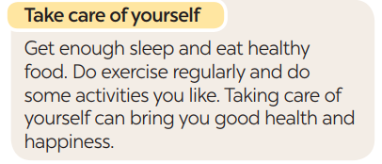
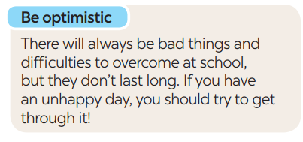
TIPS FOR BEING HAPPY ON SCHOOL DAYS
Read the text and complete each sentence that follows with a suitable word.
3

Slide 16
TIPS FOR BEING HAPPY ON SCHOOL DAYS
3
Read the text and complete each sentence that follows with a suitable word.
happy
1. You should make others feel ______ by giving them encouragement or being thankful to them.
2. You shouldn’t ______ doing your homework or assignment or preparing for a test. This will reduce your stress.
3. Getting enough sleep, eating healthy food, and doing what you like can bring you good health and ___________.
4. You should always be expecting good things to happen and try to ____________ difficulties.
delay
happiness
overcome
Notes:
1. happy 2. delay 3. happiness 4. overcome

Slide 17
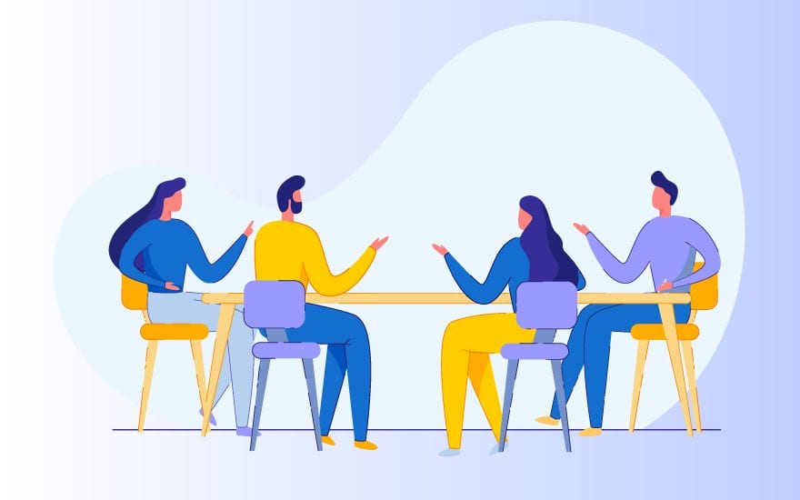
TIPS FOR BEING HAPPY ON SCHOOL DAYS
4
Work in groups. Write tips for one of the following situations.
Situation 1: A friend of yours cannot get a good night’s sleep.
Situation 2: A friend of yours does not feel very well.
Situation 3: A friend of yours cannot remember the words he / she learnt.
Notes:
1. happy 2. delay 3. happiness 4. overcome

Slide 18
TIPS FOR BEING HAPPY ON SCHOOL DAYS
4
Work in groups. Write tips for one of the following situations.
Situation 1: A friend of yours cannot get a good night’s sleep.
-You should try to go to bed and wake up at the same time every day, even on weekends. This helps regulate your body's internal clock and improve the quality of your sleep.
Situation 2: A friend of yours does not feel very well.
You should pay attention to your symptoms and their progression. If they become severe or unusual, you should seek medical attention.
Situation 3: A friend of yours cannot remember the words he / she learnt.
You should try using the words you've learned in sentences or conversations. This helps create a stronger connection in your brain and makes the words easier to remember.
Notes:
1. happy 2. delay 3. happiness 4. overcome

Slide 19
TIPS FOR BEING HAPPY ON SCHOOL DAYS
5
Present your tips to the class.

Slide 20
CONSOLIDATION
1
Wrap-up
What have we learnt in this lesson?
Ask for repetition and respond.
Learn about tips to make students feel happy on school days.
Further develop their reading skill for specific information (scanning).
Give presentation of the tips.

Slide 21
CONSOLIDATION
2
Homework
Do exercises in the workbook.

Slide 22
Website: hoclieu.vn
Fanpage: facebook.com/www.tienganhglobalsuccess.vn/

