Slide 2
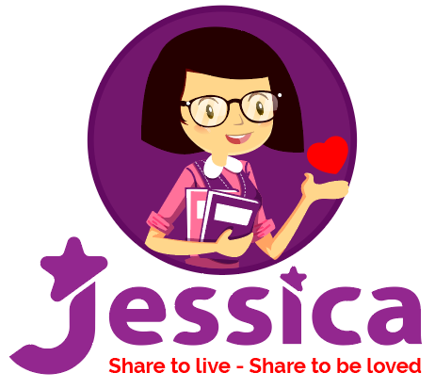
WARM UP
Designed by Jessica Lee

Slide 3
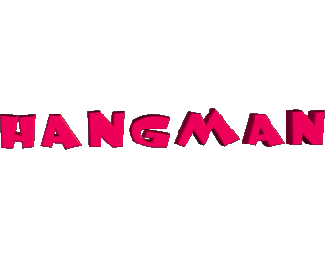
R
O
M
S
2
3
1
0
4
5
Notes:
3

Slide 4
UNIT 2
MY HOUSE
A CLOSER LOOK 1
Designed by Jessica Lee

Slide 5
A closer look 1
Vocabulary
- Rooms and furniture
Pronunciation
- Final sounds:
/s/ - /z/

Slide 6
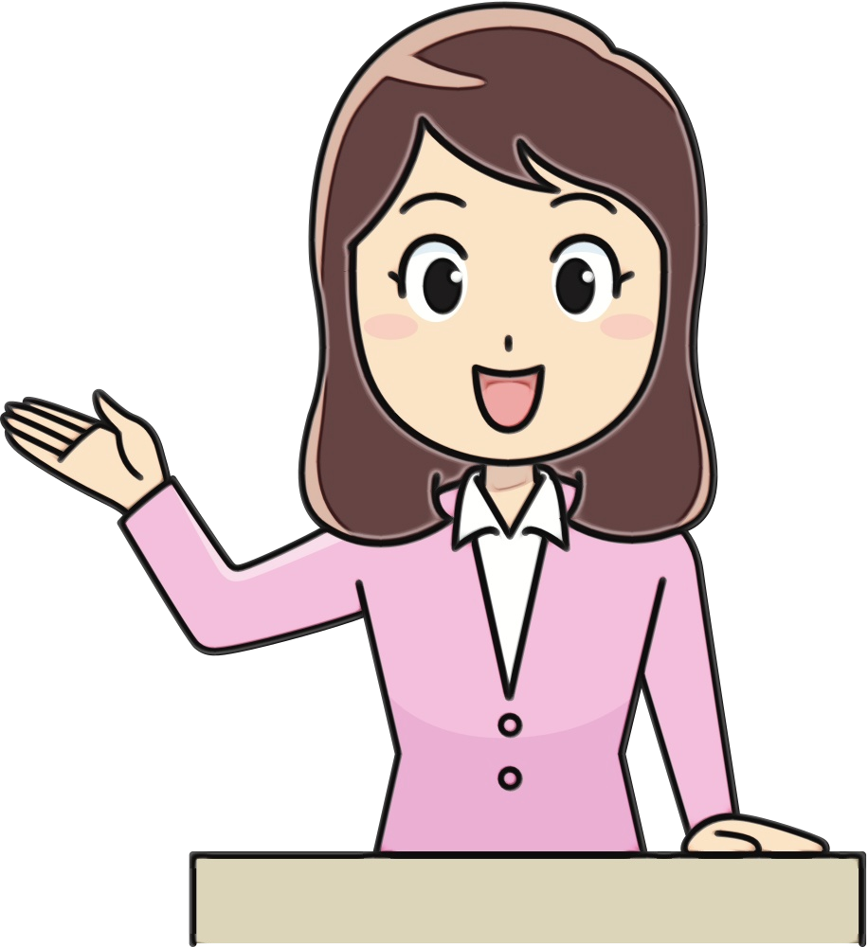
VOCABULARY
Designed by Jessica Lee

Slide 7
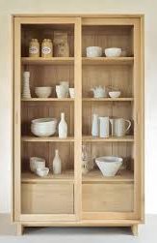
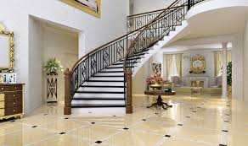
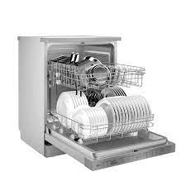
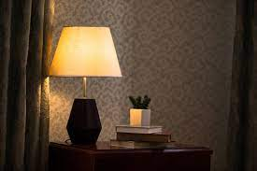
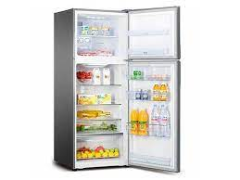
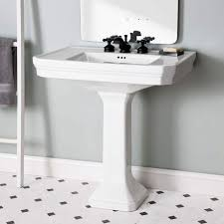
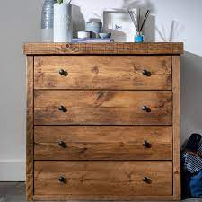
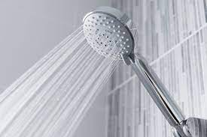
Unit 2: MY HOUSE
Lesson 2: A closer look 1
I/ VOCABULARY
- hall (n) :
sảnh, đại sảnh
- lamp (n) :
đèn để bàn
- cupboard (n) :
tủ chén/ bát
- dishwasher (n) :
máy rửa bát
- chest of drawers (n):
tủ có nhiều ngăn kéo
- sink (n) :
bồn rửa
- shower (n) :
vòi hoa sen
- fridge (n) :
tủ lạnh

Slide 8
(*) Checking vocabulary: Matching
1. hall (n) :
a. đèn để bàn
2. cupboard (n) :
b. tủ chén/ bát
3. fridge (n) :
c. máy rửa bát
4. sink (n) :
d. tủ có nhiều ngăn kéo
5. shower (n) :
e. vòi hoa sen
6. chest of drawers (n):
f. tủ lạnh
7. dishwasher (n) :
g. sảnh, đại sảnh
8. lamp (n) :
h. bồn rửa

Slide 9
Unit 2. My house
A closer look 1
Look at the house. Name the rooms in it.
Designed by Jessica Lee

Slide 10
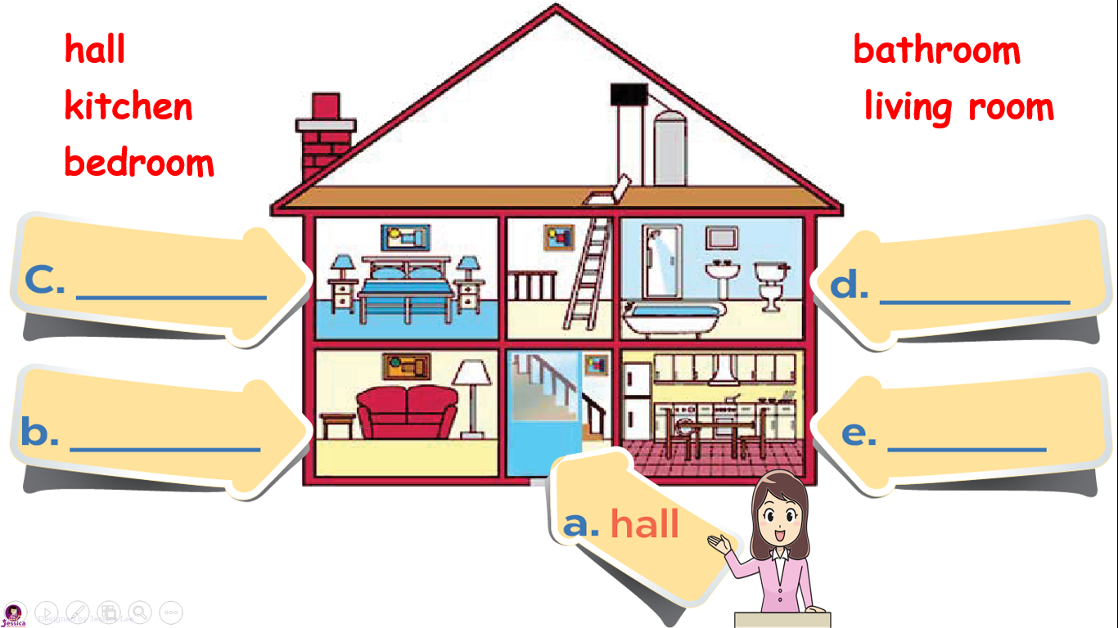
chimney
1. Match name of rooms in the house.
hall
bathroom
kitchen
living room
attic
bedroom
bedroom
bathroom
living room
kitchen
hall
Designed by Jessica Lee

Slide 11
Unit 2. My house
A closer look 1
Look at the house. Name the rooms in it.
Name the things in each room in 1.
Use the word list below.
Designed by Jessica Lee

Slide 12
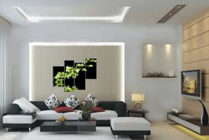
2. Name the things in each room in.
a. Things in the living room:
- Lamp
- Sofa
- Pictures
3
- Television
4
1
2

Slide 13
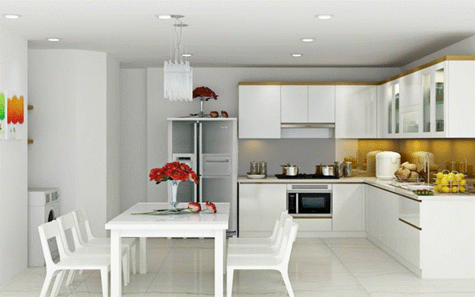
b. Things in the kitchen:
- Cupboard
- Fridge
- Sink
- Dishwasher
- Chairs
- Table
- Cooker(n):

Slide 14
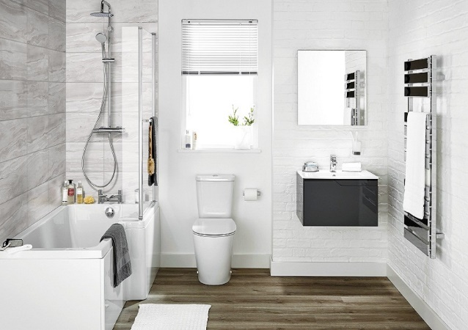
c. Things in the bathroom:
3
- Toilet
6
- Sink
5
- Shower
- Bath
2
- Towel rack
1
- Mirror (n):
4

Slide 15
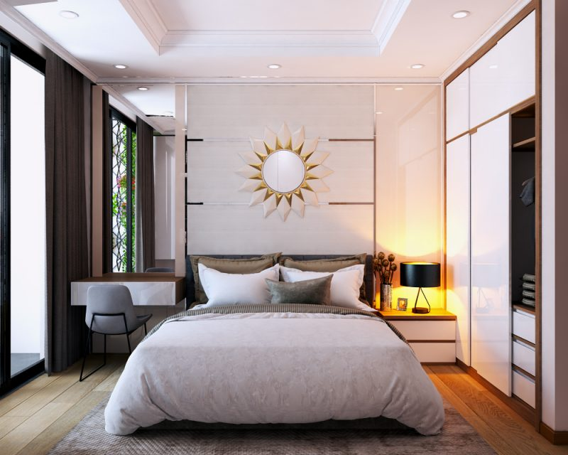
d. Things in the bedroom:
- Chest of drawers
3
- Lamp
- Picture
- Wardrobe
4
- Bed
6
2
- Pillows
5
1

Slide 16
Unit 2. My house
A closer look 1
Look at the house. Name the rooms in it.
Name the things in each room in 1.
Use the word list below.
3. Think of a room in your house. In pairs, ask and answer questions to guess it.
Designed by Jessica Lee

Slide 17
Example:
A: What's in your room? B: A sofa and a television. A: Is it the living room? B: Yes.
Designed by Jessica Lee

Slide 18
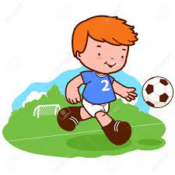
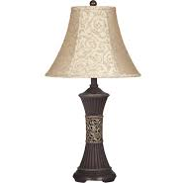
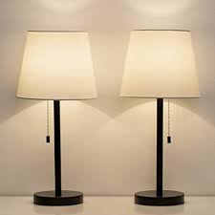
What’s this?
What does he often do after school?
a lamp
He often plays football.
plays
lamps
/z/
/s/

Slide 19
Pronunciation
/s/
/z/
Designed by Jessica Lee

Slide 20
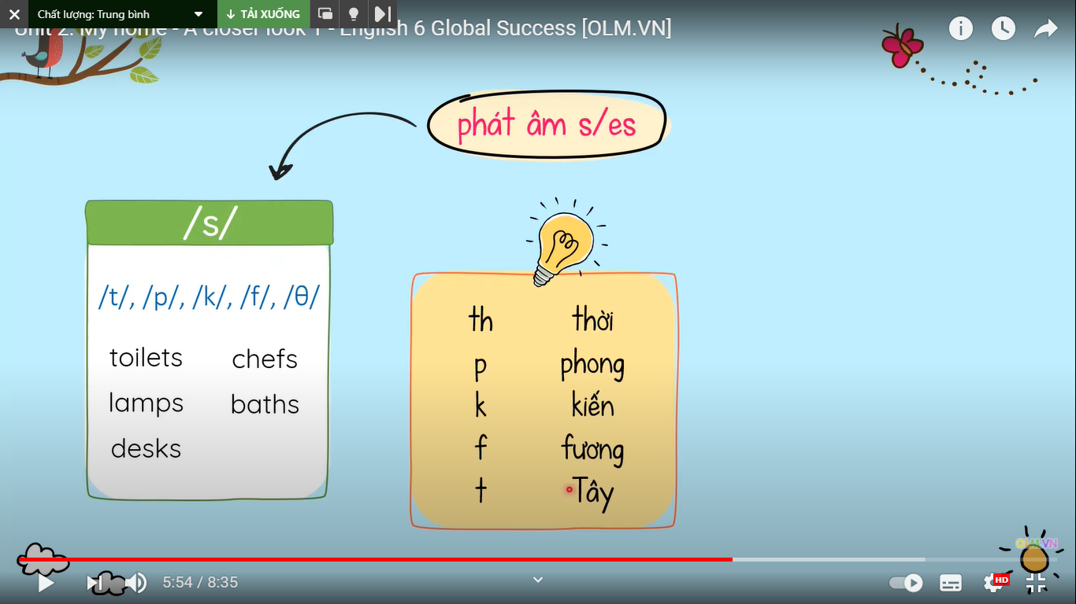
Final sounds
Âm cuối: b, n, l, d, v, m, r, y, u, e, o, a, i ...
pens tables
pictures decides

Slide 21
Unit 2. My house
A closer look 1
Look at the house. Name the rooms in it.
Name the things in each room in 1.
Use the word list below.
3. Think of a room in your house. In pairs, ask and answer questions to guess it.
4. Listen and repeat the words
Designed by Jessica Lee

Slide 22
4. Listen and repeat the words
/z/
/s/
lamps
cupboards
sinks
sofas
flats
kitchens
toilets
rooms
Note: nhấn các ô chữ màu xanh để nghe
Designed by Jessica Lee

Slide 23
Unit 2. My house
A closer look 1
Look at the house. Name the rooms in it.
Name the things in each room in 1.
Use the word list below.
3. Think of a room in your house. In pairs, ask and answer questions to guess it.
4. Listen and repeat the words
5. Listen to the conservation. Underline the final s in the words and put them in the correct column
Designed by Jessica Lee

Slide 24
5. Listen to the conservation
Mi: Mum, are you home?
Mum: Yes, honey. I'm in the kitchen. I've bought these new bowls and chopsticks.
Mi: They're beautiful, Mum. Where did you buy them?
Mum: In the department store near our house. They have a lot of things for homes.
Mi: Don't forget we need two lamps for my bedroom, Mum.
Mum: Let's go there this weekend.
Designed by Jessica Lee

Slide 25
5. … underline the final s in the words
Mi: Mum, are you home?
Mum: Yes, honey. I'm in the kitchen. I've bought these new bowls and chopsticks.
Mi: They're beautiful, Mum. Where did you buy them?
Mum: In the department store near our house. They have a lot of things for homes.
Mi: Don't forget we need two lamps for my bedroom, Mum.
Mum: Let's go there this weekend.
Designed by Jessica Lee

Slide 26
5… put the words in the correct column
/s/
/z/
bowls
chopsticks
things
homes
lamps
bowls
chopsticks
lamps
things
homes
Designed by Jessica Lee

Slide 27
5. … now practice the conservation with a partner
Mi: Mum, are you home?
Mum: Yes, honey. I'm in the kitchen. I've bought these new bowls and chopsticks.
Mi: They're beautiful, Mum. Where did you buy them?
Mum: In the department store near our house. They have a lot of things for homes.
Mi: Don't forget we need two lamps for my bedroom, Mum.
Mum: Let's go there this weekend.
Designed by Jessica Lee

Slide 28
Goodbye!
See you again!

