Slide 1
Hoai Huong Secondary School
Welcome teachers to class 7A3
English 7

Slide 2
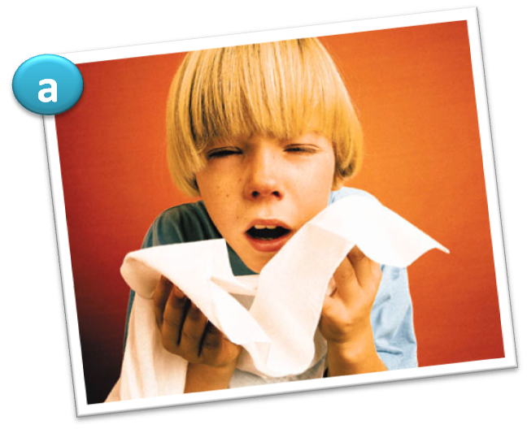
Look at the pictures. Which advice would you give to each of these people?
He is having a flu.
=> Eat more fruit / vegetables.
- Sleep more.
- Wash your hands more.

Slide 3
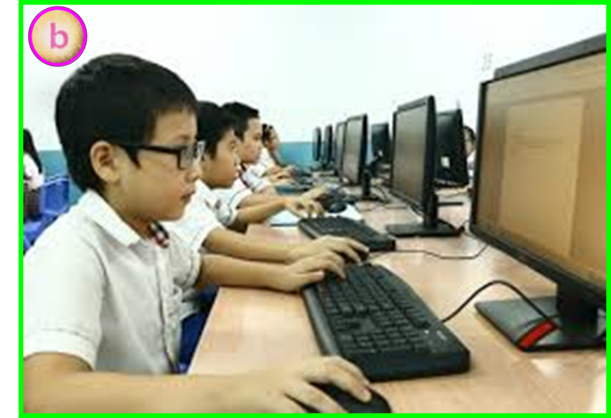
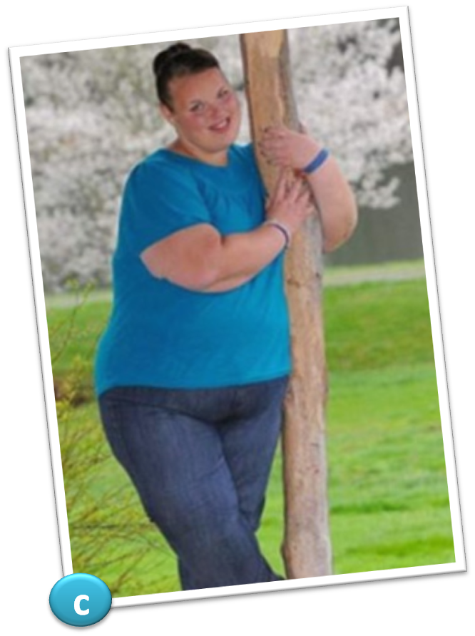
He has problem with his eyesight
She is overweight and she is obese now.
=> Spend less time playing computer games.
=> Do more exercise.
Eat less junk food.

Slide 4
Wednesday, October 20^{th,} 2021
TOPIC 2:
HEALTH
Lesson:
SKILLS 1

Slide 5
TOPIC 2: Lesson 4: SKILLS 1
I/ VOCABULARY:
- energy (n)
: năng lượng
- expert (n)
: chuyên gia
- diet (n)
: chế độ ăn kiêng
- tip ( n)
: mẹo vặt, lời khuyên
- (to) stay in shape
: giữ dáng
- amount (n)
: lượng, số lượng

Slide 6
1. Quickly read the text. Match the correct headings with the paragraphs.
We need calories or energy to do the things we do every day: walking, riding a bike, and even sleeping! We get calories from the food we eat.. If we eat too many, we can get fat. If we don’t eat enough, we feel tired and weak.
People should have between 1,600 and 2,500 calories a day to stay in shape. Sports and activities like riding a bike and running use a lot of calories. Sleeping and watching TV use less. Do you think you are eating more or less calories than you need?
Dr. Dan Law is a diet expert. He knows exactly how much people need to eat, so many people listen to his advice. His calorie tips? Eat less junk food, and count your calories if you’re becoming fat.
1. JUST THE RIGHT AMOUNT
2. WHAT IS A CALORIE?
3. AN EXPERT’S VIEW

Slide 7
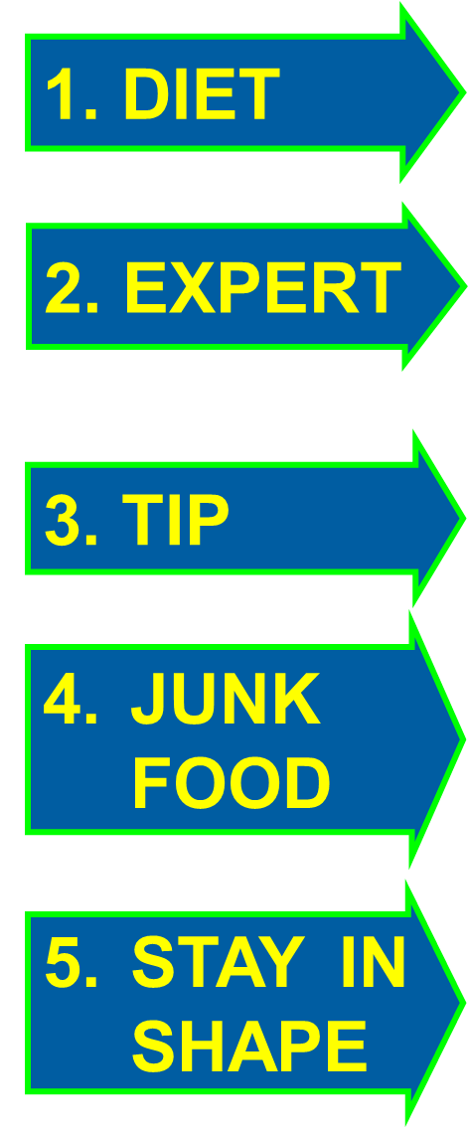
2.Discuss the meaning of each word / phrase with a partner. Then match the words with their meaning
A. usually convenience food like Mc Donald, KFC …
B. an advice on how to do something quickly and successfully, usually from one’s own experience.
C. someone who has studied a lot about a subject or topic and understands it well.
D. be fit and healthy.
E. the food that you eat on a daily basis.

Slide 8
True or False
1. We get calories from the food
T
2. We will feel tired and weak if we don’t eat enough food
T
less
F
3. Sleeping and watching TV use a lot of calories
need to
F
4. If you’re becoming fat, you needn’t count calories
We need calories or energy to do the things we do every day: walking, riding a bike, and even sleeping! We get calories from the food we eat. If we eat too many, we can get fat.
If we don’t eat enough, we feel tired and weak.
People should have between 1,600 and 2,500 calories a day to stay in shape. Sports and activities like riding a bike and running use a lot of calories. Sleeping and watching TV use less. Do you think you are eating more or less calories than you need?
Dr. Dan Law is a diet expert. He knows exactly how much people need to eat, so many people listen to his advice. His calorie tips? Eat less junk food, and
count your calories if you’re becoming fat.
need to
from the
food we eat
Sleeping and
watching TV use less
If we don’t eat enough,
we feel tired and weak.
count your calories

Slide 9
LUCKY NUMBER
1
7
2
GROUP A
GROUP B
20
50
60
40
30
10
70
20
30
40
10
50
60
70
6
3
5
4
NEXT

Slide 10
5. Why do people listen to Dr. Law’s advice?
Because he is a diet / nutrition expert.
10
ĐÁP ÁN
9
3
2
1
7
6
5
4
8
BACK

Slide 11
3. What is a healthy number of calories per day?
It is between 1,600 and 2,500 calories per day.
10
ĐÁP ÁN
9
3
2
1
7
6
5
4
8
BACK

Slide 12
1. What is a calorie?
A calorie is energy that helps us do our everyday activities.
10
ĐÁP ÁN
9
3
2
1
7
6
5
4
8
BACK

Slide 13
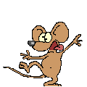
Lucky Number
Lucky Number
BACK

Slide 14
4. Which activity uses a lot of calories?
Sports like riding a bike and running use a lot of calories.
10
ĐÁP ÁN
9
3
2
1
7
6
5
4
8
BACK

Slide 15
2. What happens we have too many calories?
We get fat.
10
ĐÁP ÁN
9
3
2
1
7
6
5
4
8
BACK

Slide 16
1. What is calories?
A calorie is energy that helps us do our everyday activities.
2. What happens we have too many calories?
If we eat too many calories we get fat.
3. What is a healthy number of calories per day?
To stay healthy you need between 1,600 and 2,500 calories.
4. Which activity uses a lot of calories?
Sports activities and running use a lot of calories.
5. Why do people listen to Dr. Law’s advice?
Because he is an diet expert.

Slide 17
WORK IN GROUPS
Example: I do morning exercises
Sleep ing 8 hours each day
What activities do you usually do everyday to use calories?
Watching TV
Cycling to school

Slide 18
HOMEWORK
- Learn new words by heart.
- Practise the exercises again.
- Do exercises D1, 2, 3 (page 13, 14 / workbook).
- Prepare SKILLS 2.

Slide 19
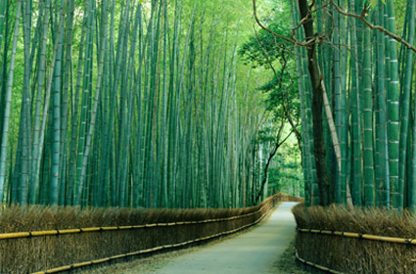
THANKS FOR YOUR ATTENTION!
Goodbye!
See you again!

Slide 20
4. Look at the table and discuss the following questions.
Activity | Calories use per hour
sleeping | 60
watching TV | 75
walking | 230
gardening | 275
aerobics | 330
swimming | 460
cycling | 590
running | 880

Slide 21
4. Look at the table and discuss the following questions.
1. Why do you think some activities use more calories than others?
Because each activity needs different amount of calories.
Which activity uses more calories: gardening or walking?
Gardening uses more calories.
How many calories do you use doing aerobics for 2 hours?
It is 660 calories.
4. What do you think happens when we have too few calories, but use too many calories?
We feel tired and weak.

Slide 22
5. Choose two or three activities you like to do. Complete the table about those activities.
Activity | Number of hours (per day) | Total number of calories
watching TV
2
150
swimming
1
460
cycling
0,5
295

Slide 23
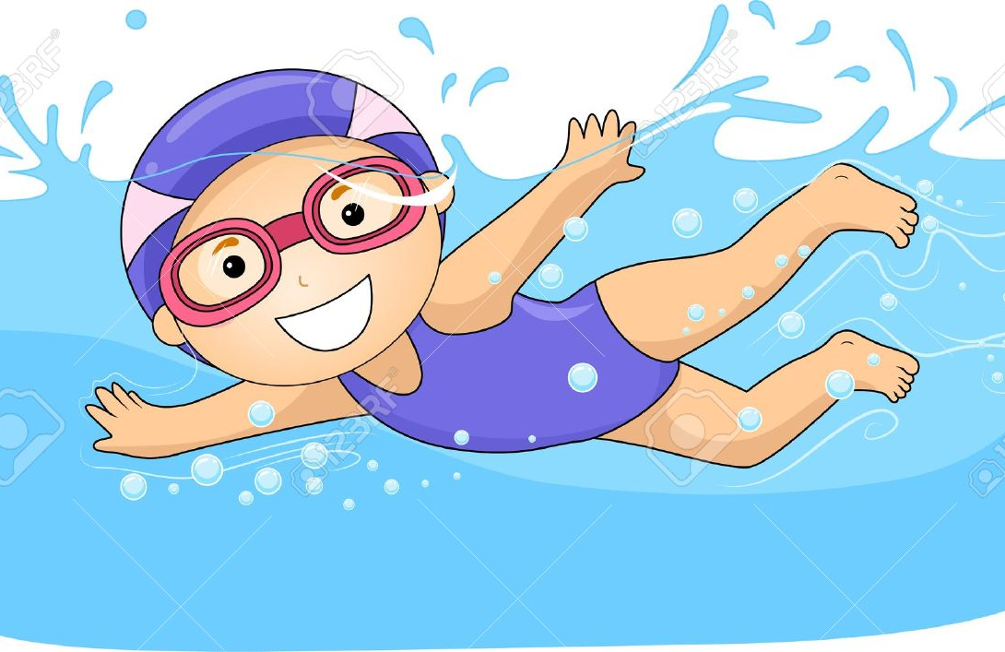
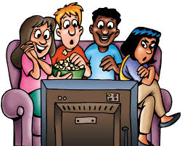
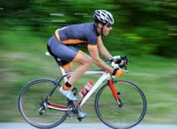
6. Present your table to the class. Try to include the following information.
What activities do you do;
How long you do them every day;
How many calories you use doing these activities.
Model: I go swimming, go cycling and watch TV every day. I spend one hour swimming, half an hour cycling and two hours watching TV. I think I need 905 calories for these activities every day.

