Slide 1
Welcome to our class

Slide 2
Ho Chi Minh city

Slide 3
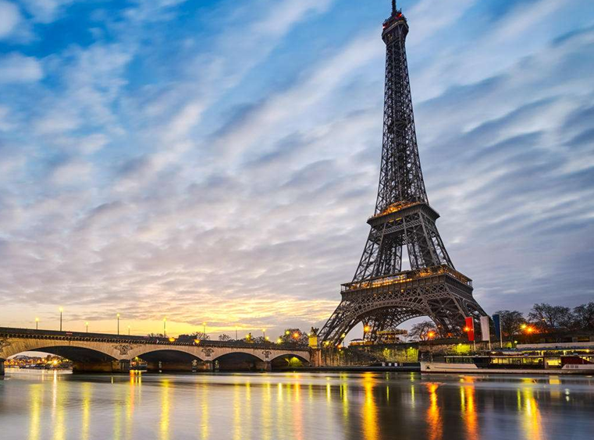
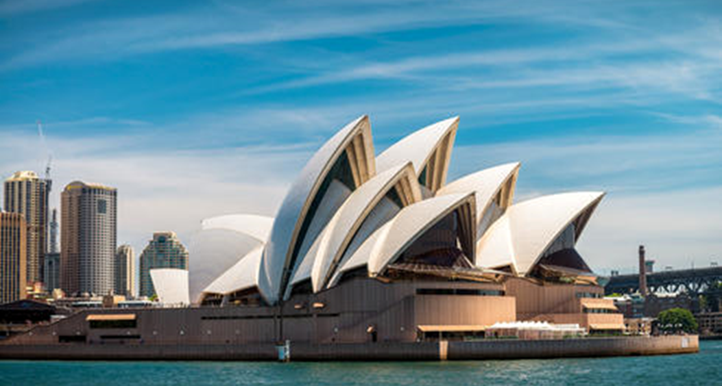
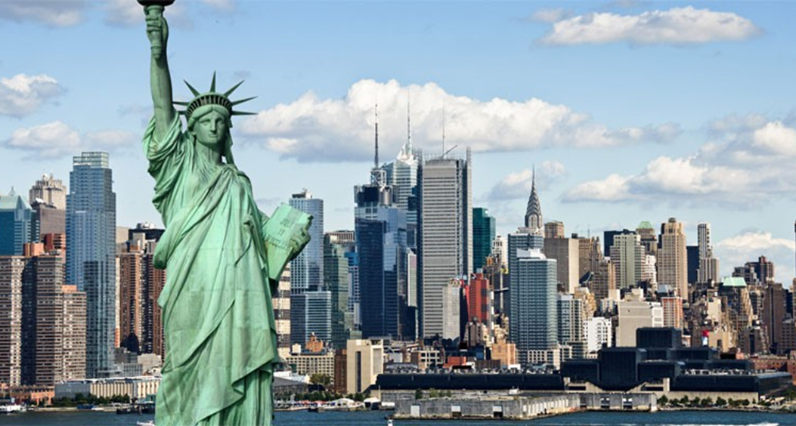
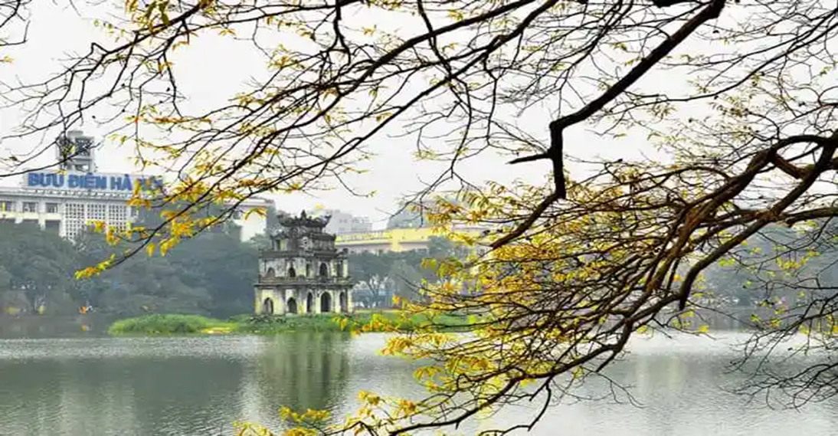
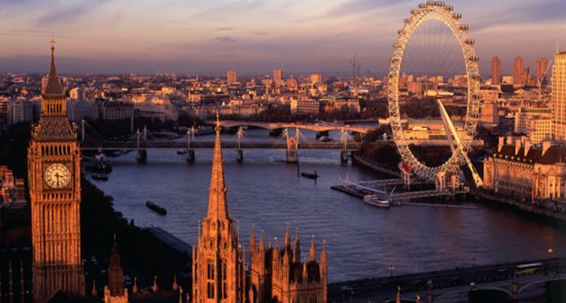

Slide 4
Paris

Slide 5
New York

Slide 6
Sydney

Slide 7
Hanoi

Slide 8
London

Slide 9
Congratulation

Slide 10
UNIT 9 : CITIES OF THE WORLD
Period 70th: Lesson: A closer look 1

Slide 11
Tasty /ˈ ˈteɪ.sti / (a)
ngon
ˈtāstē

Slide 12
Sunny /ˈsʌni/ (a)
nhiều nắng

Slide 13
Street food /ˈstriːt ˌfuːd/
món ăn đường phố

Slide 14
Palace /ˈpæləs/
Cung điện

Slide 15
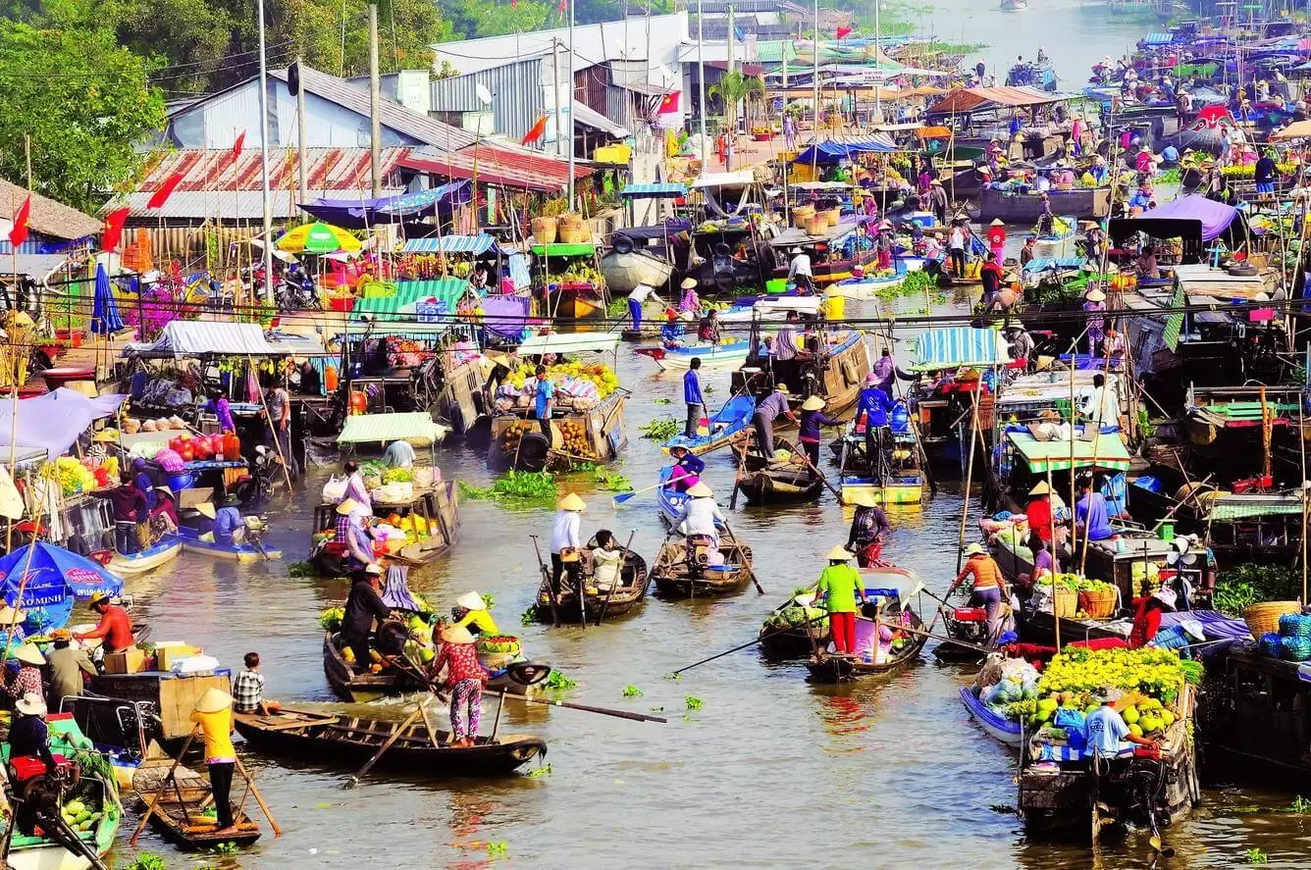
Floating market /ˈfləʊtɪŋ/ /ˈmɑːkɪt/
Chợ nổi

Slide 16
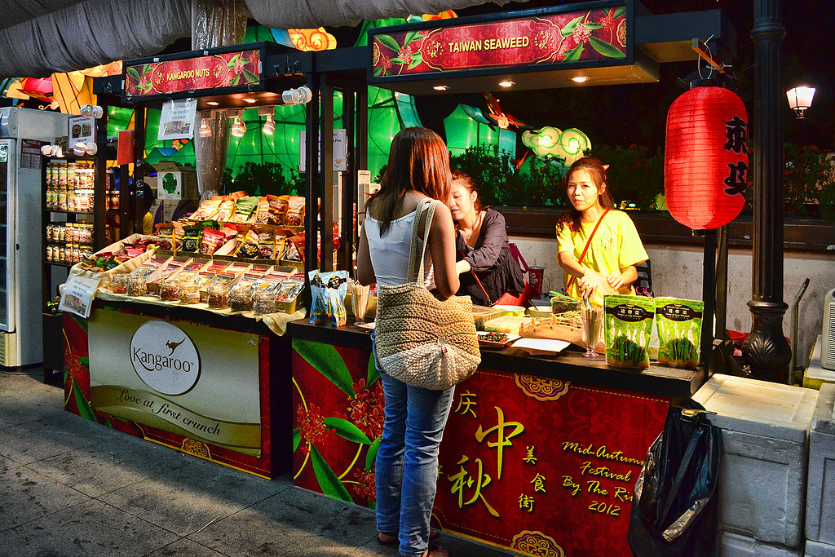
Stall /stɑːl/
Quầy hàng

Slide 17
Close your books

Slide 18
Fill each box with an adjective.
Vocabulary:
rainy
old
exciting
old
city
delicious
delicious
tasty
friendly
food
exciting
friendly
helpful
sunny
people
tasty
rainy
sunny
helpful
weather

Slide 19
Complete the sentences with the words in 1.
* Vocabulary
1.
- What’s the weather like in Sydney in summer?
- It’s and dry.
2.
I love the buildings in Edinburgh. I feel that they can tell stories.
3.
There are so many things to do in New York. It’s very .
4.
The people in my city are and helpful.
5.
Ha Noi is famous for its street food.
Game : Lucky number

Slide 20
LUCKY NUMBER
1
8
2
Team A
Team B
2
3
8
10
4
7
4
6
6
8
10
2
6
4
5
TIẾP

Slide 21
Complete the sentences with the words in 1.
1.
What’s the weather like in Sydney in summer?
- It’s ________and dry.
sunny

Slide 22
LUCKY NUMBER!

Slide 23
LUCKY NUMBER!

Slide 24
Complete the sentences with the words in 1.
2.
I love the _____buildings in Edinburgh.
I feel that they can tell stories.
old

Slide 25
Complete the sentences with the words in 1.
3.
There are so many things to do in New York.
It’s very _______.
exciting

Slide 26
Complete the sentences with the words in 1.
4.
The people in my city are ________and helpful.
friendly

Slide 27
Complete the sentences with the words in 1.
5.
Ha Noi is famous for its______________
street food.
delicious / tasty

Slide 28
LUCKY NUMBER!
YOU GET A GIFT

Slide 29
Complete the sentences with the words in 1.
Vocabulary
1.
- What’s the weather like in Sydney in summer?
sunny
- It’s and dry.
old
2.
I love the buildings in Edinburgh. I feel that they can tell stories.
3.
There are so many things to do in New York. It’s very .
exciting
friendly
4.
The people in my city are and helpful.
delicious / tasty
5.
Ha Noi is famous for its street food.

Slide 30
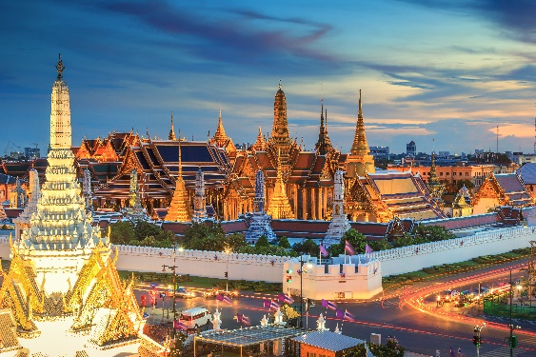
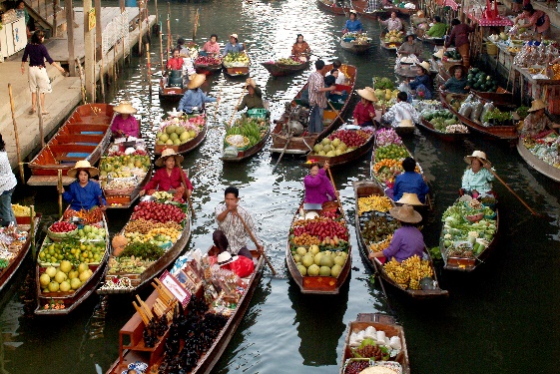
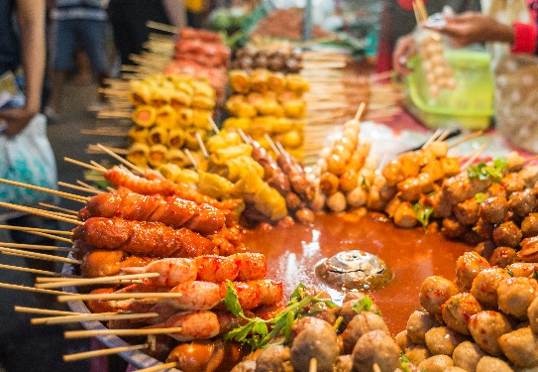
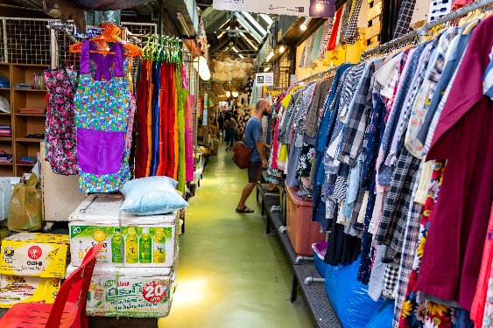
Write the words / phrases below under the correct pictures.
Vocabulary
stall
street food
palace
floating market
1.
palace
2.
floating market
3.
4.
street food
stall

Slide 31
Complete the sentences with the words / phrases in the box.
city
street food
night markets
people
landmarks
1. Kyoto is an ancient ________ in Japan.
2. Ho Chi Minh City is famous for its _____________. It’s so delicious!
3. – “Could you name some ____________ in Paris?”
– “Sure. The Eiffel Tower and Notre Dame Cathedral.”
4. Most big cities in Viet Nam has _______________. There you can buy souvenirs and eat local food.
5. I love the __________ of Manila. They’re friendly and helpful.

Slide 32
Listen and write the words in the correct column. Then listen and repeat.
III. Pronunciation
/əʊ/ and /aʊ/
boat
house
town
tower
postcard
crowded
coast
pagoda
/əʊ/
/aʊ/
boat
house
postcard
town
coast
tower
pagoda
crowded

Slide 33
Listen and repeat. Pay attention to the underlined words.
III. Pronunciation
/əʊ/ and /aʊ/
1.
The town is crowded at the weekend.
2.
There’s lots of snow in Tokyo in winter.
3.
It’s very cold on the boat.
4.
He’s running around the house.

Slide 34
THANK YOU FOR YOUR ATTENTION

