Slide 1




Unit 1
Local Environment
Lesson 6: Skills 2
Teacher: Ms. Huong

Slide 2


Slide 3
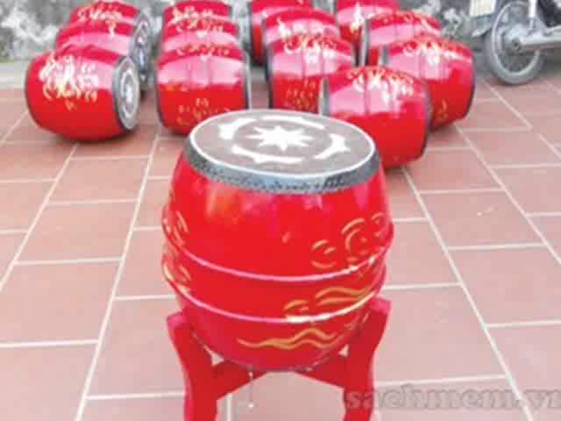
Do you know what places they are?

Slide 4


Slide 5
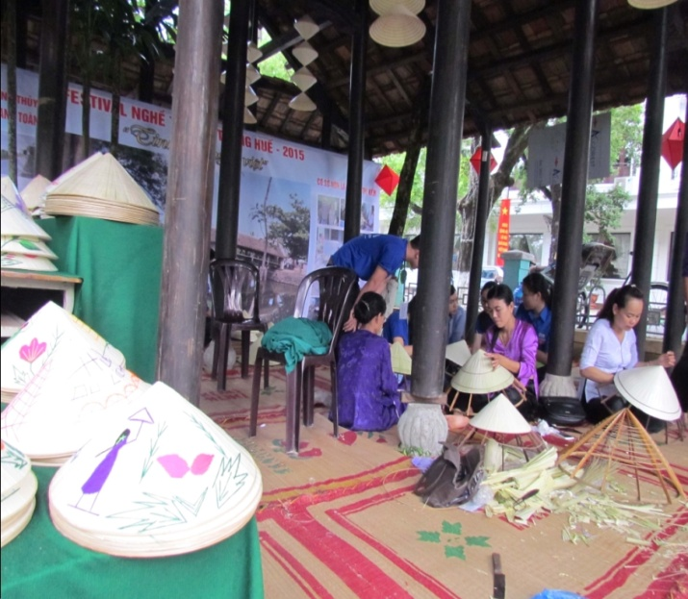
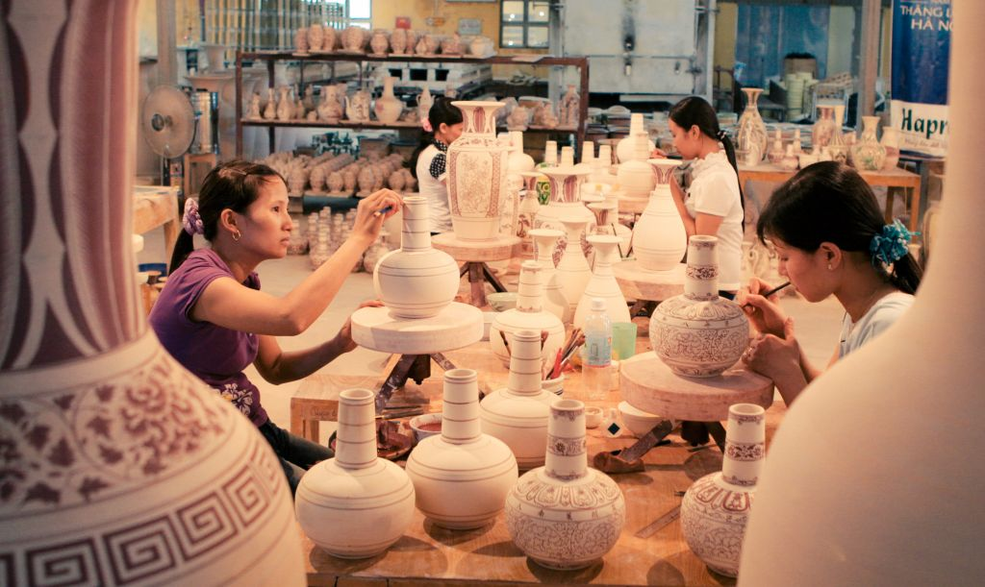
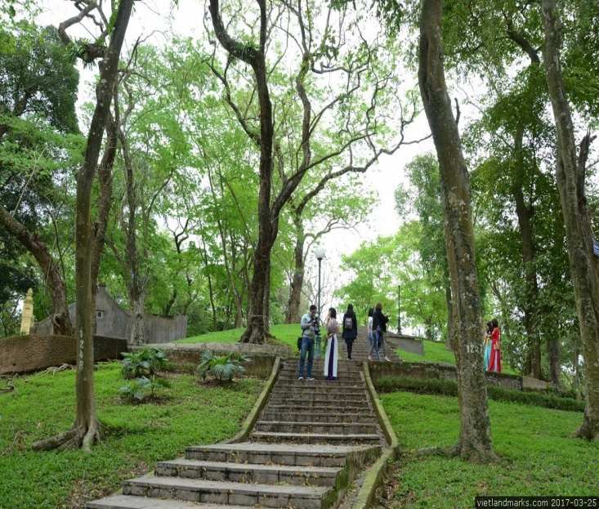
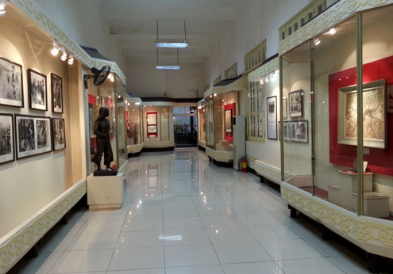
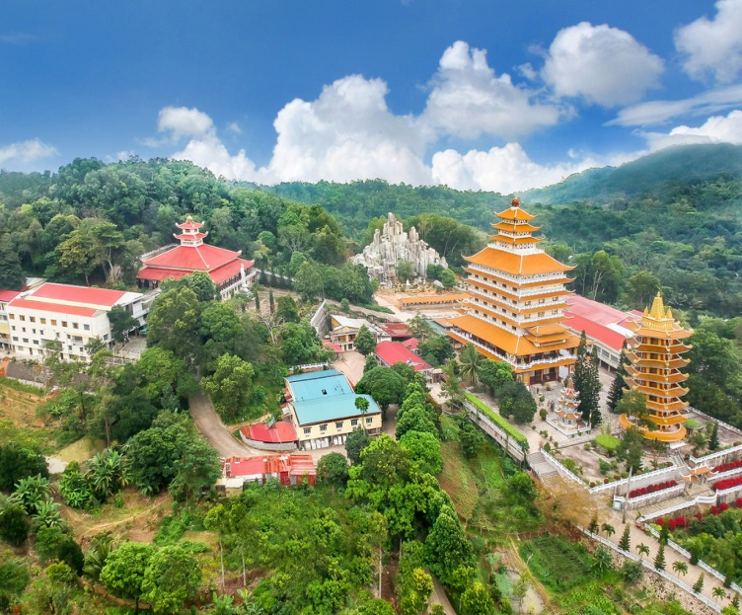

Match the places to the pictures.
a. Ha Long bay b. Bat Trang village c. Cam mountain
d. Botanical Garden e. Conical village f. Museum
e. Conical village
b. Bat Trang village
d. Botanical Garden
f. Museum
c. Cam mountain
a. Ha Long bay

Slide 6


SKILL 2
Listening
- Desribe pictures
- Listen to what these students say and choose T or F.
- Listen and complete the table.
2. Writing
- Suggest some places and activitities for a visitor spending in your hometown.
- Write an email

Slide 7


Slide 8
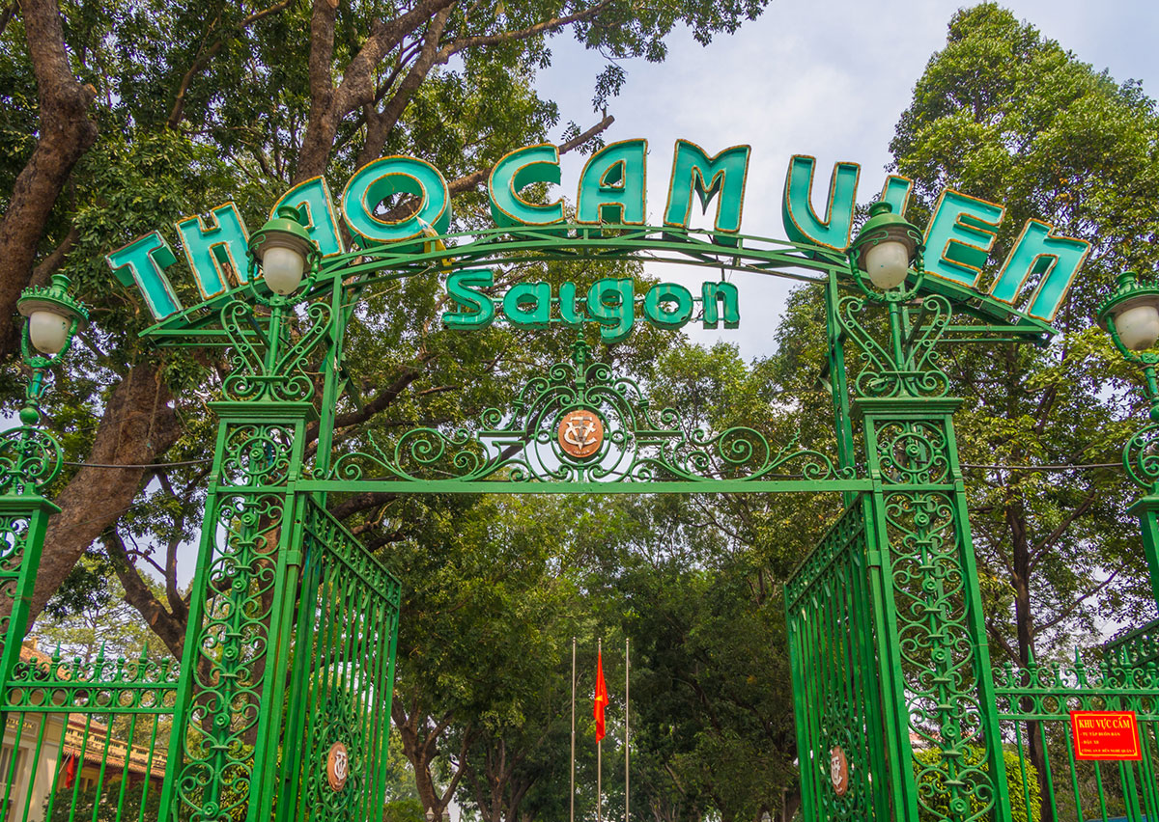
Botanical Garden (n):
Vườn Bách thảo

Slide 9
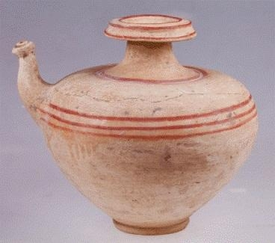
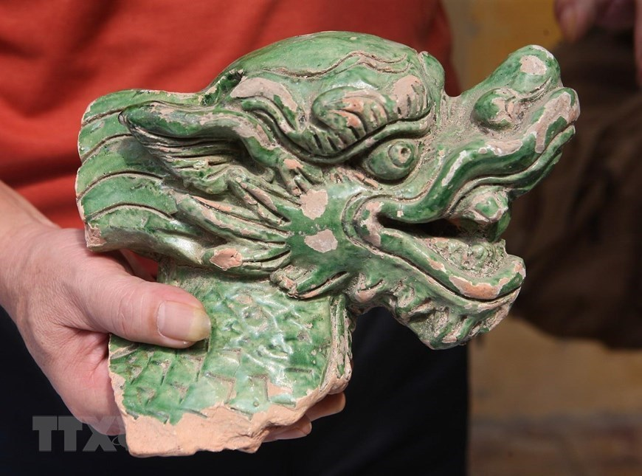
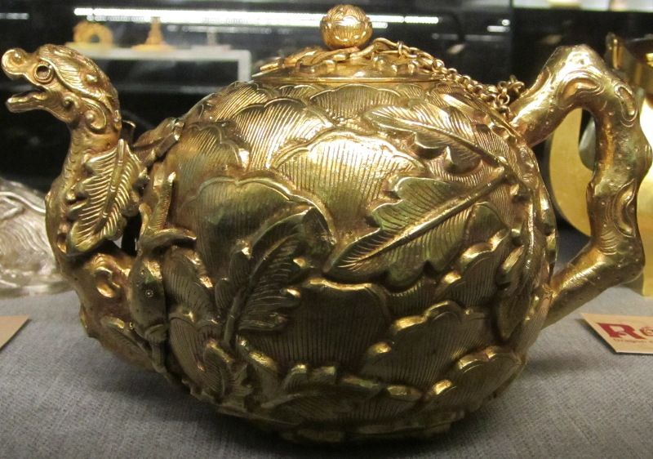
Artefact (n):
đồ tạo tác

Slide 10
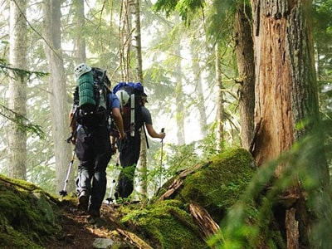
Explore (v):
khám phá

Slide 11
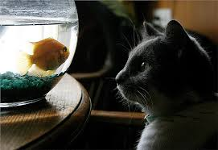
Fascinate (v):
mê hoặc, quyến rũ

Slide 12
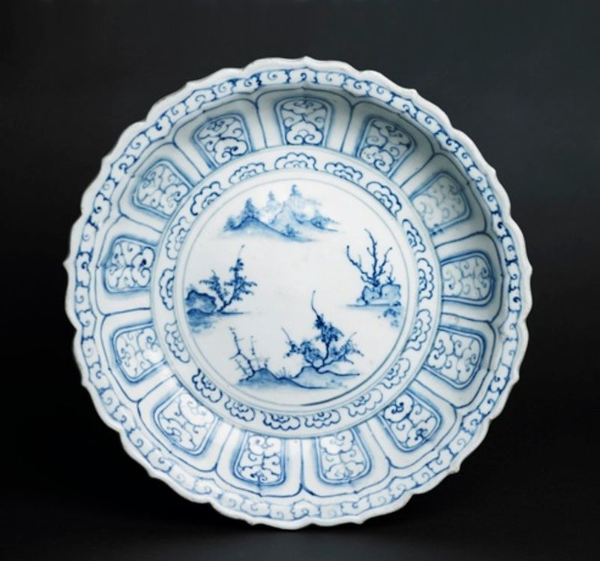
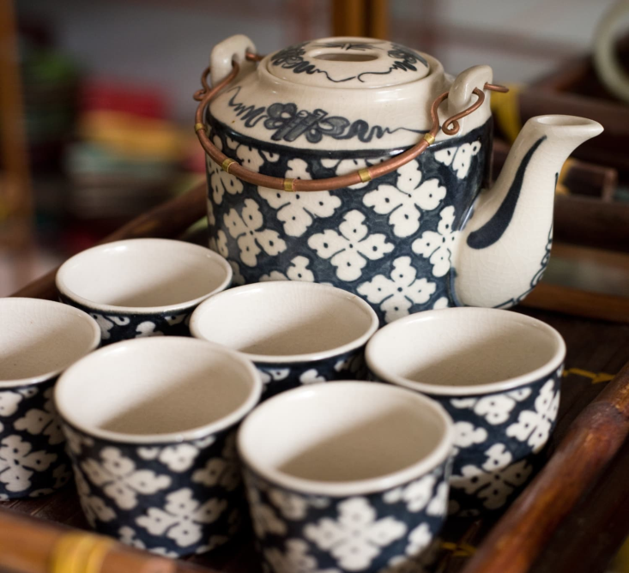
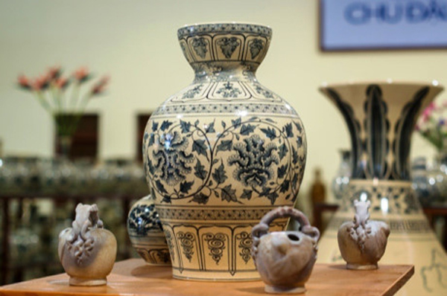
Ceramics (n):
đồ gốm

Slide 13
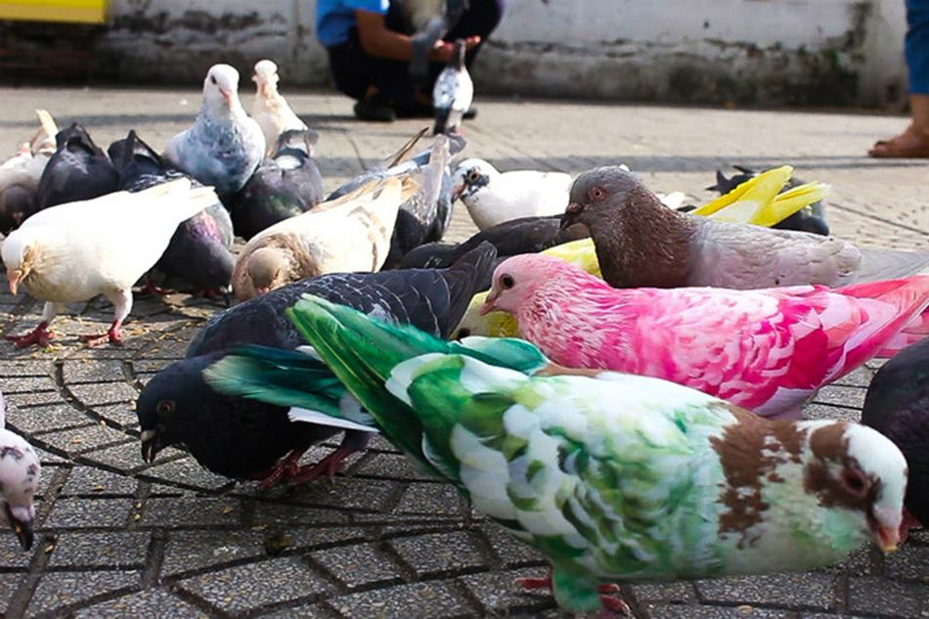
Pigeon (n):
chim bồ câu

Slide 14
Tuesday, September 19, 2023
* Vocabulary:
- Botanical Garden (n): Vườn Bách thảo
- Artefact (n): đồ tạo tác
- Explore (v): khám phá
- Fascinate (v): mê hoặc, quyến rũ
- Ceramics (n): đồ gốm
- Pigeon (n): chim bồ câu

Slide 15
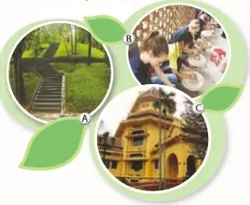

Slide 16


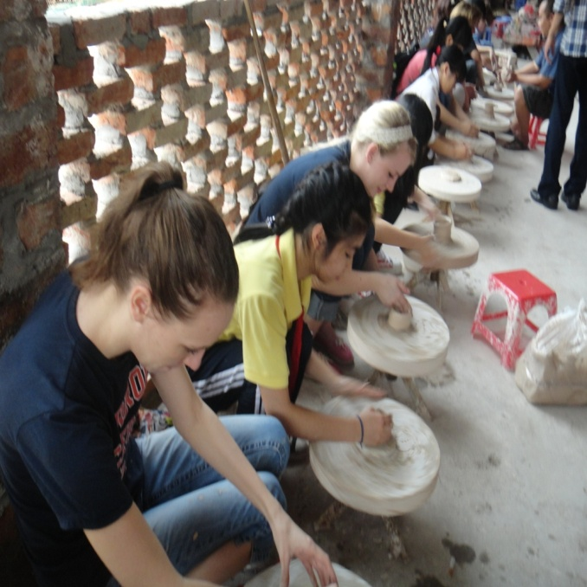
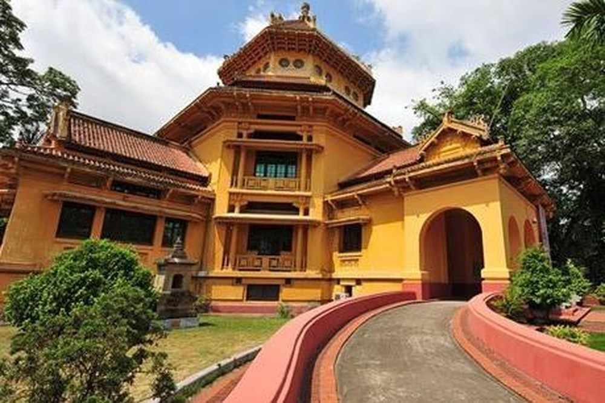
Listening
4Teen radio is asking different students about their places of interest.
1. Describe what you see in each picture. Do you know what places they are?
A
B
C
Ha Noi Botanical Garden
Bat Trang pottery village
Viet Nam National Museum of History
Listen and check your answers.

Slide 17
2. Listen to what these students say and decide if the statements are true (T) of false (F)
1. Tra is interested in history.
T
2. Nam likes making things with his hands.
T
3. Nam's family owns a workshop in Bat Trang.
F
=> His friend's relative own a workshop in Bat Trang.
4. The trees in the garden only come from provinces of Viet Nam.
F
=> The trees in the garden come from both provinces of Viet Nam and other countries).
5. Hoa loves nature and quietness.
T

Slide 18



3. Listen again and complete the table. Use no more than three words for each blank.
Student | Place of interest | Activities
Tra | Viet Nam National Museum of History | - Seeing various (1)__________ - Looking round and (2)_______ __________________________
Nam | Bat Trang pottery village | - Learning to (3)_____________ and (4)____________________
Hoa | Ha Noi Botanical Garden | - Climbing up (5)____________ - Reading (6)_______________ - Feeding (7)_______________ - (8)________________ people
artefacts
exploring Vietnamese culture
make things
paint on ceramics
the hill
books
pigeons
watching

Slide 19
Tra: I love history, so my place of interest is Viet Nam National Museum of History. There's an extensive collection of artefacts tracing Viet Nam's history. They're arranged chronologically from primitive life to modern times. It's also near Hoan Kiem Lake and the Old Quater, so you can spend time looking around and exploring Vietnamese culture.
Nam: I'm fascinated by traditional handicraft. At weekends, I usually go to Bat Trang, a pottery village not far from Ha Noi centre. My friend's relatives live there and they own a workshop. Every time I go there, they teach me how to make things such as pots, vases, or bowls. I'm learning to paint on ceramics now.
Hoa: Ha Noi Botanical Garden is the place I like. There are lots of trees from different countries, a lake, and a small hill. I usually climb up the hill and read books at the top because there's a large lawn. After that, I go down and feed the pigeons. Sometimes I just sit on the bench, watching people dancing or playing sports. It's a nice place for those who love nature and quietness.

Slide 20
Writing
4. If a visitor has a day to spend in your hometown/city, where will you advise him/her to go? What can they do there? Work in pairs, discuss and take notes of your ideas.
Places | Activities
Place 1: ……………………… | …………………………………………………
Place 2: ……………………… | …………………………………………………
Place 3: ……………………… | …………………………………………………

Slide 21
Place of interest | Activities
Hoan Kiem lake | Walk around. Practice English with foreigners. Eat Trang Tien ice-cream.
Bat Trang pottery village | - Learning to make things and paint on ceramics
Ho Chi Minh Mausoleum | - Visit and go sightseeing. - Discuss Uncle Ho

Slide 22
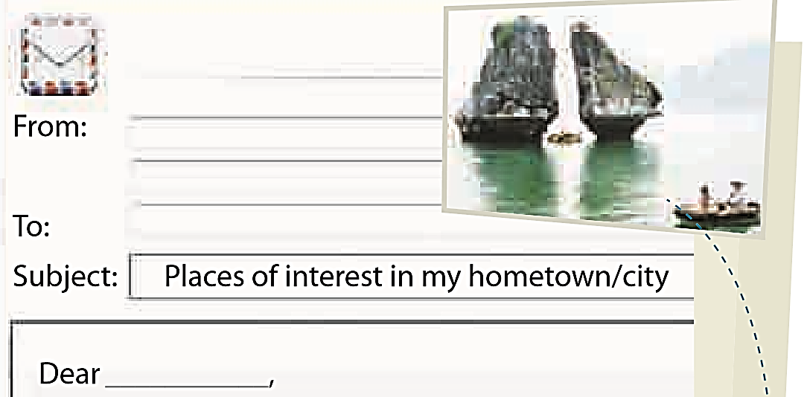

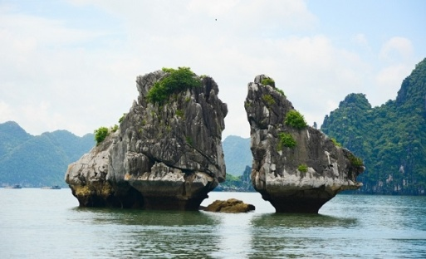
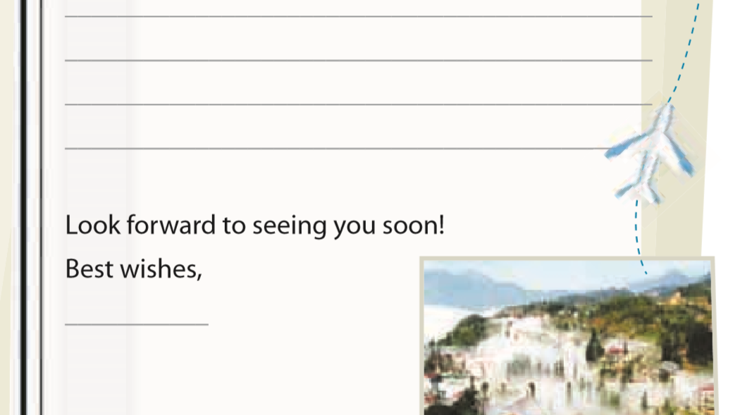
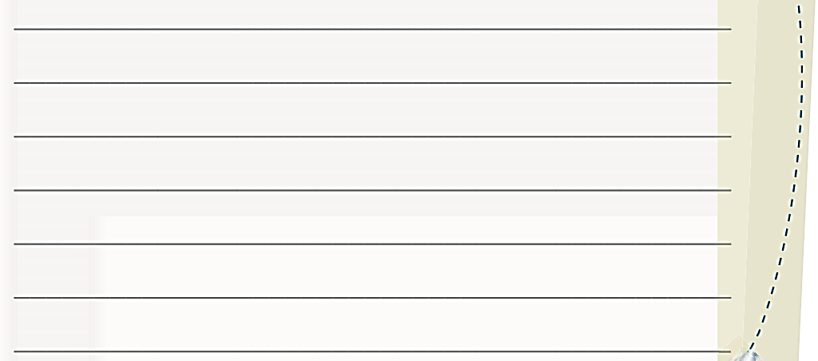
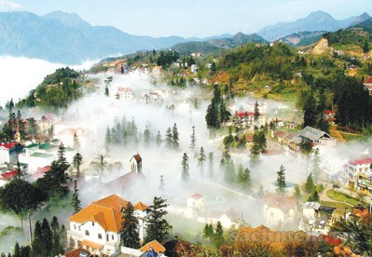
5. Imagine that your Australia pen friend is coming to Viet Nam and will spend a day in your hometown/city. He/She has asked for your advice on the places of interest they should go to and the thing they can do there.
Write an email to give him/her some
information.

Slide 23
Nam@gmail.com
From: ……………………………………
To: ……………………………………
Subject: ……………………………………
Dear…………………,
Look forward to seeing you soon!
Best wishes,
…………………
tony@fastmail.com
Tony
It’s great to know that you are coming to Viet Nam. What a pity you can only spend one day in Ha Noi.
There are many interesting places in Viet Nam, but I think within one day you should be able to visit three places. The first place I suggest is Hoan Kiem lake. You can walk around and practice speaking English with foreigners, especially, you can try Trang Tien ice-cream. The second place is the Temple of Literature. If you go there, you can ask calligraphists for wishes written in Han characters. Finally, you can visit Ho Chi Minh Mausoleum. There you can discuss Uncle Ho and go sightseeing.
Tell me when you’re coming, so I can show you around these places.
Nam

Slide 24
-Practice writing more.
-Learn vocabulary by heart.
-Prepare LOOKING BACK
↑ Homework:

Slide 25


