Slide 1
Unit 10: Communication – Skills 2
wED, April $5$, 2023

Slide 2
I. Listening: Netiquette
Unit 10: Communication – Skills 2

Slide 3
1. Look at the way this message is posted on an e-learning message board. Can you find any problems with it?

Slide 4
2. Listen to this interview between a 4Teen magazine reporter and Dr Minh Vu about netiquette and answer the questions
1. What is 'netiquette'?
→
2. What is the main rule of netiquette?
→
3. Besides the content of what we're communicating, what else should we pay attention to?
→
The word is a combination of 'net' and 'etiquette'. It's a set of rules for behaving properly online.
Don't say and do unpleasant things online, just like in real life.
It's how we communicate with each other online.

Slide 5
2. Listen to this interview between a 4Teen magazine reporter and Dr Minh Vu about netiquette and answer the questions
1. What is 'netiquette'?
→
2. What is the main rule of netiquette?
→
3. Besides the content of what we're communicating, what else should we pay attention to?
→
Reporter: Dr Minh Vu, what exactly is ‘netiquette’?
Dr Minh Vu: The word is a combination of ‘net’ and ‘etiquette’. It’s a set of rules for behaving properly online.
Reporter: Could you tell us the main rule of netiquette?
Dr Minh Vu: Remember that the people we’re communicating with online are real people. Don’t say and do unpleasant things online, just like in real life.
Reporter: But sometimes perhaps it’s not what we communicate, but how we communicate…?
Dr Minh Vu: Absolutely. For example, if you write emails, or post comments using CAPS LOCK, this means you are shouting at people!
Reporter: Of course it’s not polite at all. What else should we do when sending emails?
Dr Minh Vu: Check your message for spelling mistakes before you send it. It shows respect towards the other person. Don’t use too much shorthand. This may confuse your reader.
Reporter: How about behaviour in chat rooms and on message boards?
Dr Minh Vu: Follow discussion rules. Use polite language. People may not know who you are but you’re judged by the quality of your writing.
The word is a combination of 'net' and 'etiquette'. It's a set of rules for behaving properly online.
Don't say and do unpleasant things online, just like in real life.
It's how we communicate with each other online.

Slide 6
3. Listen again to the interview an complete the following grid
 | Should | Shouldn't | Why/Why not?
1. use CAPS LOCK in emails, posts, and comments
2. check your email for mistakes or errors
3. use a lot of shorthand
4. respect discussion rules and use polite language
It looks like you are shouting at people.
$√$
It shows respect for your reader.
$√$
This may confuse your reader.
$√$
People may not know who you are but you're judged by the quality of your writing.
$√$

Slide 7
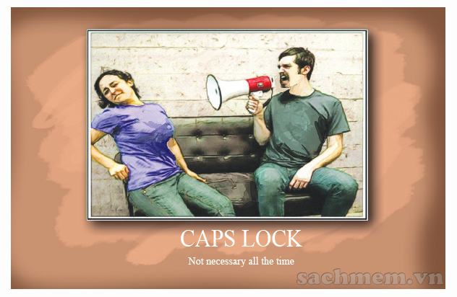
3. Listen again to the interview an complete the following grid
Reporter: Dr Minh Vu, what exactly is ‘netiquette’?
Dr Minh Vu: The word is a combination of ‘net’ and ‘etiquette’. It’s a set of rules for behaving properly online.
Reporter: Could you tell us the main rule of netiquette?
Dr Minh Vu: Remember that the people we’re communicating with online are real people. Don’t say and do unpleasant things online, just like in real life.
Reporter: But sometimes perhaps it’s not what we communicate, but how we communicate…?
Dr Minh Vu: Absolutely. For example, if you write emails, or post comments using CAPS LOCK, this means you are shouting at people!
Reporter: Of course it’s not polite at all. What else should we do when sending emails?
Dr Minh Vu: Check your message for spelling mistakes before you send it. It shows respect towards the other person. Don’t use too much shorthand. This may confuse your reader.
Reporter: How about behaviour in chat rooms and on message boards?
Dr Minh Vu: Follow discussion rules. Use polite language. People may not know who you are but you’re judged by the quality of your writing.

Slide 8
4. Look at the message in 1. Work with a partner to improve it with the netiquette you have learnt so far.

Slide 9
II. Writing: an email using netiquette.
Unit 10: Communication – Skills 2

Slide 11
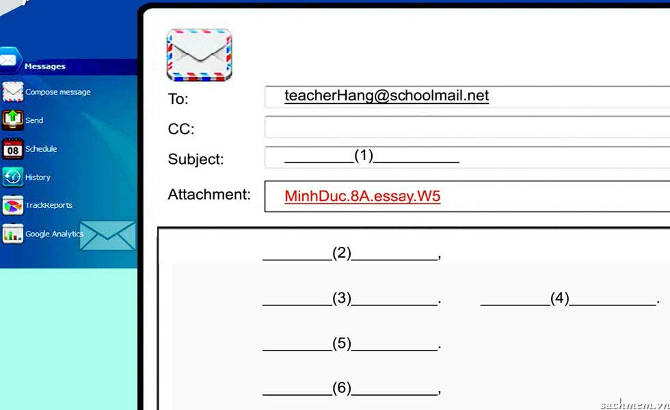
5. Put the following parts in their correct place to make an email
a. Thank you very much. b. Please find attached my essay for week 5. c. Essay submission week 5 d. Best regards, e. My name is Vu Minh Duc, and I am your student from class 8A. f. Dear Teacher,
c
f
e
b
a
d

Slide 12
6. Write a short email to your teacher to submit your group homework for this week. Check if you have used the netiquette learnt

Slide 13
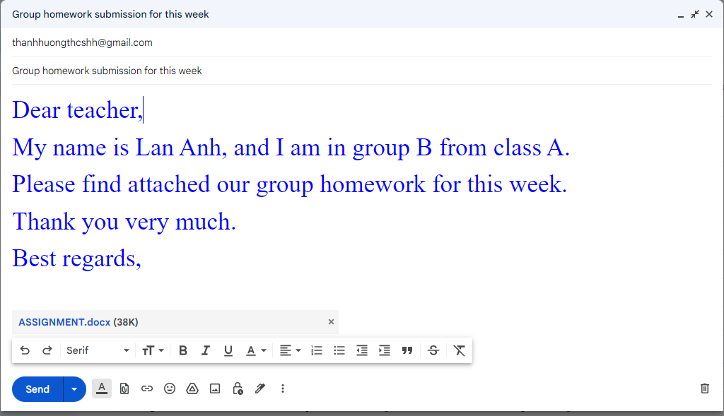
6.Write a short email to your teacher to submit your group homework for this week. Check if you have used the netiquette learnt.

