Slide 1




SECONDARY SCHOOL
Welcome to our class
ENGLISH 8
SCHOOL YEAR: 2022-2023

Slide 2
WELCOME  TO  OUR  CLASS
ENGLISH 8
Unit 7:
POLLUTION
PERIOD 58: COMMUNICATION

Slide 3
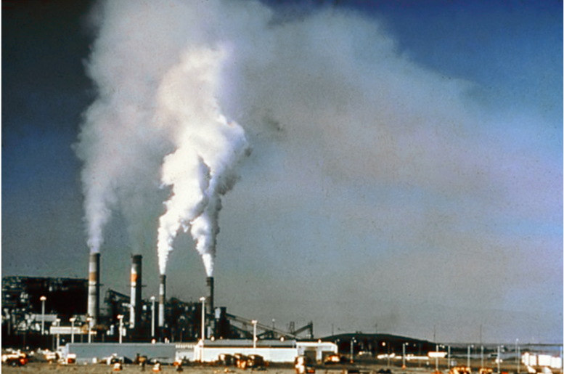
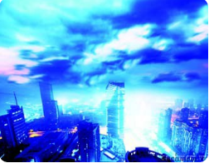
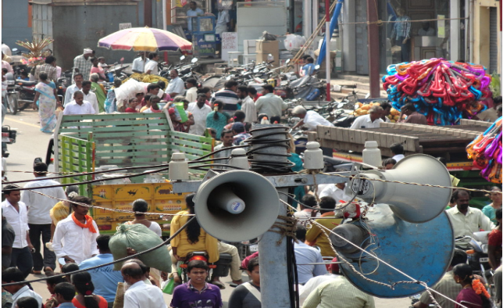
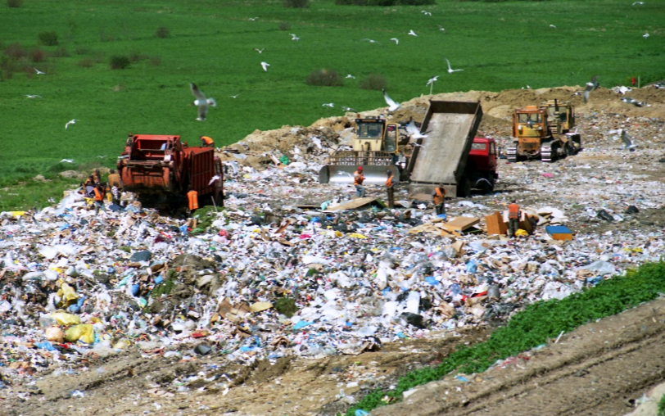
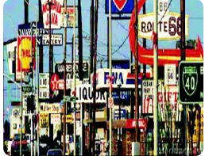
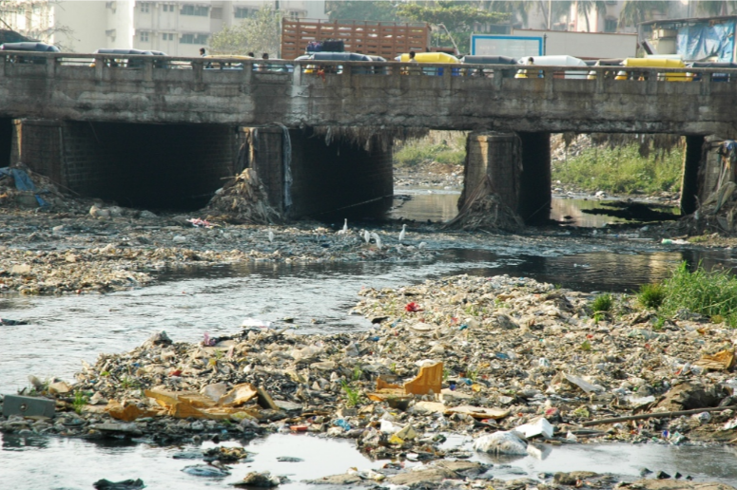
Warm up : LABEL THE POLLUTION
1.
air pollution
2.
light pollution
3.
noise pollution
4.
soil pollution
5.
visual pollution
6.
water pollution

Slide 4

I. VOCABULARY
- permanent | (adj) | /ˈpɜːmənənt/ | vĩnh viễn
- earplug | (n) | /ˈɪəplʌɡ/ | cái nút tai
- affect | (v) | /əˈfekt/ | làm ảnh hưởng
- hearing loss | (n) | /ˈhɪərɪŋ lɒs/ | mất thính lực
- blood pressure | (n) | /blʌd ˈpreʃə/ | huyết áp

Slide 5
1. Noise pollution is more common and more damaging than many people realise. The Green Organisation is doing a survey on how much teenagers know about this type of pollution. Help them answer the questions.
QUESTIONNAIRE
Please help us complete the questionnaire by circling the correct answer A, B or C.
1.Noise is ______ .
A. any sound that makes you relaxed and peaceful
B. any sound that is loud and constant
C. any sound you hear in the street
2. A unit used to measure the loudness of sounds is a decibel (dB). Noise pollution happens when a sound’s loudness is _________.
A. more than 30 dBs B. more than 50 dBs
C. more than 70 dBs

Slide 6
3. Which of the following noises can cause permanent hearing loss after eight hours?
A. Motorcycle B. Ocean wave
C. Whistling
4. Which of the following noises can cause immediate and permanent hearing loss?
A. Motorcycle B. Concert
C. Vacuum cleaner
5. If you experience noise pollution for a long time, you can have ____________ and hearing loss.
A. headaches B. high blood pressure C. both A and B

Slide 7
6.If you are listening to music and other people can hear the sounds from your headphones, what does it mean?
A. The sounds are too loud.
B. You like the music a lot.
C. Other people don’t like the music.
7. What is a symptom showing that noise is affecting you?
A. There seems to be a ringing or buzzing in your ears.
B. You jump up and down
C. You fall asleep as soon as you lie down in bed.
8. Which of the following ways can reduce the effects of noise pollution?
A. Wearing earplugs when you go to concerts or other loud events
B. Listening to music through headphones or headsets at safe levels
C. Both A and B

Slide 8
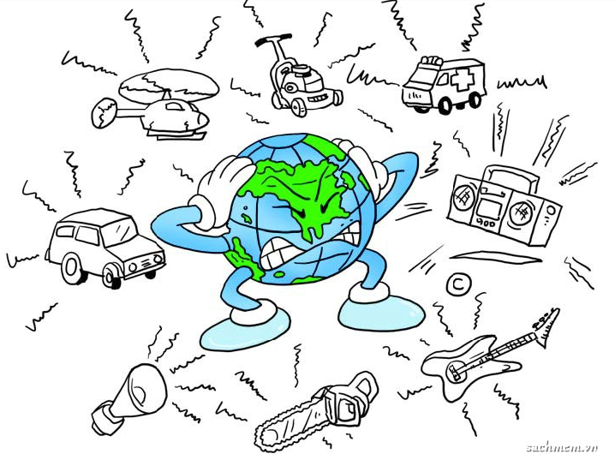


2. Compare your answers with those of a classmate. How many different answers have you got?

Slide 9
3. Now listen to a short presentation about noise pollution. How many correct answer have you got?

Slide 10

Audio script.
Noise is constant and loud sound. To measure the loudness, or volume of sounds, people use a unit called decibel. When a sound is louder than 70 decibels, it can cause noise pollution. Do you know that the noise from a vacuum cleaner or a motorcycle can result in permanent hearing loss after eight hours? The sounds of a concert are even more serious. They can reach as high as 130 decibels and may cause immediate and permanent hearing loss. Noise pollution can also lead to headaches and high blood pressure. If you are listening to music through headphones, and other people can hear it, it means the music too loud and unsafe. If there seems to be a ringing or buzzing in your ears, it means the noise is affecting you and damaging your hearing. Wearing earplugs when you go to concerts or other loud events, and listening to music through headphones or headsets at safe levels can help you reduce the effects of noise pollution.

Slide 11
1. Noise pollution is more common and more damaging than many people realise. The Green Organisation is doing a survey on how much teenagers know about this type of pollution. Help them answer the questions.
QUESTIONNAIRE
Please help us complete the questionnaire by circling the correct answer A, B or C.
1.Noise is ______ .
A. any sound that makes you relaxed and peaceful
B. any sound that is loud and constant
C. any sound you hear in the street
2. A unit used to measure the loudness of sounds is a decibel (dB). Noise pollution happens when a sound’s loudness is _________.
A. more than 30 dBs B. more than 50 dBs
C. more than 70 dBs

Slide 12
3. Which of the following noises can cause permanent hearing loss after eight hours?
A. Motorcycle B. Ocean wave
C. Whistling
4. Which of the following noises can cause immediate and permanent hearing loss?
A. Motorcycle B. Concert
C. Vacuum cleaner
5. If you experience noise pollution for a long time, you can have ____________ and hearing loss.
A. headaches B. high blood pressure C. both A and B

Slide 13
6.If you are listening to music and other people can hear the sounds from your headphones, what does it mean?
A. The sounds are too loud.
B. You like the music a lot.
C. Other people don’t like the music.
7. What is a symptom showing that noise is affecting you?
A. There seems to be a ringing or buzzing in your ears.
B. You jump up and down
C. You fall asleep as soon as you lie down in bed.
8. Which of the following ways can reduce the effects of noise pollution?
A. Wearing earplugs when you go to concerts or other loud events
B. Listening to music through headphones or headsets at safe levels
C. Both A and B

Slide 14


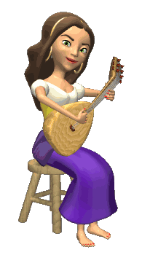


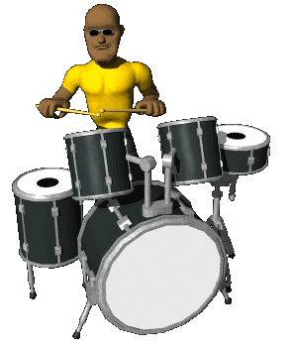





THANK YOU FOR ATTENTION!
GOOD BYE!
the end

Slide 15
If I ______(go) out tonight, I ______(go) with my friends.
If you ______(stay) up late, you ______(be) exhausted.
If I ______(not meet) him today, I ______(phone) him.
If Mary ______(come), they ______(be) happy.
If we ______(continue) staying here, we ______(be) late.
If we ______(go) on holiday this summer, we ______ (visit) Tokyo.
If it ______(rain) too much, he ______(stay) at home.
If the baby ______(eat) all the candies, he ______(feel) sick.
If my family ______(not want) to go out, I ______(cook) for dinner.
The coffee ______(taste) bad unless you ______(add) the milk.
If I ______(be) you, I ______(see) that movie.
If my father ______(be) younger, he ______(travel) more.
If you ______(agree) to come to the party with me, I ______(not be) angry.
If she ______(have) enough money, she ______(buy) a new car.
He ______(be) happy if his girlfriend ______(accept) his proposal.
______ (you/buy) a house if you ______(live) in Japan?
We ______(be) healthier if we ______(not smoke).
It ______(be) nice if you ______(trust) me.
If you ______(not speak) Vietnamese, ______(you/understand) me?
If we ___(win) the lottery, we ___(travel) around the world.

Slide 16
If I ______(be) you, I ______(see) that movie.
If my father ______(be) younger, he ______(travel) more.
If you ______(agree) to come to the party with me, I ______(not be) angry.
If she ______(have) enough money, she ______(buy) a new car.
He ______(be) happy if his girlfriend ______(accept) his proposal.
______ (you/buy) a house if you ______(live) in Japan?
We ______(be) healthier if we ______(not smoke).
It ______(be) nice if you ______(trust) me.
If you ______(not speak) Vietnamese, ______(you/understand) me?
If we ___(win) the lottery, we ___(travel) around the world.

