Slide 2
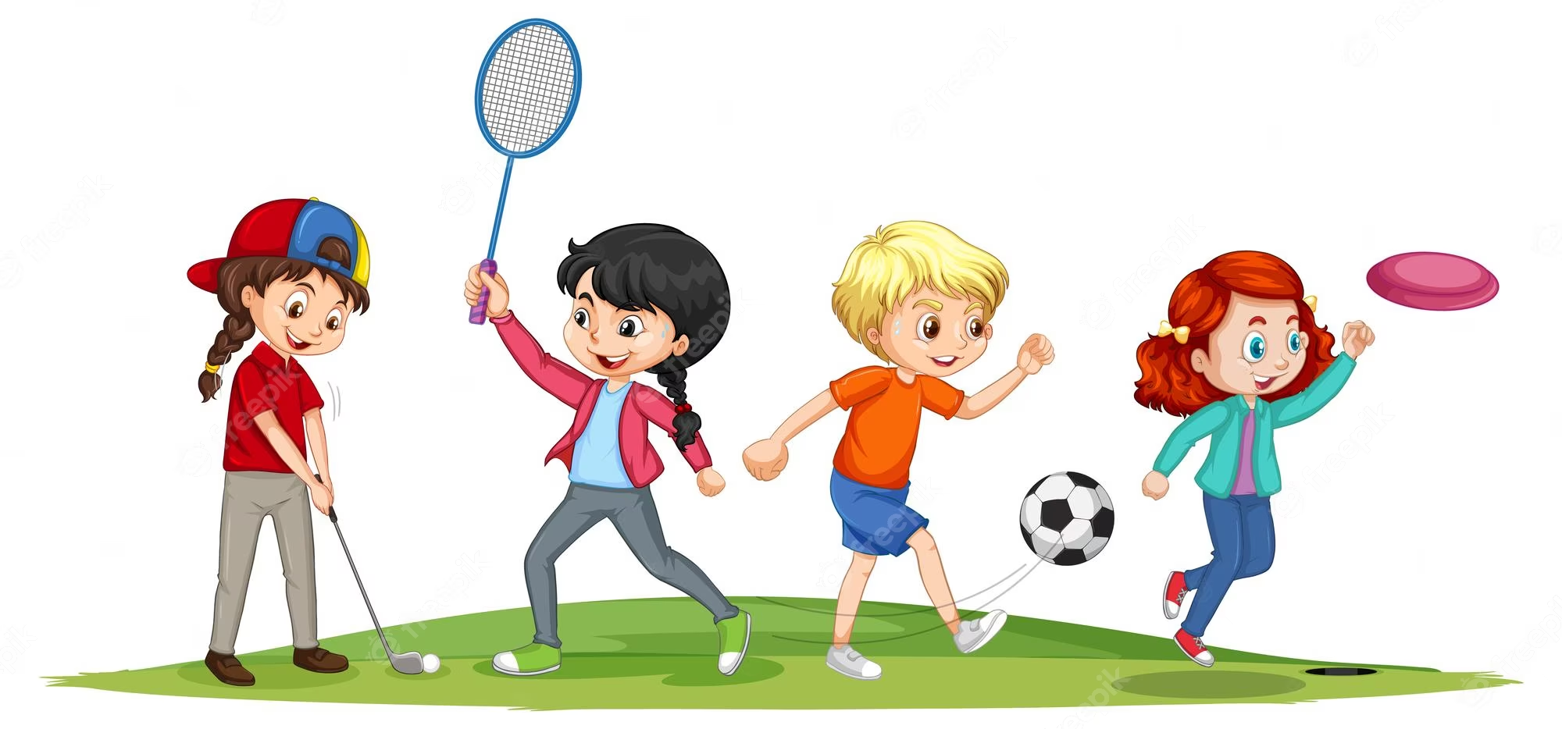
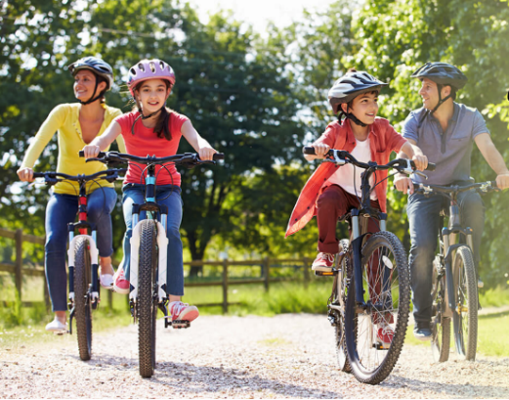
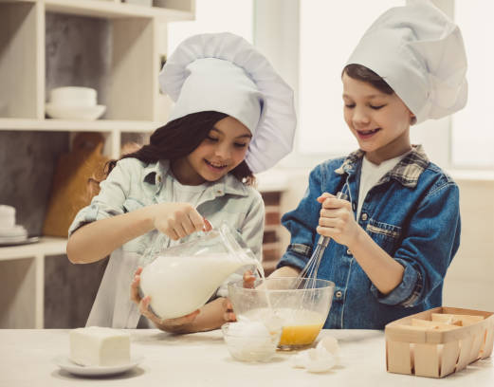
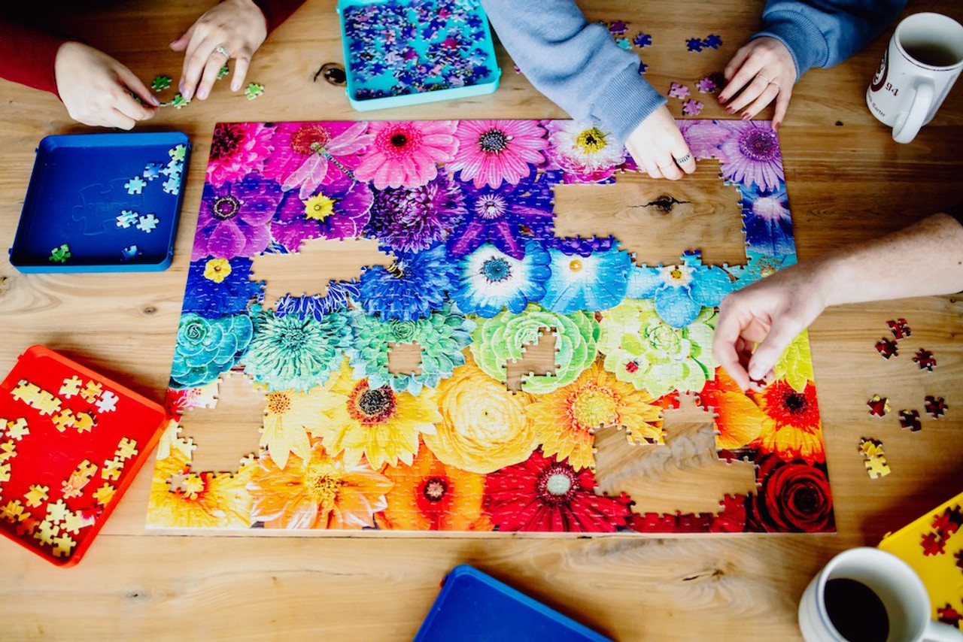
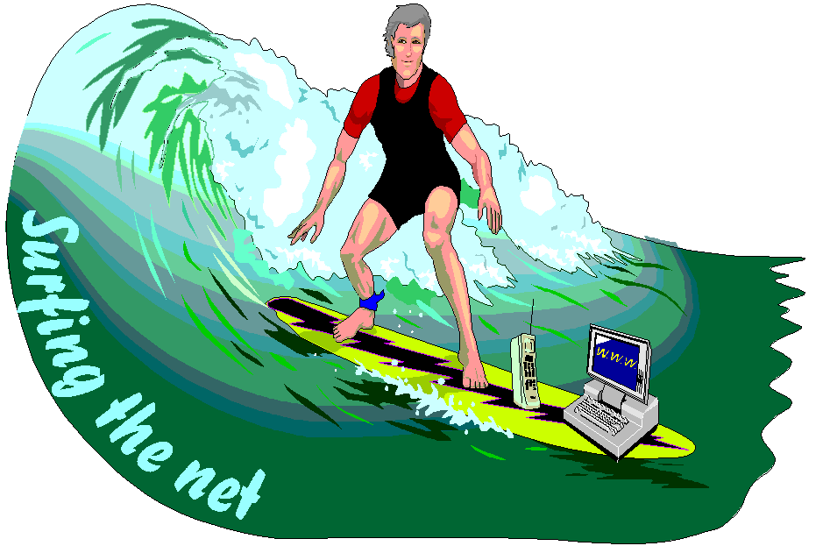
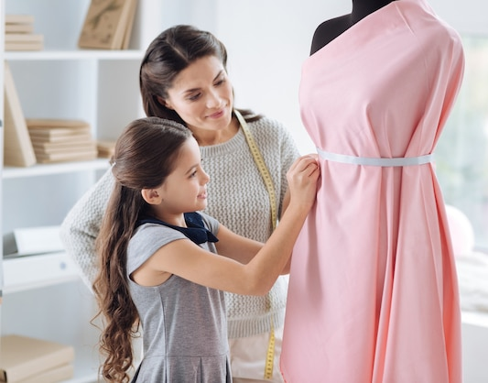
WARM-UP
Look at the pictures. Remember the name of leisure activities
playing
sports
riding a bike/ cycling
LEISURE ACTIVITIES
cooking
doing puzzles
doing DIY
surfing the net
making a dress

Slide 3
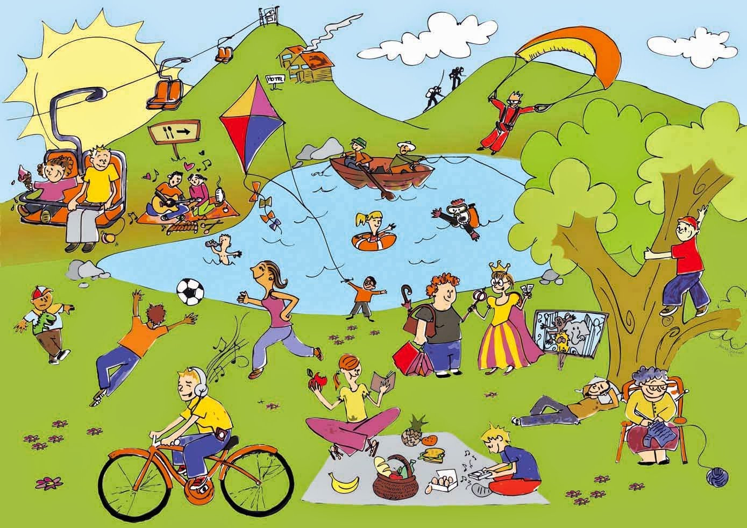
Unit
1
LEISURE TIME
LESSON 5: SKILL 1
1

Slide 4
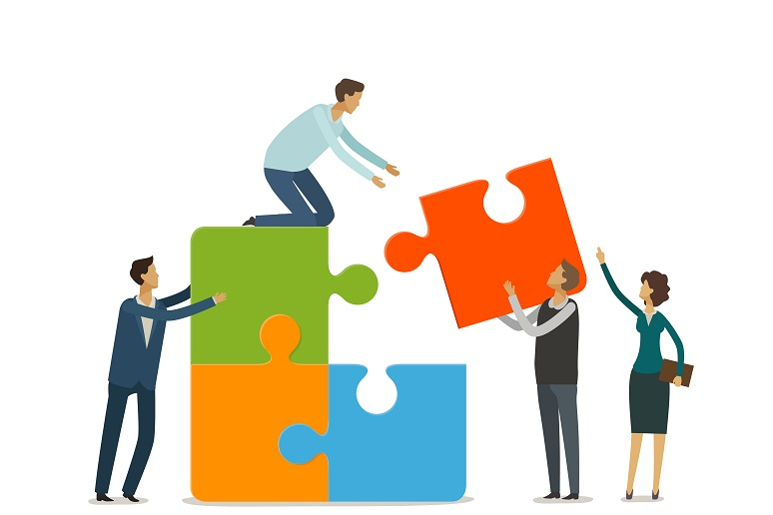
PRESENTATION
connect (v)
/kəˈnekt/
kết nối

Slide 5
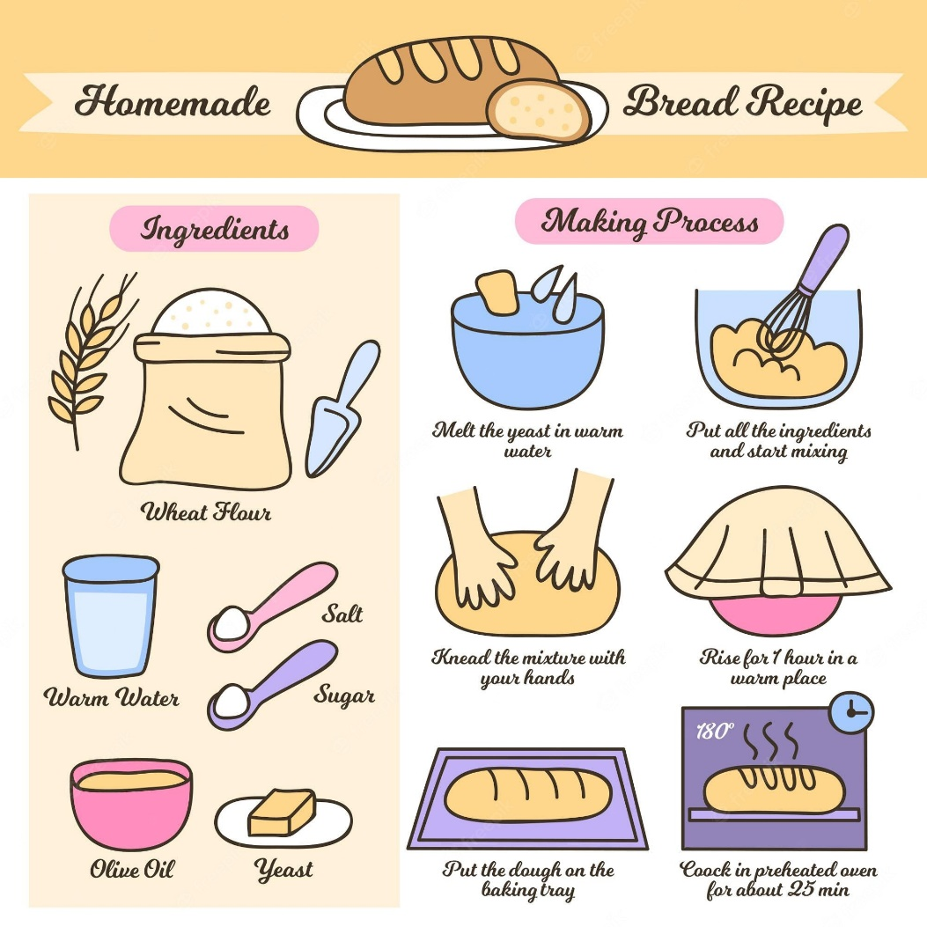
PRESENTATION
recipe (n)
/ˈresɪpi/
công thức

Slide 6
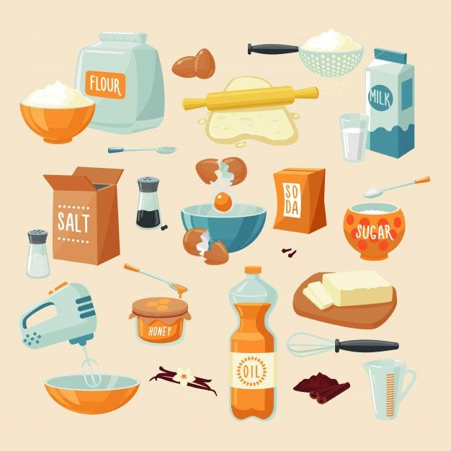
PRESENTATION
ingredient (n)
/ɪnˈɡriːdiənt/
nguyên liệu

Slide 7
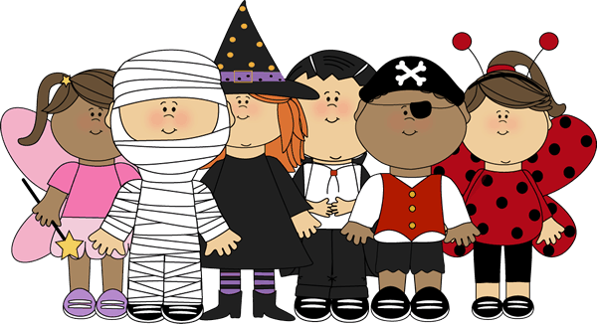
PRESENTATION
costume (n)
/ˈkɒstʃuːm/
trang phục

Slide 8
PRESENTATION
New words | Pronunciation | Meaning
1. connect (v) | /kəˈnekt/ | kết nối
2. recipe (n) | /ˈresɪpi/ | công thức
3. ingredient (n) | /ɪnˈɡriːdiənt/ | nguyên liệu
4. costume (n) | /ˈkɒstʃuːm/ | trang phục

Slide 9
READING
2
Read about Trang’s leisure activities. Choose the correct answer.
1. The text is about Trang’s leisure activities ______.
A. in the past B. with her friends C. with her family
2. The word “connect” is closest in meaning to ______. A. join with something
B. better understand someone
C. speak to someone by phone

Slide 10
READING
3
Trang’s leisure activties
Read the text again and answer the questions.
Questions
Some teenagers enjoy spending free time with their friends. Others prefer doing leisure activities with their family members. I love spending time with my family because it's a great way to connect with them.
At the weekend, we usually go for a bike ride. We cycle to some nearby villages to enjoy the fresh air. We take photos and look at them later. My big brother and I are also into cooking. My brother looks for easy recipes. After that, we prepare the ingredients and cook. Sometimes the food is good, but sometimes it isn't; nevertheless, we love whatever we cook. The leisure activity I like the most is doing DIY projects with my mum. She teaches me to make my own dresses and doll clothes. On special occasions, we make special dresses together. Once I won the first prize in a costume contest at my school.
1. What does Trang do with her family members at the weekend?
2. Who looks for recipes when Trang and her brother cook?
3. Which leisure activity does she love the most?
4. What did she win?

Slide 11
1. What does Trang do with her family members at the weekend?
A. All are corrects
B. go for a bike ride
C. take photos, cook
D. do DIY projects

Slide 12
2. Who looks for recipes when Trang and her brother cook?
A. Her mother does
B. Her brother does
C. Her father does
D. No one

Slide 13
3. Which leisure activity does she love the most?
A. Taking photos
B. Cooking
C. Doing DIY projects
D. Cycling

Slide 14
4. What did she win?
A. the 2nd prize in a costume contest
B. the 4th prize in a costume contest
C. the 3rd prize in a costume contest
D. the 1st prize in a costume contest

Slide 15
SPEAKING
4
Work in groups. Take turns to ask and answer the questions. Record your friends’ answer in the table below.
1. What leisure activities do you usually do with your family?
2. Which one do you like the most? Why?
3. How do you feel when you spend time with your family members?
Questions 1 | Questions 2 | Questions 3
Doing DIY
Cooking
Watching TV
Playing Sports
…
Cooking
happy/ comfortable/ funny/ cozy …

Slide 16
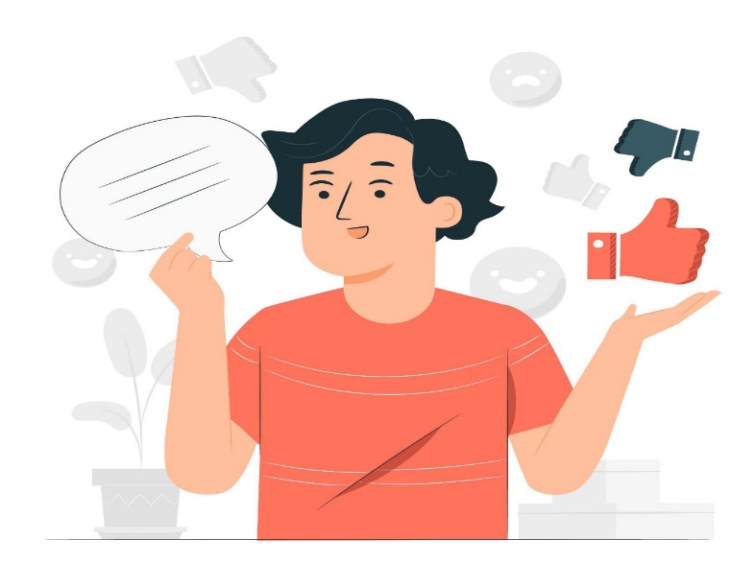
SPEAKING
5
Report
Questions 1 | Questions 2 | Questions 3
Doing DIY
Cooking
Watching TV
Playing Sports
…
Cooking
happy/ comfortable/ funny/ cozy …
In my free time, I usually do DIY, cook a meal, and watch TV. However, the most common activities is playing sports because it helps to connect my family members

Slide 17
CONSOLIDATION
1
Wrap-up
What have we learnt in this lesson?
read about teen’s leisure activities
talk about friends’ leisure activities

Slide 18
CONSOLIDATION
2
Homework
Do exercises in the workbook.

Slide 19
Website: hoclieu.vn
Fanpage: facebook.com/www.tienganhglobalsuccess.vn/

