Slide 2
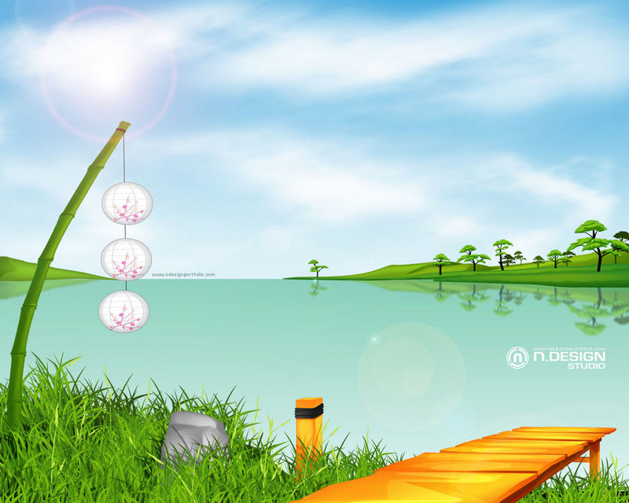
WELCOME TO CLASS 9A2,4,6
Teacher: LE THI PHUONG GIAO

Slide 3
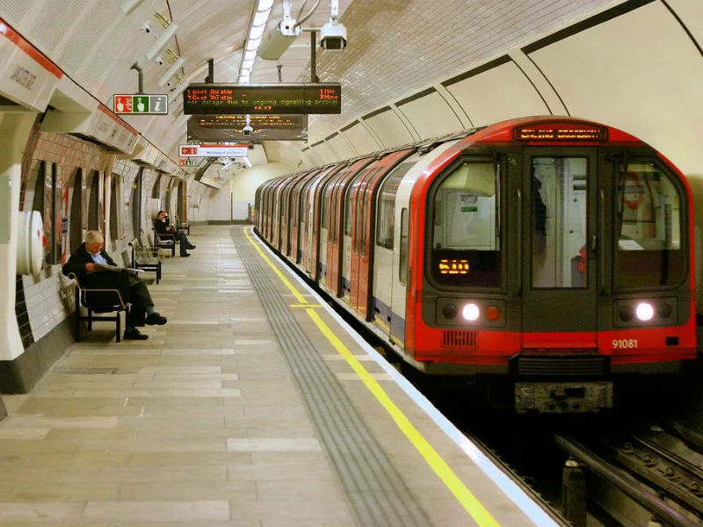
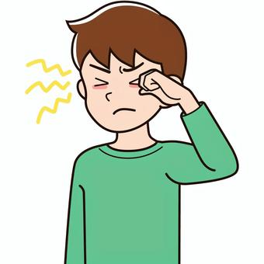
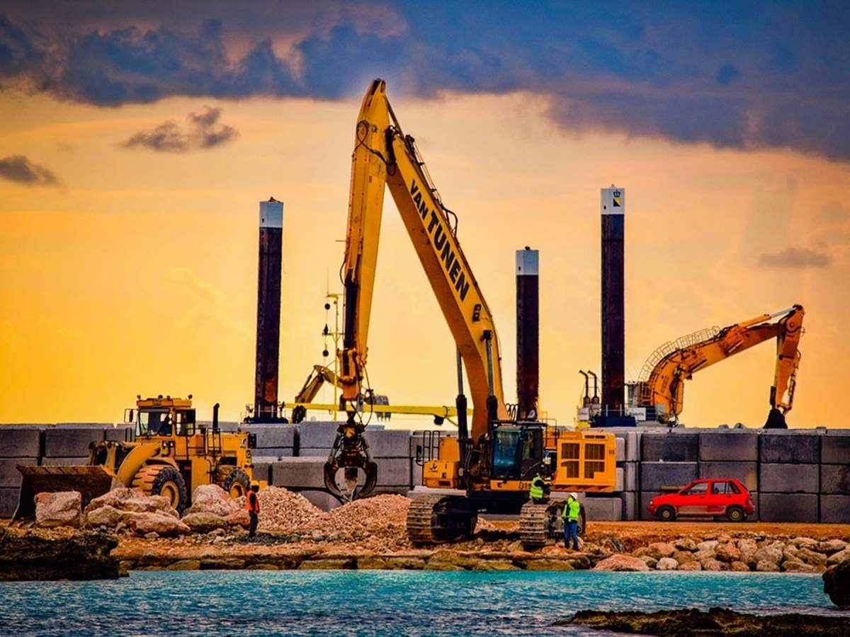
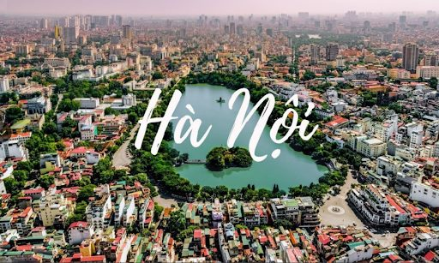
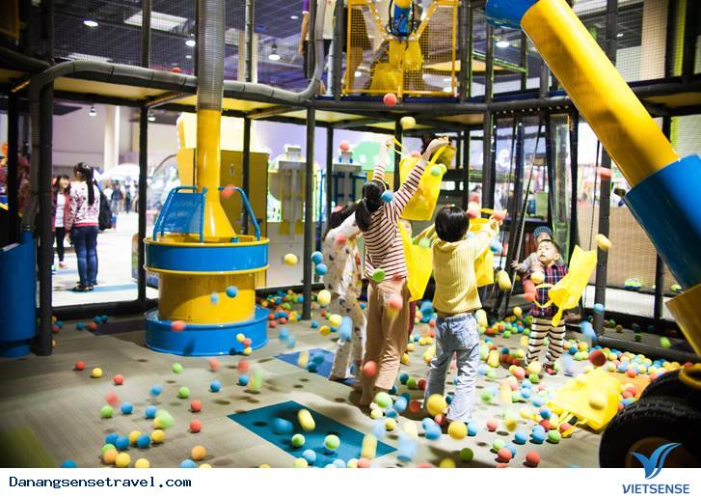
construction site
Congested road
underground
Entertainment centre
Downtown of the city
Itchy eyes

Slide 4
/ˈmetrəʊ/

Slide 5
/ˌkɒŋkriːt ˈdʒʌŋɡl/

Slide 6
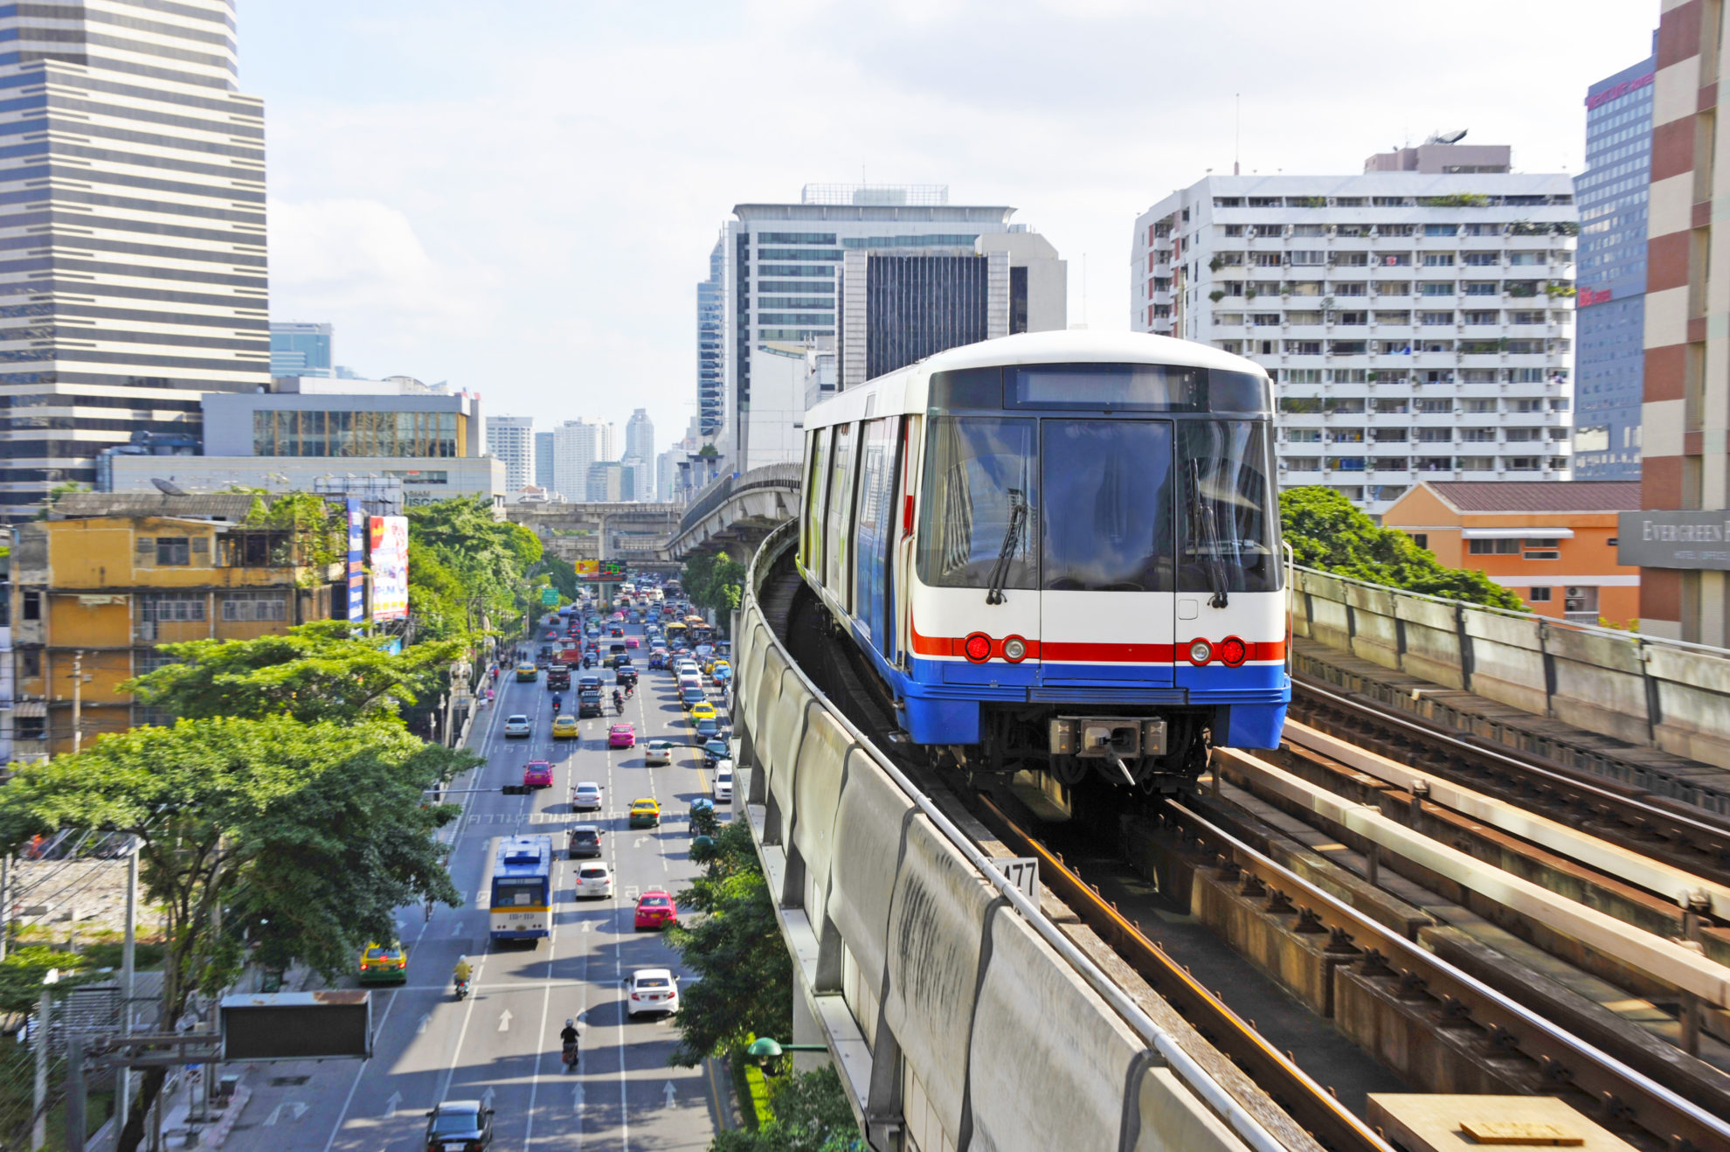
/skaɪ treɪn/

Slide 7
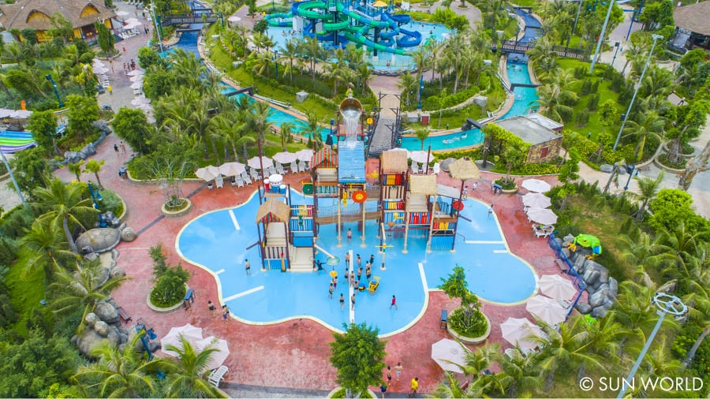
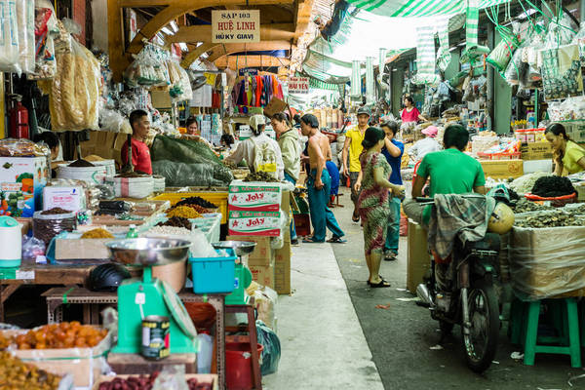
Park
Shopping center
/ˈpʌblɪk əˈmiːnəti/

Slide 8
VOCABULARY
New words | Pronunciation | Meaning
1.concrete jungle (n) | /ˌkɒŋkriːt ˈdʒʌŋɡl/ | rừng bê tông
2. metro (n) | /ˈmetrəʊ/ | hệ thống tàu điện ngầm
3.public amenity | /ˈpʌblɪk əˈmiːnəti/ | tiện ích công cộng
4. Sky train (n) | /skaɪ treɪn/ | Tàu trên chạy không

Slide 9
Match the words/phrases with their explanations
1. downtown | a. an underground train system
2. concrete jungle | b. a city or part of a city with many buildings next to each other
3. sky train | c. the centre of a city, especially its main business area
4. metro | d. things in a neighbourhood that make life more comfortable such as parks and shopping centres
5. public amenities | e. a type of train that runs on a railway high above the ground

Slide 10
busy
/ˈbʌs.lɪŋ/
/ˈlɪvəbl/
Boring

Slide 11
/ˈpɪkpɒkɪtɪŋ /

Slide 12
VOCABULARY
New words | Pronunciation | Meaning
1. Bustling (adj) | /ˈbʌs.lɪŋ/ | Nhộn nhịp
2. Liveable (adj) | /ˈlɪvəbl/ | Đáng sống
3. Picpocketing (n) | /ˈpɪkpɒkɪtɪŋ / | Nạn móc túi
4. commuter(n) | /kəˈmjuː.t̬ɚ/ | Hành khách

Slide 13
2. Choose the correct answer A, B, C, or D to complete each sentence.
The sky train is _______ with commuters at rush hour.
A. packed B. full C. busy D. Interesting
2. The town's public amenities make it a _______ place for its residents.
A. crowded B. boring C. liveable D. Dull
3. It's not always _______ on the metro. Pickpocketing sometimes takes place
A. careful B. dangerous C. noisy D. Safe
4. It is often more _______ to live in the downtown than in the suburbs.
A. convenient B. peaceful C. quiet D. Silent
5. Hong Kong is like a concrete jungle with so many people in it. It's a _______ city.
A. calm B. quiet C. bustling D. high

Slide 14
3. Complete the texts, using the words and phrases from the box.
metro safe liveable
concrete jungles downtown public amenities
John: City life is great! People can travel by public transport, like buses and the (1) ……………. There are good schools and hospitals, and other (2) …………………………… such as parks, cinemas, and sports facilities. They make cities
(3) …………… places for people.
Jenny: City life is terrible! The (4) ………………… area is too crowded. Public transport is always packed with people. Some cities are like(5) ……………………….. with so many buildings. Some cities are not (6) ……………. because of high crime rates.
metro
public amenities
liveable
downtown
concrete jungles
safe

Slide 15
- Who do you agree with, John or Jenny? Why?
I agree with……………….because ………………..
John: City life is great! People can travel by public transport, like buses and the metro. There are good schools and hospitals, and other public amenities such as parks, cinemas, and sports facilities. They make cities livevable places for people.
Jenny: City life is terrible! The downtown area is too crowded. Public transport is always packed with people. Some cities are like concrete jungles with so many buildings. Some cities are not safe because of high crime rates.

Slide 16
PRONUNCIATION
Review the diphthong sounds.
/aʊ/
/əʊ/
/eə/
/aʊ/ | /əʊ/ | /eə/

Slide 17
PRONUNCIATION
4
Put the words in the correct column. Then listen and check.
crowded locate square
outdoor repair airport
council coastal overseas
- Say some words you know that have diphthong sounds /aʊ/, /əʊ/, and /eə/
/aʊ/ | /əʊ/ | /eə/
crowded
locate
repair
outdoor
coastal
square
council
overseas
airport

Slide 18
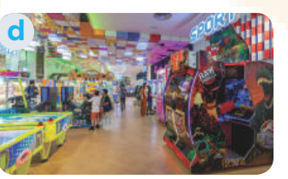
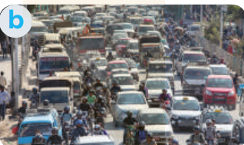
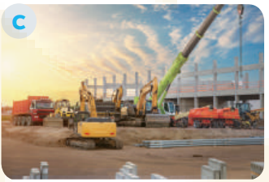
PRONUNCIATION
Read the sentences. Circle the words with /aʊ/, underline those with /əʊ/, and put a tick (√) next to those with /eə/. Then listen, check, and practise the sentences.
5
- Look at the sentences in exercise 5 p.20
- You need to circle the words with /aʊ/, underline those with /əʊ/, and put a tick (√) next to those with /eə/.

Slide 19
PRONUNCIATION
1. They go shopping downtown.
2. The chairman comes from a coastal city.
3. Buses in the old days were not as crowded as they are now.
4. She gets around the city easily thanks to the apps on her phone.
5. I hope we will arrive at the city square in time for the fashion show.
√
√
Now, listen and check.

Slide 20
CONSOLIDATION
1
Wrap-up
What have we learnt in this lesson?
Use the lexical items related to the topic City life;
Pronounce the diphthong sounds /aʊ/, /əʊ/, and /eə/ in words and sentences correctly.

Slide 21
CONSOLIDATION
2
Homework
- Do exercises in the workbook.
- Find 3 more words that have the diphthong sounds /aʊ/, /əʊ/, and /eə/.

Slide 22
- Who do you agree with, John or Jenny? Why?
Example 1:
I agree with John. I think that life in the city is great. There are many good public amenities. The public transport system is convenient, too.
Example 2:
I agree with Jenny. City life is terrible. Cities are often too crowded. They don’t have much green space. They are not liveable.

Slide 23
Website: hoclieu.vn
Fanpage: facebook.com/www.tienganhglobalsuccess.vn/

