Slide 2
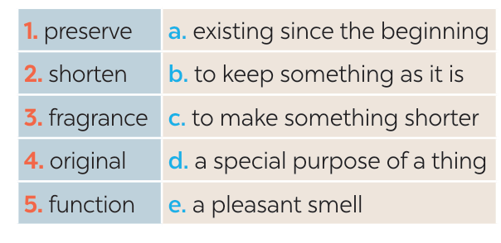
WHILE READING
2
Read the brochure introducing different places with special products. Match each highlighted word with its definition.
1. b
2. c
3. e
4. a
5. d

Slide 3
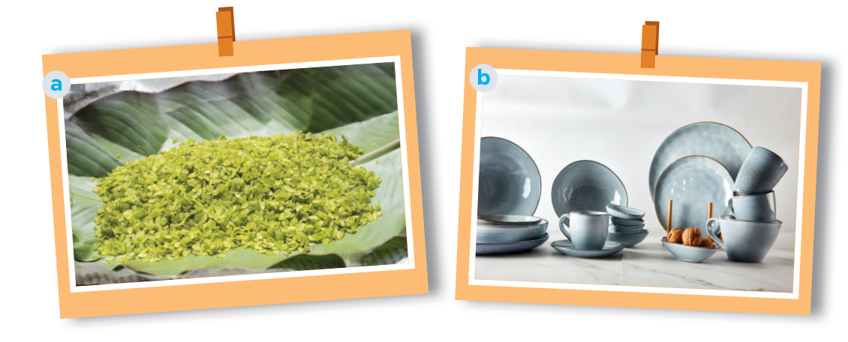
PRE READING
1
Work in pairs. Answer the questions.
1. What can you see in each picture? 2. Do you know any place(s) where people make the thing(s) in each picture?

Slide 4
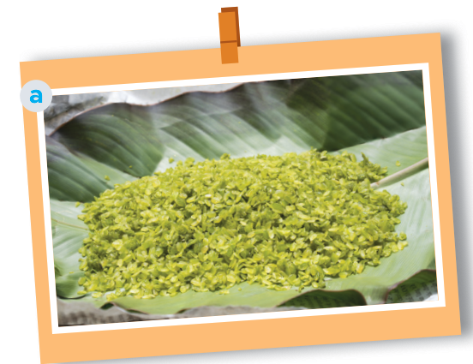
PRE READING
1
Work in pairs. Answer the questions.
Picture a: cốm (young sticky rice)- from Vong Village, Ha Noi
Another place which makes com: Tu Le Commune in Yen Bai Province

Slide 5
PRE READING
1
Work in pairs. answer the questions.
Picture b: pottery – from Denby, England.
In Viet Nam, there are some pottery villages: Bat Trang, Bau Truc, Phu Lang, …

Slide 6
WHILE READING
2
Read the brochure introducing different places with special products. Match each highlighted word with its definition.

Slide 7
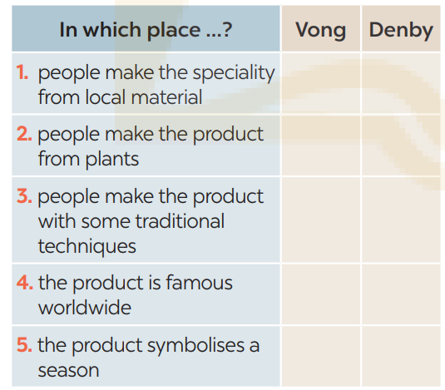
WHILE READING
3
Read the brochure again. Decide which place each detail below belongs to
Vong: 2, 3, 5
Denby: 1, 3, 4

Slide 8
SPEAKING
4
Work in pairs. Ask and answer about a speciality in Vong village/ or in Denby
What speciality is it in Vong village?/ Denby? 2. What do people make it from? 3. Do people make it in the traditional way? 4. Is it well known in only Viet Nam or around the world?
Sticky rice flakes
pottery
Sticky rice
The finest local clay
Yes.
In only Viet Nam
Around the world

Slide 9
SPEAKING
4
Work in pairs. Ask and answer about a speciality in your neighbourhood, your home town, or the area you know. Use the questions below.
1. What speciality is it? 2. What do people make it from? 3. Do people make it in the traditional way? 4. Is it well known in only your country or around the world?
Banh xeo
rice
yes
around the world

Slide 10
SPEAKING
5
Work in groups. Give a short presentation about the speciality you discussed in 4.
I live in Tay Ho Village, 12 kilometres from Hue City. My village is famous for its conical hats. We make conical hats from goi leaves. We still follow 15 traditional steps to make a hat. A conical hat protects us from the sun and the rain as well as makes us more graceful. What is special about our conical hats is that each of them carries a poem. Tay Ho conical hats are not only famous in Hue but all over Viet Nam.

Slide 11
CONSOLIDATION
1
Wrap-up
What have we learnt in this lesson?
Read for specific information about special products in some areas.
Give a short presentation about a speciality.

Slide 12
CONSOLIDATION
2
Homework
- Do exercises in the Workbook.

Slide 13
Website: hoclieu.vn
Fanpage: facebook.com/www.tienganhglobalsuccess.vn/

