Slide 2
Unit
2
LIFE IN THE COUNTRYSIDE
LESSON 5: SKILLS 1

Slide 3
LESSON 5: SKILLS 1
WARM-UP
Task 1: Work in pairs. Look at the picture and discuss the questions.
Vocabulary
Task 2: Read the text and match the highlighted words in the text with their meanings.
Task 3: Read the text again and tick T (True) or F (False) for each sentence.
READING
Task 4: Make notes about the village or town where you live or which you know.
Task 5: Work in groups. Take turns to talk about the village or town where you live or which you know. Use the information in 4.
SPEAKING
Wrap-up
Homework
CONSOLIDATION

Slide 4
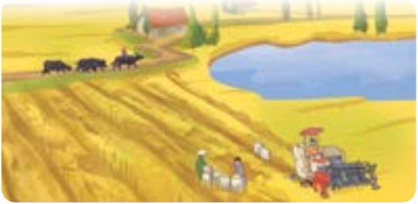
WARM-UP
1
Work in pairs. Look at the picture and discuss the following questions.
1. What can you see in it?
2. Which of the following adjectives describe the picture?

Slide 5
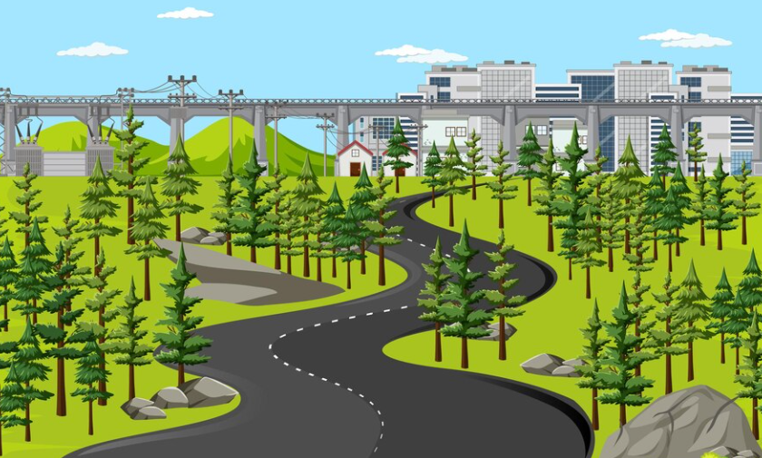
READING
stretch (v)
/stretʃ/
trải dài

Slide 6
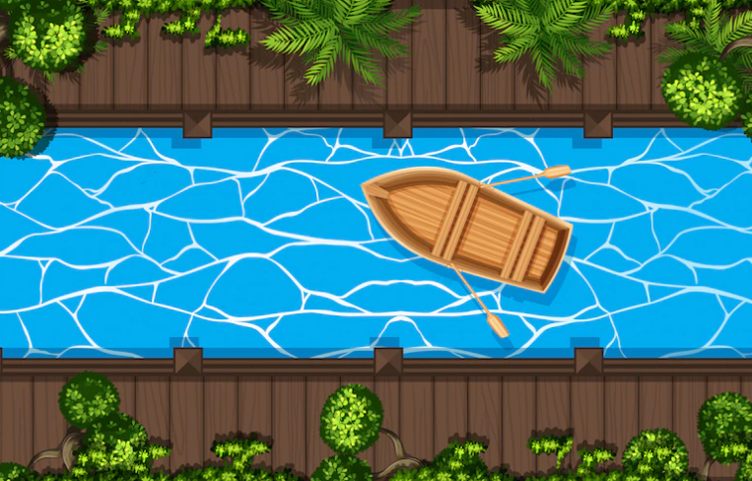
READING
canal (n)
/kəˈnæl/
kênh đào

Slide 7
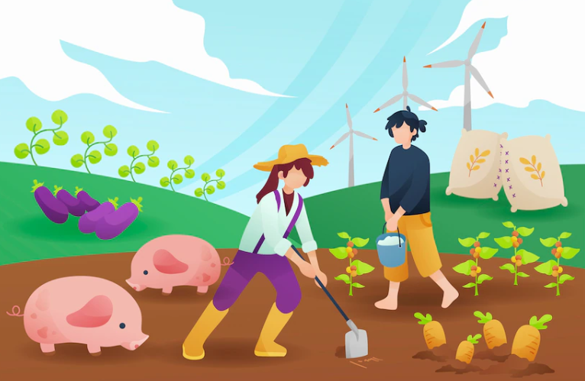
READING
cultivate (v)
/ˈkʌltɪveɪt/
canh tác

Slide 8
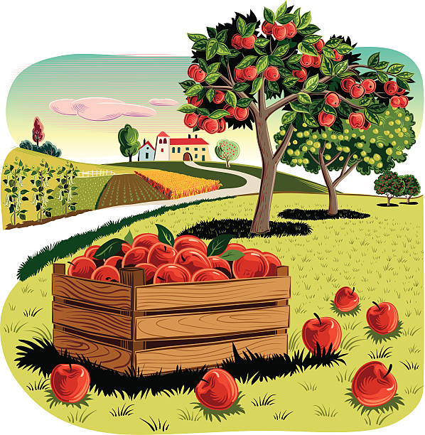
READING
orchard (n)
/ˈɔːtʃəd/
vườn cây ăn quả

Slide 9
READING
New words | Pronunciation | Vietnamese equivalent
1. stretch (v) | /stretʃ/ | trải dài
2. canal (n) | /kəˈnæl/ | kênh đào
3. cultivate (v) | /ˈkʌltɪveɪt/ | canh tác
4. orchard (n) | /ˈɔːtʃəd/ | vườn cây ăn quả

Slide 10
READING
2
Read the text about life in a village in Viet Nam. Match the highlighted words in the text with their meanings

Slide 11
READING
3
Read the text again and tick T (True) or F (False) for each sentence.
 | T | F
1. Life in the author’s village is very peaceful.
2. The people in the village work very hard.
3. Villagers live only by catching fish in lakes, ponds, and canals.
4. The children are always busy helping their parents.
5. The villagers get along well.

Slide 12
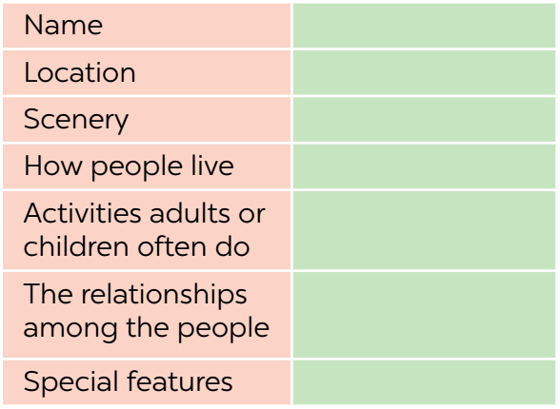
SPEAKING
Make notes about the village or town where you live or which you know.
-Phu An
- In Hoai huong, hoai nhon
- traditional markets, pagodas
-Catch fish and grow rice
- children go to school and help parents after class
- get on well together
- Peaceful

Slide 13
SPEAKING
5
Work in groups. Take turns to talk about the village or town where you live or which you know. Use the information in 4.
Example:
I live in Duong Lam. It’s an old village outside Hanoi. It has ...

Slide 14
CONSOLIDATION
1
Wrap-up
What have we learnt in this lesson?
read about different aspects of a Vietnamese village;
talk about a village or town where one lives or which one knows;

Slide 15
CONSOLIDATION
2
Homework
Do exercises in the workbook.

Slide 16
Website: hoclieu.vn
Fanpage: facebook.com/www.tienganhglobalsuccess.vn/

