Slide 2
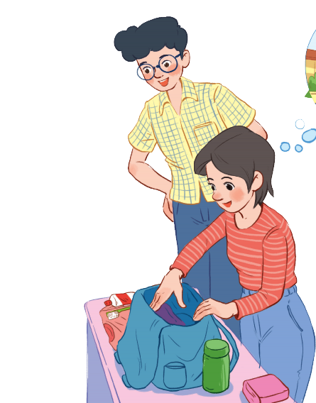
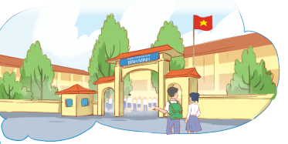
Unit
6
A VISIT TO A SCHOOL
LESSON 1: GETTING STARTED
A visit to Hoai Duc Secondary School
Unit
HOBBIES

Slide 3
LESSON 1: GETTING STARTED
WARM-UP
Chatting
Aims of the stage:
to introduce the topic
to lead in the lesson

Slide 4
WARM-UP
What did you see when you first came to our school?
How did you feel?
Have you ever had a visit to Chu Van An High school (or a famous school in your area)?

Slide 5
WARM-UP
What is the girl doing?
What are they talking about?

Slide 6
PRESENTATION
lower secondary school
/ˈləʊər ˈsekəndrɪ skuːl/
trường trung học cơ sở

Slide 7
PRESENTATION
member (n)
/ˈmembər/
thành viên

Slide 8
PRESENTATION
remind (v)
/rɪˈmaɪnd/
gợi nhớ, nhắc nhở

Slide 9
PRESENTATION
New words | Pronunciation | Meaning
lower secondary school | /ˈləʊər ˈsekəndrɪ skuːl/ | trường trung học cơ sở
member | /ˈmembər/ | thành viên
remind | /rɪˈmaɪnd/ | gợi nhớ/ nhắc nhở

Slide 10
PRACTICE
1
Listen and read.
Phong: What are you doing, Mi? Mi: I’m preparing to visit Binh Minh Lower Secondary School. Phong: Sounds great! I think that’s one of the best schools in my neighbourhood. Who is going with you and when? Mi: My teacher and my classmates. We’re going in the afternoon. Phong: I see. What will you do there? Mi: Well, I think we’ll visit the school library, the computer room, and the gym. We’ll meet the students and share ideas for a project in our English class. Phong: That’s interesting. What else will you do there? Mi: We’ll meet the members of their Go Green Club and take photos of the school. Phong: Fantastic! so don’t forget to take your camera. Mi: I almost forgot. Thanks for reminding me.

Slide 11
PRACTICE
2
Read the conversation again and answer the questions by circling A, B, or C.
1. What are they talking about?
A. A visit to a computer room. B. A visit to a school. C. A visit to a school library.
Phong: What are you doing, Mi?
Mi: I’m preparing to visit Binh Minh Lower Secondary School.

Slide 12
PRACTICE
2
Read the conversation again and answer the questions by circling A, B, or C.
2. Who is going to visit the school? A. Mi and her teacher. B. Mi and her classmates. C. Mi, her teacher and her classmates.
Phong: Sounds great! I think that’s one of the best schools in my neighbourhood. Who is going with you and when? Mi: My teacher and my classmates. We’re going in the afternoon.

Slide 13
PRACTICE
2
Read the conversation again and answer the questions by circling A, B, or C.
3. Where is the school? A. In the city. B. In the countryside. C. In Phong’s neighbourhood.
Phong: Sounds great! I think that’s one of the best schools in my neighbourhood. Who is going with you and when?

Slide 14
PRACTICE
2
Read the conversation again and answer the questions by circling A, B, or C.
4. When are they going?
A. In the morning. B. In the afternoon. C. At noon.
Phong: Sounds great! I think that’s one of the best schools in my neighbourhood. Who is going with you and when? Mi: My teacher and my classmates. We’re going in the afternoon.

Slide 15
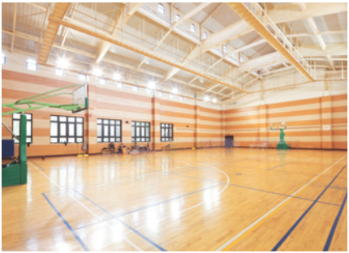
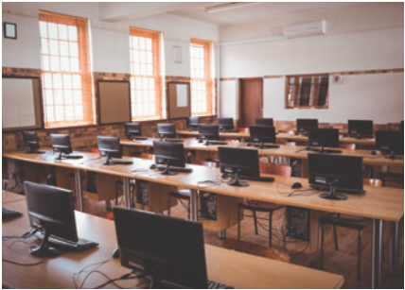
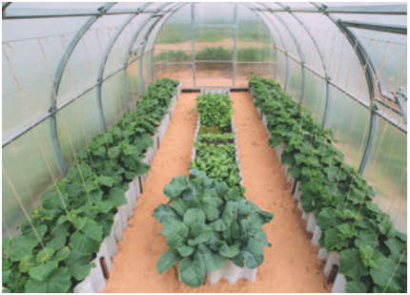
PRACTICE
3
Name these places, using the words and phrases from the box.
gym
computer room
school garden
1. ____________
2. ________________
3. ________________

Slide 16
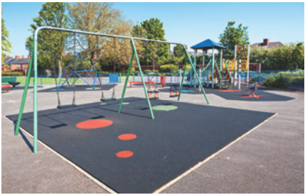
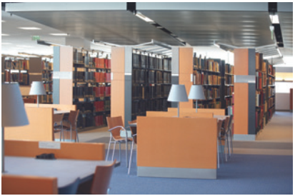
PRACTICE
3
Name these places, using the words and phrases from the box.
playground
4. ____________
school library
5. ______________

Slide 17
PRACTICE
4
Complete the following sentences with the words in the box.
computer room
school library
school garden
playground
gym
playground
1. The school _______________ is very small, so not many children can play in it.
2. We learn how to use the Internet in the _______________ twice a week.
3. They have school meetings in the _______________ when it rains.
4. There are a lot of books, magazines, and newspapers in the _______________.
5. Our class usually waters the vegetables in the _______________ on Friday afternoons.
computer room
gym
school library
school garden

Slide 18
PRODUCTION
5
Work in pairs. Ask and answer questions about Nick’s timetable, using when and where.
Subject | Time | Place
Maths | 8 a.m. Monday, Tuesday, Friday | Classroom (room 302)
Biology | 9 a.m. Thursday | Science lab
Information Technology | 2 p.m. Wednesday | Computer room
Physical Education | 3 p.m. Monday, Thursday | School gym
History | 3:30 p.m. Tuesday | School library
Example: A: When does Nick have maths? B: At 8 a.m. on Monday, Tuesday, and Friday. A: And where does he have it? B: In his classroom, room 302.

Slide 19
CONSOLIDATION
1
WRAP-UP
Topic of the unit
A visit to a school
Vocabulary
School facilities

Slide 20
CONSOLIDATION
2
HOMEWORK
Exercises in Workbook.

Slide 21
Website: hoclieu.vn
Fanpage: facebook.com/www.tienganhglobalsuccess.vn/

