Slide 2
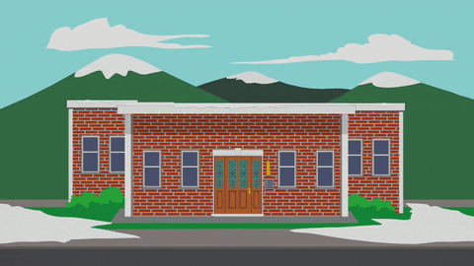
Unit
6
A VISIT TO A SCHOOL
LESSON 6: SKILLS 2

Slide 3
OBJECTIVES
By the end of the lesson, students will be able to:
listen for general and special information about school activities
write a short paragraph about outdoor activities at one’s school

Slide 4
LESSON 6: SKILLS 2
WARM-UP
Game: The hidden word
Aims of the stage:
to waken up students’ interest

Slide 5
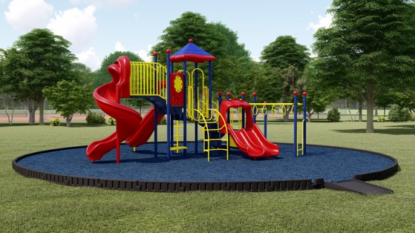
WARM-UP
1. What is this?
PLAYGROUND
_ _ _ _ _ _ _ _ _ _
SUBJECT
2. My favourite _ _ _ _ _ _ _ is Maths.
CLUB
3. My and Phong are members of “Go Green _ _ _ _ .”
FOUNDED
4. Quoc Hoc – Hue was _ _ _ _ _ _ _ in 1986.
ON
5. The school year usually begins _ _ September 5th every year.

Slide 6
WARM-UP
The hidden word:
ROTUODO
OUTDOOR
_ _ _ _ _ _ _

Slide 7
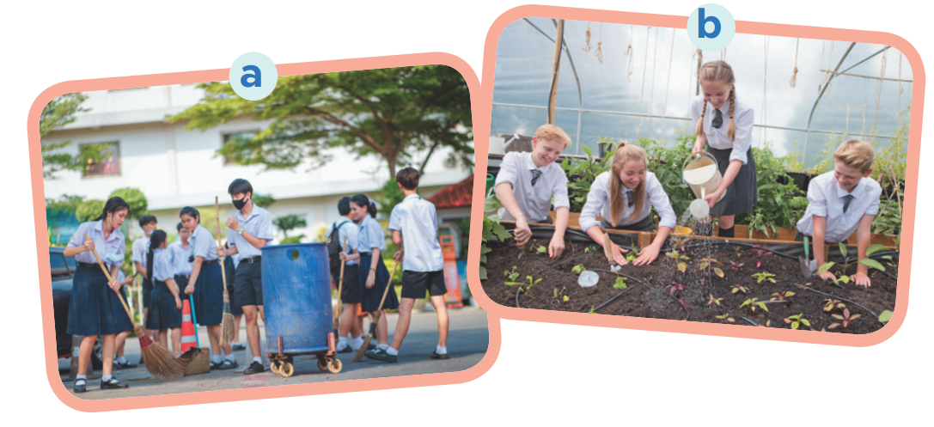
PRE-LISTENING
1
Work in pairs. Look at the pictures and discuss the questions.
What outdoor activities do they take part in?
Why do they do these activities?

Slide 8
WHILE-LISTENING
2
Listen to an interview between a reporter and two students. Circle the appropriate option (A, B, or C) to complete each sentence.
1. Trang and Phong are talking about _____. A. school subjects B. school timetables C. outdoor activities 2. They are members of _____ club(s). A. one B. two C. three 3. The Go Green Club cleans streets on _____.
A. Saturday afternoons B. Saturday mornings C. Sunday afternoons 4. They grow _____ in the school garden. A. vegetables B. flowers C. trees

Slide 9
WHILE-LISTENING
3
Listening to the interview again and answer the questions.
1. What do Trang’s club members encourage their classmates to do? 2. What does the reporter think about their activities? 3. When and where do Nam’s club members grow vegetables?
They encourage their classmates to recycle glass, cans and paper.
The reporter thinks their activities protect the environment.
They grow vegetables in the school garden after school.

Slide 10
PRE-WRITING
4
Work in pairs. Ask and answer questions about your school’s outdoor activities.
1. What outdoor activities do you take part in at school? 2. Which outdoor activity do you like the best?
3. Why do you like doing it?

Slide 11
WHILE-WRITING
5
Write a paragraph of about 70 words about an outdoor activity at your school. You can use the information in Task 4.

Slide 12
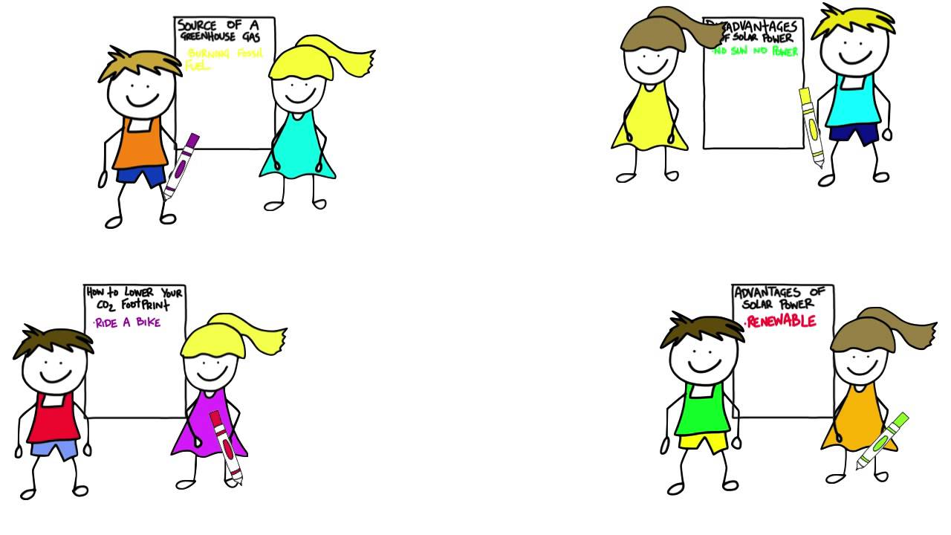
POST-LISTENING & WRITING
CLASS GALLERY
Students can:
go and see others’ work
give comments to one another

Slide 13
CONSOLIDATION
1
WRAP-UP
In this lesson, we have learnt to:
listen for general and special information about school activities
write a short paragraph about outdoor activities at one’s school

Slide 14
CONSOLIDATION
2
HOMEWORK
Prepare for the next lesson: Looking back & Project

Slide 15
Website: hoclieu.vn
Fanpage: facebook.com/www.tienganhglobalsuccess.vn/

