Slide 2
Unit
5
OUR CUSTOMS AND TRADITIONS
Unit
ETHNIC GROUPS OF VIET NAM
LESSON 7: LOOKING BACK & PROJECT
LESSON 3: A CLOSER LOOK 2
VOCABULARY REVIEW
GRAMMAR REVIEW
Unit
PROJECT

Slide 3
LESSON 7: LOOKING BACK & PROJECT
WARM-UP
Brainstorming
VOCABULARY
Task 1: Choose the correct option to complete each sentence.
Task 2: Fill in each blank with the suitable form of the word given.
Task 3: Complete the sentences with a, an, the or Ø.
Task 4: Complete the text with a, an, the or Ø.
GRAMMAR
PROJECT
LOCAL CUSTOMS AND TRADITIONS
CONSOLIDATION
Wrap-up
Homework

Slide 4
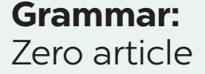
WARM-UP

Slide 5
VOCABULARY
1
Choose the correct option to complete each sentence below.
1. It is becoming a ______ for many families in Viet nam to celebrate Women’s Day and Family Day.
A. habit B. custom
2. ______, we hold the Spring Festival on the 15th of January in lunar calendar.
A. Traditionally B. In the past
3. Janet is from a family of doctors, but she broke with ______ when she went to an art college.
A. tradition B. habit

Slide 6
VOCABULARY
1
Choose the correct option to complete each sentence below.
4. Having dinner at my grandparents’ house on Saturdays is one of the customs our family ______.
A. does B. practises
5. Story telling is a great way to ______ the local tradition alive.
A. maintain B. keep

Slide 7
VOCABULARY
2
Fill in each blank with the suitable form of the word given.
1. Kien was so tall that no one recognized him at the family _______ last summer. (union)
2. My mum puts in a lot of eﬀort to prepare ________ to worship our ancestors. (oﬀer)
3. The festival ______ gathered on the riverside to cheer the boat racers. (go)
reunion
offerings
goers

Slide 8
VOCABULARY
2
Fill in each blank with the suitable form of the word given.
4. Dragon-snake (Rong ran len may) is a __________ Vietnamese game for children. It is very enjoyable. (tradition)
5. We happened to see some locals ___________ animals in their village temples. (worship)
traditional
worshipping

Slide 9
GRAMMAR
3
Complete the sentences with a, an, the or Ø (zero article).
Ø
1. These days, many teenagers write ______ emails instead of letters.
2. My dad bought ______ ornamental kumquat tree for Tet.
3. I don’t like that restaurant. ______ food there isn’t very good.
4. Don’t wear ______ hat when you go into a temple or a pagoda.
5. It’s becoming a custom for us to stay out very late on ______ New Year’s Eve.
an
The
a
Ø

Slide 10
GRAMMAR
4
Complete the text with a, an, the or Ø (zero article).
Here are two easy ways to raise children’s awareness of (1) ______ customs and traditions. First, it is (2) ______ good idea for parents to teach children to cook. By doing this, children can learn and preserve their family recipes. Second, parents can take children to (3) ______ local festivals. This helps them discover (4) ______ culture of their community and develop (5) ______ understanding of local traditions.
Ø
a
Ø
the
an

Slide 11
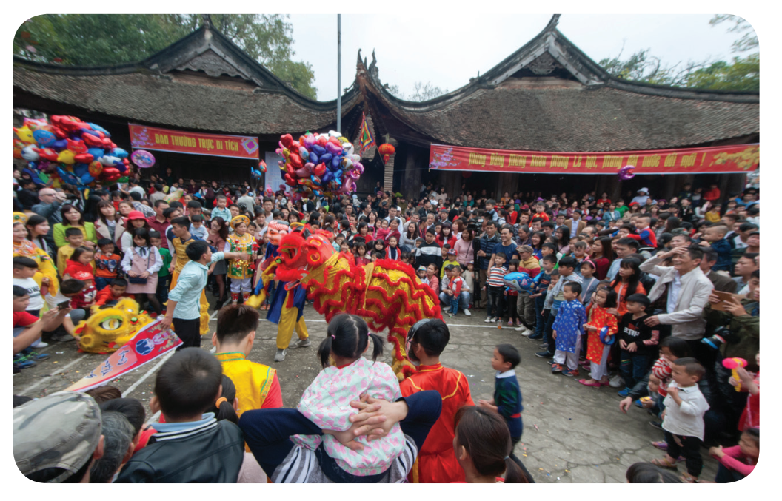
PROJECT
LOCAL CUSTOMS AND TRADITIONS

Slide 12
CONSOLIDATION
1
Wrap-up
Vocabulary review
Grammar review
Project: Local customs and traditions

Slide 13
CONSOLIDATION
2
Homework
Do exercises in the workbook.
Prepare for the next lesson.

Slide 14
Website: hoclieu.vn
Fanpage: facebook.com/www.tienganhglobalsuccess.vn/

