Slide 1

Unit 6: Life on other planets
Lesson 3.2 – Speaking & Writing
Page 63

Slide 2
Lesson Outline
Warm-up
Speaking
Writing
Consolidation
Wrap-up

Slide 3

By the end of this lesson, students will be able to…
- talk about seeing UFOs and aliens.
- write a story about seeing visitors from another planet.

Slide 4

WARM UP

Slide 5
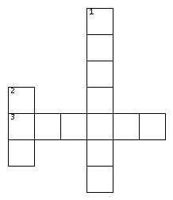
Puzzle time!
ACROSS
3. They were having lunch when the ____ saucer arrived.
DOWN
1. He was ____ (look) for his shoes when a strange man knocked on the door.
2. James was playing football in the yard when he saw a ____.

Slide 6
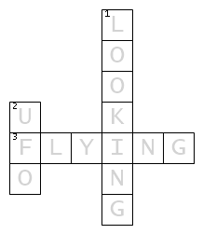
Puzzle time!
ACROSS
3. They were having lunch when the ____ saucer arrived.
DOWN
1. He was ____ (look) for his shoes when a strange man knocked on the door.
2. James was playing football in the yard when he saw a ____.

Slide 7

Pre-writing

Slide 8

Work in pairs
Discuss UFOs and aliens.
What do you think they usually look like and what do they do?

Slide 9
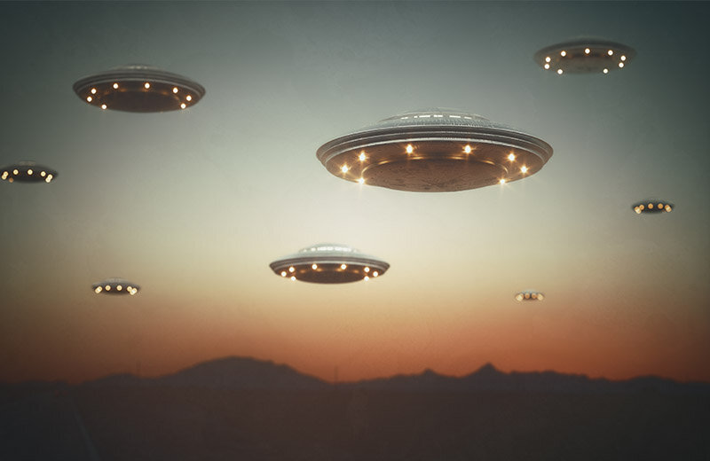
What do they look like?
What do they do?

Slide 10
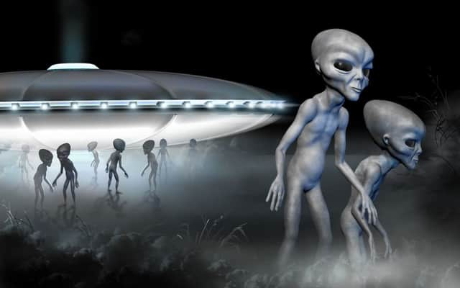
What do they look like?
What do they do?

Slide 11
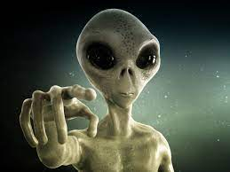
What do they look like?
What do they do?

Slide 12
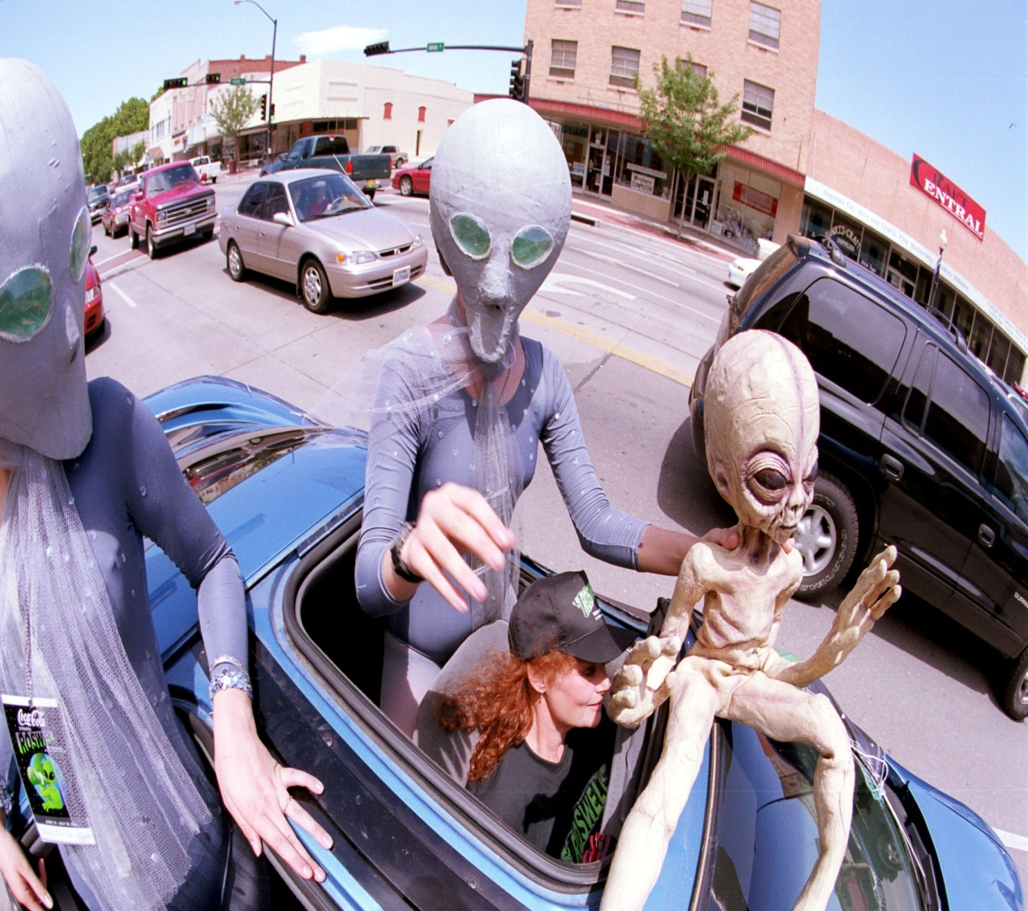
What do they look like?
What do they do?

Slide 13

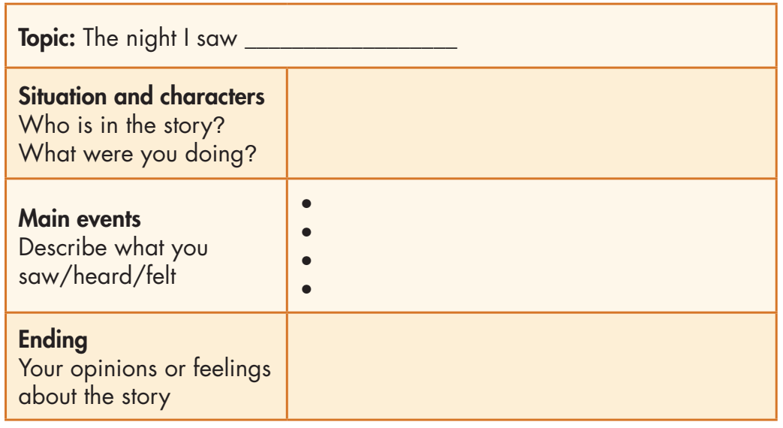
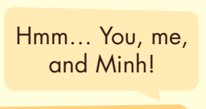
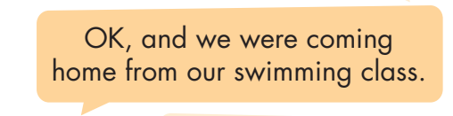
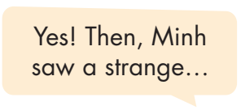
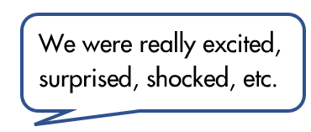
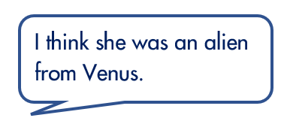
Now, imagine you and your partner saw a strange visitor.
In pairs: Plan the story together and fill in the table with your own ideas.

Slide 14

While-Writing

Slide 15

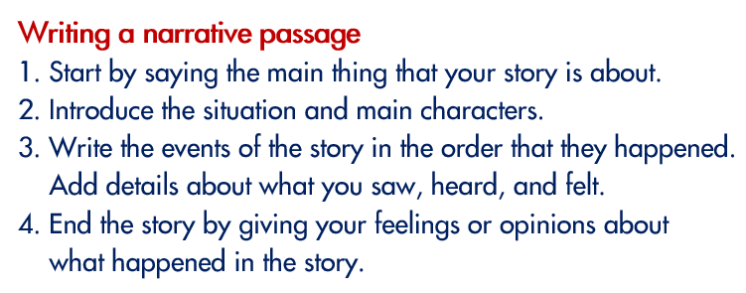
Now, write a narrative passage to tell the story you planned in Speaking. Use the Writing Skill box and your speaking notes to help you. Write 80 to 100 words.

Slide 16
Can you remember?
What is a structure of a narrative?
How many sections are there in a narrative passage?
What do you write in the topic section?
Do you write about people in the character section?
In which section do you write about what you saw/heard/felt, the main event or the ending section?

Slide 17
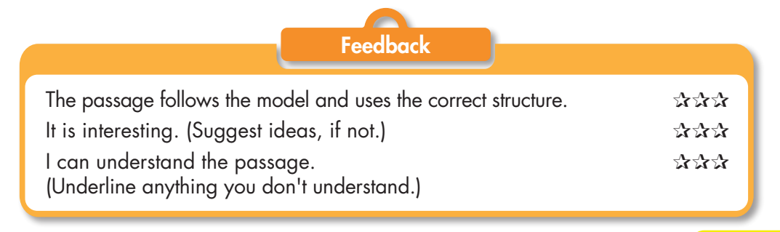
Write a narrative passage.
Check your answers with a partner, using the feedback form.

Slide 18

Post-writing

Slide 19
You will have your passages assessed thanks to these criteria:
• narrative structure
• main idea and focus
• sentence fluency
• word choice
• spelling and punctuation

Slide 20
Suggested writing
I'll never forget the night I saw an alien. I was in the car with my mom. We were coming home from swimming class at my local swimming pool. We were driving through a forest when we saw a strange, tall man on the road. He was making a strange noise. He was wearing silver clothes, and he was pointing at the sky. It was really scary. We drove home quickly and called the police. I really believe he was an alien from another planet.

Slide 21

CONSOLIDATION

Slide 22
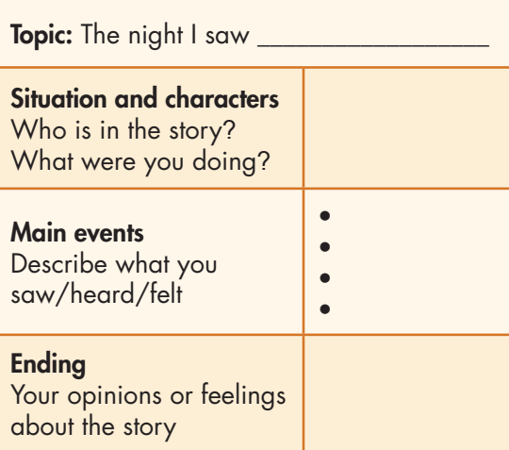
How many parts are there in a narrative passage?

Slide 23

WRAP-UP

Slide 24
Today’s lesson
Speaking: Plan the story about a strange visitor from another planet
Writing: How to write a narrative passage.

Slide 25
Homework
- Review how to write a narrative passage.
- Finish the writing part.
- Do the exercises in WB: Writing (page 37).
- Do the exercise in Tiếng Anh 8 i-Learn Smart World Notebook (page 53).
- Play consolidation games in Tiếng Anh 8 i-Learn Smart World DHA App on www.eduhome.com.vn
- Prepare: Unit 6 – Review – page 98.

Slide 26
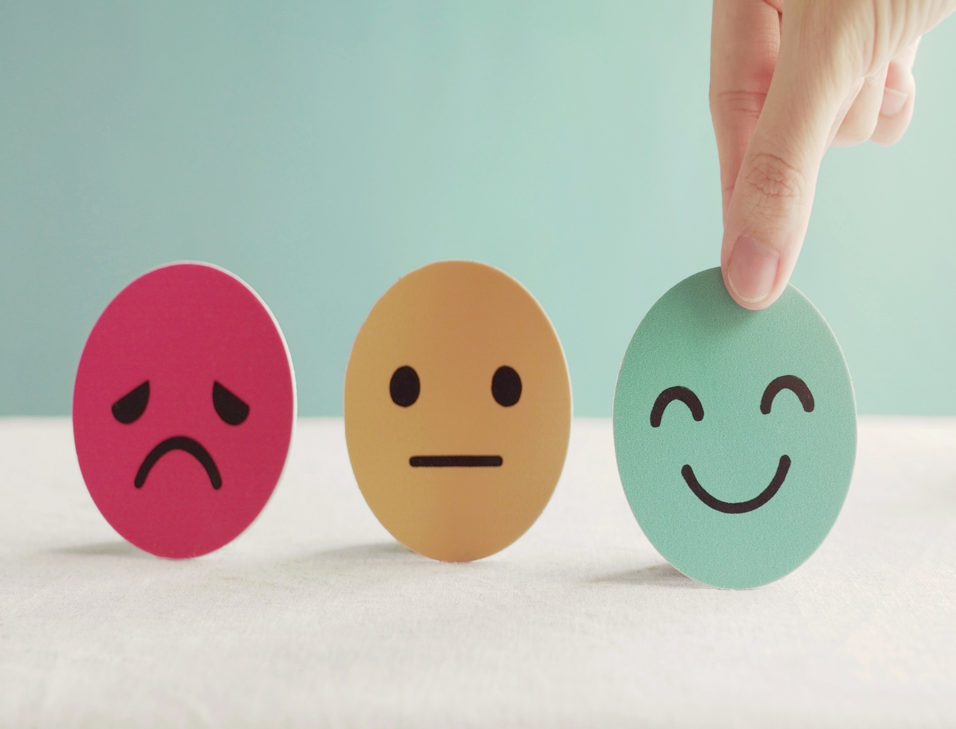
Lesson 3
Stay positive and have a nice day!

