Slide 1








Welcome to
English Class
Class: 6a1
Teacher: Huynh Pham Diem Quynh

Slide 2
UNIT 1: MY NEW SCHOOL
LESSON: SKILL 1
Class: 6a1
Teacher: Huynh Pham Diem Quynh

Slide 3





I. VOCABULARY

Slide 4
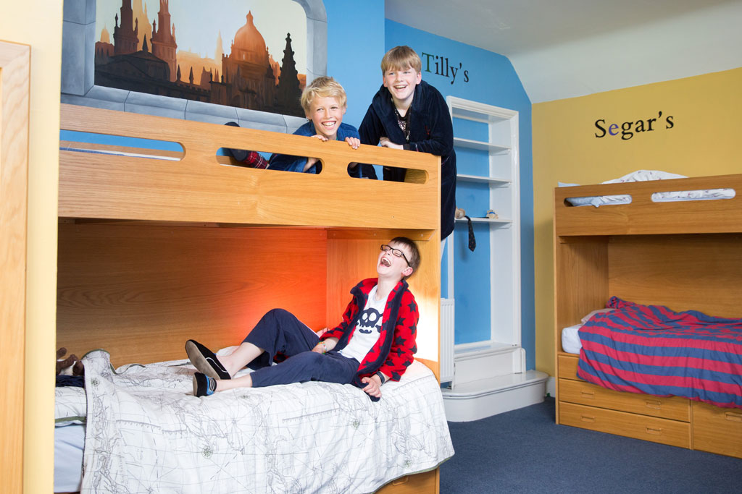

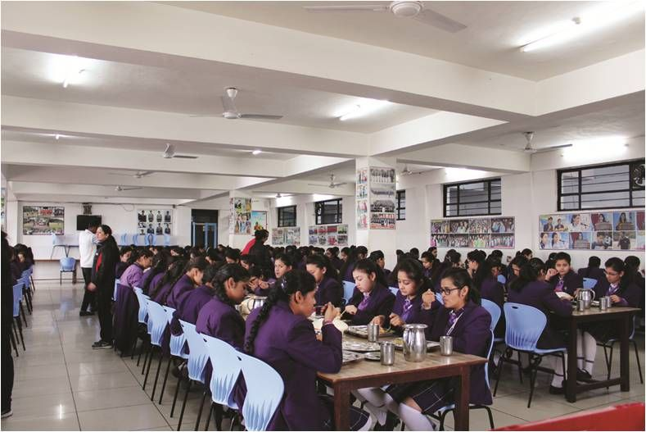
VOCABULARY
boarding school (n)
A school where students live and study
/ˈbɔːdɪŋ ˌskuːl/
trường nội trú

Slide 5
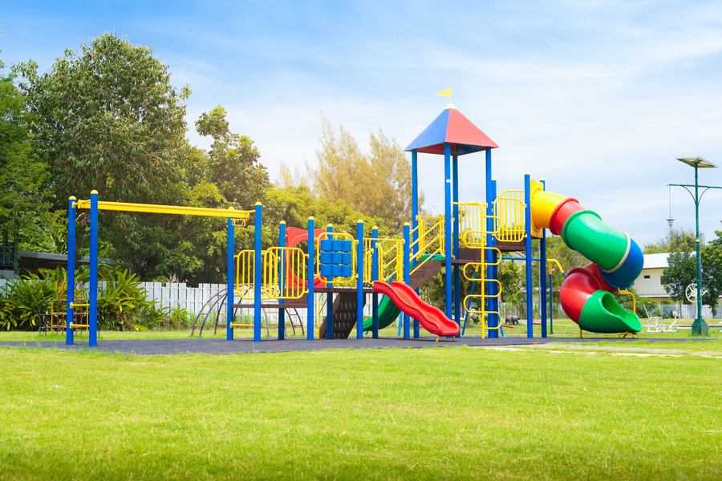
VOCABULARY
playground (n)
/ˈpleɪɡraʊnd/
sân chơi

Slide 6

VOCABULARY
international (adj)
/ˌɪntəˈnæʃənəl/
(mang tính)
quốc tế

Slide 7
VOCABULARY
New words | Pronunciation | Meaning
1. boarding school (n) | /ˈbɔːdɪŋ ˌskuːl/ | trường nội trú
2. playground (n) | /ˈpleɪɡraʊnd/ | sân chơi
3. international (adj) | /ˌɪntəˈnæʃənəl/ | (mang tính) quốc tế

Slide 8
II. READING

Slide 9
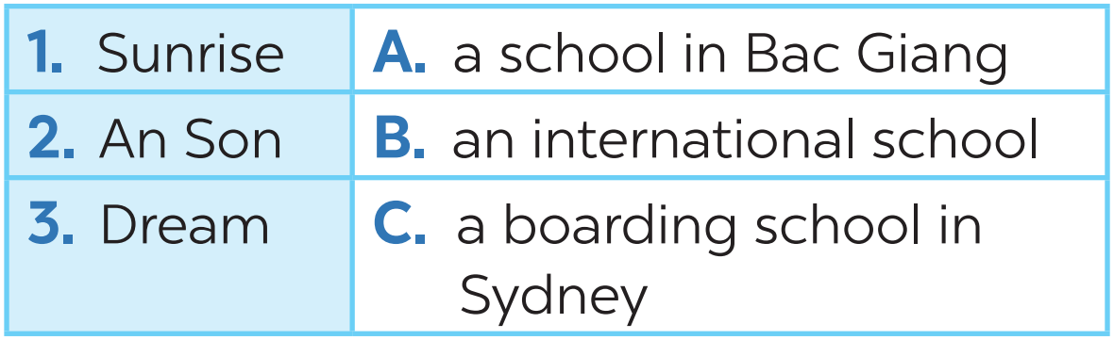
READING
1
Look at the picture and quickly read the passages. Match 1-3 with A-C.

Slide 10
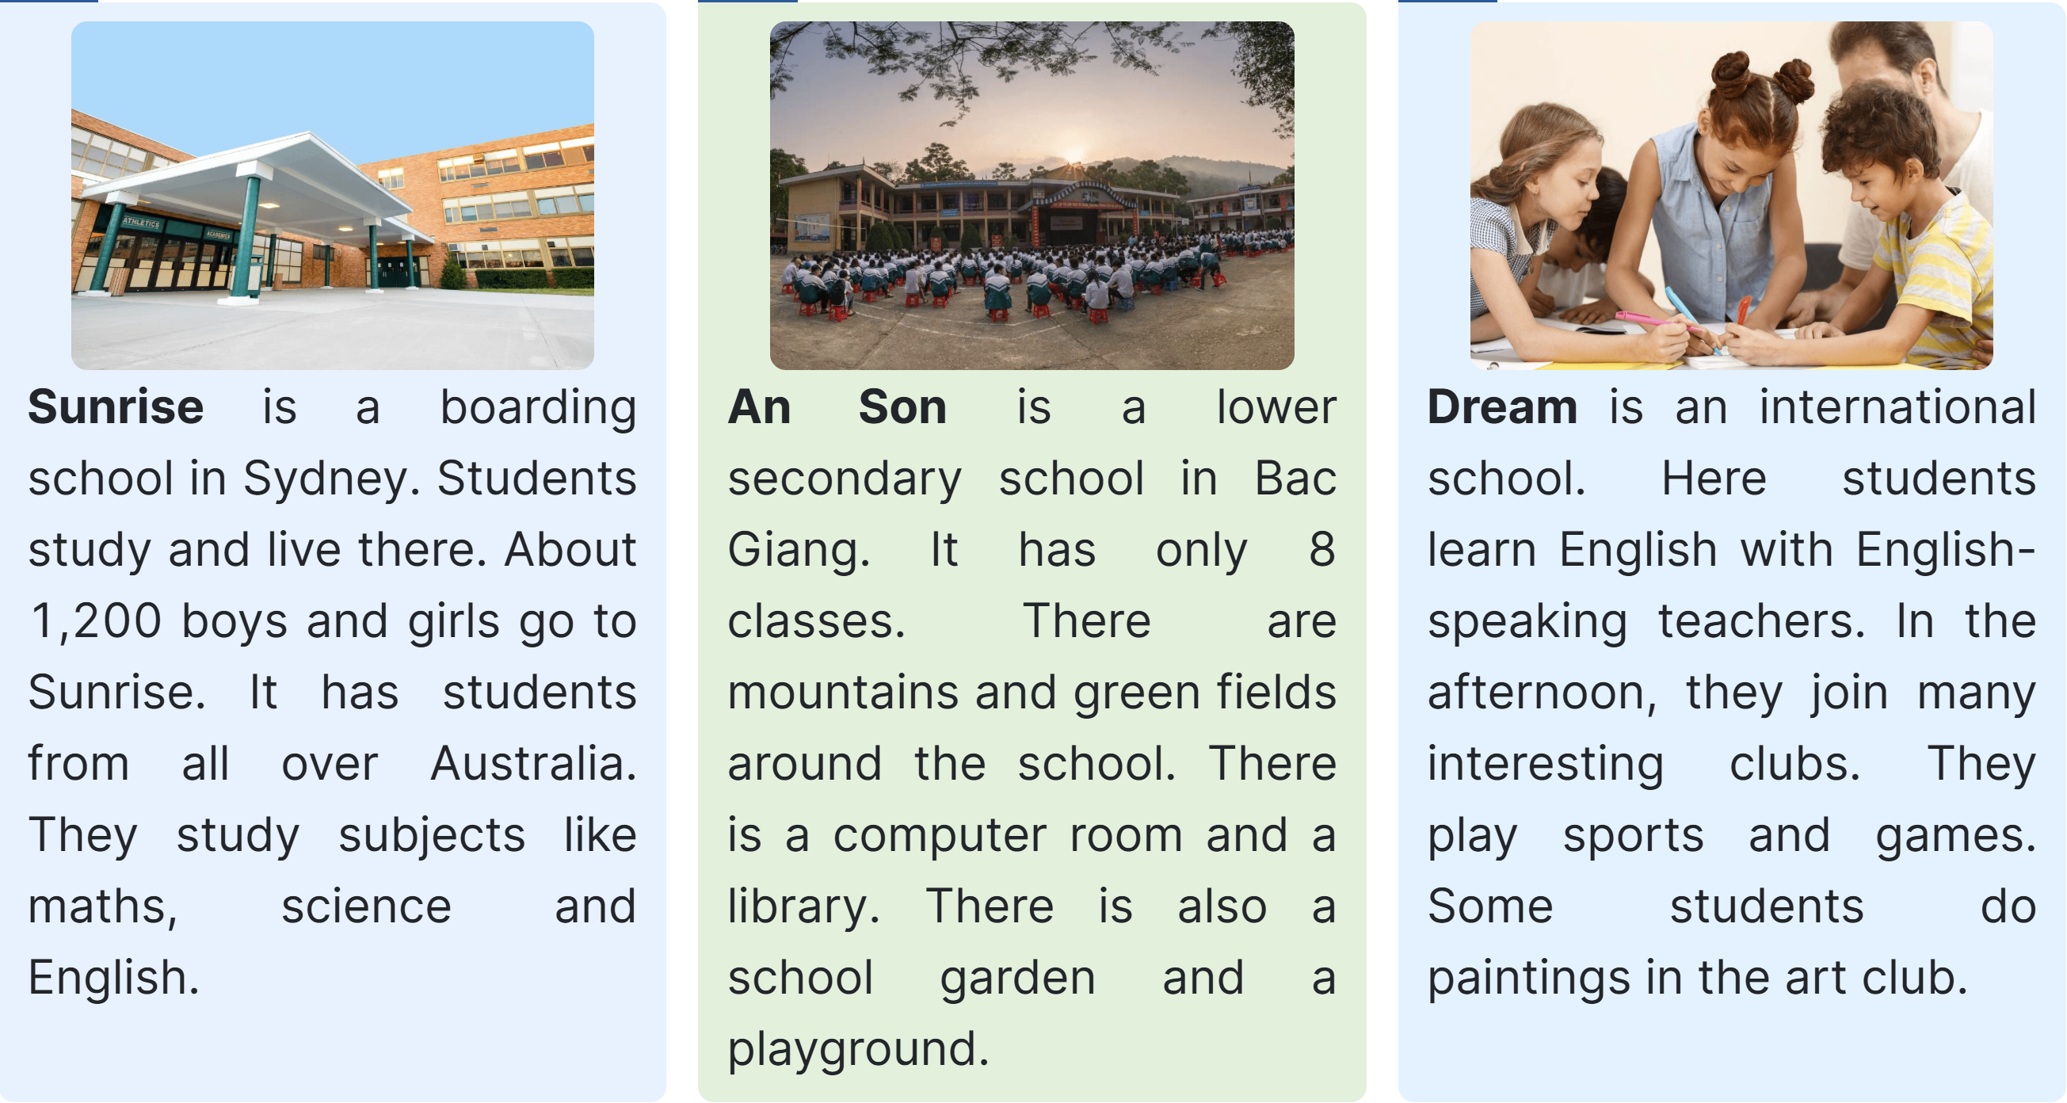

The Significance of Word Origins
Many words in the English language have been borrowed or derived from other languages, especially Latin and Greek. Understanding a word's origin can often provide clues about its meaning and how it's spelled. For example, 'photo' is derived from the Greek word for 'light'.
TASK1
TASK 2

Slide 11
READING
1
Look at the picture and quickly read the passages. Match 1-3 with A-C.

Slide 12
READING
2
Read the passages again and complete the sentences.
1. Students live and study in a ________ school. They only go home at weekends.
2. Sunrise is a school in _______.
3. There are ______________________ around An Son School.
4. ____________ has an art club.
5. At Dream School, students learn English with _______________________.
boarding
Sydney
mountains and green fields
Dream School
English-speaking teachers

Slide 13
The Significance of Word Origins
Many words in the English language have been borrowed or derived from other languages, especially Latin and Greek. Understanding a word's origin can often provide clues about its meaning and how it's spelled. For example, 'photo' is derived from the Greek word for 'light'.

Slide 14
READING
3
Answer the questions.
1. Which school is a boarding school?
→ Sunrise (is).
2. Where is An Son School?
→ It is in Bac Giang.
3. Is there a school garden in An Son School?
→ Yes, there is.
4. What do Dream School students do in the afternoon?
→ They join many interesting clubs.

Slide 15
III. SPEAKING

Slide 16
SPEAKING
4
Which school in Exercise 1 would you like to go to? Why? Complete the table.
Name of school | Reasons you like it
 | I

Slide 17
SPEAKING
4
Which school in Exercise 1 would you like to go to? Why? Complete the table.
Name of school | Reasons you like it
Dream School | Because I'd like to paint in the art club

Slide 18
SPEAKING
Discuss your choice with your friends.
Name of school | Reasons you like it
Interview:
- Ask your classmate
- Complete your survey

Slide 19




INTERVIEW:
A: Which school would you like to go to ?
B: I'd like to go to Dream School
A: Why?
B: Because I'd like to paint in the art club.

Slide 20
SPEAKING
Name of your friend | Name of school | Reasons you like it
Lan | Dream School | Because I'd like to paint in the art club
My friend is Lan. She'd like to go to Dream School. Because she'd like to paint in the art club.

Slide 21

CONSOLIDATION
1
Wrap-up
What have we learnt in this lesson?
Read about type of school
Speak about type of school you would like to go to

Slide 22

CONSOLIDATION
2
Homework
- Do exercises in the workbook.
- Write down your opinions about a school in your notebooks.

Slide 23






THANK YOU

Slide 24

Exploring Prefixes
Prefixes are added at the beginning of a base word. They modify the meaning of the word. For example, 'un-' added to 'happy' results in 'unhappy'. By mastering prefixes, we can infer the meanings of many words.

Slide 25


Base Words and Their Importance
A base word is a word in its simplest form, without any prefixes or suffixes added. For instance, 'happy' is a base word. Recognising base words can aid in comprehending the meanings of more complex words.

Slide 26
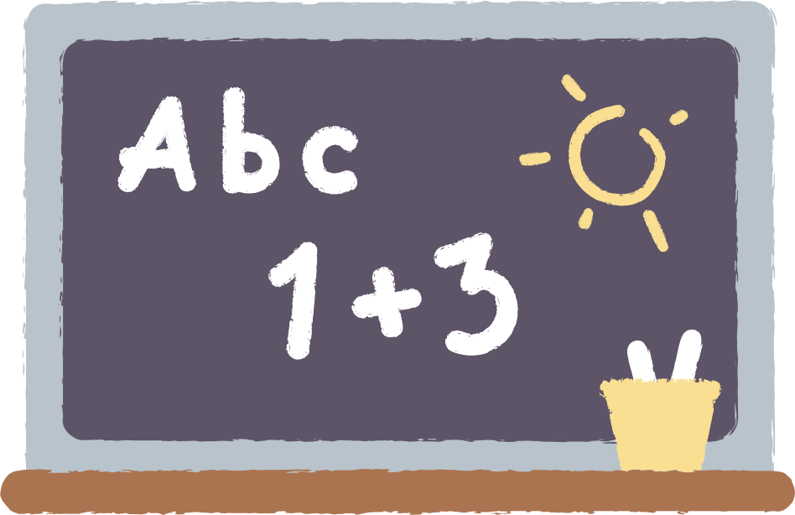
spelling patterns
Spelling patterns are recurring sequences of letters in words that often produce the same sounds. Examples include 'igh' in 'light', or 'ough' in 'though'. Recognising these patterns can improve spelling accuracy.

Slide 27



The Power of Compound Words
Compound words are formed by combining two base words. Examples include 'toothbrush' and 'basketball'. Understanding the individual base words can often reveal the compound word's meaning.

Slide 28

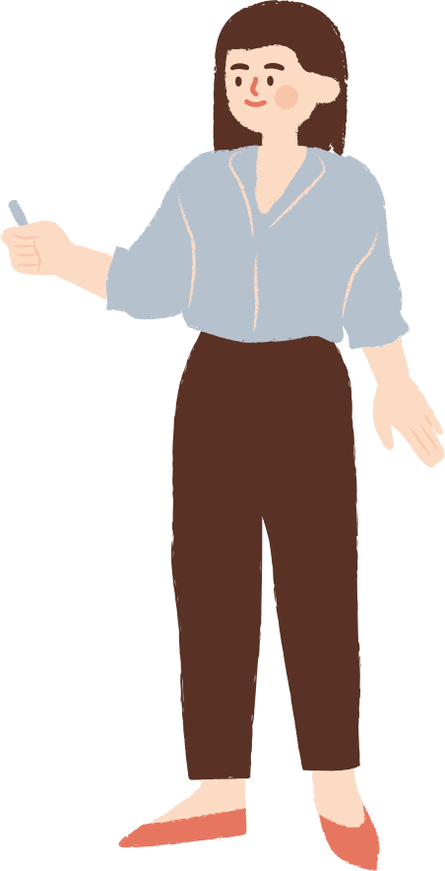

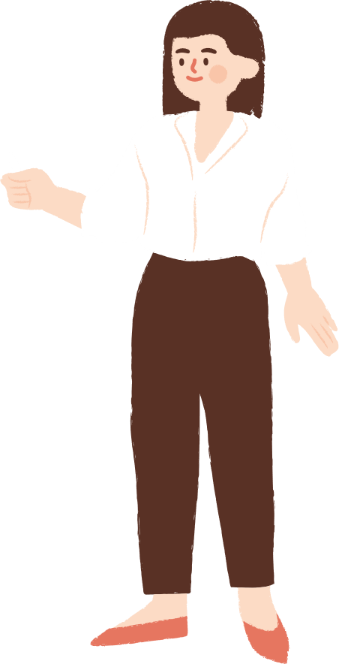
summary
Mastering the elements of word origins, base words, prefixes, suffixes, and spelling patterns is a powerful tool for improving vocabulary and spelling skills. Regular practice and real-world application will help you
to reinforce this knowledge.

Slide 29





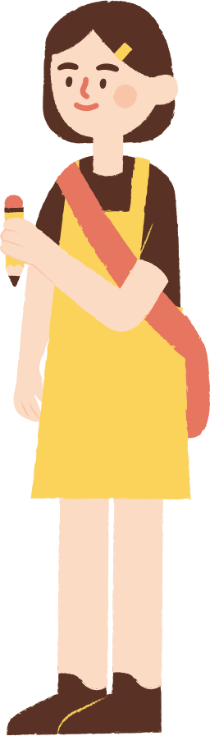

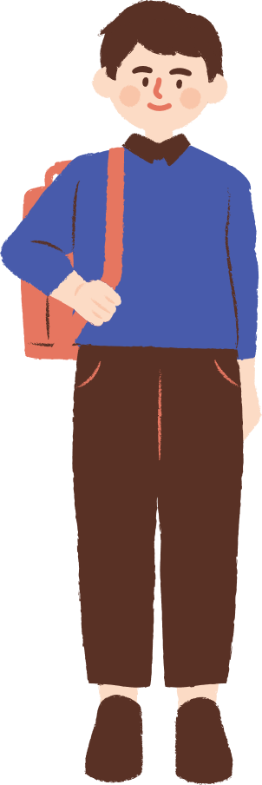
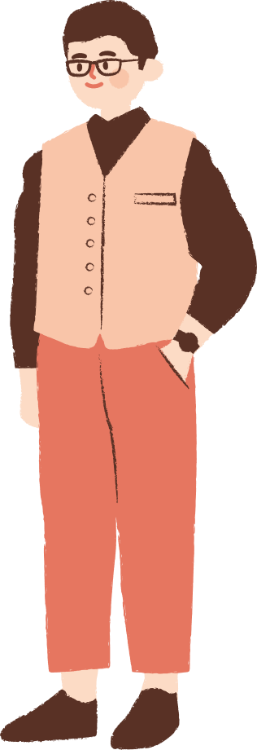




















Resource Page

