Slide 2
Unit 1
Life stories we admire
LESSON I
GETTING STARTED
The diary of Dang Thuy Tram

Slide 3
LESSON I
GETTING STARTED
WARM-UP
Game: Who is this?
PRESENTATION
Vocabulary
Task 1: Listen and read.
Task 2: Circle the correct answer.
Task 3: Find words and a phrase.
Task 4: Complete the sentences.
PRACTICE
PRODUCTION
Poster design
CONSOLIDATION
Wrap-up
Homework

Slide 4
WARM-UP
Game: Who is this?

Slide 5
WARM-UP
Rules
- Work in two teams.
- There are 7 pictures of 7 famous people.
- Only one student from each group sees a picture.
- Use your own words to describe the person.
- Others guess the famous person’s name.
+ If the answer is correct ➔ one point for your team.
+ If the answer is incorrect ➔ the chance to answer is transferred to the other team.
+ The team having more points is the winner of the game.

Slide 6
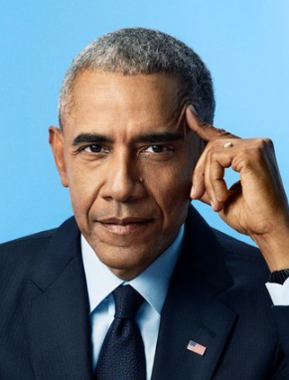
WARM-UP
Barack Obama

Slide 7

WARM-UP
Dang Thuy Tram

Slide 8
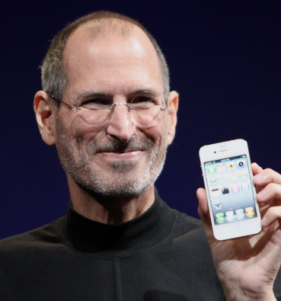
WARM-UP
Steve Jobs

Slide 9
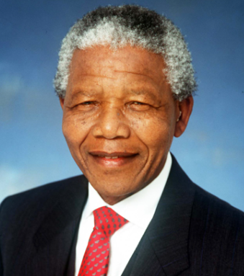
WARM-UP
Nelson Mandela

Slide 10
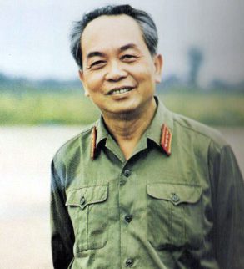
WARM-UP
General
Vo Nguyen Giap

Slide 11
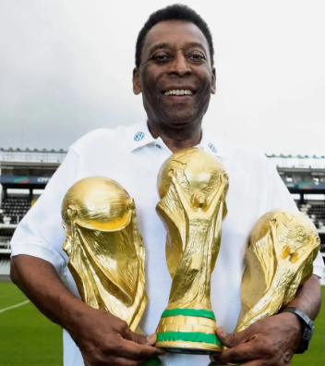
WARM-UP
Pelé

Slide 12
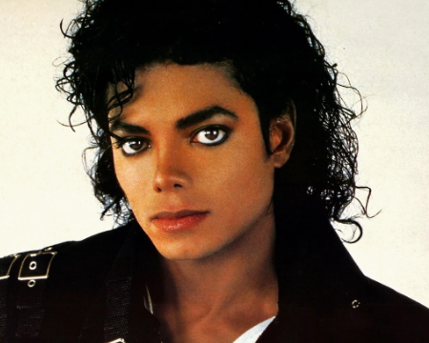
WARM-UP
Michael Jackson

Slide 13


PRESENTATION
surgeon (n)
/ˈsɜːdʒən/
a doctor who is trained to perform surgery

Slide 14
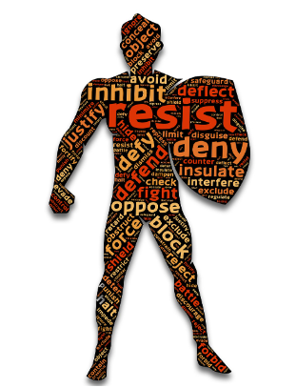
PRESENTATION
resistance (n)
/rɪˈzɪstəns/
the act of using force to oppose somebody/ something

Slide 15

PRESENTATION
enemy (n)
/ˈenəmi/
a country or group that you are fighting a war against

Slide 16

PRESENTATION
soldier (n)
/ˈsəʊldʒə(r)/
a member of an army, especially one who is not an officer

Slide 17
PRESENTATION
devote (sth to sth)
/dɪˈvəʊt/
to give an amount of time, attention, etc. to something

Slide 18
Form | Pronunciation | Meaning | Vietnamese equivalent
1. surgeon (n) | /ˈsɜːdʒən/ | a doctor who is trained to perform surgery | bác sĩ phẫu thuật
2. resistance (n) | /rɪˈzɪstəns/ | the act of using force to oppose somebody/something | sự chống lại
3. enemy (n) | /ˈenəmi/ | a country or group that you are fighting a war against | quân địch
4. soldier (n) | /ˈsəʊldʒə(r)/ | a member of an army, especially one who is not an officer | người lính
5. devote (sth to sth) | /dɪˈvəʊt/ | to give an amount of time, attention, etc. to something | cống hiến

Slide 19
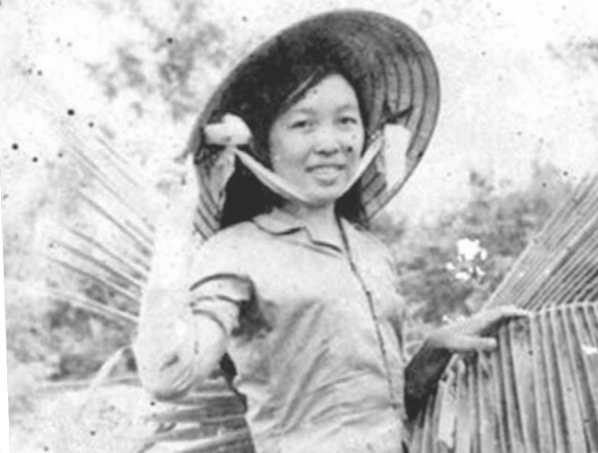
PRACTICE
1
Listen and read.

Slide 20
PRACTICE
2
Read the conversation again and circle the correct answer to complete each of the sentences.
1. Dang Thuy Tram was born in Ha Noi / Hue.
2. Tram wrote about / operated on injured soldiers during the war.
3. She died when she was very young / old.
4. An American soldier kept her diary for 27 years / more than three decades before returning a copy to her family.

Slide 21
PRACTICE
3
Find words and a phrase in Task 1 with the following meanings.
1. accounts
descriptions of things that have happened
the end of somebody's life
giving time, attention, etc. to something
the period of time when a person is young
2. death
3. devoting
4. youth

Slide 22
PRACTICE
4
Complete the sentences based on the conversation.
Dang Thuy Tram was a young surgeon. She (1) ______ her diary while she (2) ___________ in a field hospital during the war. One day, she (3) _________ while she (4) ________________ in the jungle. She was only 27 then. An American soldier (5) ______ her diary for many years before returning a copy to her family.
wrote
was working
was killed
was doing her duty
kept

Slide 23

PRODUCTION
Design a poster to introduce the life events of Dang Thuy Tram.

Slide 24
CONSOLIDATION
1
Wrap-up
What have you learnt today?
Some lexical items about a famous person’s life
Reading for specific information
Past simple and Past continuous

Slide 25
CONSOLIDATION
2
Homework
Do exercises in the workbook.
Prepare for the project in Lesson 8.

Slide 26
Website: hoclieu.vn
Fanpage: facebook.com/www.tienganhglobalsuccess.vn

