Slide 1






Unit 7:
The world of
mass media

Slide 2
Unit 7:
The world of
mass media

Slide 3



reading
VOCABULARY
GAME: DEBATE
ACTIVITIES

Slide 4
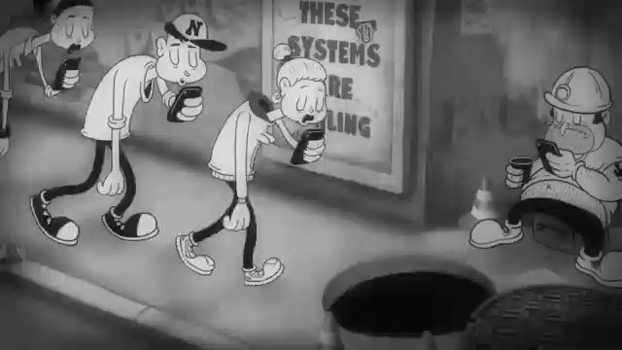

Slide 5

THIS IS A VERY COMMON PHENOMENON TODAY, SO WHAT IS IT?
=> Social media addiction

Slide 6



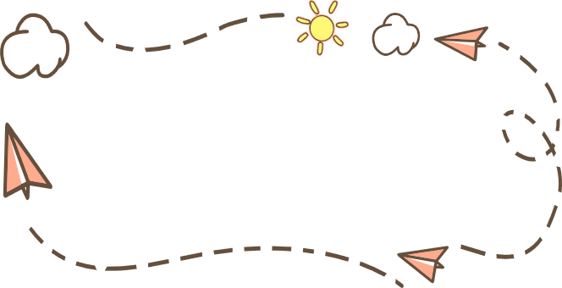




VOCABULARY

Slide 7

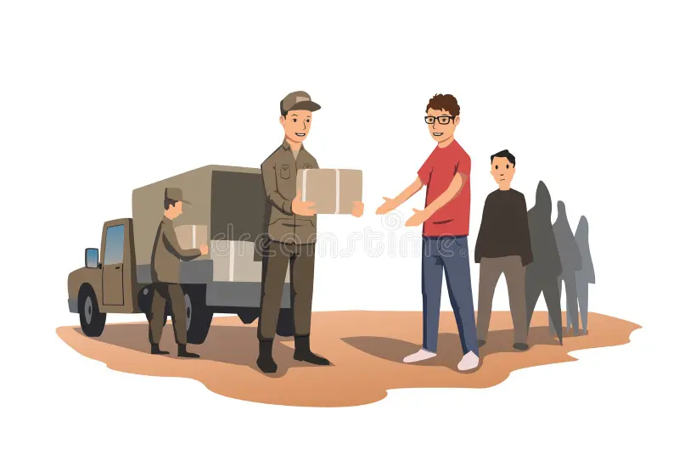



1
d _ _ _ _ _ _ _ _ _
DISTRIBUTE (V)
/dɪˈstrɪb.juːt/

Slide 8



2
accessible (a)
a _________ (a)
#
# unavailable (a)
/əkˈses.ə.bəl/

Slide 9


3
interactive (a)
I _ _ _ _ _ _ _ _ _ _ (a)
= involving communication between people

Slide 10







credible (a)
= able to be believed or trusted
c_ _ _ _ _ _ _

Slide 11
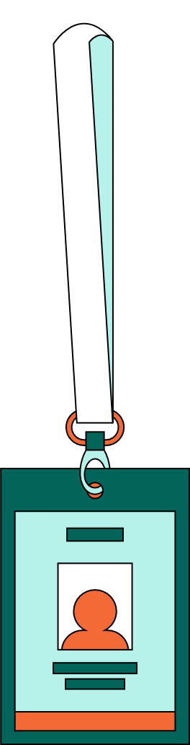

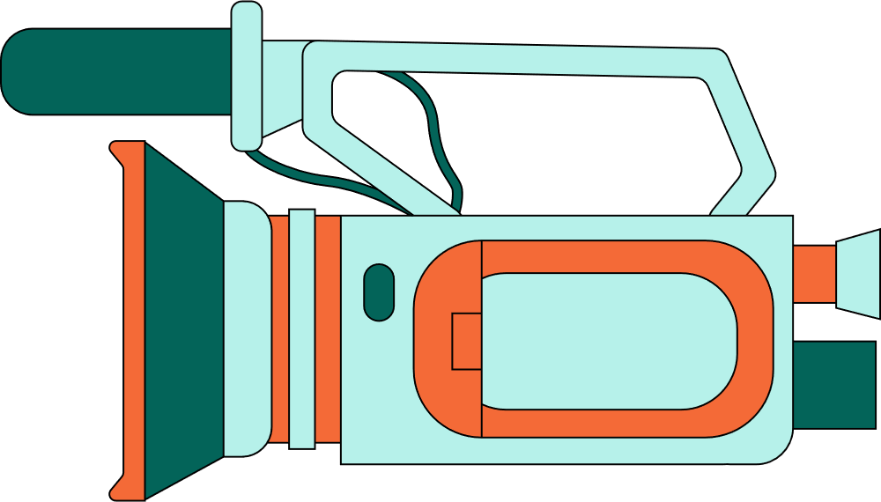
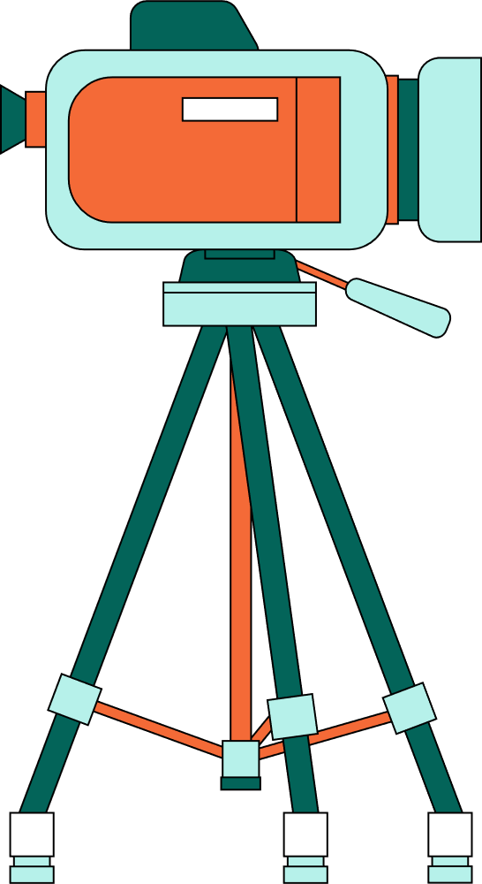

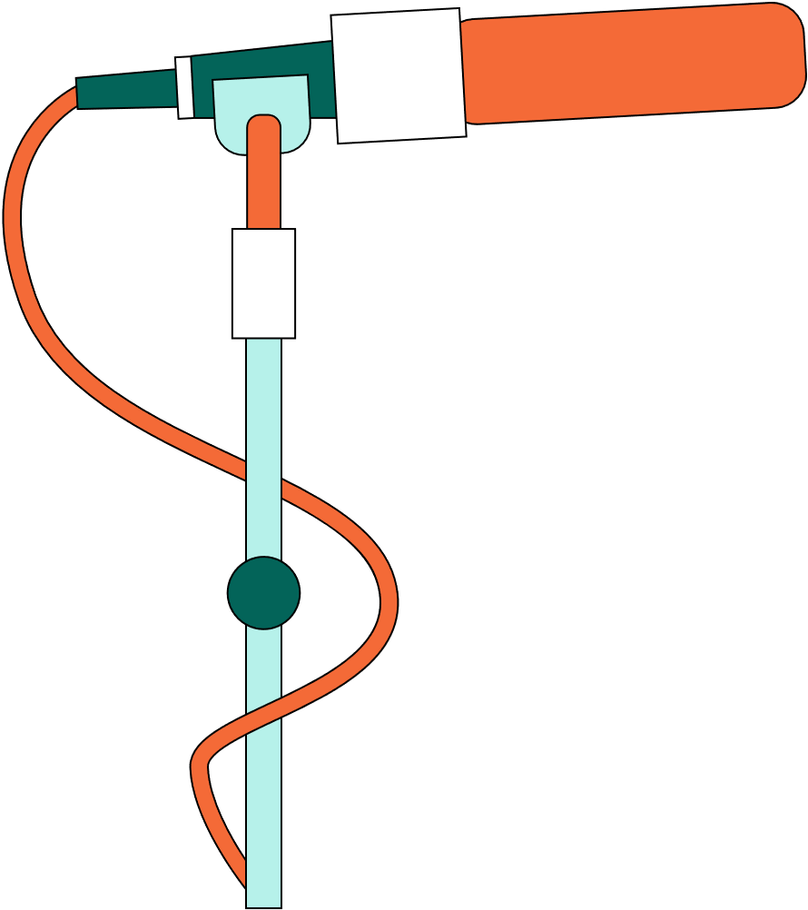
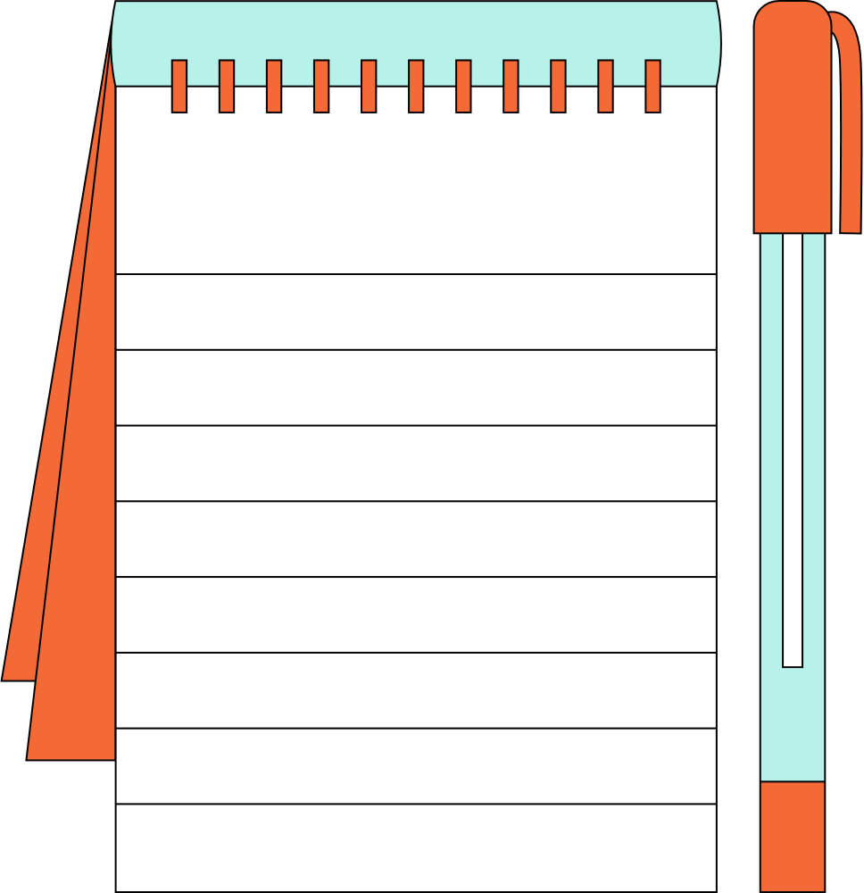
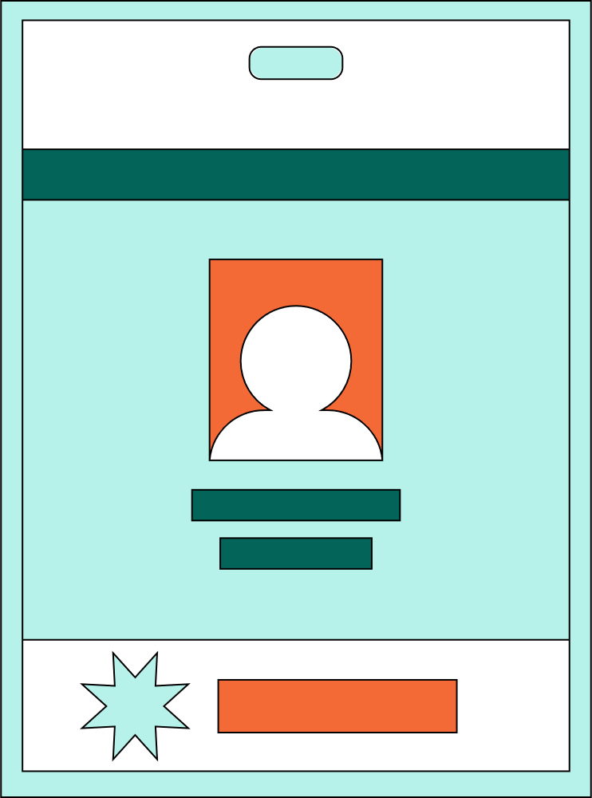
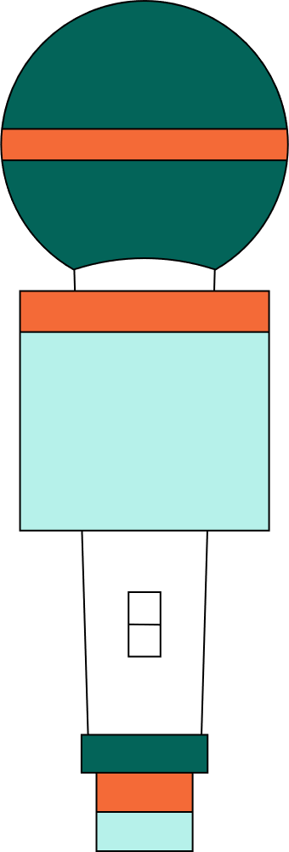
f_ _ _ - c_ _ _ _ (v)
fact - check (v)
/ˈfæktˌtʃek/

Slide 12

Vocab
Pronunciation
Definition
Meaning
distribute (v)
/dɪˈstrɪb.juːt/
to give something out to several people, or to spread or supply something
phân phát
accessible (a)
/əkˈses.ə.bəl/
able to be reach or easily obtained
có thế tiếp cận
interactive (a)
/ˌɪn.təˈræk.tɪv/
involving communication between people
tương tác (a)
credible (a)
/ˈkred.ə.bəl/
đáng tin cậy
able to be believed or trusted
to check that all the facts in a piece of writing, a new article, a speech etc. are correct
fact-check (v)
đã kiểm tra thực tế
/ˈfæktˌtʃek/

Slide 13
ACtivities

Slide 14


Activity 1: Work in pairs. Read the first section of the article. Discuss the following questions:
Do you think that digital media can replace traditional media? Why/Why not?
  Digital media is any form of media that is created, viewed, and distributed via electronic devices. Examples of digital media include websites, social media, videos, video games, digital advertising, software, and electronic books. With the development of technology and smart devices in recent years, digital media saw a sharp rise. This raises the question of whether digital media will replace traditional media such as printed newspapers, broadcast TV, and radio. Below are two opinion pieces sent to our Debate Corner this week.

Slide 15
Activity 1: Work in pairs. Read the first section of the article. Discuss the following questions:
Do you think that digital media can replace traditional media? Why/Why not?
Example:
  The fact that not everyone has access to the internet or smart gadgets makes me believe that digital media cannot completely replace conventional media. In some places, traditional media can guarantee a larger audience reach. Additionally, compared to the abundance of "fake news" online, conventional media frequently employs stronger fact-checking, making it a more trustworthy source of information.

Slide 16


ACtivity 2:
Read the following article. Match the highlighted words with their meanings

Slide 17


Digital media is any form of media that is created, viewed, and distributed via electronic devices. Examples of digital media include websites, social media, videos, video games, digital advertising, software, and electronic books. With the development of technology and smart devices in recent years, digital media saw a sharp rise. This raises the question of whether digital media will replace traditional media such as printed newspapers, broadcast TV, and radio. Below are two opinion pieces sent to our Debate Corner this week.
Nowadays, it is much easier and more convenient to access information via digital media. Most digital content is also freely accessible. All it takes is a few clicks, and you can read the latest news, watch videos, or see online adverts. In addition, digital media forms are more interactive. For example, customers can provide instant feedback, which can be used to solve any problems. In return, almost every organisation can reach its target customers easily via digital media. Furthermore, digital media is more flexible since information can be updated easily and frequently. By contrast, articles in printed newspapers or adverts on TV cannot be changed immediately. With more than 75 million social media users in Viet Nam and the number is increasing, it will not be long before traditional media becomes a thing of the past. (Minh Quang)
Digital media is very convenient, but its strengths are also its own weaknesses. Since anyone with access to computers and the Internet can post or share information online, it raises the question of how credible it is. On the other hand, traditional media offers information from reliable sources that are fact-checked. Moreover, let us not forget that digital media relies on the Internet and smart devices to work well. There are still remote or disadvantaged areas in Viet Nam where access to technology is limited or too expensive. Many people also still struggle with technology. So although digital media is on the rise, traditional media such as printed newspapers, broadcast TV, and radio is here to stay. (Pham Hoa)

Slide 18

Match the highlighted word with their meanings
distributed
a. that can be trusted or believed
accessible
b. that allows information to be passed continuously and in both directions between different devices or users
interactive
c. that can be reached, used, seen, etc.
credible
d. given to a large number of people

Slide 19


ACtivity 3:
Read the article again. Write Q next to Quang's opinion, H next to Hoa's opinion, and N if it is not their opinion.

Slide 20
Read the article again. Write Q next to Quang's opinion, H next to Hoa's opinion, and N if it is not their opinion.
1
Digital media will replace traditional media in our country soon
----
2
Digital media will replace traditional media, but that won't be soon.
----
3
Traditional media will become more accessible in the future.
----
4
Both traditional and digital media will be in use in the future.
----
5
The future is uncertain for both traditional and digital media.
----

Slide 21
Read the article again. Write Q next to Quang's opinion, H next to Hoa's opinion, and N if it is not their opinion.
1
Digital media will replace traditional media in our country soon
----

Slide 22
Read the article again. Write Q next to Quang's opinion, H next to Hoa's opinion, and N if it is not their opinion.
Q
1
Digital media will replace traditional media in our country soon
----
Paragraph 2, line 16-19: “With more than 75 million social media users in Viet Nam and the number is increasing, it will not be long before traditional media becomes a thing of the past”.

Slide 23
Read the article again. Write Q next to Quang's opinion, H next to Hoa's opinion, and N if it is not their opinion.
Q
1
Digital media will replace traditional media in our country soon
----
2
Digital media will replace traditional media, but that won't be soon.
----

Slide 24
Read the article again. Write Q next to Quang's opinion, H next to Hoa's opinion, and N if it is not their opinion.
Q
1
Digital media will replace traditional media in our country soon
----
N
2
Digital media will replace traditional media, but that won't be soon.
----
Quang :“...it will not be long before traditional media becomes a thing of the past”. ( paragraph 2, last line)
Hoa :“..So although digital media is on the rise, traditional media such as printed newspapers, broadcast TV, and radio is here to stay”.( paragraph 3 ,last line)

Slide 25
Read the article again. Write Q next to Quang's opinion, H next to Hoa's opinion, and N if it is not their opinion.
Q
1
Digital media will replace traditional media in our country soon
-----
N
2
Digital media will replace traditional media, but that won't be soon.
----
3
Traditional media will become more accessible in the future.
----

Slide 26
Read the article again. Write Q next to Quang's opinion, H next to Hoa's opinion, and N if it is not their opinion.
Q
1
Digital media will replace traditional media in our country soon
----
N
2
Digital media will replace traditional media, but that won't be soon.
----
3
N
Traditional media will become more accessible in the future.
----
Quang:“Nowadays, it is much easier and more convenient to access information via digital media. Most digital content is also freely accessible”.( paragraph 2, the first line)
His opinion doesn’t talk about traditional media

Slide 27
Read the article again. Write Q next to Quang's opinion, H next to Hoa's opinion, and N if it is not their opinion.
Q
1
Digital media will replace traditional media in our country soon
----
N
2
Digital media will replace traditional media, but that won't be soon.
----
3
N
Traditional media will become more accessible in the future.
----
4
Both traditional and digital media will be in use in the future.
----

Slide 28
Read the article again. Write Q next to Quang's opinion, H next to Hoa's opinion, and N if it is not their opinion.
Q
1
Digital media will replace traditional media in our country soon
----
N
2
Digital media will replace traditional media, but that won't be soon.
----
3
N
Traditional media will become more accessible in the future.
----
4
Both traditional and digital media will be in use in the future.
H
----
Paragraph 3,line 4:“So although digital media is on the rise, traditional media such as printed newspapers, broadcast TV, and radio is here to stay”.

Slide 29
Read the article again. Write Q next to Quang's opinion, H next to Hoa's opinion, and N if it is not their opinion.
Q
1
Digital media will replace traditional media in our country soon
----
N
2
Digital media will replace traditional media, but that won't be soon.
----
3
Traditional media will become more accessible in the future.
N
----
4
Both traditional and digital media will be in use in the future.
H
----
5
The future is uncertain for both traditional and digital media.
----

Slide 30
Read the article again. Write Q next to Quang's opinion, H next to Hoa's opinion, and N if it is not their opinion.
1
Digital media will replace traditional media in our country soon
Q
----
2
Digital media will replace traditional media, but that won't be soon.
N
----
3
Traditional media will become more accessible in the future.
N
----
4
Both traditional and digital media will be in use in the future.
H
----
5
The future is uncertain for both traditional and digital media.
N
----
Quang :“...it will not be long before traditional media becomes a thing of the past”. ( paragraph 2, last line)
Hoa :“..So although digital media is on the rise, traditional media such as printed newspapers, broadcast TV, and radio is here to stay”.( paragraph 3 ,last line)

Slide 31


ACtivity 4:
Read the article again. Choose the correct answers.

Slide 32

1
What are the three main reasons that Quang gives to support his view? (Circle THREE correct choices)
A.
All digital media content is free to use
B.
Digital media can be accessed easily
C.
Information on digital media can be updated many times.
D.
Users can interact with content and post opinions on digital media.
E.
Customers are more flexible online.

Slide 33
1
What are the three main reasons that Quang gives to support his view? (Circle THREE correct choices)
B.
Digital media can be accessed easily
Paragraph 2, line 3-4: “Most digital content is also freely accessible”.
C.
Information on digital media can be updated many times.
Paragraph2,line 12-14: “Furthermore, digital media is more flexible since information can be updated easily and frequently”.
D.
Users can interact with content and post opinions on digital media.
Paragraph 2,line 6-9: “In addition, digital media forms are more interactive. For example, customers can provide instant feedback, which can be used to solve any problems”.

Slide 34
2
Why does Quang mention the fact that many organisations can reach its customers via digital media?
A.
To prove that advertisements on digital media are highly accessible.
B.
To suggest that customers can interact well on digital media.
C.
To show that digital media allows interaction between both sides.
D.
To prove that digital media forms are easier to use than traditional ones.

Slide 35

2
Why does Quang mention the fact that many organisations can reach its customers via digital media?
A.
To prove that advertisements on digital media are highly accessible.
B.
To suggest that customers can interact well on digital media.
C.
To show that digital media allows interaction between both sides.
D.
To prove that digital media forms are easier to use than traditional ones.
Paragraph 2,line 10-12:”In return, almost every organisation can reach its target customers easily via digital media. Furthermore, digital media is more flexible since information can be updated easily and frequently.”

Slide 36
3
What are the three main reasons that Hoa gives to support her view? (Circle THREE correct choices)
A.
Information on digital media cannot always be trusted.
B.
The government only supports the use of traditional media.
C.
People in areas with limited access to technology still use traditional media.
D.
Not everyone is comfortable with technology.
E.
Traditional media forms are friendlier to users than digital ones.

Slide 37
3
What are the three main reasons that Hoa gives to support her view? (Circle THREE correct choices)
A.
Information on digital media cannot always be trusted.
Paragraph 3,line 3-6:“Since anyone with access to computers and the Internet can post or share information online, it raises the question of how credible it is”.
C.
People in areas with limited access to technology still use traditional media.
Paragraph 3, line 11-15:“There are still remote or disadvantaged areas in Viet Nam where access to technology is limited or too expensive”.
D.
Not everyone is comfortable with technology.
Paragraph 3,line 14-15:“Many people also still struggle with technology”.

Slide 38
4
Why does Hoa say 'here to stay' in her opinion piece?
A.
To show that digital media will only continue to be used in her country.
B.
To confirm her opinion that traditional media has become a part of life and will continue to be popular.
C.
To emphasize that printed newspapers can easily be sent to remote places.
D.
To state her opinion that digital media is on the rise

Slide 39

4
Why does Hoa say 'here to stay' in her opinion piece?
A.
To show that digital media will only continue to be used in her country.
B.
To confirm her opinion that traditional media has become a part of life and will continue to be popular.
C.
To emphasize that printed newspapers can easily be sent to remote places.
D.
To state her opinion that digital media is on the rise
Paragraph 3, 4 last line: “So although digital media is on the rise, traditional media such as printed newspapers, broadcast TV, and radio is here to stay”.

Slide 40









Quiz time
LET’S PLAY

Slide 41
Quiz time
LET’S PLAY

Slide 42






Rules
  There are 6 boxes from 1 to 6.
  You can pick any number and there will be a surprise after each choice

Slide 43






Are you ready?

Slide 44
Are you ready?

Slide 45



1
2
3
4
5
6

Slide 46




Multiple choice
1.Millions of TV ______ are tuning in to the special New Year's Eve programme tonight.
A. viewers
B. readers
C. listeners
D. spectator

Slide 47

Multiple choice
2.______ news stories often come from websites designed to change people's perception of real events and facts.
A. False
B. Wrong
C. Fake
D. Unreal

Slide 48
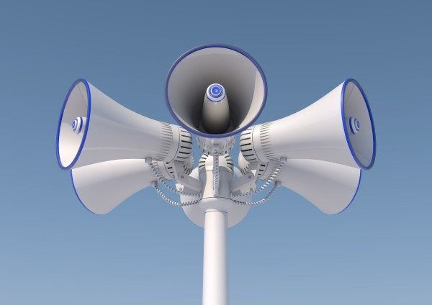
Multiple choice
3.Guess the word
_ _ _ _ _ _ _ _ _ _ _ (n)

Slide 49
Multiple choice
3.Guess the word
L o u d s p e a k e r (n)

Slide 50

LUCKY
GUY!

Slide 51
Multiple choice
5._Choose word with the closest meaning to "credible"
A. Susceptible
B. Congenital
C. Reliable
D. Unconvincing

Slide 52


Multiple choice
6.Some singers are ______ popular that their tours sell out in minutes.
A. very
B. too
C. such
D. so

Slide 53



Thank you for playing

