Slide 2
Unit 7
The world of mass media
LESSON 8
LOOKING BACK AND PROJECT

Slide 3
WARM-UP
WARM-UP
What did you learn in Unit 7?
1. Pronunciation
2. Vocabulary
3. Grammar

Slide 4


LOOKING BACK
1. Pronunciation
Work in pairs and mark ( ) the places where the link /r/ can appear. Listen and check. Then practice saying the sentences.
1. Peter and I are discussing the news in the local press.
2. There is a huge poster on the wall advertising the public event.
3. The village is far away in the mountains, but the villagers have a fast Internet connection.
4. The singer is the focus of media attention.

Slide 5
LOOKING BACK
2. Vocabulary
Solve the crossword with the words you’ve learnt in this unit. What is the hidden word?
1. Broadcast TV, radio, and printed newspapers are typical examples of traditional mass ______.
2. We should only use information which comes from ______ sources.
3. The press report has strong ______ in favour of male consumers.
4. The Internet makes information easily ______ to everyone using a computer or a smart device.

Slide 6
LOOKING BACK
2. Vocabulary
Solve the crossword with the words you’ve learnt in this unit.
What is the hidden word?
 |  |  |  |  | 1 | M | E | D | I | A
 | 2 | R | E | L | I | A | B | L | E
 |  | 3 | B | I | A | S
4 | A | C | C | E | S | S | I | B | L | E

Slide 7
LOOKING BACK
3. Grammar
Circle the mistake in each sentence. Then correct it.
1. The Internet has become so a convenient tool that people can’t A B C live without it. D
2. My sister has never been to Mexico, but she writes a blog A about it on the Internet as like she had spent a lot of time there.
B C D
→ such
→ if

Slide 8
LOOKING BACK
3. Grammar
Circle the mistake in each sentence. Then correct it.
3. There are so many adverts in the local press so I get A B C D really annoyed.
4. Today it does not take much time for news to reach A people around the world as if it used to take in the past. B C D
→ that
→ as

Slide 9
PROJECT
The pros and cons of mass media
Work in groups. Choose two types of mass media you are interested in and compare them. Give a group presentation.
Use these questions as cues.
What are the mass media types?
How are they similar or different?
What are the advantages and disadvantages of each type?
Which of them do you think will be more popular in the future? Why?

Slide 10

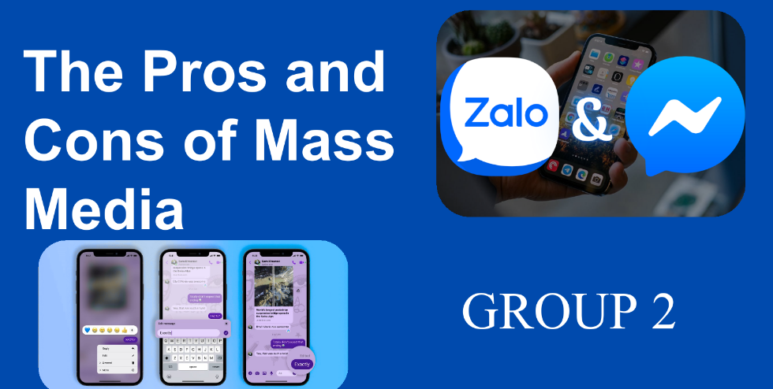
PROJECT
The pros and cons of mass media

Slide 11
CONSOLIDATION
1
Wrap-up
What have you learnt today?
Review the vocabulary and grammar of Unit 7;
Apply vocabulary and grammar into practice through a project.

Slide 12
CONSOLIDATION
2
Homework
- Do exercises in the workbook.
- Prepare for the next lesson – Unit 8.

Slide 13
Website: hoclieu.vn
Fanpage: facebook.com/www.tienganhglobalsuccess.vn

