Slide 1
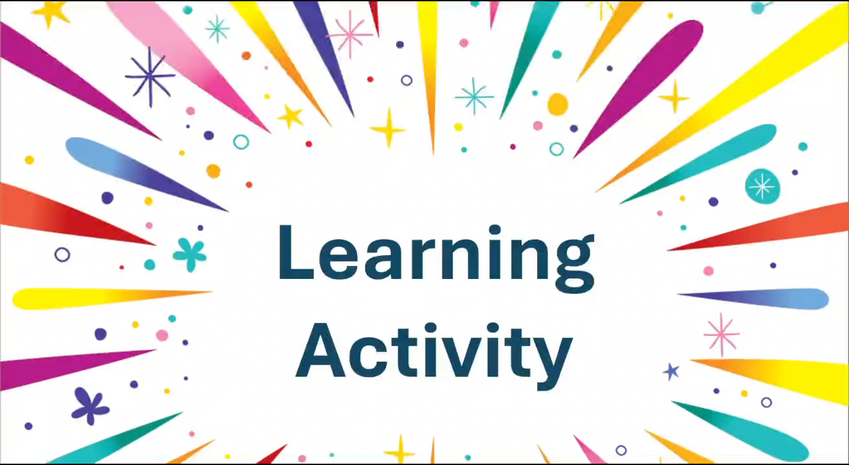

Slide 2


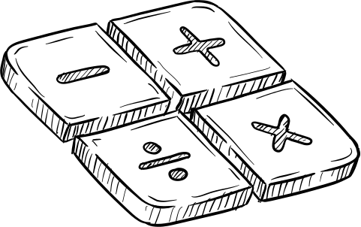
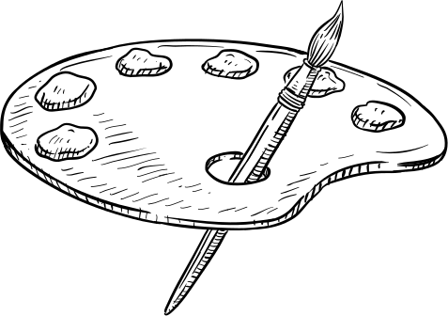



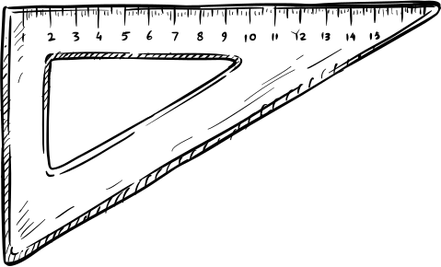
Unit 8: New ways to learn
Lesson: Getting started
(New learning activities)

Slide 3



1) Listen and read
Long: Hi, Nick. What are you doing?
Nick: I’m watching the video that my geography teacher uploaded on Eclass.
Long: Really? What is it about?
Nick: It’s about global warming. My teacher asked us to watch the video and find more information about this topic.
Long: So, is watching the video part of your homework?
Nick: Yes, then next week, we’ll work in groups and discuss the topic in class.
Long: Sounds interesting. You can watch the video many times and also search for more information at home.
Nick: You’re right. I’m not good at taking notes in class, you know. So I prefer this way of learning. It gives me a chance to discuss with my classmates, who may have original ideas on the topic.
Long: Does your teacher often ask you to prepare materials at home and discuss in class, Nick?
Nick: Yes, she does. We’re doing a lot of projects that help us understand the lessons better. This way of studying, which gives us more control over our own learning, is quite useful.
Long: You’re lucky. My teachers use very traditional methods of teaching at my schools. I wish I could try these new learning activities.

Slide 4
2) True or False
 | T | F
1. Nick is preparing for his next geography class.
2. Nick’s note taking skills are quite good.
3. Nick’s class is working on many projects now.

Slide 5
2) True or False
1. Nick is preparing for his next geography class.
T
Long: Hi, Nick. What are you doing?
Nick: I’m watching the video that my geography teacher uploaded on Eclass.
Long: Really? What is it about?
Nick: It’s about global warming. My teacher asked us to watch the video and find more information about this topic.
Long: So, is watching the video part of your homework?
Nick: Yes, then next week, we’ll work in groups and discuss the topic in class.
Long: Sounds interesting. You can watch the video many times and also search for more information at home.
Nick: You’re right. I’m not good at taking notes in class, you know. So I prefer this way of learning. It gives me a chance to discuss with my classmates, who may have original ideas on the topic.
Long: Does your teacher often ask you to prepare materials at home and discuss in class, Nick?
Nick: Yes, she does. We’re doing a lot of projects that help us understand the lessons better. This way of studying, which gives us more control over our own learning, is quite useful.
Long: You’re lucky. My teachers use very traditional methods of teaching at my schools. I wish I could try these new learning activities.

Slide 6
2) True or False
2. Nick’s note taking skills are quite good.
F
Long: Hi, Nick. What are you doing?
Nick: I’m watching the video that my geography teacher uploaded on Eclass.
Long: Really? What is it about?
Nick: It’s about global warming. My teacher asked us to watch the video and find more information about this topic.
Long: So, is watching the video part of your homework?
Nick: Yes, then next week, we’ll work in groups and discuss the topic in class.
Long: Sounds interesting. You can watch the video many times and also search for more information at home.
Nick: You’re right. I’m not good at taking notes in class, you know. So I prefer this way of learning. It gives me a chance to discuss with my classmates, who may have original ideas on the topic.
Long: Does your teacher often ask you to prepare materials at home and discuss in class, Nick?
Nick: Yes, she does. We’re doing a lot of projects that help us understand the lessons better. This way of studying, which gives us more control over our own learning, is quite useful.
Long: You’re lucky. My teachers use very traditional methods of teaching at my schools. I wish I could try these new learning activities.

Slide 7
2) True or False
3. Nick’s class is working on many projects now.
T
Long: Hi, Nick. What are you doing?
Nick: I’m watching the video that my geography teacher uploaded on Eclass.
Long: Really? What is it about?
Nick: It’s about global warming. My teacher asked us to watch the video and find more information about this topic.
Long: So, is watching the video part of your homework?
Nick: Yes, then next week, we’ll work in groups and discuss the topic in class.
Long: Sounds interesting. You can watch the video many times and also search for more information at home.
Nick: You’re right. I’m not good at taking notes in class, you know. So I prefer this way of learning. It gives me a chance to discuss with my classmates, who may have original ideas on the topic.
Long: Does your teacher often ask you to prepare materials at home and discuss in class, Nick?
Nick: Yes, she does. We’re doing a lot of projects that help us understand the lessons better. This way of studying, which gives us more control over our own learning, is quite useful.
Long: You’re lucky. My teachers use very traditional methods of teaching at my schools. I wish I could try these new learning activities.

Slide 8
3) Match the verbs with the nouns to make phrases in 1
Long: Hi, Nick. What are you doing?
Nick: I’m watching the video that my geography teacher uploaded on Eclass.
Long: Really? What is it about?
Nick: It’s about global warming. My teacher asked us to watch the video and find more information about this topic.
Long: So, is watching the video part of your homework?
Nick: Yes, then next week, we’ll work in groups and discuss the topic in class.
Long: Sounds interesting. You can watch the video many times and also search for more information at home.
Nick: You’re right. I’m not good at taking notes in class, you know. So I prefer this way of learning. It gives me a chance to discuss with my classmates, who may have original ideas on the topic.
Long: Does your teacher often ask you to prepare materials at home and discuss in class, Nick?
Nick: Yes, she does. We’re doing a lot of projects that help us understand the lessons better. This way of studying, which gives us more control over our own learning, is quite useful.
Long: You’re lucky. My teachers use very traditional methods of teaching at my schools. I wish I could try these new learning activities.
1. upload | notes
2. do | b. a video
3. find | c. a project
4. take | d. Information

Slide 9
4) Complete each of the following sentences with ONE word from the conversation
1. Nick is watching the video _______ his geography teacher uploaded on Eclass.
2. This way of learning gives him a chance to discuss with his classmates, _______ may have original ideas on the topic.
3. They are doing a lot of projects _______ help them understand the lessons better.
4. That way of studying, _______ gives them more control over their own learning, is quite useful
that
who
that
which

Slide 10
5) Talk about your favorite learning activity in 2 minutes
1. What is it called? (debate, presentation, experiment ...)
2. In what subject have you applied this learning activity?
3. What have you learnt from this activity? (teamwork, note-taking, confidence....)
Marking criteria:
Task achievement: answer all 3 questions above
Pronunciation
Fluency
Vocabulary: use words/phrases we have learnt today
Grammar

