Slide 1

Unit
8
1
FAMILY LFE
Unit
NEW WAYS TO LEARN
LESSON 3
READING

Slide 2
01
Warm-up
Guessing game

Slide 3
WARM-UP
Game rules
- 2 teams.
3 sets of pictures (3 pictures/set)
If one team:
+ gets the correct answer after the 1st picture ➔ 3 points
+ gets the correct answer after the 2nd picture ➔ 2 points
+ gets the correct answer after the 3rd picture ➔ 1 point
- The team with more points will be the winner.

Slide 4
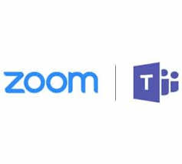
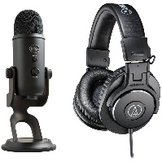

WARM-UP
Set 1
online learning

Slide 5



WARM-UP
Set 2
self-study

Slide 6
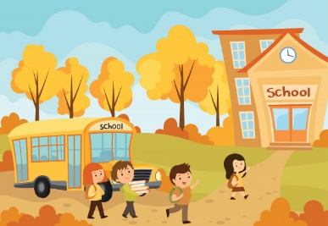
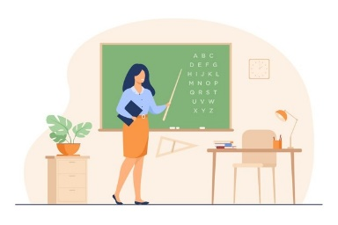
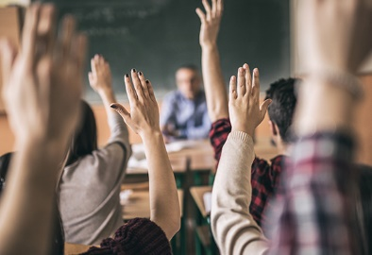
WARM-UP
Set 3
face-to-face learning

Slide 7
02
Pre-reading

Slide 8
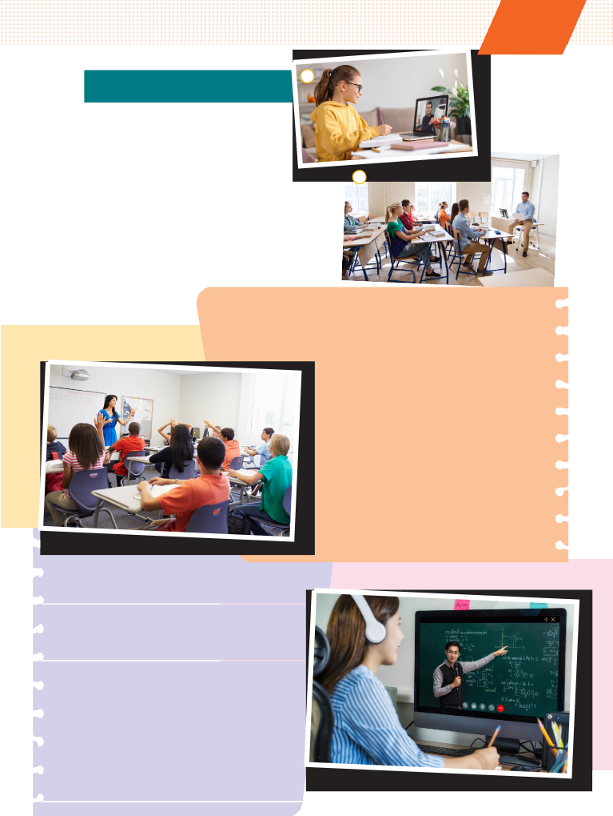
PRE-READING
1
Look at the photos and answer the questions.
a
b

Slide 9
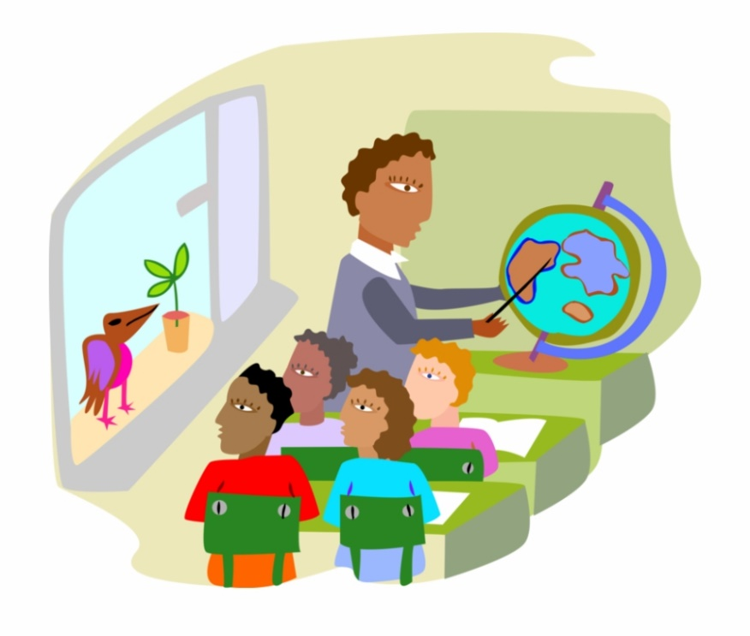

PRE-READING
distraction (n)
/dɪˈstrækʃən/
something that prevents someone from giving their attention to something else

Slide 10

PRE-READING
strategy (n)
/ˈstrætədʒi/
a way of doing something or dealing with something

Slide 11

PRE-READING
(to) exchange (v)
/ɪksˈtʃeɪndʒ/
to give something to someone and receive something from that person

Slide 12
PRE-READING
New words | Pronunciation | Meaning
distraction (n) | /dɪˈstrækʃən/ | something that prevents someone from giving their attention to something else
strategy (n) | /ˈstrætədʒi/ | a way of doing something or dealing with something
(to) exchange (v) | /ɪksˈtʃeɪndʒ/ | to give something to someone and receive something from that person

Slide 13
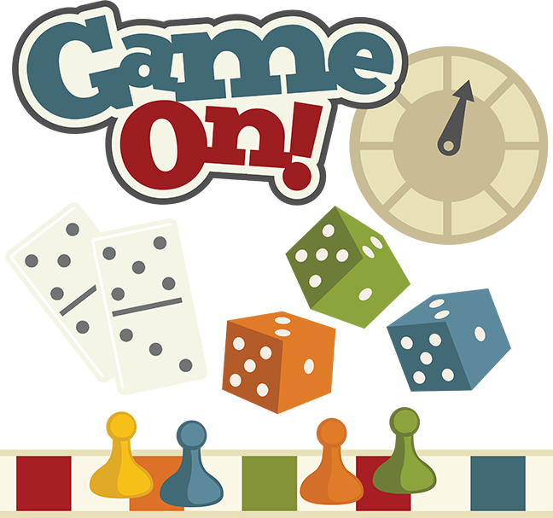

Slide 14
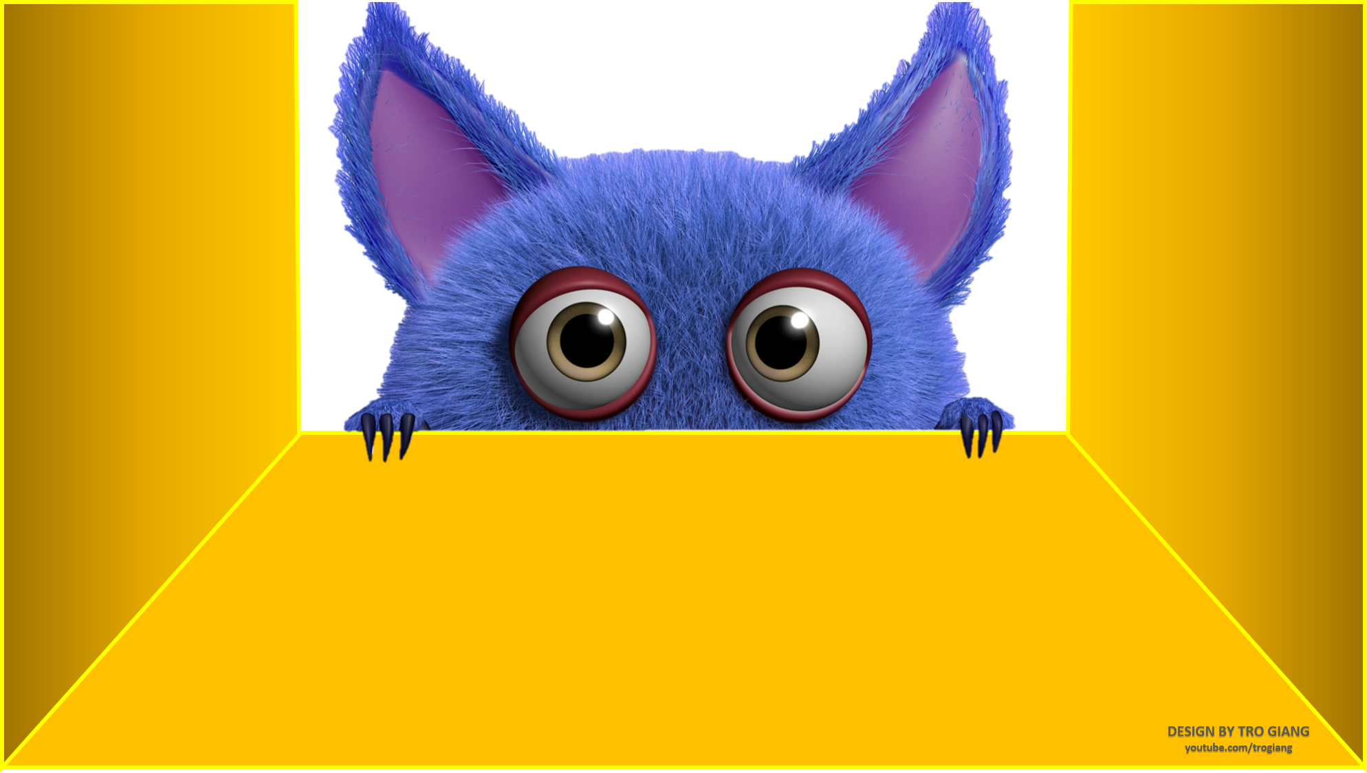
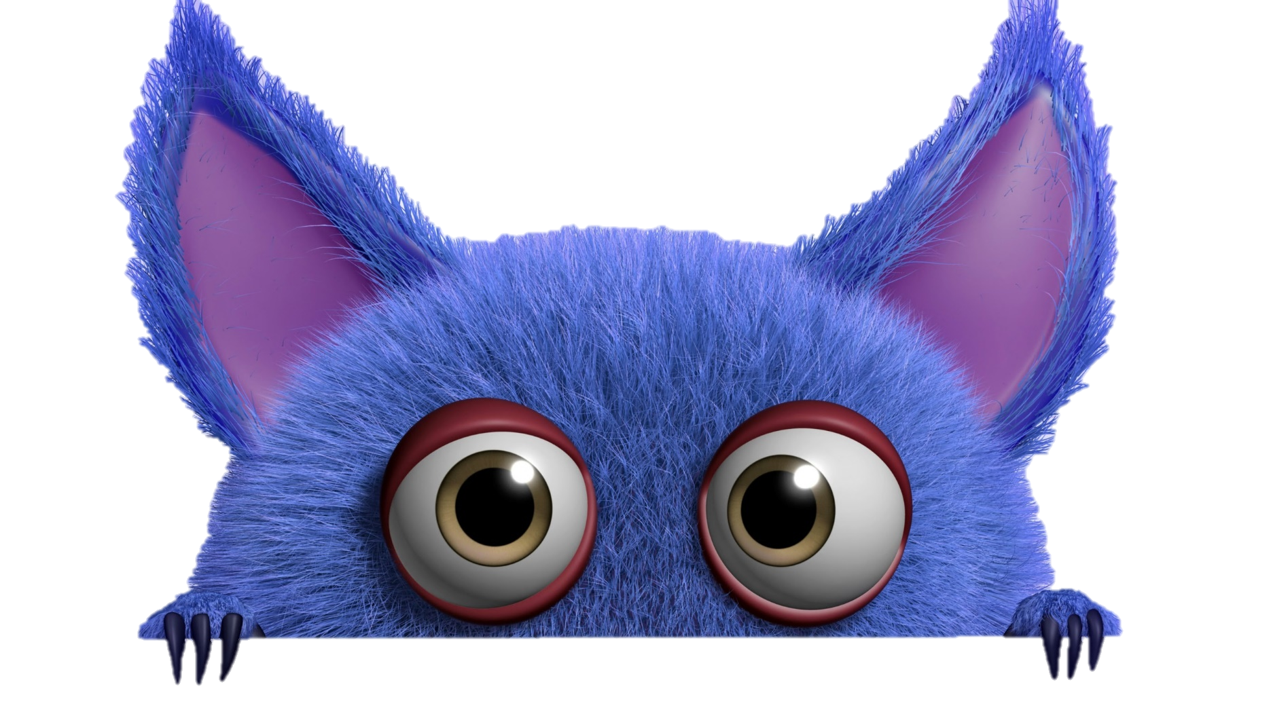
Gift box secret game

Slide 15













Slide 16









Question 1: It's traditional for the two teams to ________ shirts after the game (exchangeable).
exchange
You are given 3 points.
Back

Slide 17
You are given 10 points.
Back

Slide 18
Question 2: I find it hard to work at home because there are too many ________ (distract).
distractions
You are given 7 points.
Back

Slide 19
Question 3: ________ combines online materials with traditional classroom methods.
Blended learning
You are given 2 points.
Back

Slide 20
Question 4: We have a ________ for deciding who we pick (strategic).
strategy
You are given 8 points.
Back

Slide 21
03
While-reading

Slide 22
WHILE-READING
Fill in the blanks with suitable words or phrases to complete the steps of finding the main idea of a passage.
repetition identify first and last summarize
How to find the main idea of a passage?
- (1) _____________ the topic.
- (2) _____________ the passage in your own words.
- Check the (3) _________________ sentences.
- Look for (4) _______________ of ideas.
Identify
Summarize
first and last
repetition

Slide 23
WHILE-READING
Task 2. Read the texts. What are the two students talking about? Choose the correct answer.
Kim
A. Ways of helping students
B. Ways of learning
C. How to enjoy learning
I think face-to-face learning is better than online learning because I can communicate with teachers and other classmates immediately and directly when I have questions.
In class, I can work in groups and discuss with friends. This helps me understand the lessons better. When I have a problem, I can ask for answers or help immediately. I can’t do this in online classes. I have to email my teachers and wait for their reply. Learning in a traditional classroom also has fewer distractions than learning online. My teachers have many strategies to keep us focused on the lessons. I really enjoy my lessons and learn a lot.
Laura
I think online learning has more advantages than disadvantages. My school is trying to change from face-to-face to blended learning, so sometimes we have online classes. I don’t have to go to school, but I don’t feel I’m missing any lessons by taking online classes. Furthermore, I think I learn online as much as I learn in a traditional class. I can’t talk to my teacher and classmates, but I can email them at any time. I also have an online discussion board where I can exchange comments and ideas about my projects with my classmates. The only disadvantage is I really need to have a fast Internet connection.

Slide 24
WHILE-READING
Reorder the steps of reading for specific information:
1. Read the passage and scan for key words or synonyms/paraphrased expressions.
2. Compare and decide answers.
3. Underline key words in the questions.
4. Read the instructions.

Slide 25
WHILE-READING
WHILE-READING
Reorder the steps of reading for specific information:
Read the instructions.
Underline key words in the questions.
Read the passage and scan for key words or synonyms/paraphrased expressions.
Compare and decide answers.

Slide 26

WHILE-READING
3
Decide who mentions the following by putting a tick in the correct box.
This person ….
1. thinks that online learning isn’t as good as face-to-face learning.
2. gains the same knowledge in both ways of learning.
3. has more direct conversations and discussions.
4. uses emails to contact classmates
5. can pay more attention in class.
6. needs to have access to high-speed Internet.
Kim | Laura

Slide 27
WHILE-READING
Kim
1. This person thinks that online learning isn’t as good as face-to-face learning.
I think face-to-face learning is better than online learning because I can communicate with teachers and other classmates immediately and directly when I have questions.
In class, I can work in groups and discuss with friends. This helps me understand the lessons better. When I have a problem, I can ask for answers or help immediately. I can’t do this in online classes. I have to email my teachers and wait for their reply. Learning in a traditional classroom also has fewer distractions than learning online. My teachers have many strategies to keep us focused on the lessons. I really enjoy my lessons and learn a lot.
Laura
I think online learning has more advantages than disadvantages. My school is trying to change from face-to-face to blended learning, so sometimes we have online classes. I don’t have to go to school, but I don’t feel I’m missing any lessons by taking online classes. Furthermore, I think I learn online as much as I learn in a traditional class. I can’t talk to my teacher and classmates, but I can email them at any time. I also have an online discussion board where I can exchange comments and ideas about my projects with my classmates. The only disadvantage is I really need to have a fast Internet connection.

Slide 28
WHILE-READING
Kim
2. This person gains the same knowledge in both ways of learning.
I think face-to-face learning is better than online learning because I can communicate with teachers and other classmates immediately and directly when I have questions.
In class, I can work in groups and discuss with friends. This helps me understand the lessons better. When I have a problem, I can ask for answers or help immediately. I can’t do this in online classes. I have to email my teachers and wait for their reply. Learning in a traditional classroom also has fewer distractions than learning online. My teachers have many strategies to keep us focused on the lessons. I really enjoy my lessons and learn a lot.
Laura
I think online learning has more advantages than disadvantages. My school is trying to change from face-to-face to blended learning, so sometimes we have online classes. I don’t have to go to school, but I don’t feel I’m missing any lessons by taking online classes. Furthermore, I think I learn online as much as I learn in a traditional class. I can’t talk to my teacher and classmates, but I can email them at any time. I also have an online discussion board where I can exchange comments and ideas about my projects with my classmates. The only disadvantage is I really need to have a fast Internet connection.

Slide 29
WHILE-READING
Kim
3. This person has more direct conversations and discussions.
I think face-to-face learning is better than online learning because I can communicate with teachers and other classmates immediately and directly when I have questions.
In class, I can work in groups and discuss with friends. This helps me understand the lessons better. When I have a problem, I can ask for answers or help immediately. I can’t do this in online classes. I have to email my teachers and wait for their reply. Learning in a traditional classroom also has fewer distractions than learning online. My teachers have many strategies to keep us focused on the lessons. I really enjoy my lessons and learn a lot.
Laura
I think online learning has more advantages than disadvantages. My school is trying to change from face-to-face to blended learning, so sometimes we have online classes. I don’t have to go to school, but I don’t feel I’m missing any lessons by taking online classes. Furthermore, I think I learn online as much as I learn in a traditional class. I can’t talk to my teacher and classmates, but I can email them at any time. I also have an online discussion board where I can exchange comments and ideas about my projects with my classmates. The only disadvantage is I really need to have a fast Internet connection.

Slide 30
WHILE-READING
Kim
4. This person uses emails to contact classmates.
I think face-to-face learning is better than online learning because I can communicate with teachers and other classmates immediately and directly when I have questions.
In class, I can work in groups and discuss with friends. This helps me understand the lessons better. When I have a problem, I can ask for answers or help immediately. I can’t do this in online classes. I have to email my teachers and wait for their reply. Learning in a traditional classroom also has fewer distractions than learning online. My teachers have many strategies to keep us focused on the lessons. I really enjoy my lessons and learn a lot.
Laura
I think online learning has more advantages than disadvantages. My school is trying to change from face-to-face to blended learning, so sometimes we have online classes. I don’t have to go to school, but I don’t feel I’m missing any lessons by taking online classes. Furthermore, I think I learn online as much as I learn in a traditional class. I can’t talk to my teacher and classmates, but I can email them at any time. I also have an online discussion board where I can exchange comments and ideas about my projects with my classmates. The only disadvantage is I really need to have a fast Internet connection.

Slide 31
WHILE-READING
Kim
5. This person can pay more attention in class.
I think face-to-face learning is better than online learning because I can communicate with teachers and other classmates immediately and directly when I have questions.
In class, I can work in groups and discuss with friends. This helps me understand the lessons better. When I have a problem, I can ask for answers or help immediately. I can’t do this in online classes. I have to email my teachers and wait for their reply. Learning in a traditional classroom also has fewer distractions than learning online. My teachers have many strategies to keep us focused on the lessons. I really enjoy my lessons and learn a lot.
Laura
I think online learning has more advantages than disadvantages. My school is trying to change from face-to-face to blended learning, so sometimes we have online classes. I don’t have to go to school, but I don’t feel I’m missing any lessons by taking online classes. Furthermore, I think I learn online as much as I learn in a traditional class. I can’t talk to my teacher and classmates, but I can email them at any time. I also have an online discussion board where I can exchange comments and ideas about my projects with my classmates. The only disadvantage is I really need to have a fast Internet connection.

Slide 32
WHILE-READING
Kim
6. This person needs to have access to high-speed Internet.
I think face-to-face learning is better than online learning because I can communicate with teachers and other classmates immediately and directly when I have questions.
In class, I can work in groups and discuss with friends. This helps me understand the lessons better. When I have a problem, I can ask for answers or help immediately. I can’t do this in online classes. I have to email my teachers and wait for their reply. Learning in a traditional classroom also has fewer distractions than learning online. My teachers have many strategies to keep us focused on the lessons. I really enjoy my lessons and learn a lot.
Laura
I think online learning has more advantages than disadvantages. My school is trying to change from face-to-face to blended learning, so sometimes we have online classes. I don’t have to go to school, but I don’t feel I’m missing any lessons by taking online classes. Furthermore, I think I learn online as much as I learn in a traditional class. I can’t talk to my teacher and classmates, but I can email them at any time. I also have an online discussion board where I can exchange comments and ideas about my projects with my classmates. The only disadvantage is I really need to have a fast Internet connection.

Slide 33
04
Post-reading

Slide 34
POST-READING
Discussion
You are students who are taking part in a forum about educational innovations. The topic of the forum this year is: face-to-face learning or online learning? Raise your voice and express your personal viewpoint.

Slide 35
POST-READING
USEFUL EXPRESSIONS
Expressions to talk about advantages
Expressions to talk about disadvantages
- A positive aspect of …….
- A benefit of ……. is …..
- A good point about… is …
- An argument in favor of .. is …
- An advantage of … is …
- A negative aspect of…. is ……
- An argument against …. is …..
- A drawback of .… is ….
- A frequent criticism of … is …
- A downside of … is …

Slide 36
05
Consolidation

Slide 37
CONSOLIDATION
1
Wrap-up
1. Knowledge
Develop reading skills for general ideas and for specific information about types of learning
2. Core competence
Develop communication skills and creativity
Be collaborative and supportive in pair work and team work
Develop presentation skills
Actively join in class activities
3. Personal qualities
Understand more about advantages and disadvantages of online and face-to-face learning, therefore, students can make use of the strong points of each method
Develop self-study skills

Slide 38
CONSOLIDATION
2
Homework
Do exercises in the workbook
Prepare for the next lesson: Speaking

