Slide 1







Unit 7: The World of Mass Media
Writing

Slide 2


WARM - UP
Look at the picture and guess the mass media.

Slide 3

???

Slide 4
NEWSPAPER

Slide 5

???

Slide 6
CAMERA

Slide 7

???

Slide 8
INTERNET

Slide 9

???

Slide 10
TELEVISION

Slide 11

???

Slide 12
RADIO

Slide 13
VOCABULARY

Slide 14

Vocab 1
Guess the word with 4 letters

Slide 15


B
I
N
G
O
_ _ _ _
V
B
L
R
N
Q
S
I
K
B
A strong feeling in favour of or against a group of people
R
I
Z
A
E
R
M
O
Y
S
E
P
K
E
I

Slide 16



bias
B
I
N
G
O
V
B
L
R
N
/ˈbaɪəs/
Q
S
I
K
B
(n)
R
I
Z
A
E
"It's important to be aware of our own biases when making decisions."
R
M
O
Y
S
E
P
K
E
I

Slide 17
Vocab 2
Guess the word with 10 letters

Slide 18



C _ _ _ _ _ _ _ _ _

Slide 19
comparison
/kəmˈpærɪsn/
(n)
"Comparison with other oil-producing countries is extremely interesting”

Slide 20
Vocab 3
Guess the word with 9 letters

Slide 21



Hear the word and identify it. Tell me its meaning.
_ _ _ _ _ _ _ _ _

Slide 22



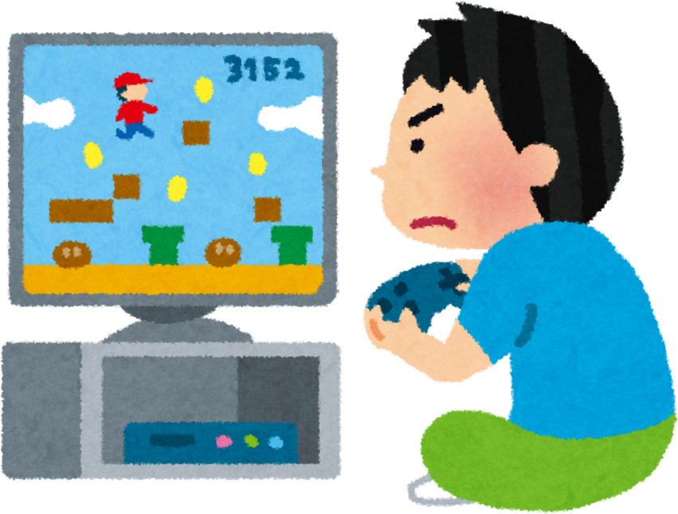
meanwhile
At 9 p.m
/ˈmiːnwaɪl/
(adv)
“Nam's studying for her exam. Meanwhile, Huy is playing video games.”
Nam
Huy

Slide 23
Vocab 4
Guess the phrasal verb with 11 letters

Slide 24



Synonyms
_ _ _ _ _ _ _ _ _ _ _
instead of, rather than, ...
Example
I prefer to work in a quiet environment, _____ a noisy one.

Slide 25




as opposed to
/əz əˈpəʊzd tə/
(ph.v)
“I prefer to work in a quiet environment, as opposed to a noisy one.”

Slide 26
Vocab 5
Guess the phrasal verb with 6 letters

Slide 27






Rearrange the letters to make a correct phrase.
_ _ _ _ _ _

Slide 28
Rearrange the letters to make a correct phrase.
turn to

Slide 29

turn to
/tɜːn tə/
(ph.v)
“When I'm in trouble, I always turn to my best friend for advice. “

Slide 30
Word | Type | Pronunciation | Meaning
bias | (n) | /ˈbaɪəs/ | Thành kiến
comparison | (n) | /kəmˈpærɪsn/ | Sự so sánh
meanwhile | (adv) | /ˈmiːnwaɪl/ | Trong khi đó
as opposed to | (ph.v) | /əz əˈpəʊzd tə/ | Trái ngược với, thay vì, so với
turn to | (ph.v) | /tɜːn tə/ | Tìm đến ai đó hoặc cái gì đó để được giúp đỡ, tư vấn

Slide 31
EXERCISE 1
Study the pie charts on page 96 and choose the correct answer A or B.

Slide 32
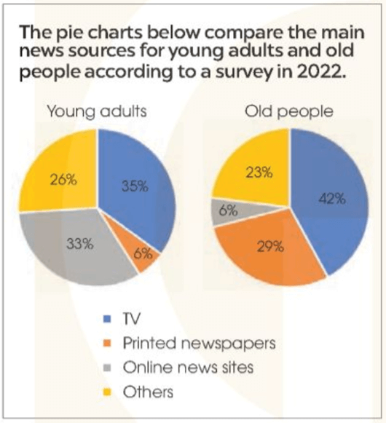

Slide 33
1, In general, which news source was very popular with both age groups?
A
Television
B
Printed newspapers.

Slide 34
1, In general, which news source was very popular with both age groups?
A
Television
B
Printed newspapers.

Slide 35
2, Which news source was least popular among young adults?
A
Printed newspapers.
B
Online news sites.

Slide 36
2, Which news source was least popular among young adults?
A
Printed newspapers.
B
Online news sites.

Slide 37
3, Which news source was least popular among old people?
A
Printed newspapers.
B
Online news sites.

Slide 38
3, Which news source was least popular among old people?
A
Printed newspapers.
B
Online news sites.

Slide 39
4, Printed newspapers were old people's ___ choice of news source.
A
Top
B
Second

Slide 40
4, Printed newspapers were old people's ___ choice of news source.
A
Top
B
Second

Slide 41
5, Other sources of news were chosen by around __ of the people in both age groups.
A
A quarter
B
Half

Slide 42
5, Other sources of news were chosen by around __ of the people in both age groups.
A
A quarter
B
Half

Slide 43
EXERCISE 2
Complete the following descriptions of the charts in 1. Use the words and phrases in the box.

Slide 45
as opposed to meanwhile while most popular
The pie charts compare the main news sources for young adults and old people according to a survey in 2022.
Overall, television was the (1)......... source of news for both age groups. It was chosen by 42 per cent of old people, and more than one third of young adults. (2)........., more young adults turned to the Internet for news. The figure was 33 per cent for young adults (3)........... just 6 per cent for old people. By contrast, printed newspapers were the second choice of news source for old people with 29 per cent (4)........... only 6 per cent of young adults reported getting their news from printed newspapers. In both age groups, around a quarter relied on other sources for news.

Slide 46
The pie charts compare the main news sources for young adults and old people according to a survey in 2022.
Overall, television was the most popular source of news for both age groups. It was chosen by 42 per cent of old people, and more than one third of young adults. Meanwhile, more young adults turned to the Internet for news. The figure was 33 per cent for young adults as opposed to just 6 per cent for old people. By contrast, printed newspapers were the second choice of news source for old people with 29 percent while only 6 per cent of young adults reported getting their news from printed newspapers. In both age groups, around a quarter relied on other sources for news.

Slide 47
TIPS
to describe pie charts, you should:

Slide 48
Tips
Introduce and decribe the most outstanding feature of the pie charts.
E.g. the pie charts show information about/ illustrate/compare ... Overall, ...
Ex: The pie charts compare the main news sources for young adults and old people according to a survey in 2022.
Overall, television was the most popular source of news for both age groups.

Slide 49
Tips
Make comparisons, using comparatives and superlatives
E.g. ... was more ... than .../ was the most
Ex: Overall, television was the most popular source of news for both age groups.

Slide 50
Tips
Compare data, using linking words at the beginning of the sentence, e.g. similarly, by contrast, meanwhile, at the beginning of a clause
E.g. while, whereas, or at the beginning of a noun phrase,
E.g. as compared with, as opposed to, both.
Ex: The figure was 33 per cent for young adults as opposed to just 6 per cent for old people.

Slide 51
EXERCISE 3
Write a description (120-150 words) of the charts below. Use the model and tips in 2 to help you.

Slide 52
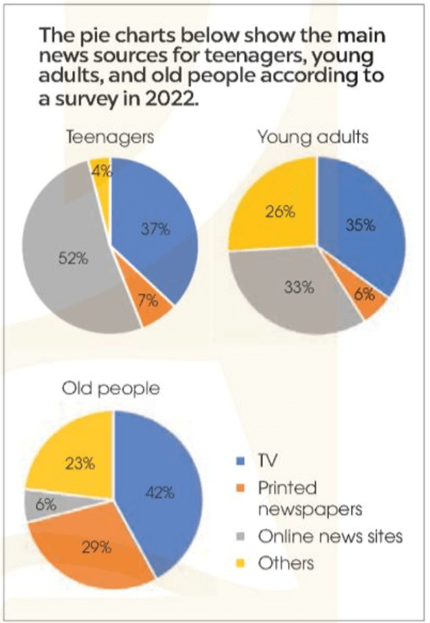
The pie charts below show the main news source for teenagers, young people and old people in 2022.

Slide 53
The pie charts compare the main news sources for teenagers, young adults and old people according to a survey in 2022.
Overall, television was a very popular source of news for all age groups. It was the top news source for old and young adults, chosen by 42 percent of old people and more than one third of young adults and teenagers. Meanwhile, online news sites were most chosen by teenagers, with more than 50 percent. By contrast, the Internet was the least common news source for old people, with just 6 percent. On the other hand, printed newspapers were the top news source for 29 percent of old people while only fewer than 10 percent of young adults and teenagers reported getting their news from them.
As for other sources of news, around a quarter of young adults and old people relied on other sources for news, as opposed to only 4 percent of teenagers.

Slide 54


Thank You

