Slide 1
Wildlife conservation
UNIT 8: WIFDLIFECONSERVATION
LESSON 5
LISTENING
Endangered species

Slide 2
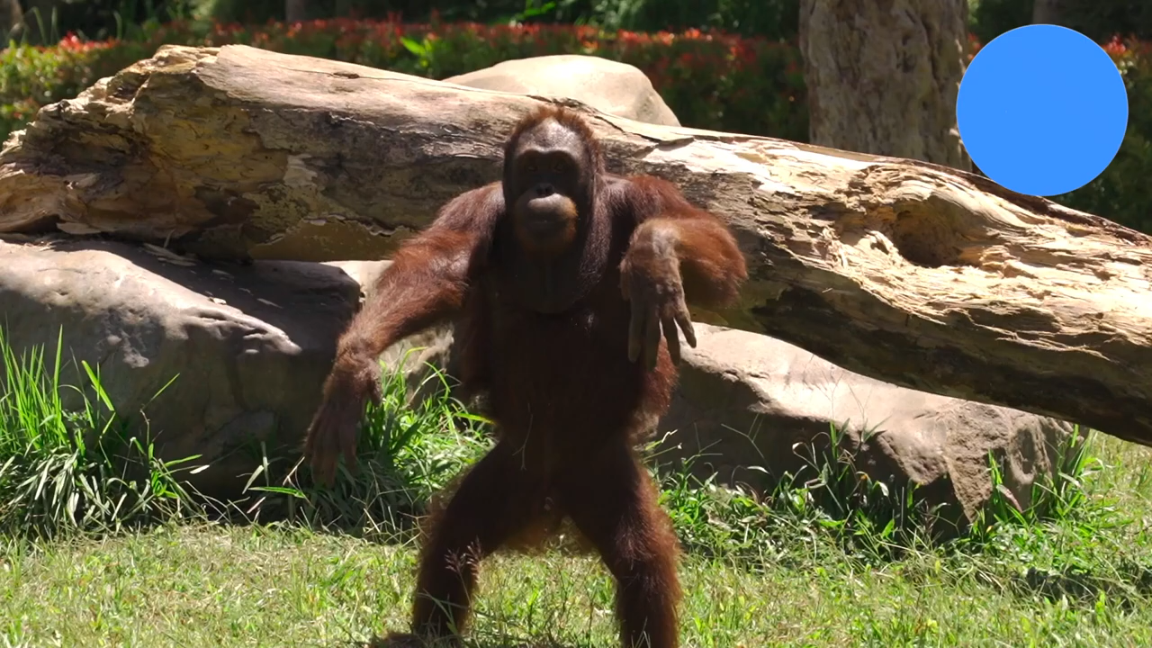
WARM-UP
Notes:
Link video: https://www.youtube.com/watch?v=F7ZvodUuXRE

Slide 3
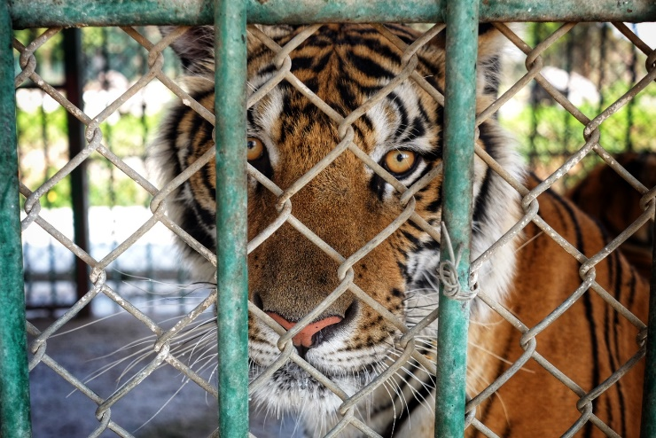
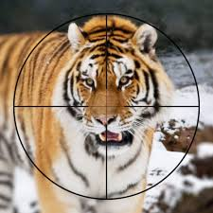
PRE-LISTENING
1
Look at the pictures and discuss the following questions.
What is happening to the tigers in the pictures? What can we do to protect the tigers?

Slide 4
PRE-LISTENING
2
Choose the correct meanings of the underlined words and phrases.
1. Natural habitats have been degraded by human activity.
A. made worse in quality
B. made endangered
2. Forest clearance to meet other land needs can destroy the natural habitats of many species.
A. removing broken trees
B. cutting down trees and other plants

Slide 5
PRE-LISTENING
2
Choose the correct meanings of the underlined words and phrases.
3. Reducing the demand for wild animal parts can help stop poaching.
A. the need or desire for particular goods
B. things that someone forces you to do
4. Animals bred in captivity would probably not survive if they were released into the wild.
A. born while being kept in special facilities
B. born while living in the forest

Slide 6

WHILE-LISTENING
3
Listen to a talk and choose the correct answer A, B, or C.
1. What is the talk mainly about?
A. Threats facing tigers.
B. Ways to protect tigers.
C. The world’s tiger population.

Slide 7
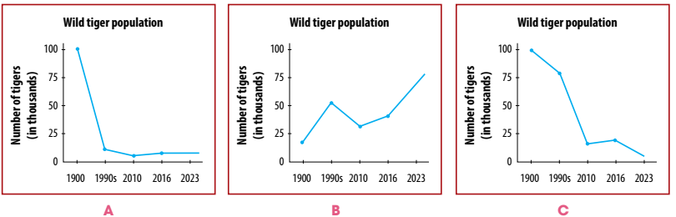
WHILE-LISTENING
3
Listen to a talk and choose the correct answer A, B, or C.
2. Which line graph shows the population of tigers over the past 100 years?

Slide 8
WHILE-LISTENING
3
Listen to a talk and choose the correct answer A, B, or C.
3. As their habitats become smaller, tigers _______.
A. look for food in forests B. enter farmers' houses C. attack farm animals
4. What have the tiger breeding farms led to?
A. The creation of conservation centres. B. An increase in poaching. C. A decrease in the use of tiger parts.

Slide 9

WHILE-LISTENING
4
Listen to the talk again and complete the notes.
TIGERS
Estimated population in 2023 | There were about (1) _________ wild tigers left in the world.
Threats facing tigers | Habitat loss: - Tigers’ habitats have been (2) ___________ or degraded by human activity. - Habitat loss forces tigers to (3) ___________ in small, unnatural environments.
4,500
destroyed
survive

Slide 10
WHILE-LISTENING
4
Listen to the talk again and complete the notes.
TIGERS
Threats facing tigers | Poaching and illegal trade in tiger parts: - Tigers were poached for their (4) __________ used to make fur coats and home decorations. - Tigers are also poached for their bones, teeth, and other body parts, which are used to make traditional (5) ____________.
skins
medicines

Slide 11
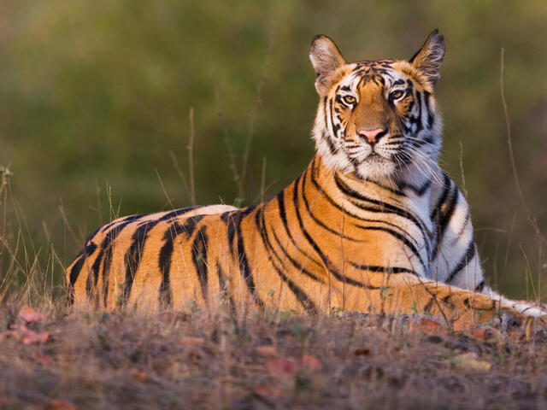
POST-LISTENING
5
Discuss the following questions.
Which threats are facing tigers in Viet Nam?
Which one is the most serious?

Slide 12
CONSOLIDATION
1
Wrap-up
What have you learnt today?
Some lexical items about endangered species
Listening for specific information and main idea

Slide 13
CONSOLIDATION
2
Homework
Do exercises in the workbook.
Practice listening and doing the exercises again

