Slide 1
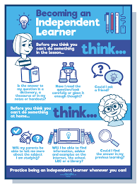
8
Unit
BECOMING INDEPENDENT
Lesson 5: LISTENING
Becoming independent learners

Slide 2
LESSON 5
LISTENING
WARM-UP
Reorder
PRE-LISTENING
Task 1. Tick the columns.
Task 2. Choose the correct answer.
Task 3. Answer the questions.
WHILE-LISTENING
POST-LISTENING
Discussion.
Wrap-up
Homework
CONSOLIDATION

Slide 3
WARM-UP
REORDER
1. Reward yourself at important milestones.
2. Learn through practical experience.
3. Teach yourself using many sources.
4. Compare your work with an expert's.
3-2-4-1

Slide 4
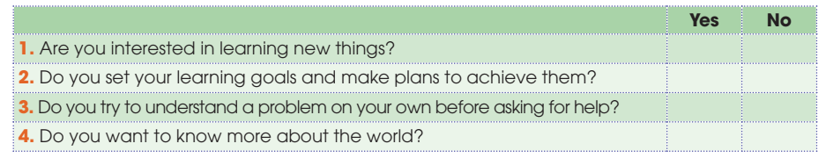
PRE-LISTENING
1
Tick the columns to complete the following table about you. Compare your answers in pairs.

Slide 5

WHILE-LISTENING
2
Listen to a conversation between Mai and Mike, and choose the correct answers A, B, or C.
1. What is the conversation mainly about?
A. What motivates independent learners.
B. Independent learners’ sense of responsibility.
C. What makes a successful independent learner.

Slide 6
WHILE-LISTENING
2
Listen to a conversation between Mai and Mike, and choose the correct answers A, B, or C.
2. What makes independent learners study hard?
A. Their motivation for learning.
B. Their learning goals.
C. The responsibility for their own learning.

Slide 7
WHILE-LISTENING
2
Listen to a conversation between Mai and Mike, and choose the correct answers A, B, or C.
3. What do independent learners do if the task they are working on is too difficult?
A. They give up and move on to something harder.
B. They make every effort to finish it.
C. They ask questions about it

Slide 8
WHILE-LISTENING
2
Listen to a conversation between Mai and Mike, and choose the correct answers A, B, or C.
4. Which of the following descriptions of
independent learners is NOT mentioned?
A. They’re self-motivated and responsible.
B. They’re confident and highly organised.
C. They’re curious about the world and they don’t give up.

Slide 9
WHILE-LISTENING
3
Listen to the conversation again and answer each of the following questions.
1. How many characteristics of independent learners does Mike find on the website?
2. What do independent learners take responsibility for?
3. What do they use to help them achieve their learning goals?
4. What are they not afraid of doing?
Four / 4
Their own learning
(Detailed) study plans
Asking difficult questions

Slide 10
POST-LISTENING
5
Work in groups. Discuss the following questions.
Which of the characteristics of independent learners do you think you have?
Which one do you want to develop in the future?

Slide 11

CONSOLIDATION

Slide 12
01
Wrap-up
What have you learnt today?
Characteristics of independent learners
Listening for main ideas and specific information

Slide 13
02
Homework
Do exercises in the workbook.
Prepare for the next lesson – Writing.

Slide 14


