Slide 1
WELCOME TO
NGUYEN DU NUMBER 1 HIGH SCHOOL

Slide 2



Unit 7:
Education options for school-leavers
Lesson 2: LANGUAGE

Slide 3
LESSON 2
LANGUAGE
WARM-UP
Solve the crossword
PRONUNCIATION
Task 1: Listen and repeat.
Task 2: Listen and mark the intonation.
Task 1: Match the words and phrases with their meanings.
Task 2: Complete the sentences.
VOCABULARY
Task 1: Find and correct the mistakes.
Task 2: Rewrite these sentences.
Task 3: Make sentences.
GRAMMAR
CONSOLIDATION
Wrap-up
Homework

Slide 4
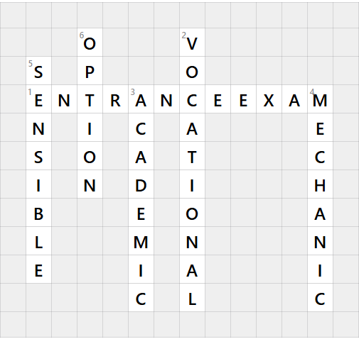
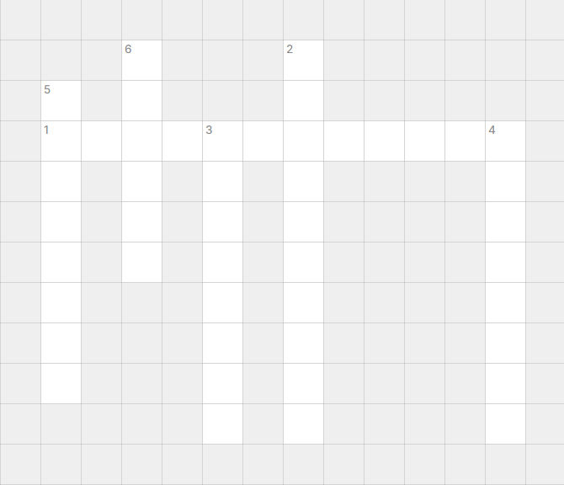

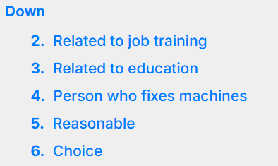
WARM - UP

Slide 5


PRONUNCIATION
1
Listen and repeat. Pay attention to the falling or rising intonation in each of the following questions.
1. Did anyone go?
2. Is academic education important nowadays?
3. What are your plans for the future?
4. When does the course start?

Slide 6
PRONUNCIATION
2
Listen and mark the intonation in these questions using or . Then practise saying them in pairs.
1. Do you want to go to university?
2. Have you talked with your parents about your plans?
3. How much does it cost to study at university?
4. What’s your favourite subject at school?

Slide 7
VOCABULARY
1
Match the words and phrases with their meanings.
1. school-leaver (n)
a. education at a college or university
2. vocational education (np)
b. the act of completing a university degree or a course of study
3. higher
education (n)
c. a person who has just left school
4. qualification (n)
d. education that prepares students for work in a specific trade
5. graduation (n)
e. an official record showing that you have finished a training course or have the necessary skills, etc.

Slide 8
PRESENTATION
VOCABULARY
1.
school-leaver
/ˈskuːl liːvə(r)/
(n)
học sinh đã tốt nghiệp
2.
vocational education
/vəʊˈkeɪʃənəlˌedʒuˈkeɪʃn/
giáo dục nghề nghiệp
(np)
3.
higher
education
/ˈhaɪə(r)ˌedʒuˈkeɪʃn/
(n)
giáo dục đại học
4.
qualification
/ˌkwɒlɪfɪˈkeɪʃn/
(n)
bằng cấp
5.
graduation
/ˌɡrædʒuˈeɪʃn/
(n)
tốt nghiệp

Slide 9
VOCABULARY
2
Complete the sentences using the correct forms of the words and phrases in 1.
1. Many parents nowadays want their children to pursue _______________ at universities after leaving school.
2. He didn’t get the job he wanted because he didn’t have the right _________________.
3. Many _________________ choose to go to university to study academic subjects.
higher education
qualifications
school-leavers

Slide 10
VOCABULARY
2
Complete the sentences using the correct forms of the words and phrases in 1.
4. More and more young people prefer ___________________ because they like to learn practical skills.
5. Many young people find it hard to get a job immediately after ____________.
vocational education
graduation

Slide 11
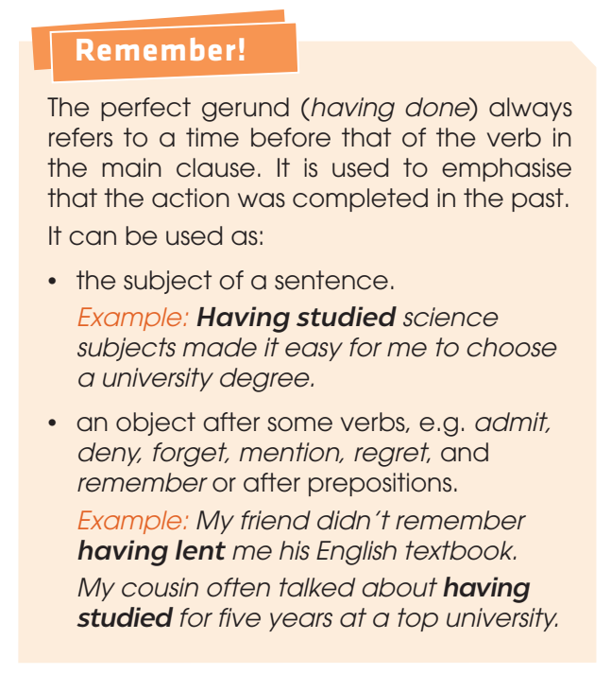
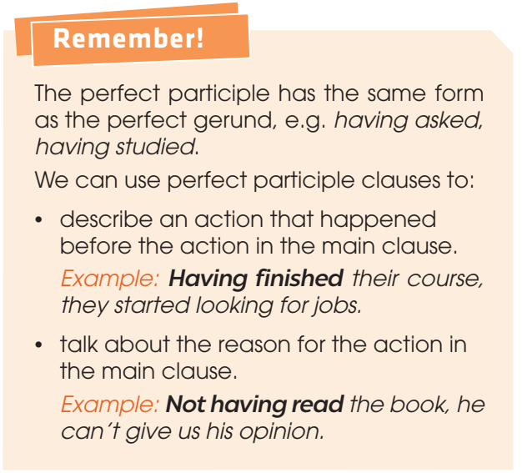
GRAMMAR
Perfect gerund
Perfect participle clauses

Slide 12
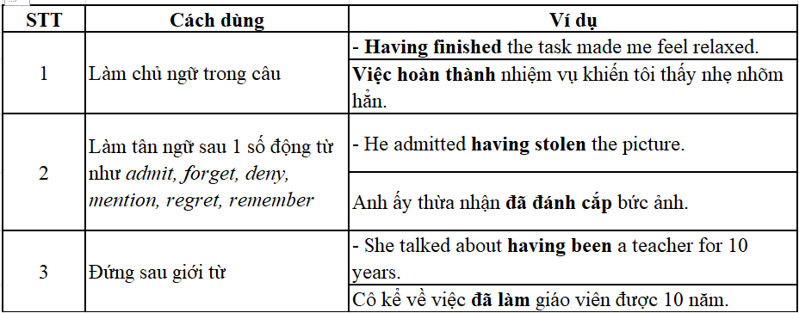
GRAMMAR
Perfect gerund (Danh động từ hoàn thành)
DĐTHT (Having + V3/ed) chỉ thời điểm trước khi động từ ở mệnh đề chính xảy ra. DĐTHT được dùng để nhấn mạnh rằng hành động đã kết thúc trong quá khứ.

Slide 13
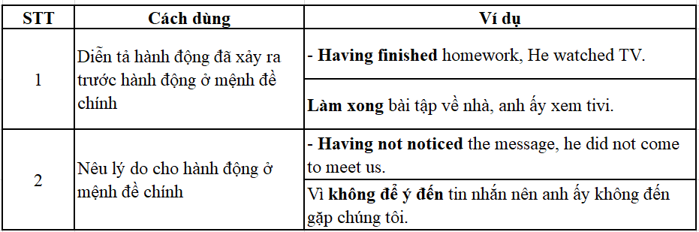
GRAMMAR
Perfect participle clauses (mệnh đề phân từ hoàn thành)
Phân từ hoàn thành có dạng giống với danh động từ hoàn thành (having + V3/ed)

Slide 14
GRAMMAR
1
Find and correct the mistakes in the following sentences.
1. I forgot have discussed this topic with you.
2. Had won many maths competitions helped me to win a place at university.
having
Having

Slide 15
GRAMMAR
1
Find and correct the mistakes in the following sentences.
3. Nam regretted not having choose a more interesting course at university.
4. He was proud of had won the first place in the biology competition.
chosen
having

Slide 16
GRAMMAR
2
Rewrite these sentences using perfect participle clauses.
1. After we listened to an introduction to the course, we asked some questions.
→ ___________________________________________, we asked some questions.
2. He failed the university entrance exams, then he decided to train to become a car mechanic.
→ ________________________________________, he decided to train to become a car mechanic.
Having listened to an introduction to the course
Having failed the university entrance exams

Slide 17
GRAMMAR
2
Rewrite these sentences using perfect participle clauses.
3. His brother had not studied hard enough, so he failed the exams.
→ _______________________, his brother failed the exams.
4. After I answered the job interview questions, I was asked to prepare a short presentation.
→ ________________________________________, I was asked to prepare a short presentation.
Not having studied hard enough
Having answered the job interview questions

Slide 18

GRAMMAR
3
Work in pairs. Make sentences, using perfect gerunds and perfect participle clauses.
Having finished school, I can apply to university.
Having completed the project gave us a feeling of satisfaction.

Slide 19
CONSOLIDATION
1
Wrap-up
What have you learnt today?
Some lexical items about education options after leaving school
Intonation in Wh- and Yes/ No questions
Perfect gerunds and perfect participle clauses

Slide 20
CONSOLIDATION
2
Homework
Do exercises in the workbook.
Prepare for Lesson 3 - Unit 7.

