Slide 1
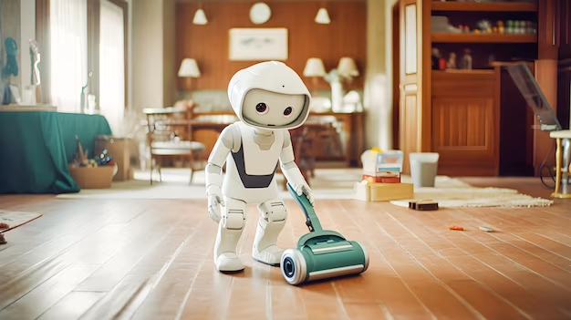


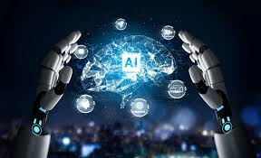
UNIT 6
ARTIFICIAL
INTELLIGENCE
WRITING

Slide 2




WARM UP
Let's work together on a short video about a home robot. What are some cool things you think it could do?

Slide 3

VIDEO
What are some cool things you think a home robot could do?

Slide 4


What are some cool things you think a home robot could do?
Sending alert to your phone
Automatic charging
Detecting unusual activities
Home
Carrying items
ROBOT
Home
monitoring
Fur-distance control
Calling with relatives
Interacting

Slide 5
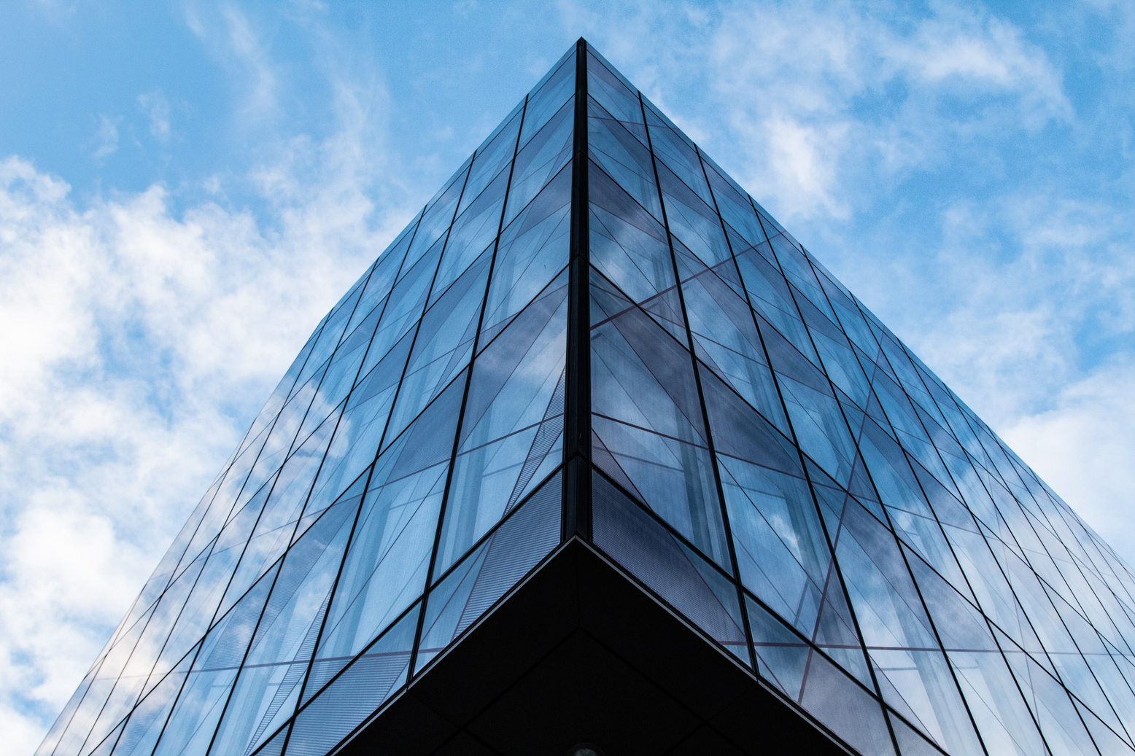
WRITING
VOCABULARY
ACTIVITY 1
ACTIVITY 2

Slide 6
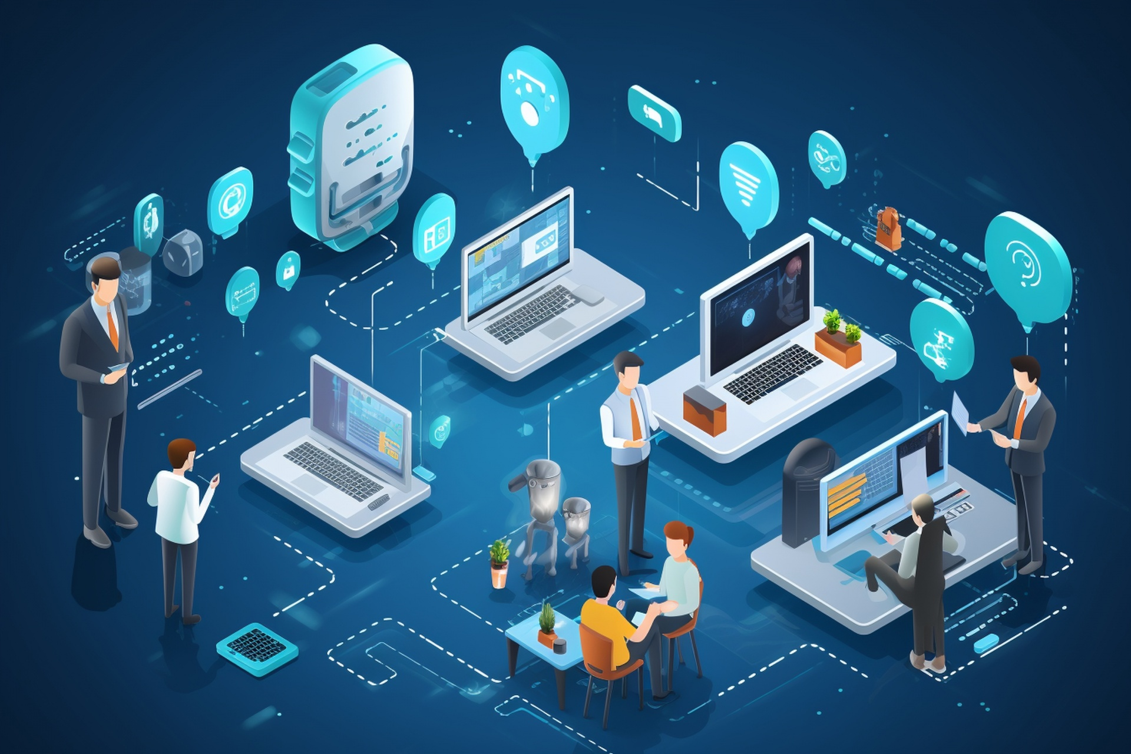
VOCABULARY

Slide 7
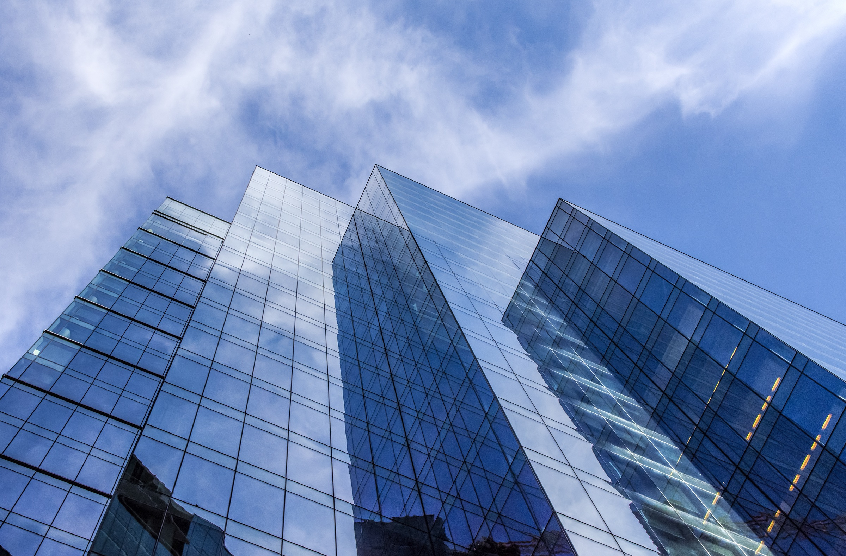

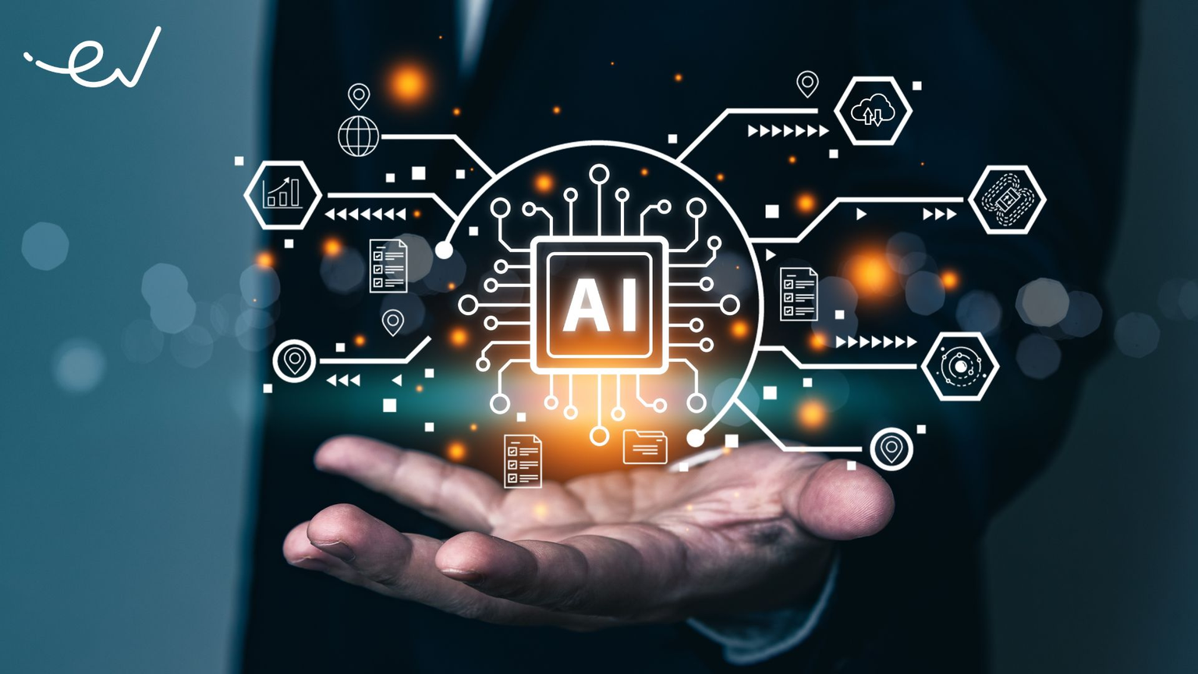
A__I____A_ I_T_______C_

Slide 8

ARTIFICIAL INTELLIGENCE (N)
/ˌɑː.tɪ.fɪʃ.əl ɪnˈtel.ɪ.dʒəns/
Computer technology that allows something to be done in a way that is similar to the way a human would do it

Slide 9
F__I__ R_____I___N
Technology that makes it possible for a computer to recognize a digital image of someone's face

Slide 10
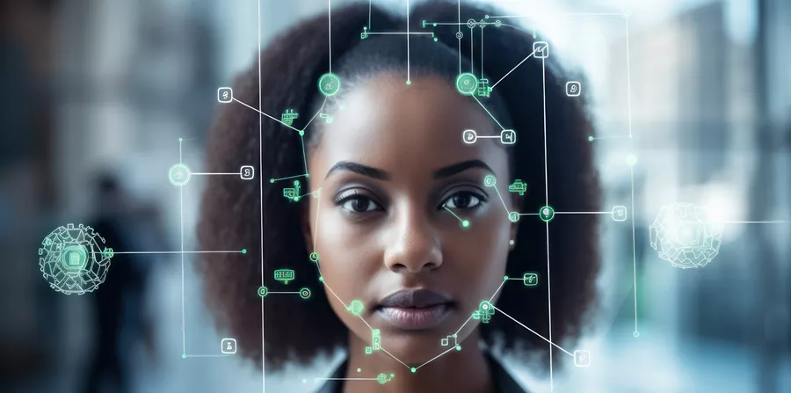
FACIAL RECOGNITION (N)
/ˌfeɪ.ʃəl rek.əɡˈnɪʃ.ən/
Technology that makes it possible for a computer to recognize a digital image of someone's face

Slide 11
With its ............. appearance and ability to walk and talk, Sophia is considered the most advanced robot in the world.
A. human-like
B. human race

Slide 12
With its ............. appearance and ability to walk and talk, Sophia is considered the most advanced robot in the world.
A. human-like
B. human race

Slide 13
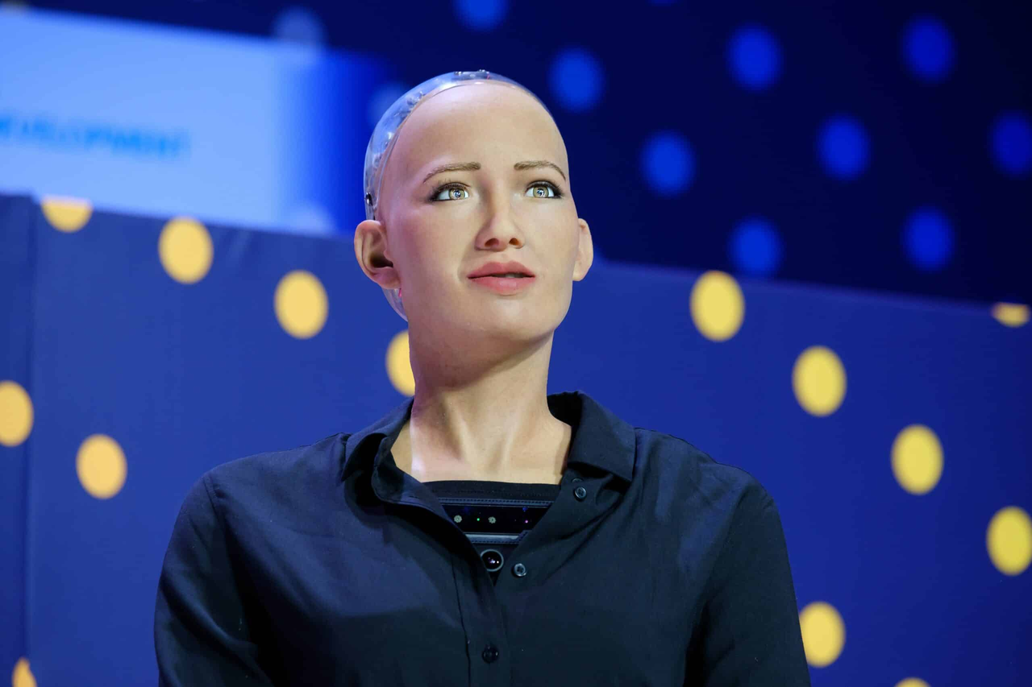
HUMAN-LIKE (A)
/ˌhjuː.mən laik/
To be very similar to a human in appearance, actions...

Slide 14
O/B/R/O/I/C/T
= mechanial
Relating to or like a robot

Slide 15
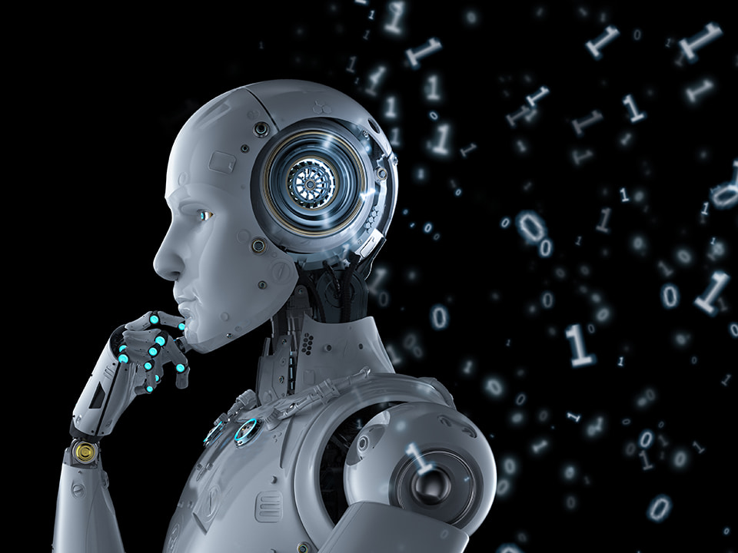
ROBOTIC (A)
/rəʊˈbɒt.ɪk/
Relating to or like a robot

Slide 16
Ex 1: The process of template match is to search the template library and find the least distort template compared with the voice command.
Ex 2: Voice command devices are becoming more widely available, and innovative ways for using the human voice are always being created.

Slide 17
VOICE COMMAND (NP)
/vɔɪs kəˈmɑːnd/
To control something by voice

Slide 18
FORM | PRONUNCIATION | MEANING | VIETNAMESE
ArtIficial Intelligence (n) | /ˌɑː.tɪ.fɪʃ.əl ɪnˈtel.ɪ.dʒəns/ | Computer technology that allows something to be done in a way that is similar to the way a human would do it | Trí thông minh nhân tạo
Facial recognition (n) | /ˌfeɪ.ʃəl rek.əɡˈnɪʃ.ən/ | Technology that makes it possible for a computer to recognize a digital image of someone's face | Khả năng nhận diện khuôn mặt
Human-like (a) | /ˌhjuː.mən laik/ | To be very similar to a human in appearance, actions... | Giống con người
Robotic (a) | /rəʊˈbɒt.ɪk/ | Relating to or like a robot | Thuộc rô bốt
Voice command (np) | /vɔɪs kəˈmænd/ | To control something by voice | Ra lệnh bằng giọng nói

Slide 19

CHECKING VOCABULARY

Slide 20
Task: Read and match the vocabulary with the correct meaning
Artificial
Intelligence
Relating to or like a robot
Facial recognition
Technology that makes it possible for a computer to recognize a digital image of someone's face
Human-like
Computer technology that allows something to be done in a way that is similar to the way a human would do it
Robotic
To control something by voice
Voice command
To be very similar to a human in appearance, actions, etc

Slide 21
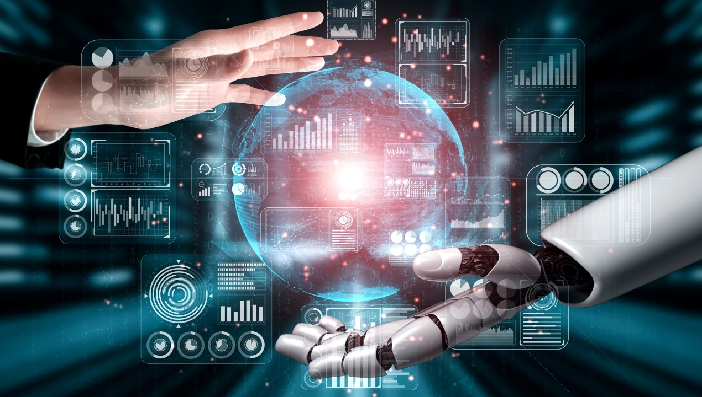
ACTIVITIES

Slide 22
ACT 1: WORK IN PAIRS. DECIDE WHETHER THE FOLLOWING IDEAS (A-D) ARE ADVANTAGES (+) OR DISADVANTAGES (-) OF HOME ROBOTS. THEN COMPLETE THE NOTES USING THE SENTENCES (A-D) IN THE BOX

Slide 23

Advantages/ Disadvantages | Ideas
 | People will have more time for leisure activities and family bonding. Robots can do repetitive and boring jobs. (1)__________________________________________
 | Humans can become dependent on AI technology. (2)___________________________________ They can become lazy.
 | Robots are expensive to develop and maintain. Robots need expensive spare parts. (3)________________________________
 | They can answer questions about many topics. (4)______________________________________ They can provide information and entertainment.
A. They may lose their critical thinking skills.
B. They can work without a break and provide 24/7 service.
C. They can interact and play games with people.
D. They need to be programmed to perform each task.

Slide 24
Advantages/ Disadvantages | Ideas
 | People will have more time for leisure activities and family bonding. Robots can do repetitive and boring jobs. (1)
 | Humans can become dependent on AI technology. (2) They can become lazy.
 | Robots are expensive to develop and maintain. Robots need expensive spare parts. (3)
 | They can answer questions about many topics. (4) They can provide information and entertainment.
+
A. They may lose their critical thinking skills.
B. They can work without a break and provide 24/7 service.
C. They can interact and play games with people.
D. They need to be programmed to perform each task.
B
-
A
-
D
+
C

Slide 25
ADVANTAGES
DISADVANTAGES
1.People will have more time for leisure activities and family bonding.
Robots can do repetitive and boring jobs.
They can work without a break and provide 24/7 service.
--------------------------------------------------
2.They can answer questions about many topics.
They can interact and play games with people.
They can provide information and entertainment.
1.Humans can become dependent on AI technology.
They may lose their critical thinking skills.
They can become lazy.
-----------------------------------------------------
2.Robots are expensive to develop and maintain.
Robots need expensive spare parts.
They need to be programmed to perform each task.

Slide 26

ACT 2: WRITE AN ESSAY (180-200 WORDS) ABOUT THE ADVANTAGES AND DISADVANTAGES OF HOME ROBOTS, USING THE IDEAS IN 1 AND THE SUGGESTED OUTLINE BELOW.
Introduction
People are beginning to use home robots.
They have advantages and disadvantages.
_______________________________________________________
Body
Advantages: Using home robots has several advantages.__________
Disadvantages:___________________________________________
Conclusion
Home robots may make lives easier and happier, but there are certain problems as well.

Slide 27
HOMEWORK
Rewrite the essay in the notebooks
Prepare for Lesson 7 – Communication & Culture.

Slide 28
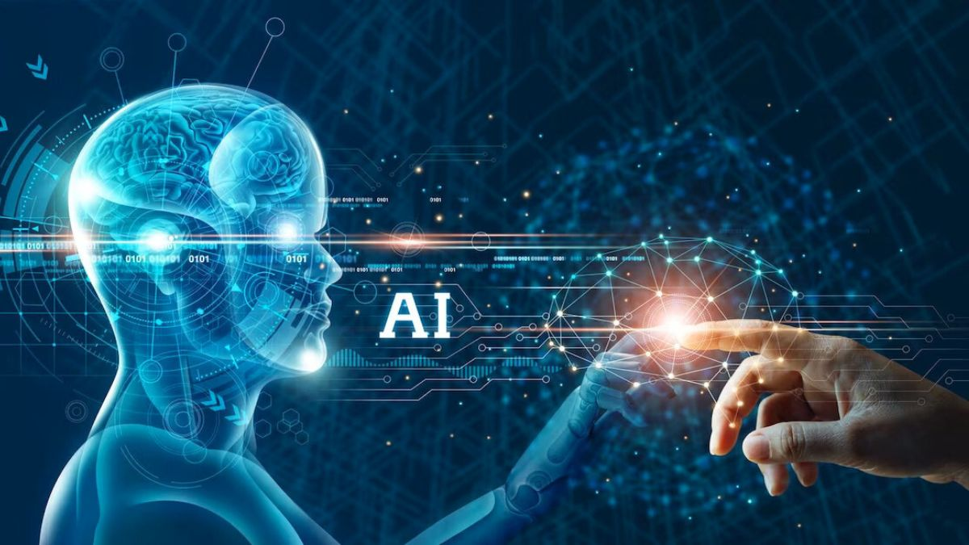
THANK YOU

