Slide 1
Unit
6
Preserving our heritage
Unit
FAMILY LIFE
LESSON I
GETTING STARTED
Heritage sites in Viet Nam

Slide 2
WARM-UP
NAME THE PLACES
- Ss work in 2 groups.
- Teacher shows pictures on the screen and Ss have to say BINGO to grasp the chance to answer where it is.
- One point for each correct answer.
- The group which gains most points is the winner of the game.

Slide 3
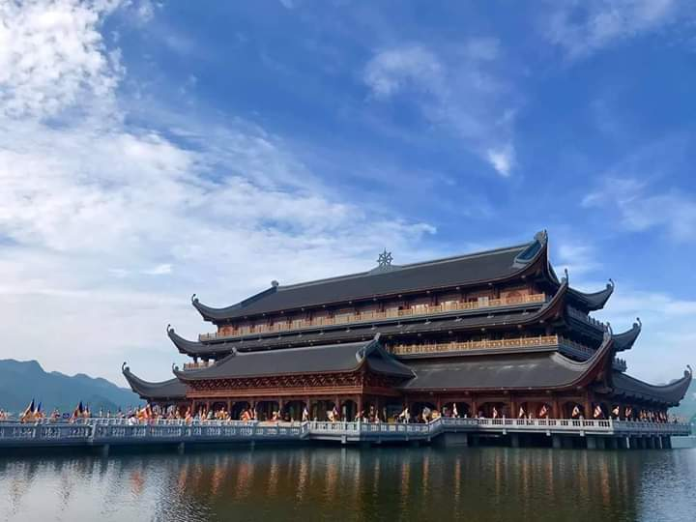
WARM-UP
Tam Chuc Pagoda

Slide 4
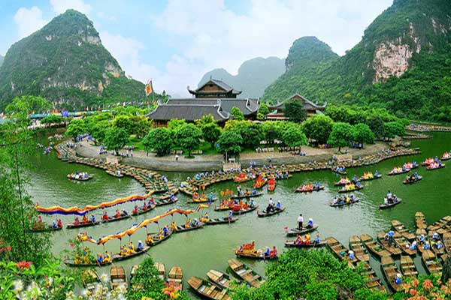
WARM-UP
Trang An Scenic Landscape Complex

Slide 5
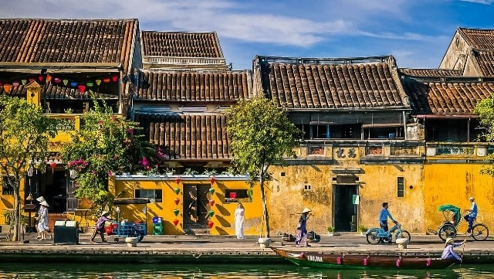
WARM-UP
Hoi An Ancient Town

Slide 6
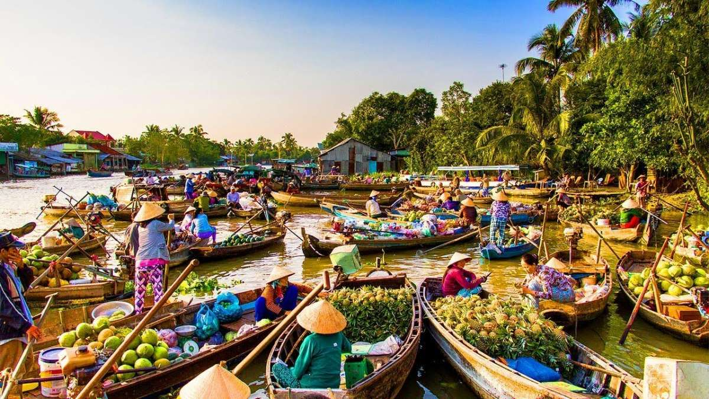
WARM-UP
Mekong River Delta

Slide 7
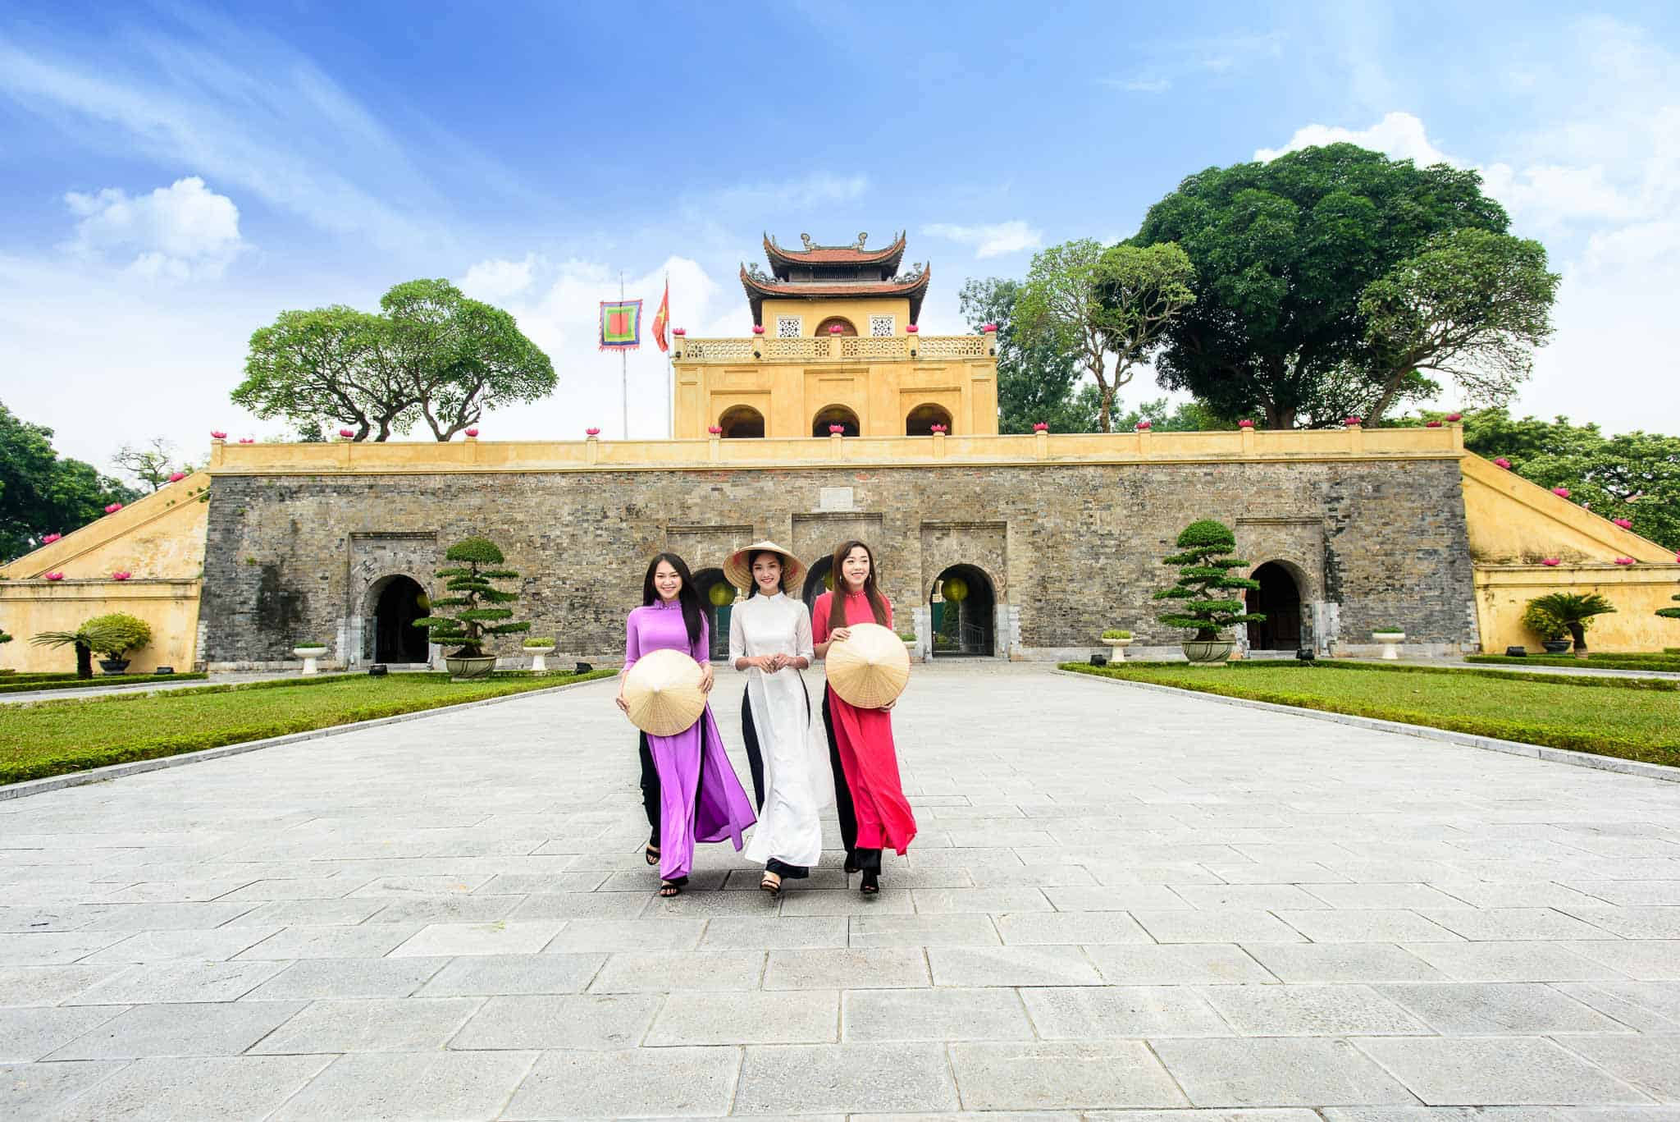
WARM-UP
Thang Long Imperial Citadel

Slide 8
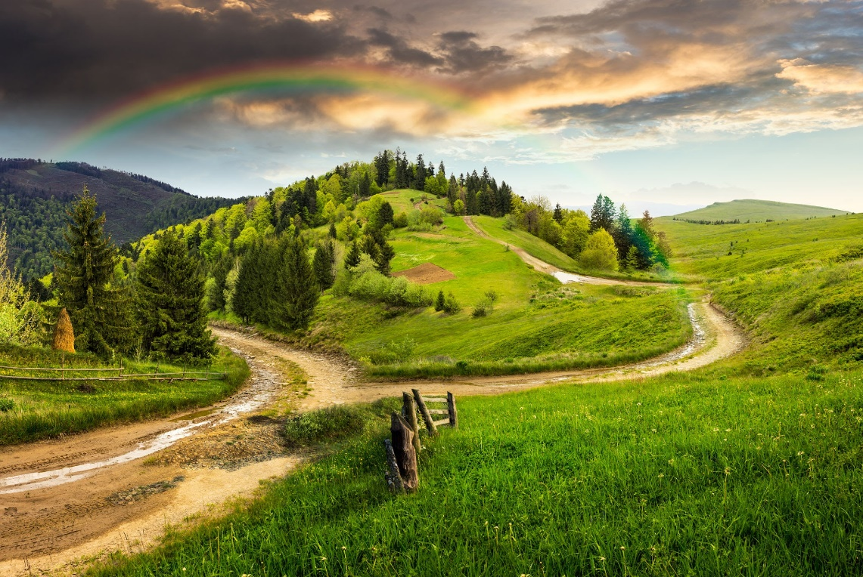

PRESENTATION
landscape (n)
/ˈlændskeɪp/
everything you can see when you look across a large area of land, especially in the country

Slide 9
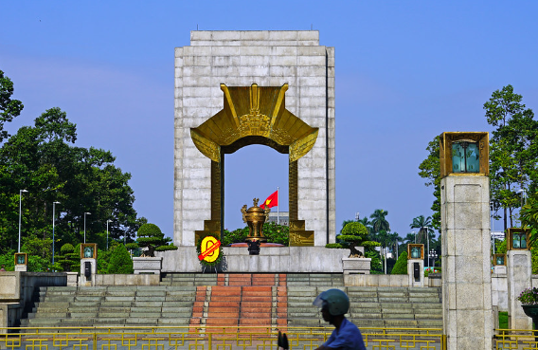
PRESENTATION
monument (n)
/ˈmɒnjumənt/
a building, column, statue, etc. built to remind people of a famous person or event

Slide 10
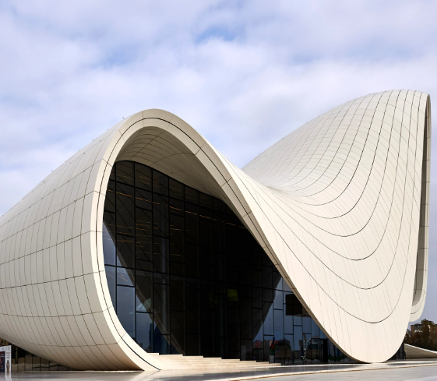
PRESENTATION
architecture (n)
/ˈɑːkɪtektʃə(r)/
the design or style of a building or buildings

Slide 11
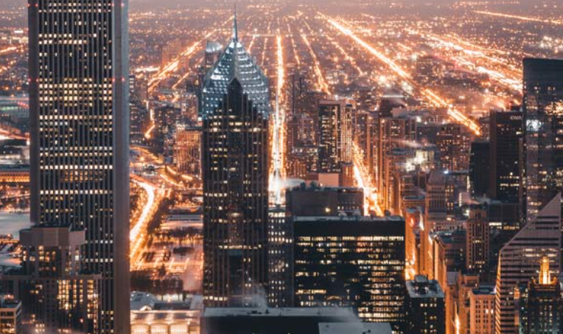
PRESENTATION
urban (adj)
/ˈɜːbən/
connected with a town or city

Slide 12

PRESENTATION
promote (v)
/prəˈməʊt/
to help something to happen or develop

Slide 13
Form | Pronunciation | Meaning | Vietnamese equivalent
1. landscape (n) | /ˈlændskeɪp/ | everything you can see when you look across a large area of land, especially in the country | phong cảnh
2. monument (n) | /ˈmɒnjumənt/ | a building, column, statue, etc. built to remind people of a famous person or event | công trình tưởng niệm
3. architecture (n) | /ˈɑːkɪtektʃə(r)/ | the design or style of a building or buildings | kiến trúc
4. urban (adj) | /ˈɜːbən/ | connected with a town or city | đô thị
5. promote (v) | /prəˈməʊt/ | to help something to happen or develop | đẩy mạnh, phát triển

Slide 14
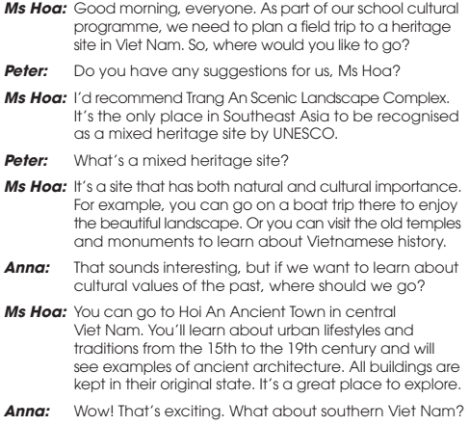
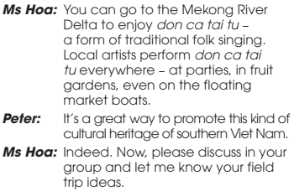
PRESENTATION
1
Listen and read.

Slide 15
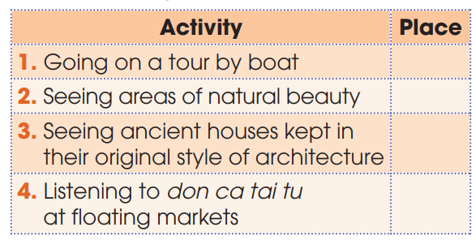
PRACTICE
2
Where can we do the following? Write T for Trang An, H for Hoi An and M for Mekong River Delta.
T
T
H
M

Slide 16
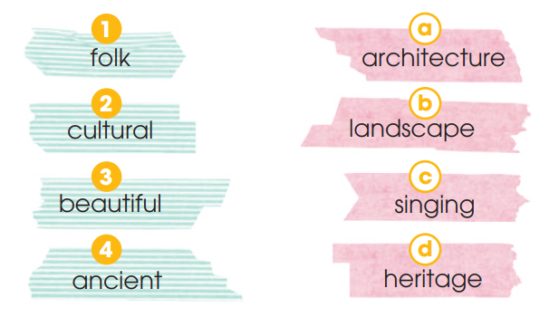
PRACTICE
3
Match the words to make phrases used in Task 1

Slide 17
PRACTICE
4
Complete the sentences, using phrases from Task 1.
1. Trang An is the only place in Southeast Asia __________________________________________. 2. You can go on a boat trip ____________________ . 3. You can visit the old temples and monuments ___________________________________________. 4. Performing folk songs at floating markets is a great way ___________________________________________.
to be recognized as a mixed heritage by UNESCO
to enjoy beautiful landscape
to learn about Vietnamese history
to promote this kind of cultural heritage of southern Viet Nam

Slide 18
PRACTICE
.
1. Trang An is the only place in Southeast Asia __________________________________________. 2. You can go on a boat trip ____________________ . 3. You can visit the old temples and monuments ___________________________________________. 4. Performing folk songs at floating markets is a great way ___________________________________________.
to be recognized as a mixed heritage by UNESCO
to enjoy beautiful landscape
to learn about Vietnamese history
to promote this kind of cultural heritage of southern Viet Nam

Slide 19
to be recognized
to enjoy
to learn
to promote
To infinitive clauses to express purpose

Slide 20
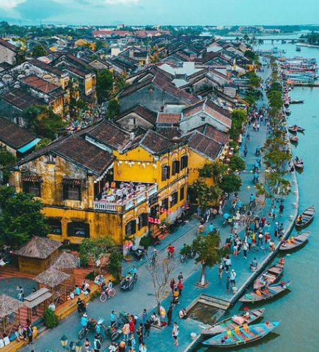
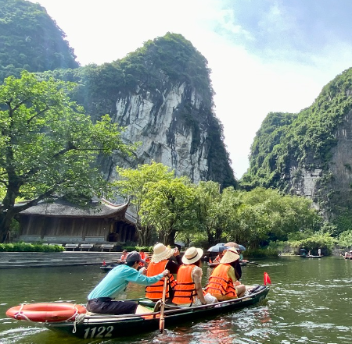
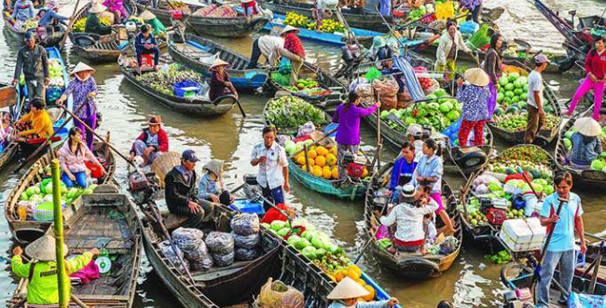
PRODUCTION
Role-play
- 3 groups: Each group will pretend to come from one place: Trang An (Ninh Binh), Hoi An (Quang Nam), Mekong River Delta.
- Each group prepares an introduction about your home land
- 3 minutes to prepare for the role-play.
- 2 minutes for a presentation.

Slide 21

Website: hoclieu.vn Fanpage: facebook.com/tienganhglobalsuccess.vn/
Website: hoclieu.vn
Fanpage: facebook.com/sachmem.vn/

