Slide 1






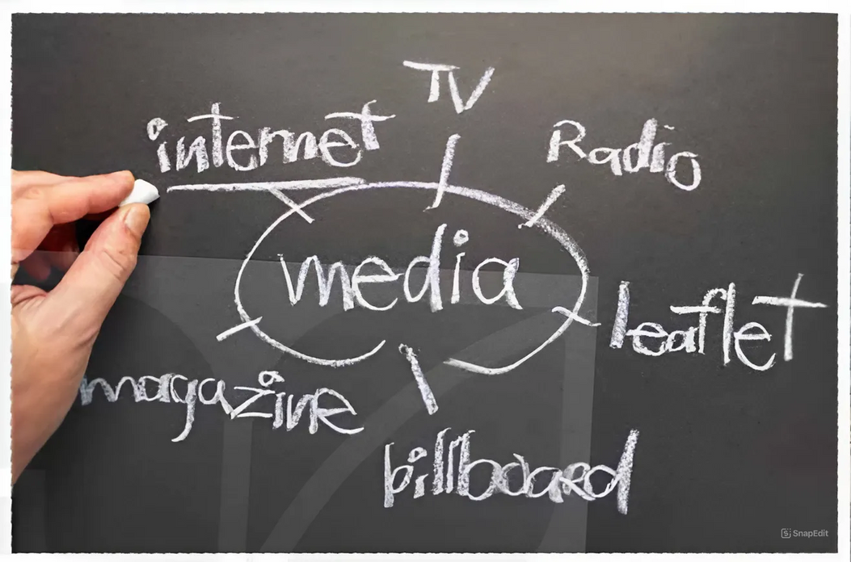
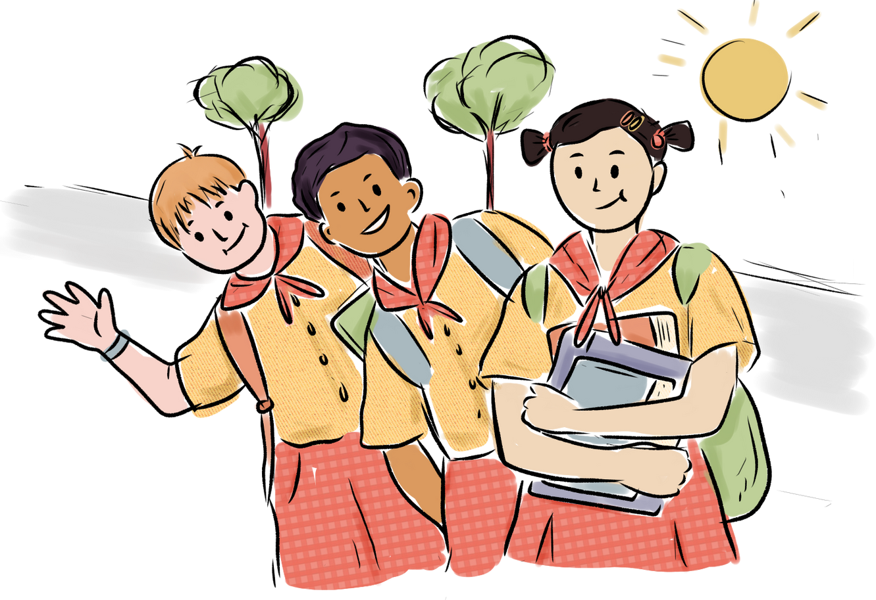


UNIT 7
THE WORLD OF MASS MEDIA
I.GETTING STARTED

Slide 2








warm-up
vocabulary
TEACHING
WHAT IS THIS?
PROGRESSION
excercise
wrap-up game

Slide 3





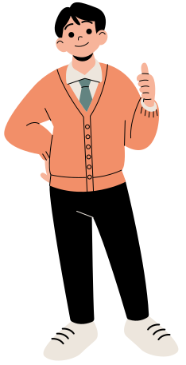
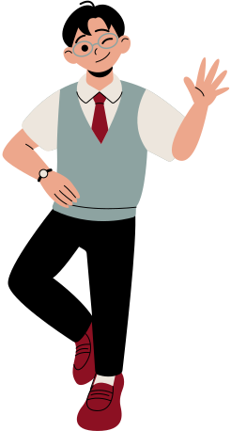







WARM-UP
WARM
UP
UNIT 7

Slide 4
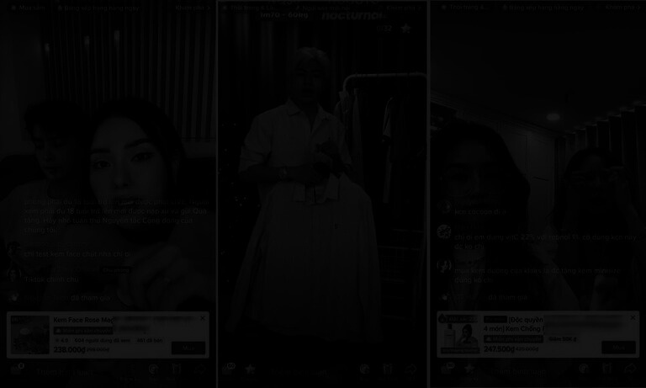
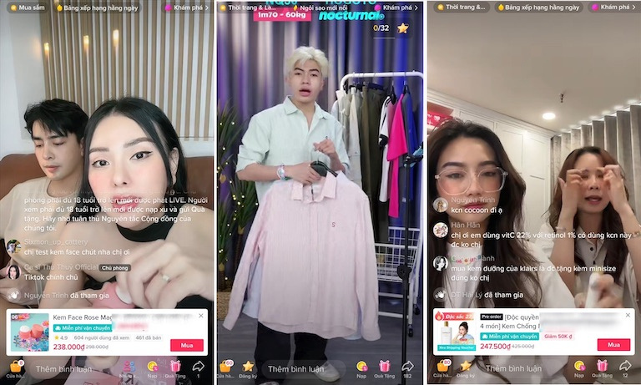



LEADING QUESTIONS
"WHAT DO YOU CALL THIS LIVE VIDEO SELLING ON TIKTOK?"

Slide 5








WARM-UP
LIVE STREAM

Slide 6
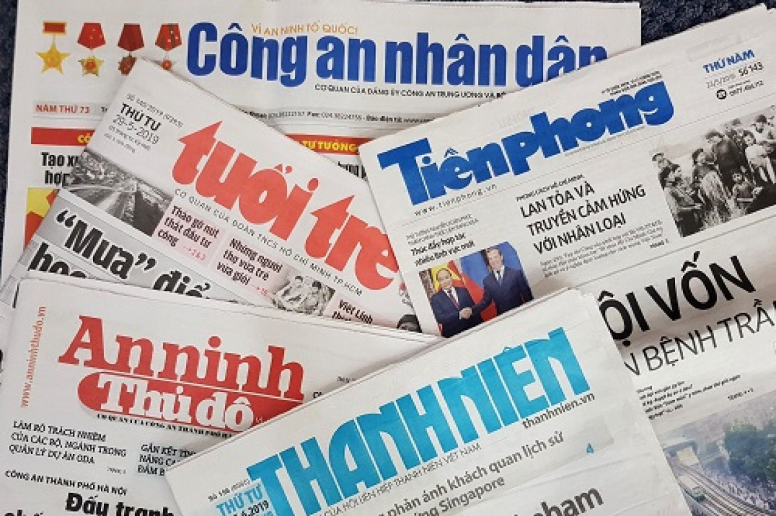


WARM-UP
"WHAT DO PEOPLE READ FOR NEWS LIKE THIS?"
WHAT IS THIS?

Slide 7
WARM-UP
NEWPAPERS

Slide 8
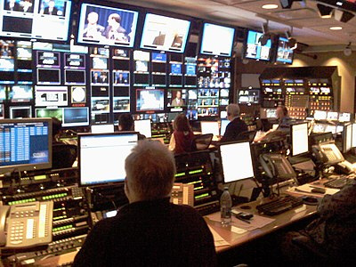
WARM-UP
"WHAT DO YOU CALL THIS WAY OF BROADCASTING PROGRAMS TO MANY PEOPLE?"
WHAT IS THIS?

Slide 9
WARM-UP
TELEVISON

Slide 10


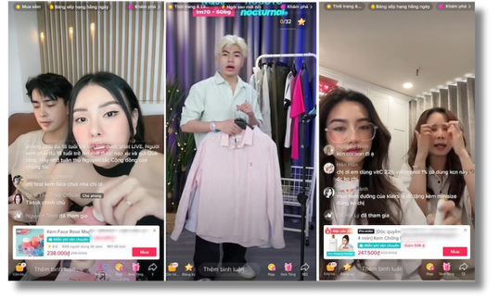
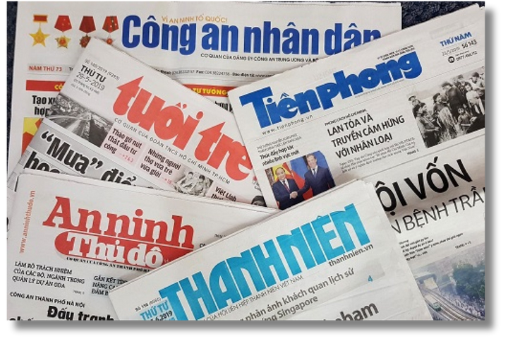
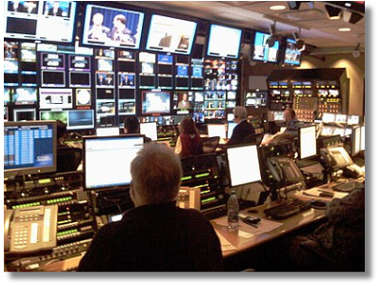





WARM-UP
WHAT DO WE CALL THE DIFFERENT TYPES OF MEDIA THAT REACH A MASS AUDIENCE, SUCH AS TV, NEWSPAPERS, AND LIVE STREAMS

Slide 11




WARM-UP
WARNER & SPENCER
MARCH 2023

Slide 12




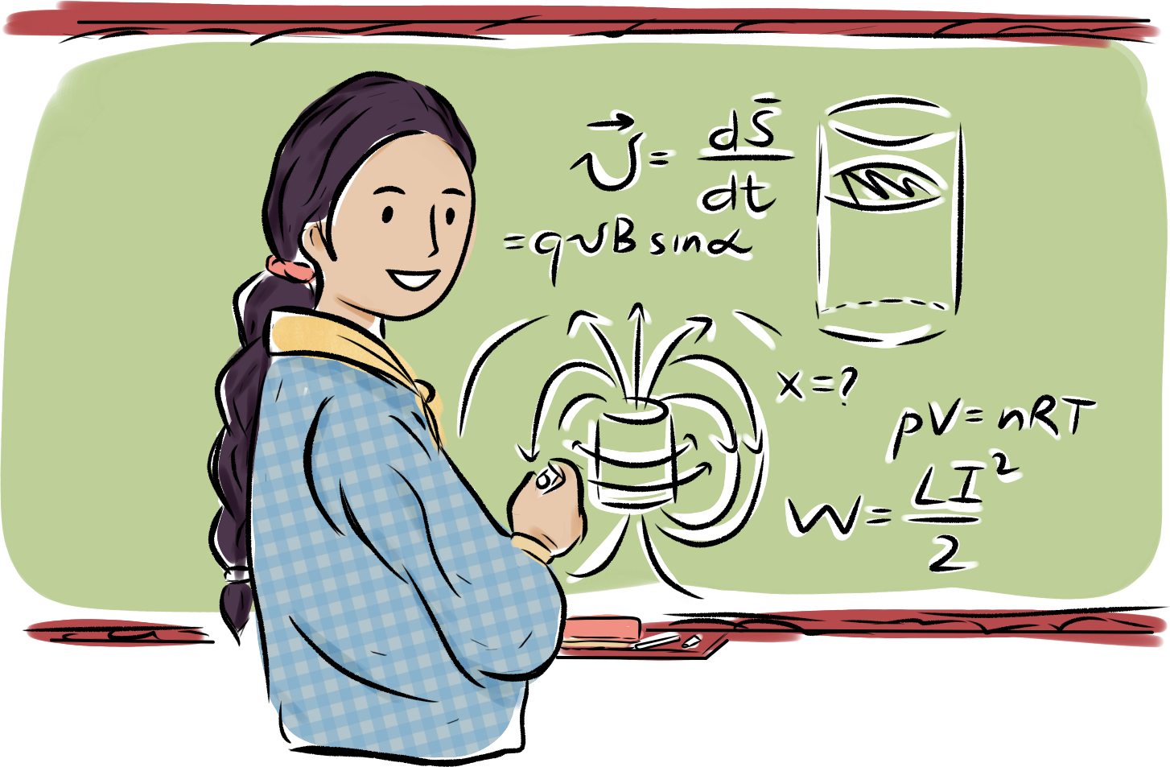

vocabulary
UNIT 7
The world
of mass media

Slide 13

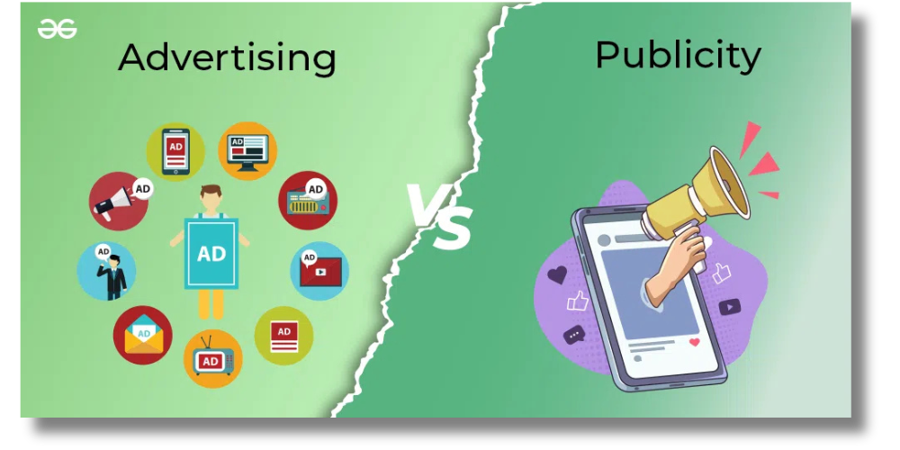

VOCABULARY
P_ _ _ _ _ _ _ _

Slide 14
VOCABULARY
P_ _ _ _ _ _ _ _
The attention that is given to somebody/something by newspapers, television, etc.

Slide 15





VOCABULARY
PUBLICITY
(N)
/PɅBˈLꞮSƏTI/
MASS MEDIA
The attention that is given to somebody/something by newspapers, television, etc.

Slide 16

VOCABULARY

Slide 17
VOCABULARY
Format:
Public media
Blog
Streaming Platform

Slide 18
VOCABULARY
Format:
Public media
Blog
Streaming Platform
Antonyms:
Private media

Slide 19

VOCABULARY
Format:
Public media
Blog
Streaming Platform
Antonym:
Private media
MASS MEDIA

Slide 20
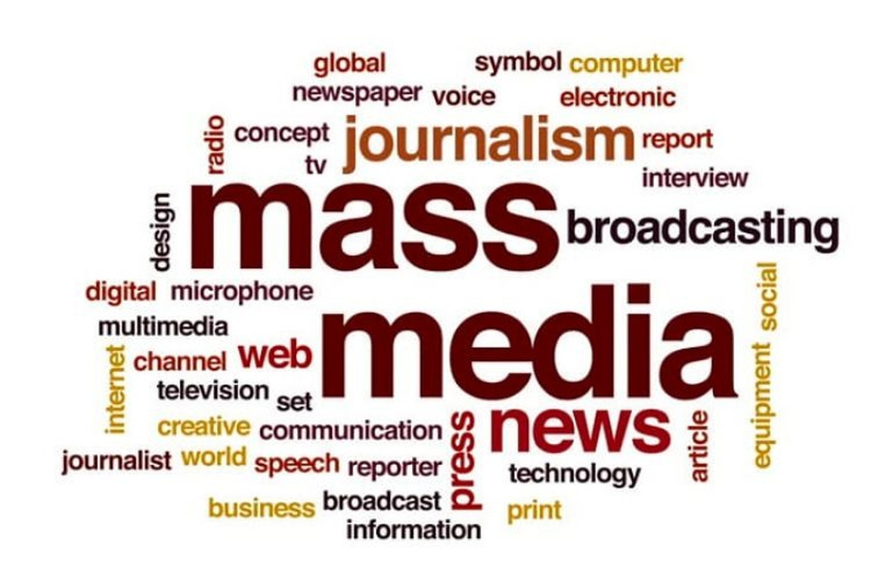
VOCABULARY
MASS MEDIA
(N)
/MÆS ˈMIːDIƏ/
Sources of information and news such as newspapers, television, radio and the internet, that reach and influence large numbers of people

Slide 21
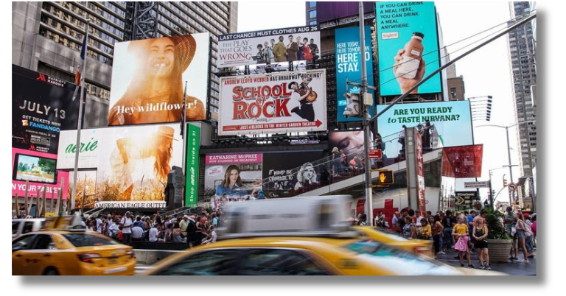
VOCABULARY

Slide 22
VOCABULARY
C_ _ _ _ _ _ _ _ _
(adj)

Slide 23
VOCABULARY
C_ _ _ _ _ _ _ _ _
(adj)
Format:
Advertisement
Publicity

Slide 24
VOCABULARY
Commercial
(adj)
Format:
Advertisement
Publicity

Slide 25
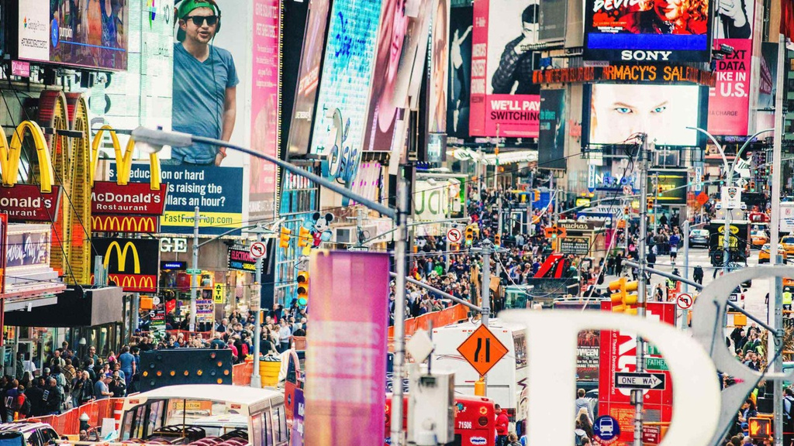

VOCABULARY
COMMERCIAL
(ADJ)
/KƏˈMꞫːƩL/
MASS MEDIA

Slide 26


VOCABULARY
PUZZLE
"I AM HERE; I CANNOT BE FORGOTTEN. IF I AM NOT HERE, WHAT WOULD YOU CALL IT?"

Slide 27
VOCABULARY
PUZZLE
"I AM HERE; I CANNOT BE FORGOTTEN. IF I AM NOT HERE, WHAT WOULD YOU CALL IT?"
Format:
Appearance
Visibility

Slide 28
VOCABULARY
PUZZLE
"I AM HERE; I CANNOT BE FORGOTTEN. IF I AM NOT HERE, WHAT WOULD YOU CALL IT?"
PRESENCE

Slide 29


VOCABULARY
PRESENCE
(N)
/ˈPREZNS/
MASS MEDIA
(of a person) the fact of being in a particular place

Slide 30

VOCABULARY

Slide 31
VOCABULARY
PUZZLE
"ON BLACK FRIDAY, SHOPS OFTEN SELL THINGS FOR LESS MONEY. WHAT WORD MEANS THIS LOWERING OF PRICES?"

Slide 32
VOCABULARY
PUZZLE
"ON BLACK FRIDAY, SHOPS OFTEN SELL THINGS FOR LESS MONEY. WHAT WORD MEANS THIS LOWERING OF PRICES?"
D_ _ _ _ _ _ _

Slide 33
VOCABULARY
PUZZLE
"ON BLACK FRIDAY, SHOPS OFTEN SELL THINGS FOR LESS MONEY. WHAT WORD MEANS THIS LOWERING OF PRICES?"
DISCOUNT

Slide 34
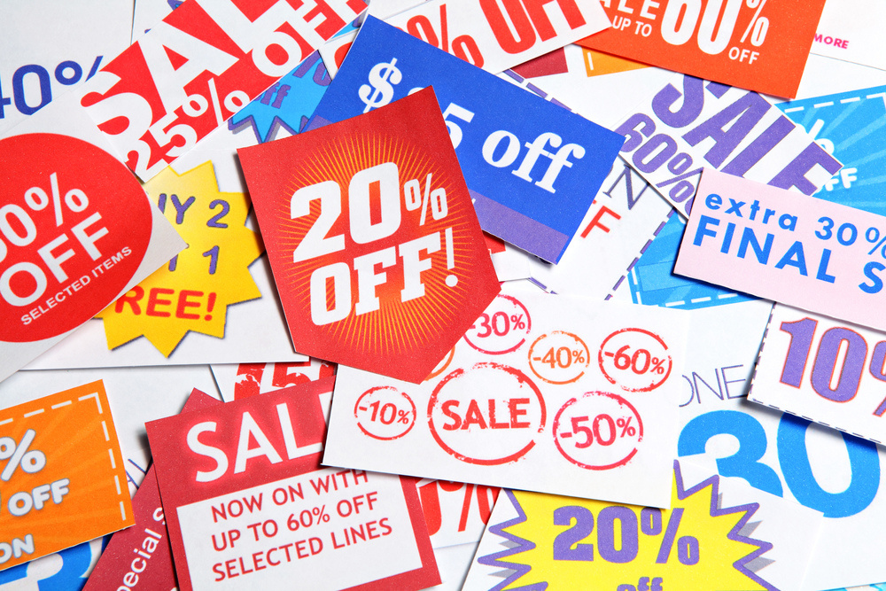


VOCABULARY
DISCOUNT
(N)
/ˈDꞮSKAƱNT/
MASS MEDIA
an amount of money that is taken off the usual cost of something

Slide 35

VOCABULARY
1 | commercial | /kəˈmɜːʃl/ | (n) bài quảng cáo
2 | mass media | /mæs ˈmiːdiə/ | (n)Truyền thông Đại chúng
3 | presence | /ˈprez.əns./ | (n) sự hiện diện
4 | publicity | /pʌbˈlɪs.ə.ti/ | (n) công khai
5 | discount | /ˈdɪskaʊnt/ | (n) giảm giá

Slide 36
Exercise
UNIT 7
The world
of mass media

Slide 37


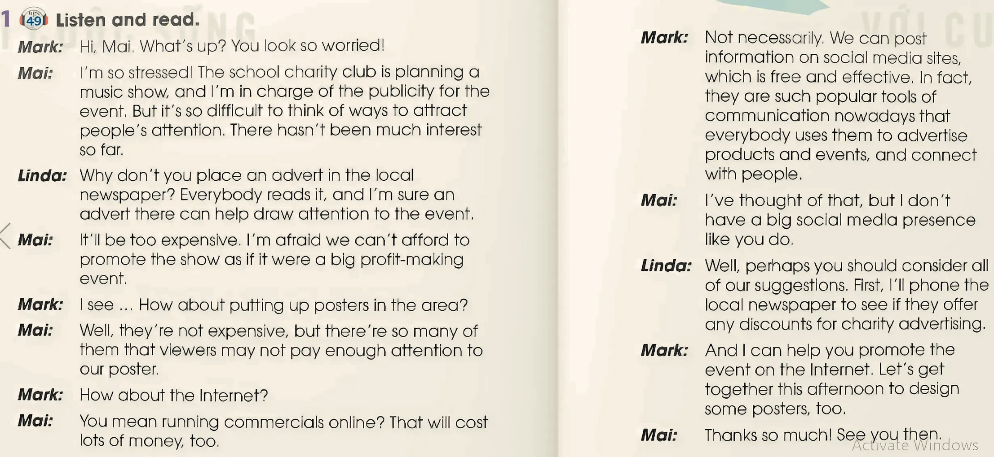
Exercise 2:
EXERCISE 2:

Slide 38


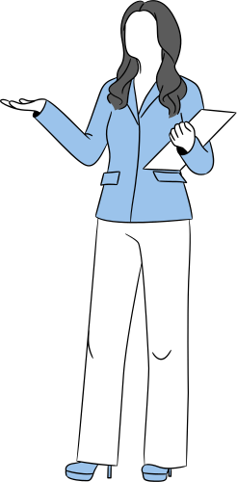


Exercise 2:
EXERCISE 2:
1
Advertising in the local newspaper is cheap / expensive, but it will attract / won't attract people's attention.
2
Posters are expensive / not expensive, but people may /
may not notice them.
3
Posting information on social media sites is a very popular way of promoting / selling things.
4
Linda/ Mark will help Mai with promoting the event on the Internet.

Slide 39
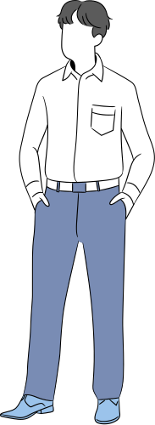
Exercise 2:
EXERCISE 2:
1
Advertising in the local newspaper is cheap/ expensive, but it will attract/ won't attract people's attention.
2
Posters are expensive / not expensive, but people may /
may not notice them.
3
Posting information on social media sites is a very popular way of promoting / selling things.
4
Linda/ Mark will help Mai with promoting the event on the Internet.

Slide 40
Exercise 2:
EXERCISE 2:
1
Advertising in the local newspaper is cheap/ expensive, but it will attract/ won't attract people's attention.
Evidence
Linda: Why don't you place an advert in the local newspaper? Everybody reads it, and I'm sure an advert there can help draw attention to the event.
Mai: It'll be too expensive. I'm afraid we can't afford to promote the show as if it were a big profit-making event.

Slide 41
Exercise 2:
EXERCISE 2:
1
Advertising in the local newspaper is cheap/ expensive, but it will attract/ won't attract people's attention.
Posters are expensive/not expensive, but people may/
may not notice them.
2
3
Posting information on social media sites is a very popular way of promoting / selling things.
4
Linda/ Mark will help Mai with promoting the event on the Internet.

Slide 42
Exercise 2:
EXERCISE 2:
Posters are expensive/not expensive, but people may/ may not notice them.
2
Evidence
Mark: I see... How about putting up posters in the area?
Mai: Well, they're not expensive, but there're so many of them that viewers may not pay enough attention to our poster.

Slide 43
Exercise 2:
EXERCISE 2:
1
Advertising in the local newspaper is cheap/ expensive, but it will attract/ won't attract people's attention.
Posters are expensive/not expensive, but people may/
may not notice them.
2
3
Posting information on social media sites is a very popular way of promoting / selling things.
4
Linda/ Mark will help Mai with promoting the event on the Internet.

Slide 44
Exercise 2:
EXERCISE 2:
3
Posting information on social media sites is a very popular way of promoting/ selling things.
Evidence
Mark: We can post information on social media sites, which is free and effective.In fact, they are such popular tools of communication nowadays that everybody uses them to advertise products and events, and connect with people.

Slide 45
Exercise 2:
EXERCISE 2:
1
Advertising in the local newspaper is cheap/ expensive, but it will attract/ won't attract people's attention.
Posters are expensive/not expensive, but people may/
may not notice them.
2
3
Posting information on social media sites is a very popular way of promoting / selling things.
4
Linda/ Mark will help Mai with promoting the event on the Internet.

Slide 46
Exercise 2:
EXERCISE 2:
4
Linda/ Mark will help Mai with promoting the event on the Internet.
Evidence
Mark: And I can help you promote the event on the Internet. Let's get together this afternoon to design some posters, too

Slide 47

Exercise 4:
Exercise 3:
Exercise 2:
EXERCISE 3:
1
p__________: the activity of ensuring that somebody or something gets a lot of attention from lots of people
2
v__________: people who watch or look at something
3
c__________: advertisements on television, on the radio, or on a website
4
p__________: the ability to make a strong impression on other people

Slide 48
Exercise 4:
Exercise 3:
Exercise 2:
EXERCISE 3:
1
Publicity: the activity of ensuring that somebody or something gets a lot of attention from lots of people
2
v__________: people who watch or look at something
3
c__________: advertisements on television, on the radio, or on a website
4
p__________: the ability to make a strong impression on other people

Slide 49
Exercise 4:
Exercise 3:
Exercise 2:
EXERCISE 3:
1
Publicity: the activity of ensuring that somebody or something gets a lot of attention from lots of people
2
Viewers: people who watch or look at something
3
c__________: advertisements on television, on the radio, or on a website
4
p__________: the ability to make a strong impression on other people

Slide 50
Exercise 4:
Exercise 3:
Exercise 2:
EXERCISE 3:
1
Publicity: the activity of ensuring that somebody or something gets a lot of attention from lots of people
2
Viewers: people who watch or look at something
3
Commercials: advertisements on television, on the radio, or on a website
4
p__________: the ability to make a strong impression on other people

Slide 51
Exercise 4:
Exercise 3:
Exercise 2:
EXERCISE 3:
1
Publicity: the activity of ensuring that somebody or something gets a lot of attention from lots of people
2
Viewers: people who watch or look at something
3
Commercials: advertisements on television, on the radio, or on a website
4
Presence: the ability to make a strong impression on other people

Slide 52

Exercise 4:
Exercise 3:
Exercise 2:
EXERCISE 4:
1. They can't afford to promote the show | a. that everybody uses them to advertise products and events, and connect with people.
2. Mai doesn't have a big social media presence | b. as if it were a big profit-making event.
3. There're so many posters | c. like Mark does.
4. They are such popular tools of communication nowadays | d. that viewers may not pay enough attention to their poster.

Slide 53
Exercise 4:
Exercise 3:
Exercise 2:
EXERCISE 4:
1. They can't afford to promote the show | a. that everybody uses them to advertise products and events, and connect with people.
2. Mai doesn't have a big social media presence | b. as if it were a big profit-making event.
3. There're so many posters | c. like Mark does.
4. They are such popular tools of communication nowadays | d. that viewers may not pay enough attention to their poster.

Slide 54
Exercise 4:
Exercise 3:
Exercise 2:
EXERCISE 4:
1. They can't afford to promote the show | a. that everybody uses them to advertise products and events, and connect with people.
2. Mai doesn't have a big social media presence | b. as if it were a big profit-making event.
3. There're so many posters | c. like Mark does.
4. They are such popular tools of communication nowadays | d. that viewers may not pay enough attention to their poster.

Slide 55
Exercise 4:
Exercise 3:
Exercise 2:
EXERCISE 4:
1. They can't afford to promote the show | a. that everybody uses them to advertise products and events, and connect with people.
2. Mai doesn't have a big social media presence | b. as if it were a big profit-making event.
3. There're so many posters | c. like Mark does.
4. They are such popular tools of communication nowadays | d. that viewers may not pay enough attention to their poster.

Slide 56







Slide 57

LEADING QUESTIONS
"What was the first mass media in the world?"

Slide 58
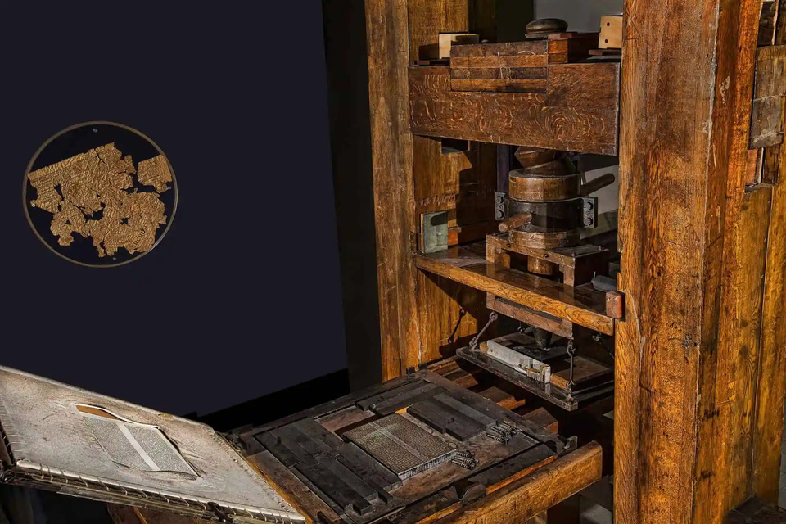
LEADING QUESTIONS
Printed newspaper
THE FIRST MASS MEDIA IN THE WORLD

Slide 59
"WHAT IS THE MOST RECENT MASS MEDIA IN THE WORLD?"

Slide 60

LEADING QUESTIONS
AI Media
THE MOST RECENT MASS MEDIA IN THE WORLD

Slide 61

LEADING QUESTIONS
"HOW DO YOU THINK MASS MEDIA INFLUENCES OUR DAILY LIVES TODAY? DO YOU THINK IT'S MORE POSITIVE OR NEGATIVE?"

Slide 62
THE END
THANK YOU
FOR YOUR ATTENTION

