Slide 1





Unit 7: Viet Nam And International Organisations
Lesson 1: Getting Started
Viet Nam and international organisations

Slide 2

Unit
1
1
FAMILY LIFE
Unit
Family Life
OBJECTIVES
Gain an overview of the topic “Viet Nam and international organisations”
Identify and use words and phrases related to the topic “Viet Nam and international organisations”
Identify and use comparative and superlative adjectives.

Slide 3
Table of contents
01
02
03
04
Warm-up
Presentation
Practice
Consolidation

Slide 4



01
Warm-up
Trivia: Guess the logo

Slide 5



Slide 6



GUESS THE LOGO!
The United Nations

Slide 7

GUESS THE LOGO!
United Nations
Children’s Fund

Slide 8

GUESS THE LOGO!
United Nations
Development
Programme

Slide 9

GUESS THE LOGO!
World Trade Organization

Slide 10

GUESS THE LOGO!
World Wide Fund
for Nature

Slide 11

GUESS THE LOGO!
The Food and Agriculture Organisation of the United Nations

Slide 12

GUESS THE LOGO!
Association of Southeast Asian Nations

Slide 13
02
Presentation

Slide 14
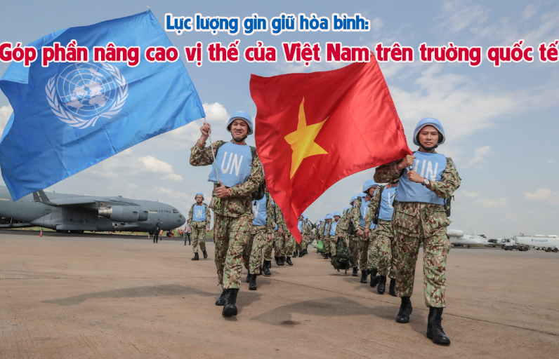

VOCABULARY
peacekeeping (adj)
/ˈpiːskiːpɪŋ/
intended to help stop people fighting and prevent war or violence in a place where this is likely

Slide 15
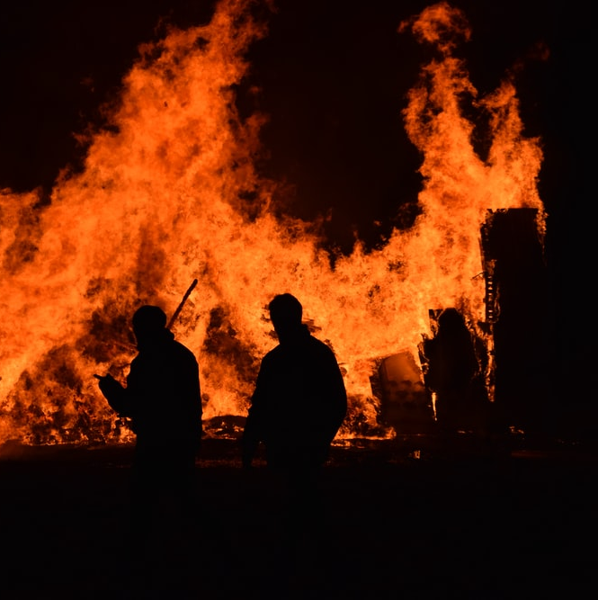
VOCABULARY
harm (n)
/hɑː(r)m/
damage or injury that is caused by a person or an event

Slide 16

VOCABULARY
expert (adj)
/ˈekspɜːrt/
having or involving great knowledge or skills

Slide 17
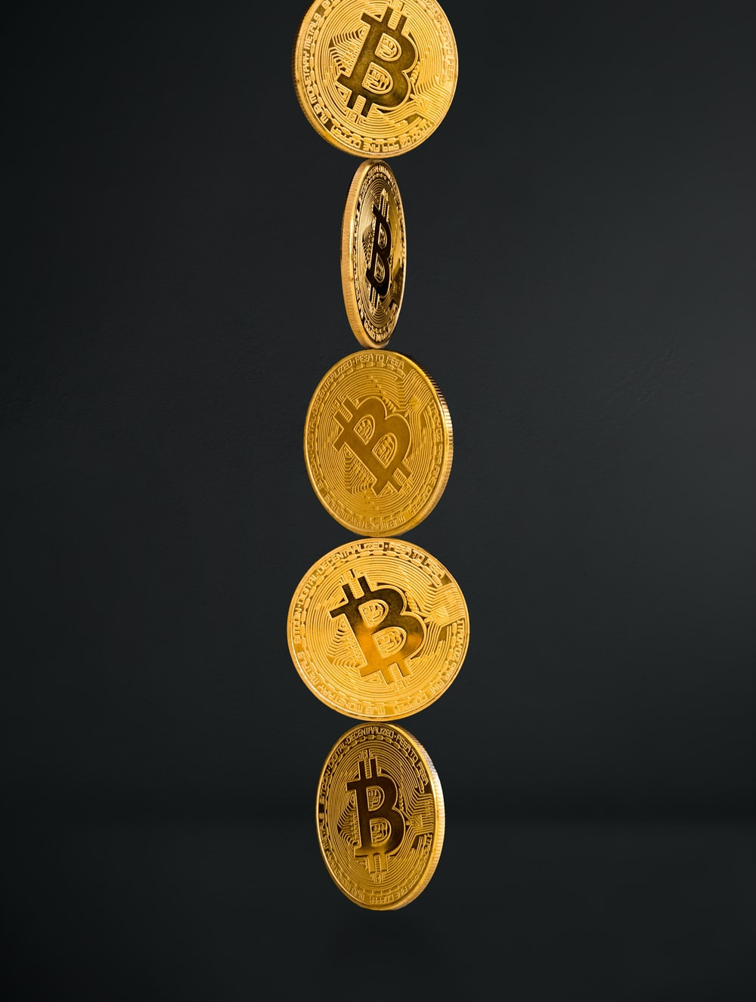
VOCABULARY
investor (n)
/ɪnˈvestə(r)/
a person or an organisation that invests money in something

Slide 18
VOCABULARY
Form | Pronunciation | Meaning
1. peacekeeping (adj) | /ˈpiːskiːpɪŋ/ | helping stop people fighting
2. harm (n) | /hɑː(r)m/ | damage or injury
3. expert (adj) | /ˈekspɜːrt/ | having great knowledge or skills
4. investor (n) | /ɪnˈvestə(r)/ | a person or an organisation that invest money

Slide 20




Slide 21

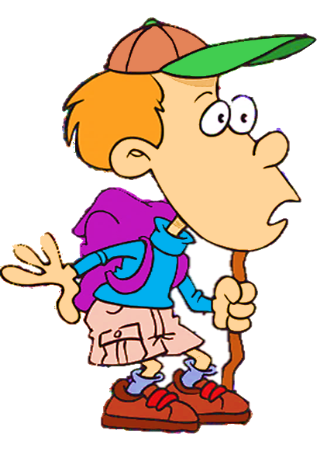

Answer the question
You are in a desert.
Where am I?
CHECK

Slide 22


Choose the correct answer to complete the sentence:
expert
The centre provides ______ advice for people with financial problems.
expert
harm

Slide 23

You are in a beach.
Where am I?
CHECK

Slide 24
Choose the correct answer to complete the sentence:
investor
The largest ________ in the non-manufacturing sector was the UK.
investor
expert

Slide 25
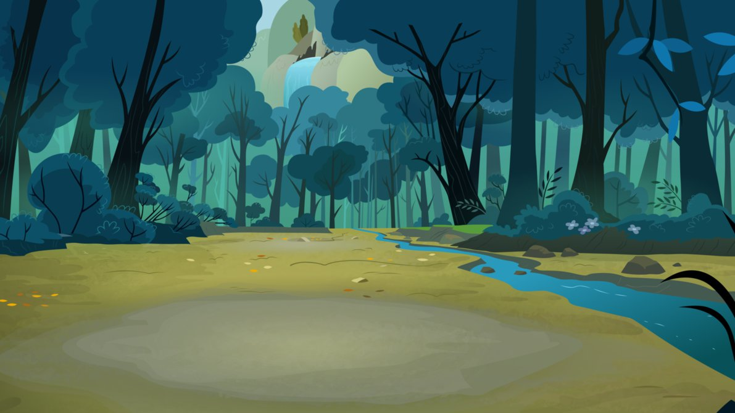
You are in a forest.
Where am I?
CHECK

Slide 26
Choose the correct answer to complete the sentence:
I can't say I like Mark very much, but I don't wish him any ______.
harm
peacekeeping
harm

Slide 27


You are in a
big city.
Where am I?
CHECK

Slide 28
Choose the correct answer to complete the sentence:
peacekeeping
There are currently 11 ______________operations deployed across Africa, the Middle East, Europe, and Asia.
peacekeeping
peaceful

Slide 29
03
Practice

Slide 30
PRACTICE
1
Listen and read.
Do You Know…?
A. The United Nations (UN) was created in 1945. It is an organisation of most of the world’s countries. Its main goal is world peace. It also works to reduce poverty and improve people’s lives in other ways. Viet Nam joined the organisation in 1977. Since then, our country has become more active and has participated in many UN activities including peacekeeping.
B. UNICEF was formed in 1946. It works in over 190 countries to help improve health and education of children. It particularly aims to support the most disadvantaged children all over the world. UNICEF’s aim in Viet Nam is to protect children and make sure they are healthy, educated and safe from harm.

Slide 31
PRACTICE
1
Listen and read.
Do You Know…?
C. UNDP was formed in 1965 as part of the UN. It provides technical support, expert advice and training to help people in developing countries have a better life. In Viet Nam, UNDP works closely with the government to reduce poverty and improve people’s lives.
D. The WTO was formed in 1995. It is the world’s largest international economic organisation. Viet Nam became a WTO member in 2007. Since then, our economy has achieved a high growth level. Viet Nam has also become more attractive to foreign investors.

Slide 32
PRACTICE
PRACTICE
2
Read the texts again and choose the correct answers.
1. Which organisation was formed in 1945?
A. The UN B. UNICEF C. The WTO
2. Which organisation aims to help improve children’s health and education?
A. UNDP B. UNICEF C. The WTO
3. Which of the following is the largest international economic organisation?
A. The UN B. UNDP C. The WTO

Slide 33
PRACTICE
3
Find words in the texts (A, B, C, or D) that mean the following.
Words | Meanings
 | helping stop people fighting (A)
 | damage or injury (B)
 | having great knowledge (C)
 | people or organisations that invest money (D)
peacekeeping
harm
expert
investors

Slide 34
PRACTICE
4
Complete the sentences with the words and phrases from Task 1.
1. Since joining the UN, Viet Nam has become _____________ and has participated in many UN activities including peacekeeping.
2. UNICEF particularly aims to support _____________________ children all over the world.
3. UNDP helps people in developing countries have a __________ life.
4. The WTO is the world's __________ international economic organisation.
5. Viet Nam has also become ______________ to foreign investors.
more active
the most disadvantaged
better
largest
more attractive

Slide 35
04
Consolidation

Slide 36
CONSOLIDATION
1
Wrap-up
Some words and phrases related to international organisations
Reading for specific information
Scanning skills

Slide 37
CONSOLIDATION
2
Homework
Do exercises in the workbook
Project preparation

Slide 38
SEE YOU NEXT TIME !!

