Slide 1


Slide 2



WARM-UP
Quiz Wheel Game
RULES
- Spin the wheel
(Spin X, lose a turn)
- Answer the question
https://www.pinkcatgames.com/games/quiz-wheel/Quiz-Wheel-Game.php?game_id=13&savedgame_id=1448798
Notes:
https://www.pinkcatgames.com/games/quiz-wheel/Quiz-Wheel-Game.php?game_id=13&savedgame_id=1448798

Slide 3

UNIT 9: SOCIAL ISSUES
Writing
A proposal against cyber bullying

Slide 4
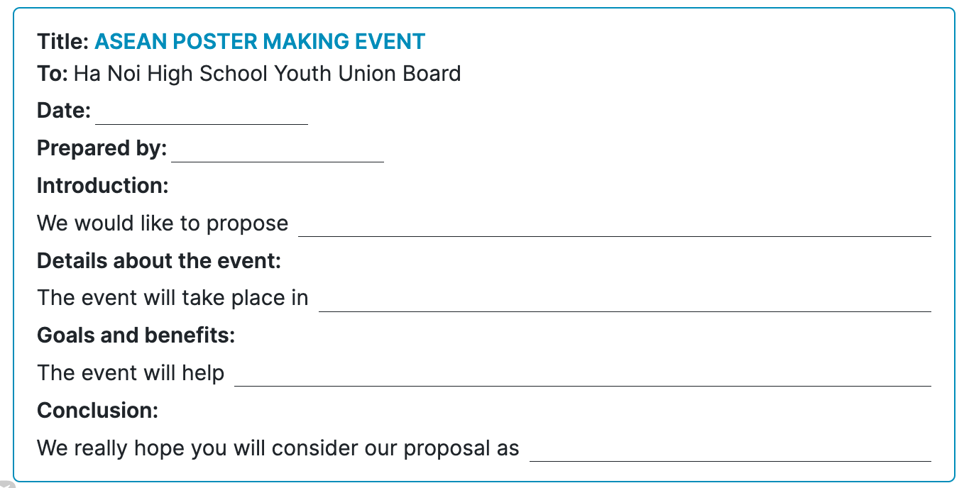


REVIEW

Slide 5
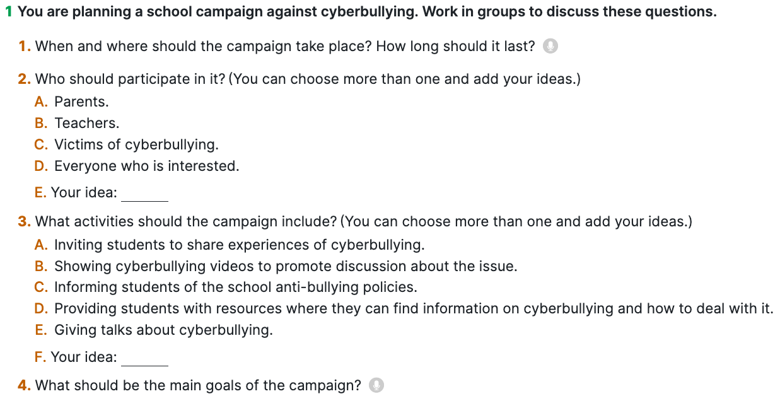
Task 1: You are planning a school campaign against cyberbullying. Work in groups to discuss these questions.
PRE-WRITING

Slide 6
Title:
A SCHOOL CAMPAIGN AGAINST CYBERBULLYING
TO:
.....................................
DATE:
.....................................
........ has become a common/serious issue nowadays because …...
- We would like to propose ...........
INTRODUCTION:
DETAILS:
Time & Place
The campaign events/ activities will take place ..........................
It would be best to organize the campaign ...................................
Duration
The campaign will last for .............
It should run for ..............to include different activities.
We propose a (two-week) campaign with different activities.
Participants
........... will take part in the campaign.
The campaign should involve ..............................
SELF-CARE TIPS
Activities
The main events/ activities will include.................
01
Goals & Benefits:
The main goal of this campaign is to...
Our campaign aims to.../ aims at........
This campaign will allow (students, teenagers ) to ......./ will help students ........
Conclusion
We hope that you will consider our proposal........

Slide 7
Proposal Writing Criteria
- The proposal addresses the topic clearly (cyberbullying campaign).
- All parts (problem, goals, activities, participants, time, benefits) are included.
- Ideas are relevant and reasonable.
01
CONTENT
- Clear structure: introduction, body, and conclusion.
- Ideas are organized logically and easy to follow.
02
ORGANISATION
03
LANGUAGE USE
- Correct use of grammar (tenses, sentence structure, subject-verb agreement).
- Variety of sentence types.
- Appropriate topic-related vocabulary (cyberbullying, campaign, raise awareness…).
- Avoid repetition.
04
VOCABULARY
03
04
- Spelling and punctuation are mostly accurate.
- Proper use of capital letters.
05
MECHANICS

Slide 8

THANKS FOR
YOUR ATTENTION

