Slide 2
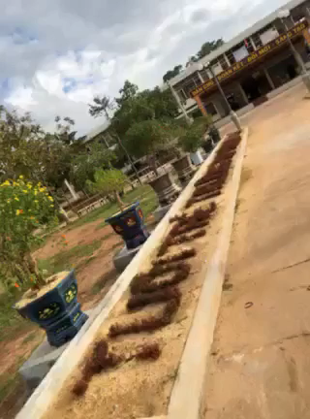
VIDEO
After seeing the video, go to the board and write as many activities as possible in teams.
1. What is the best title of the video?
2. What activities can you see in the video?
Notes:
Work in 4 groups to discuss and write on the board.

Slide 3
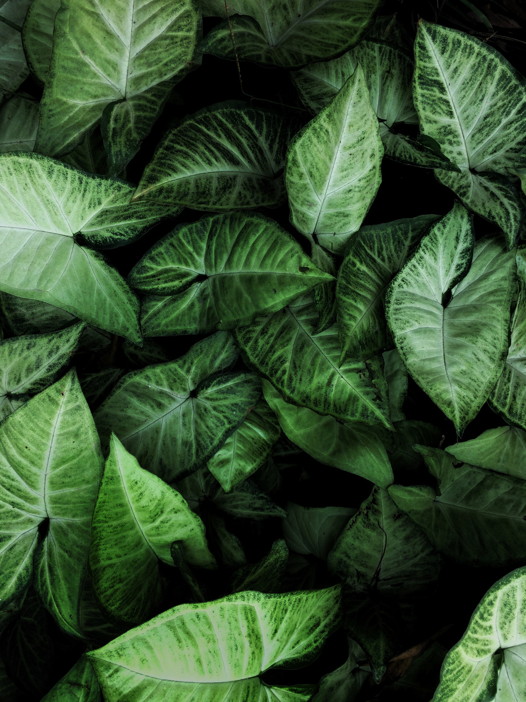

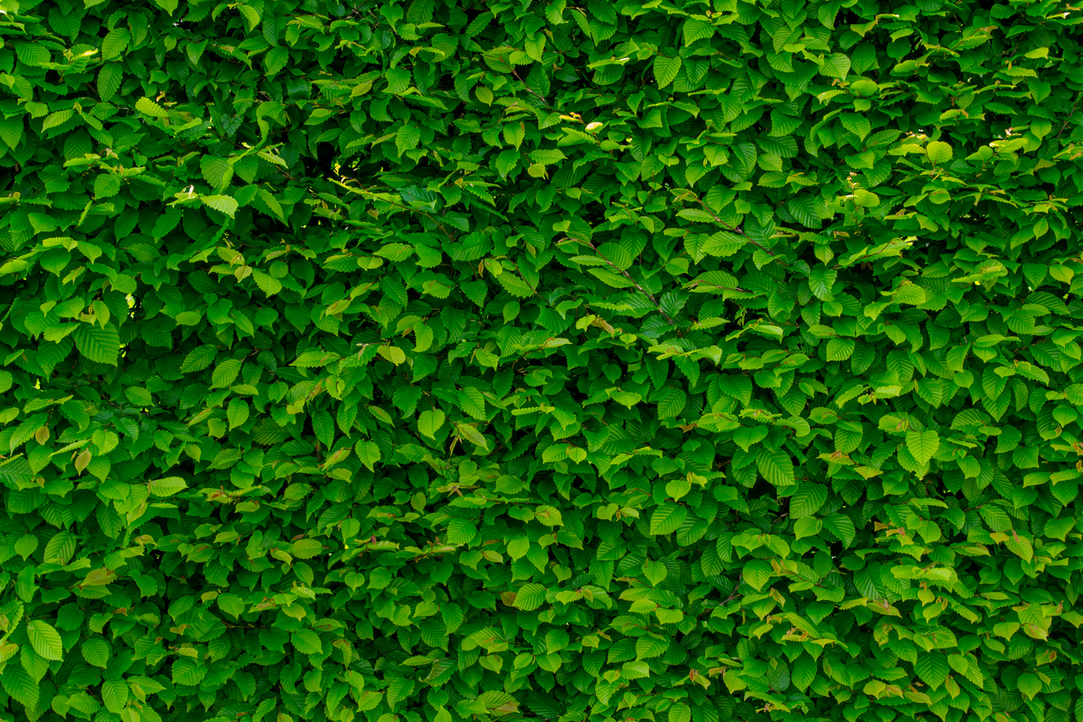



GREEN LIVING
UNIT 3
Period 20. READING
Going green with plastics

Slide 4



UNIT 3
VOCABULARY

Slide 5
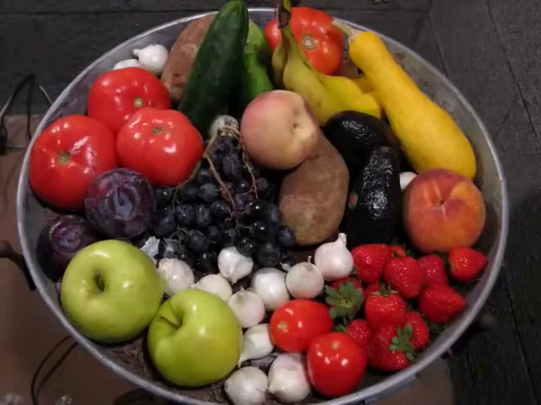
decompose (v)
/ˌdiː.kəmˈpəʊz/
to decay, or to cause
something to decay
phân hủy
→ decomposition (n)

Slide 6
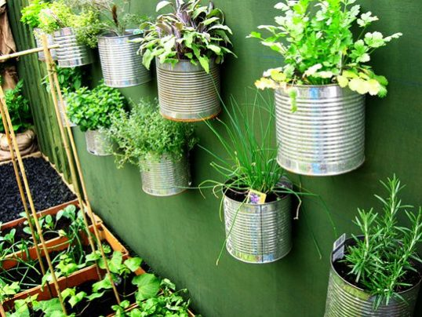

reuse (v)
/ˌriːˈjuːz/
to use something again
reusable (a)
/ˌriːˈjuː.zə.bəl/
tái sử dụng

Slide 7
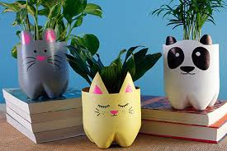
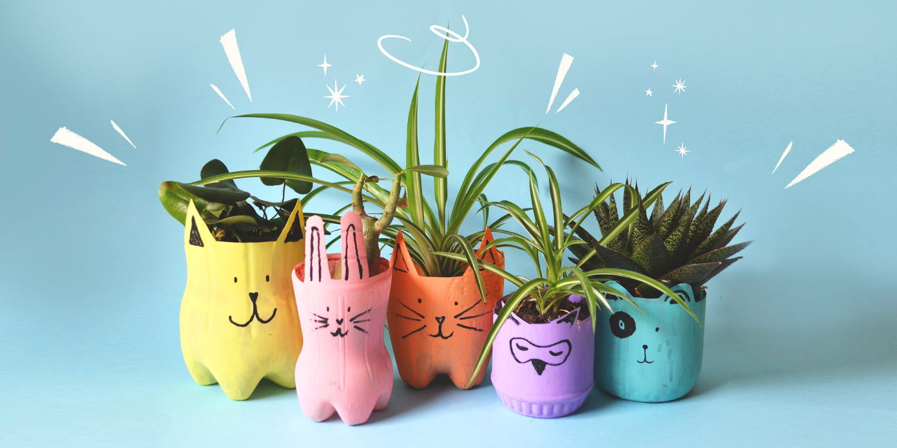
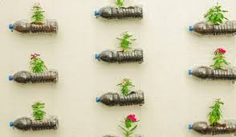
recycle (v)
Tái chế
recycling (n)
Sự tái chế
Ex: These bottles can be recycled to make plant pots.

Slide 8
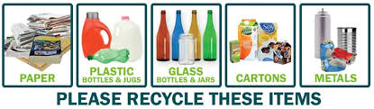
recyclable (a)
Có thể tái chế
recyclables (n)
Vật liệu tái chế
Ex: Please separate recyclables from other trash.

Slide 9
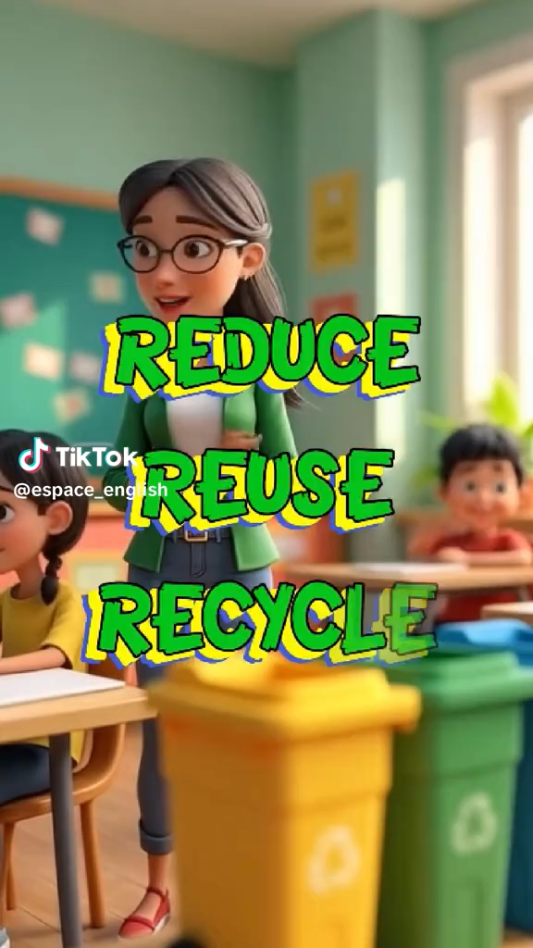
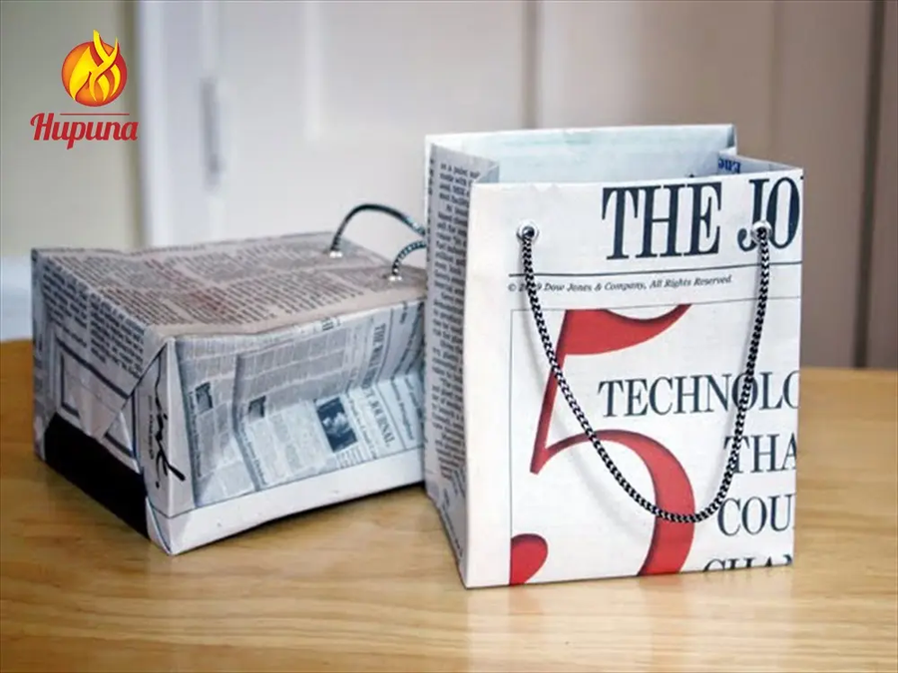
recycle (v)
recycling (n)
recyclable (a)
recyclables (n)

Slide 10
recycle (v)
recycling (n)
recyclable (a)
recyclables (n)

Slide 11
VOCABULARY
- decompose (v) phân hủy – decomposition (n)
- reuse (v) sử dụng lại – reusable (adj)
- recycle (v) tái sử dụng – recycling (n)
recyclable (a) có thể tái sử dụng
recyclables (n) vật liệu tái sử dụng

Slide 12
1. Reorder the letters to make meaning ful words.
1. eeuablsr
2. eeaysllbccr
3. eeoocdspm

Slide 13
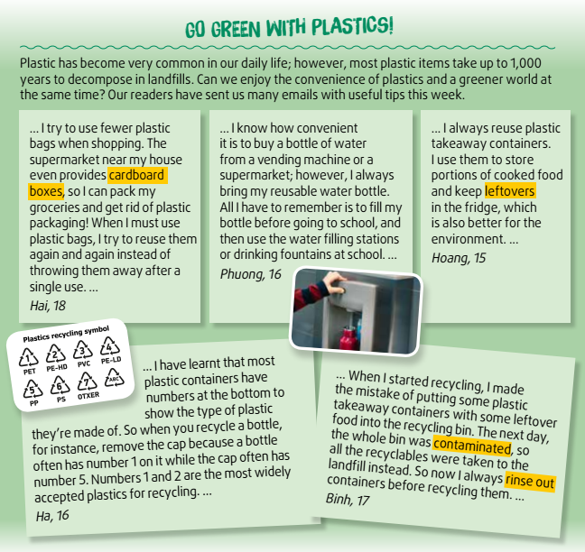
2
Match the highlighted words and phrases with the pictures.
Notes:
Work in pairs to guess the meaning of the highlighted words in context in 2 minutes.

Slide 14
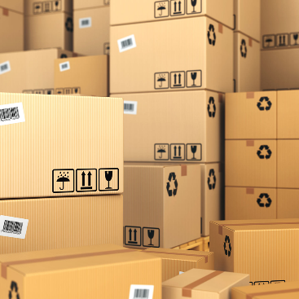
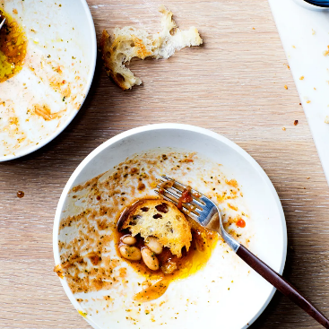
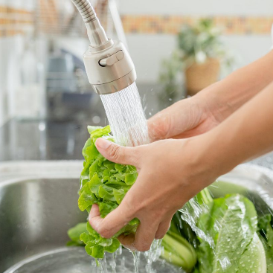
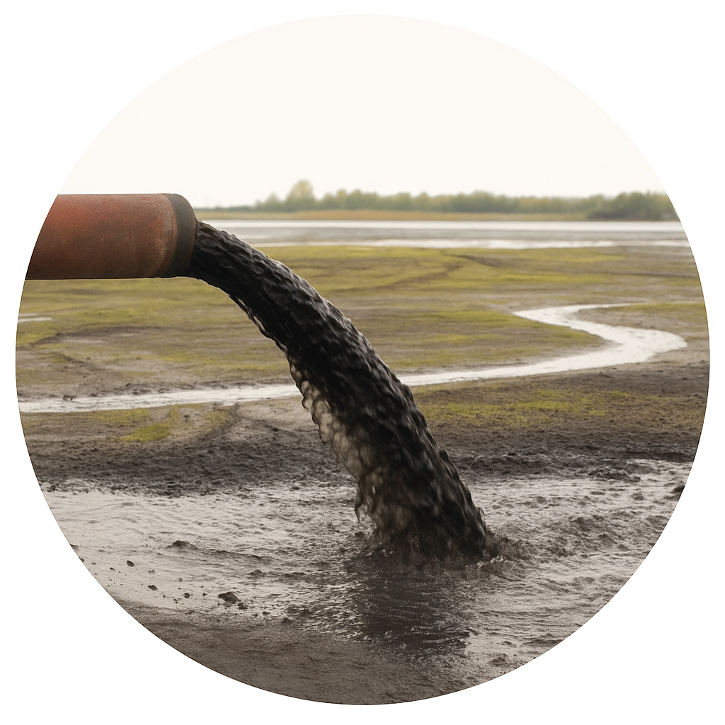
2. Match the highlighted words and phrases (1-4) with the pictures (a-d)
1
a
b
cardboard boxes (n.p)
2
leftovers (n)
3
contaminated (a)
c
d
4
rinse out (v.p)
Notes:
Ask Ss to stand up and give answers and Vietnemese equivalents.

Slide 15
3
Complete the summary notes with information from the text. Use no more than TWO words for each gap.
Single-use plastics can be: | Tips
reduced | • use (1) ___________________ instead of plastic packaging • bring a (2) ___________________ water bottle
reused | • reuse (3) ____________________ many times • reuse single-use plastic containers
recycled | • avoid plastics with (4) __________________ that are hard to recycle • (5) ______________ containers before recycling
Notes:
Work in pairs again to find out the words/ phrases. Give the location of each word/ phrase in the extracts. Where can you see them?
1. cardboard boxes 2. reusable 3. plastic bags 4. numbers 5. rinse out

Slide 16
4
1. According to Hai, what does he do to reduce the use of plastic bags? A. He buys cloth bags from stores B. He avoids shopping at supermarkets C. He reuses plastic bags many times D. He burns plastic bags after use
2. What does Phuong always remember to do before going to school? A. Buy a new water bottle B. Fill her reusable bottle C. Recycle old plastic bottles D. Bring plastic cups
3. What does Hoang use plastic takeaway containers for? A. Packing gifts B. Storing cooked food and leftovers C. Growing plants D. Collecting rainwater
4. According to Ha, why should we remove the bottle cap before recycling? A. Because caps are too small B. Because they are made of different plastic types C. Because they are dirty D. Because caps cannot be reused
5. According to Binh, what mistake did he make when he first started recycling? A. He forgot to separate paper from plastic B. He used plastic bags in the recycling bin C. He put unclean containers in the bin D. He threw glass bottles with plastic
6. The word “them” in the sentence “I try to reuse them again and again…” refers to: A. Supermarkets B. Groceries C. Plastic bags D. Cardboard boxes
7. The word “convenience” in Phuong’s paragraph is closest in meaning to: A. Comfort B. Pollution C. Packaging D. Danger
8. The word “contaminated” in Binh’s paragraph is closest in meaning to: A. Cleaned B. Reused C. Polluted D. Accepted
9. The word “reusable” in Phuong’s paragraph is OPPOSITE in meaning to: A. Refillable B. Replaceable C. Disposable D. Durable
10. Which of the following is NOT true, according to the passage? A. Hai packs groceries in cardboard boxes instead of plastic B. Phuong prefers buying bottles of water every day C. Ha knows how to identify plastic types by their recycling numbers D. Binh rinses containers before recycling now
Read the extracts from the email again and choose the best answer.
Notes:
Work in groups of 4 to discuss and answer the questions in 3 minutes.

Slide 17
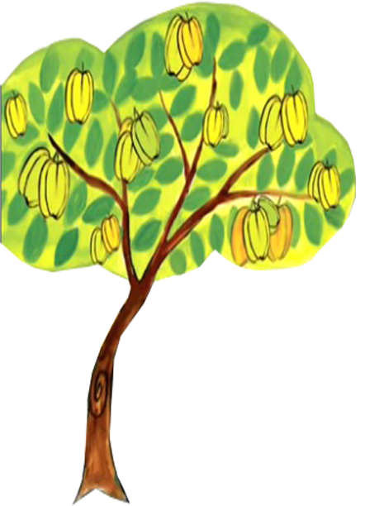
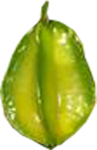
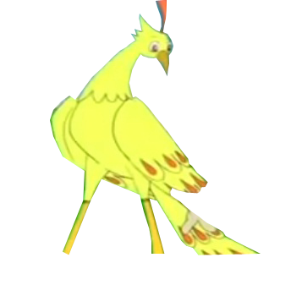






GAME *** Eat starfruits Return gold

Slide 18
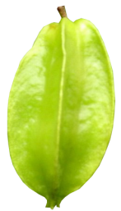

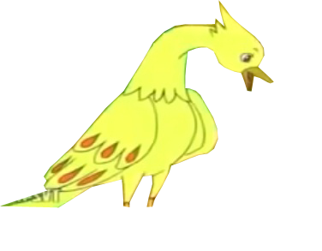
10
Why do you eat my starfruit?
8
9
1
7
6
2
4
5
Eat starfruits, Return gold!
3

Slide 19









Q1
Q2
Q3
Q4
Q5
9
10
Q6
Q7
Q8
Q9
Q10
8
7
Which starfruit?
6
1
4
5
2
3

Slide 20
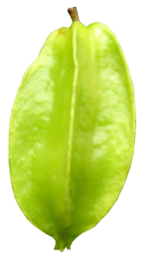

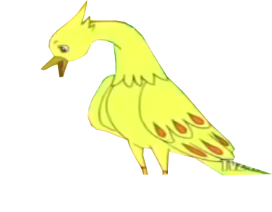
Question 1
The word “convenience” in Phuong’s paragraph is closest in meaning to: A. Comfort B. Pollution
C. Packaging D. Danger
A
Notes:
Đáp án: A. Comfort. Giải thích: “Convenience” gần nghĩa với “comfort / ease” — sự tiện lợi, tiện nghi hơn; các lựa chọn khác (pollution, packaging, danger) không đúng nghĩa.

Slide 21
Question 2
The word “contaminated” in Binh’s paragraph is closest in meaning to: A. Cleaned B. Reused
C. Polluted D. Accepted
C
Notes:
Đáp án: C. Polluted. Giải thích: “Contaminated” = bị nhiễm bẩn, bị ô nhiễm → gần nghĩa với “polluted”.

Slide 22
Question 3
The word “reusable” in Phuong’s paragraph is OPPOSITE in meaning to:
A. Refillable B. Replaceable
C. Disposable D. Durable
C
Notes:
Đáp án: C. Disposable. Giải thích: “Reusable” = có thể sử dụng lại. Từ trái nghĩa phù hợp nhất là “disposable” = dùng 1 lần, bỏ đi. (Các lựa chọn khác không đối nghĩa trực tiếp.)

Slide 23
Question 4
According to Hai, what does he do to reduce the use of plastic bags? A. He buys cloth bags from stores
B. He avoids shopping at supermarkets C. He reuses plastic bags many times
D. He burns plastic bags after use
C
Notes:
Đáp án: C. He reuses plastic bags many times. Giải thích: Hai nói rõ “When I must use plastic bags, I try to reuse them again and again…” → anh ấy tái sử dụng túi nhựa nhiều lần.

Slide 24
Question 5
What does Phuong always remember to do before going to school? A. Buy a new water bottle
B. Fill her reusable bottle C. Recycle old plastic bottles
D. Bring plastic cups
B
Notes:
Đáp án: B. Fill her reusable bottle. Giải thích: Phuong viết “I always bring my reusable water bottle. All I have to remember is to fill my bottle before going to school…” → cô ấy nhớ phải đổ đầy bình trước khi đi học.

Slide 25
Question 6
What does Hoang use plastic takeaway containers for? A. Packing gifts
B. Storing cooked food and leftovers C. Growing plants
D. Collecting rainwater
B
Notes:
Đáp án: B. Storing cooked food and leftovers. Giải thích: Hoang: “I always reuse plastic takeaway containers. I use them to store portions of cooked food and keep leftovers in the fridge…” → dùng để đựng phần ăn và đồ thừa.

Slide 26
Question 7
According to Ha, why should we remove the bottle cap before recycling? A. Because caps are too small
B. Because they are made of different plastic types C. Because they are dirty
D. Because caps cannot be reused
B
Notes:
Đáp án: B. Because they are made of different plastic types. Giải thích: Ha giải thích rằng nắp và chai có số khác nhau (chai số 1, nắp số 5) nên phải tách vì làm từ loại nhựa khác nhau.

Slide 27
Câu 8
According to Binh, what mistake did he make when he first started recycling? A. He forgot to separate paper from plastic
B. He used plastic bags in the recycling bin C. He put unclean containers in the bin
D. He threw glass bottles with plastic
C
Notes:
Đáp án: C. He put unclean containers in the bin. Giải thích: Binh kể lỗi ban đầu là để hộp mang thức ăn còn thừa (không rửa) vào thùng tái chế → làm cả thùng bị “contaminated”.

Slide 28
Question 9
C
The word “them” in the sentence “I try to reuse them again and again…” refers to: A. Supermarkets
B. Groceries
C. Plastic bags
D. Cardboard boxes
Notes:
Đáp án: C. Plastic bags. Giải thích: “I try to reuse them again and again” — từ “them” ám chỉ các “plastic bags” đã nêu trong câu trước.

Slide 29
Question 10
Which of the following is NOT true, according to the passage? A. Hai packs groceries in cardboard boxes instead of plastic B. Phuong prefers buying bottles of water every day C. Ha knows how to identify plastic types by their recycling numbers D. Binh rinses containers before recycling now
B
Notes:
Đáp án: B. Phuong prefers buying bottles of water every day. (NOT true) Giải thích: Đoạn văn nói ngược lại — Phuong không mua chai nước mỗi ngày mà mang bình dùng lại. Các đáp án A, C, D đều đúng theo đoạn văn.

Slide 30
5
1. According to Hai, what does he do to reduce the use of plastic bags?
C. He reuses plastic bags many times
2. What does Phuong always remember to do before going to school? B. Fill her reusable bottle
3. What does Hoang use plastic takeaway containers for? B. Storing cooked food and leftovers
4. According to Ha, why should we remove the bottle cap before recycling? B. Because they are made of different plastic types 5. According to Binh, what mistake did he make when he first started recycling? C. He put unclean containers in the bin
6. The word “them” in the sentence “I try to reuse them again and again…” refers to: C. Plastic bags
7. The word “convenience” in Phuong’s paragraph is closest in meaning to: A. Comfort
8. The word “contaminated” in Binh’s paragraph is closest in meaning to: C. Polluted
9. The word “reusable” in Phuong’s paragraph is OPPOSITE in meaning to: C. Disposable
10. Which of the following is NOT true, according to the passage? B -> The rest are TRUE. A. Hai packs groceries in cardboard boxes instead of plastic C. Ha knows how to identify plastic types by their recycling numbers D. Binh rinses containers before recycling now
Report the main idea
- Hai
- Phuong
- Hoang
- Ha
- Binh

Slide 31
