Slide 3
WELCOME TO
NGUYEN DU 1 HIGH SCHOOL

Slide 4

WARM-UP
PICTURE GUESSING GAME
- There are 06 pictures.
- Players guess the words related to the family activities of each picture.
- Players raise their hands to answer.
- Players will get a small gift with the correct answer.

Slide 5
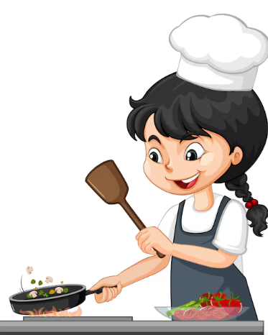

WARM-UP
=>
cooking

Slide 6


WARM-UP
=>
shopping

Slide 7
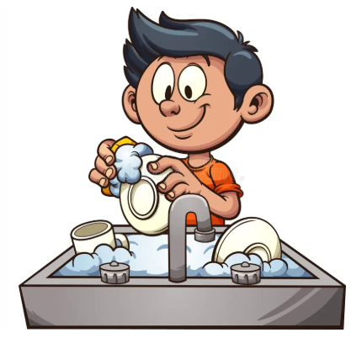
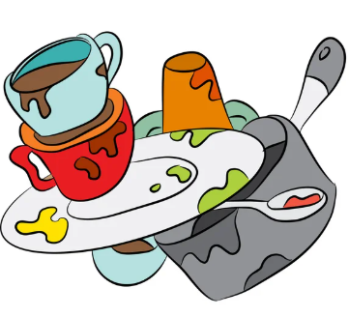
WARM-UP
=>
washing-up

Slide 8
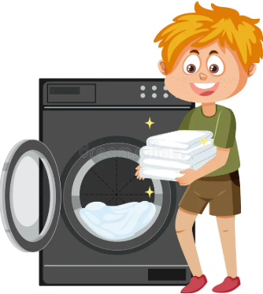

WARM-UP
=>
washing clothes

Slide 9
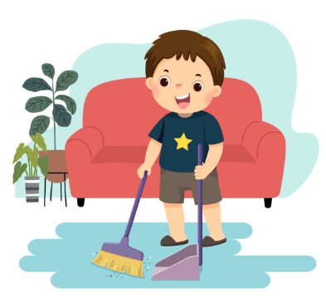

WARM-UP
=>
sweeping

Slide 10
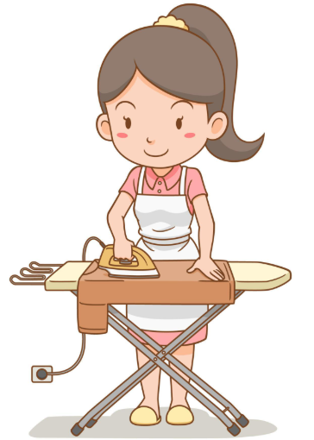

WARM-UP
=>
ironing clothes

Slide 11
WARM-UP
cooking
shopping
washing-up
washing clothes
sweeping
ironing clothes

Slide 12

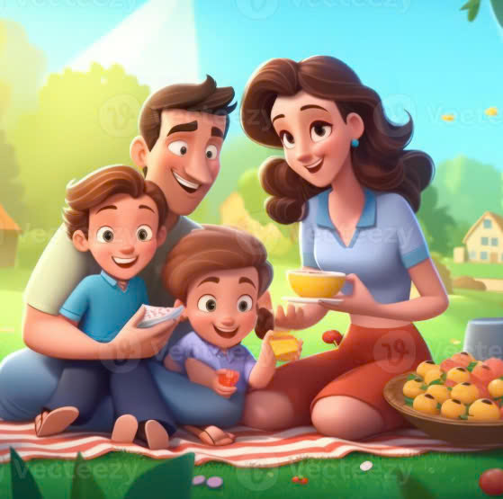

Unit 1:
FAMILY life
Getting started

Slide 13
oBjectives
Overview
Vocabulary
Grammar
Present simple & Present continuous
the topic of
family life
Household chores

Slide 14
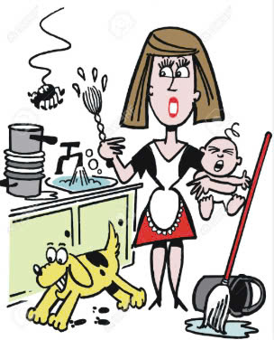
VOCABULARY
homemaker
/ˈhəʊmmeɪkə(r)/
(n):
Nội trợ
a person who manages a home and takes care of the house and family as their main job

Slide 15
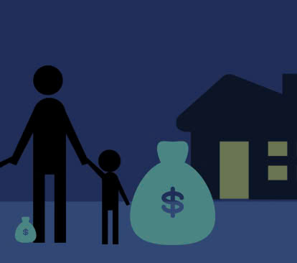
VOCABULARY
breadwinner
/ˈbredwɪnə(r)/
(n):
Trụ cột gia đình
a person who supports their family with the money they earn

Slide 16
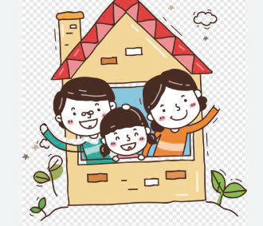
VOCABULARY
household
(n):
/ˈhaʊshəʊld/
Hộ gia đình
Ex: Most households now own at least one car.

Slide 17
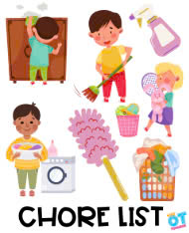
VOCABULARY
/tʃɔː(r)/
(n):
Chore
Việc vặc
Ex: You can go out to play when you’ve finished your chores.

Slide 18
homemaker
breadwinner
household
Chore

Slide 19

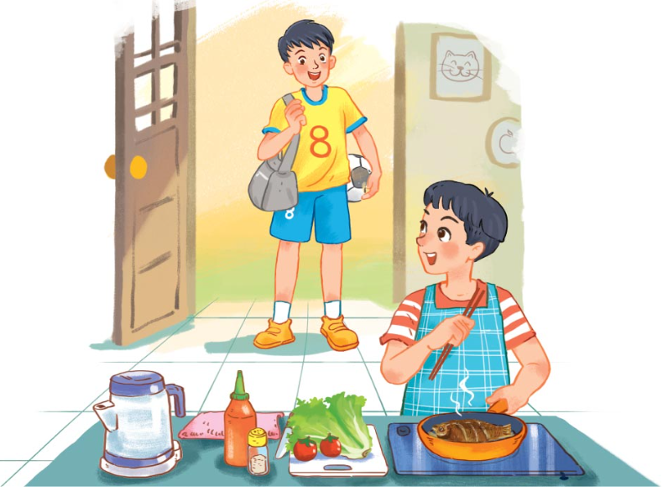
I. Listen and read

Slide 20
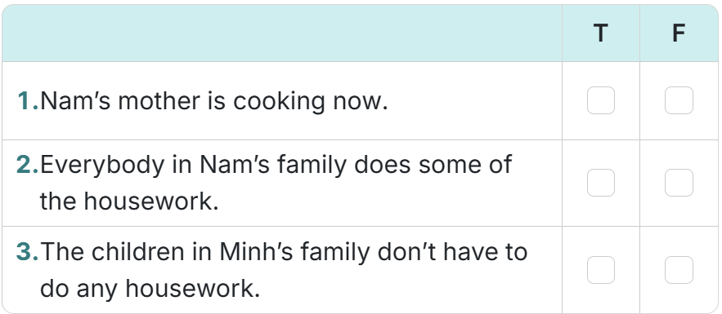
2. Read the conversation again and decide whether the following statements are true (T) or false (F).
✓
✓
✓

Slide 21
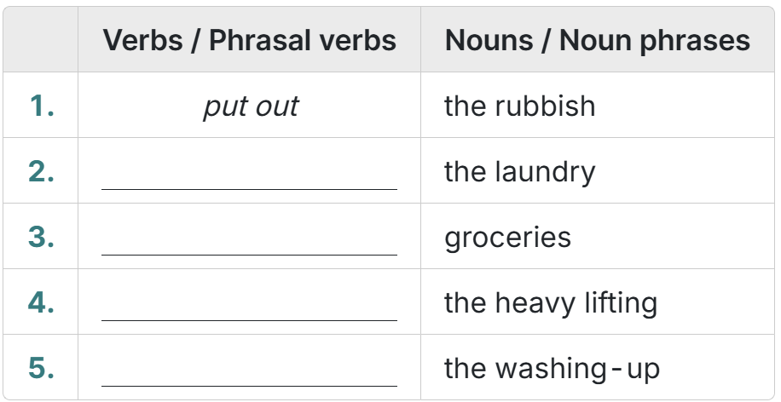
3. Write the verbs or phrasal verbs that are used with the nouns or noun phrases in the conversation in 1.
do
shop for
do
do

Slide 22
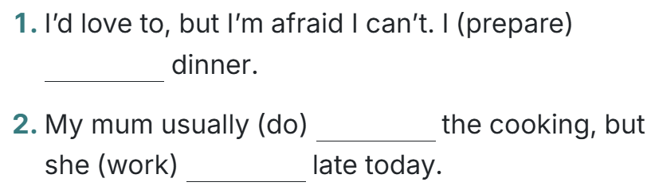
4. Complete the sentences from the conversation with the correct forms of the verbs in brackets.
‘m preparing
does
‘s working

Slide 23

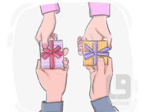
Conveyor Hot Pot Game
- 4 groups.
- 4 worksheets, 4 handouts. Each handout has two questions.
- Each group completes the worksheet within 2 minutes.
- After 2 minutes, the groups exchange the handout with each other in a clockwise direction.
- The group with the highest mark will be the winner.

Slide 24
Handout 1:
Choose the correct answer:
1. Mum is the ______________, so she does the chores.
A. breadwinner | B. homemaker | C. housewife | D. bread maker
2. She does two jobs at the same time as she is the main ______________ of the family.
A. breadwinner | B. homemaker | C. housewife | D. bread maker

Slide 25
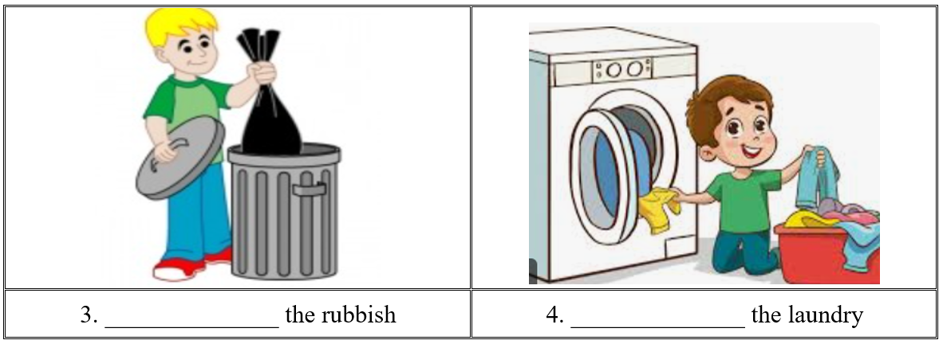
Handout 2:
Fill in the blanks
Put out
Do

Slide 26
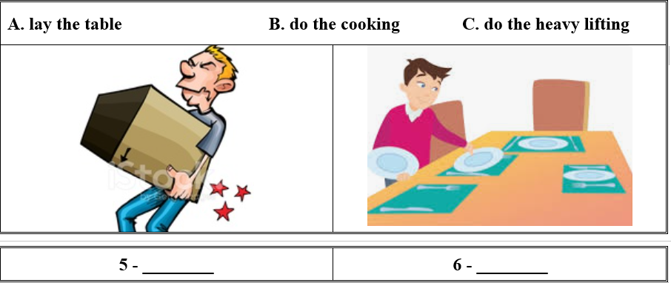
Handout 3:
Fill in the blanks
C
A

Slide 27
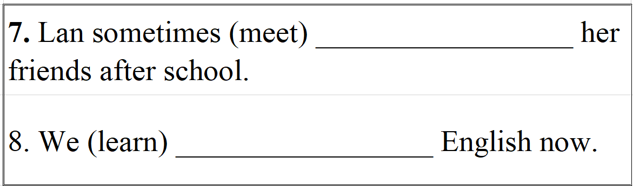
Handout 4:
Give the correct form of verbs
meets
are learning

Slide 28
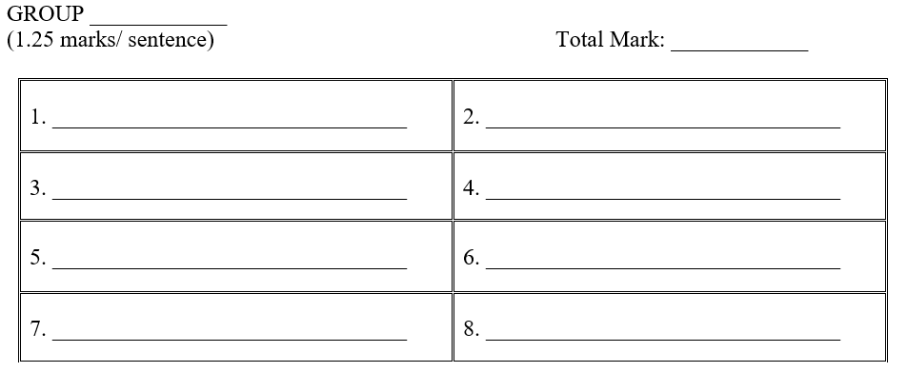
WORKSHEET

Slide 29

Consolidation
- Vocabulary: Household chores
- Grammar: Present simple & Present continuous

Slide 30

Preparing for the next lesson
▪ Prepare Unit 1. Lesson 2: Language
▪ Review: The present simple vs present continuous.

Slide 31

Rễ của học tập thì đắng,
quả của học tập thì ngọt.
Ngạn ngữ Nga

Slide 32



