Slide 1


What should we do to protect the environment?
https://wordwall.net/play/98497/867/888

Slide 2
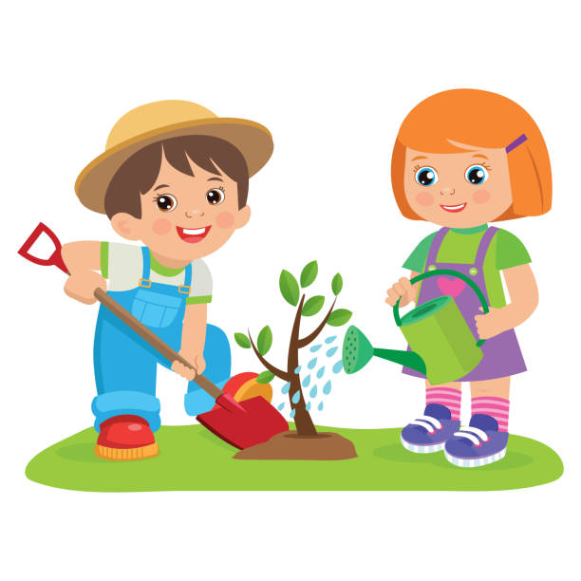
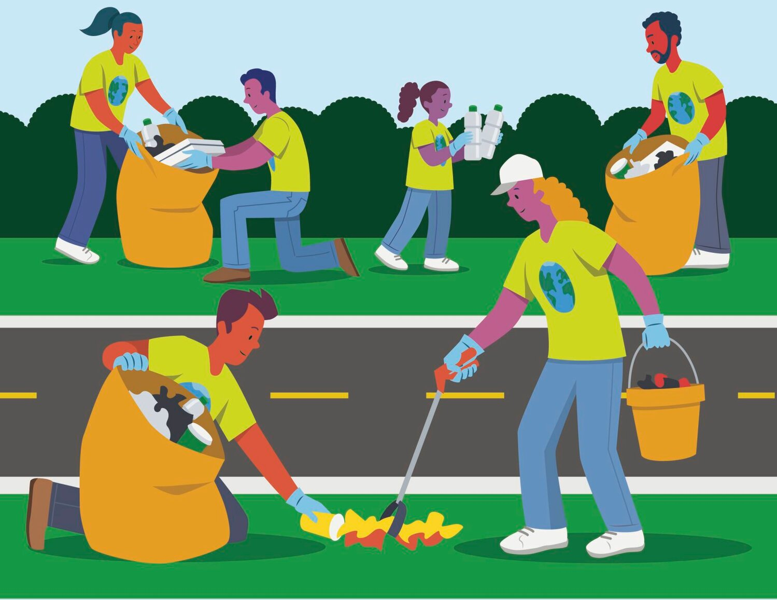
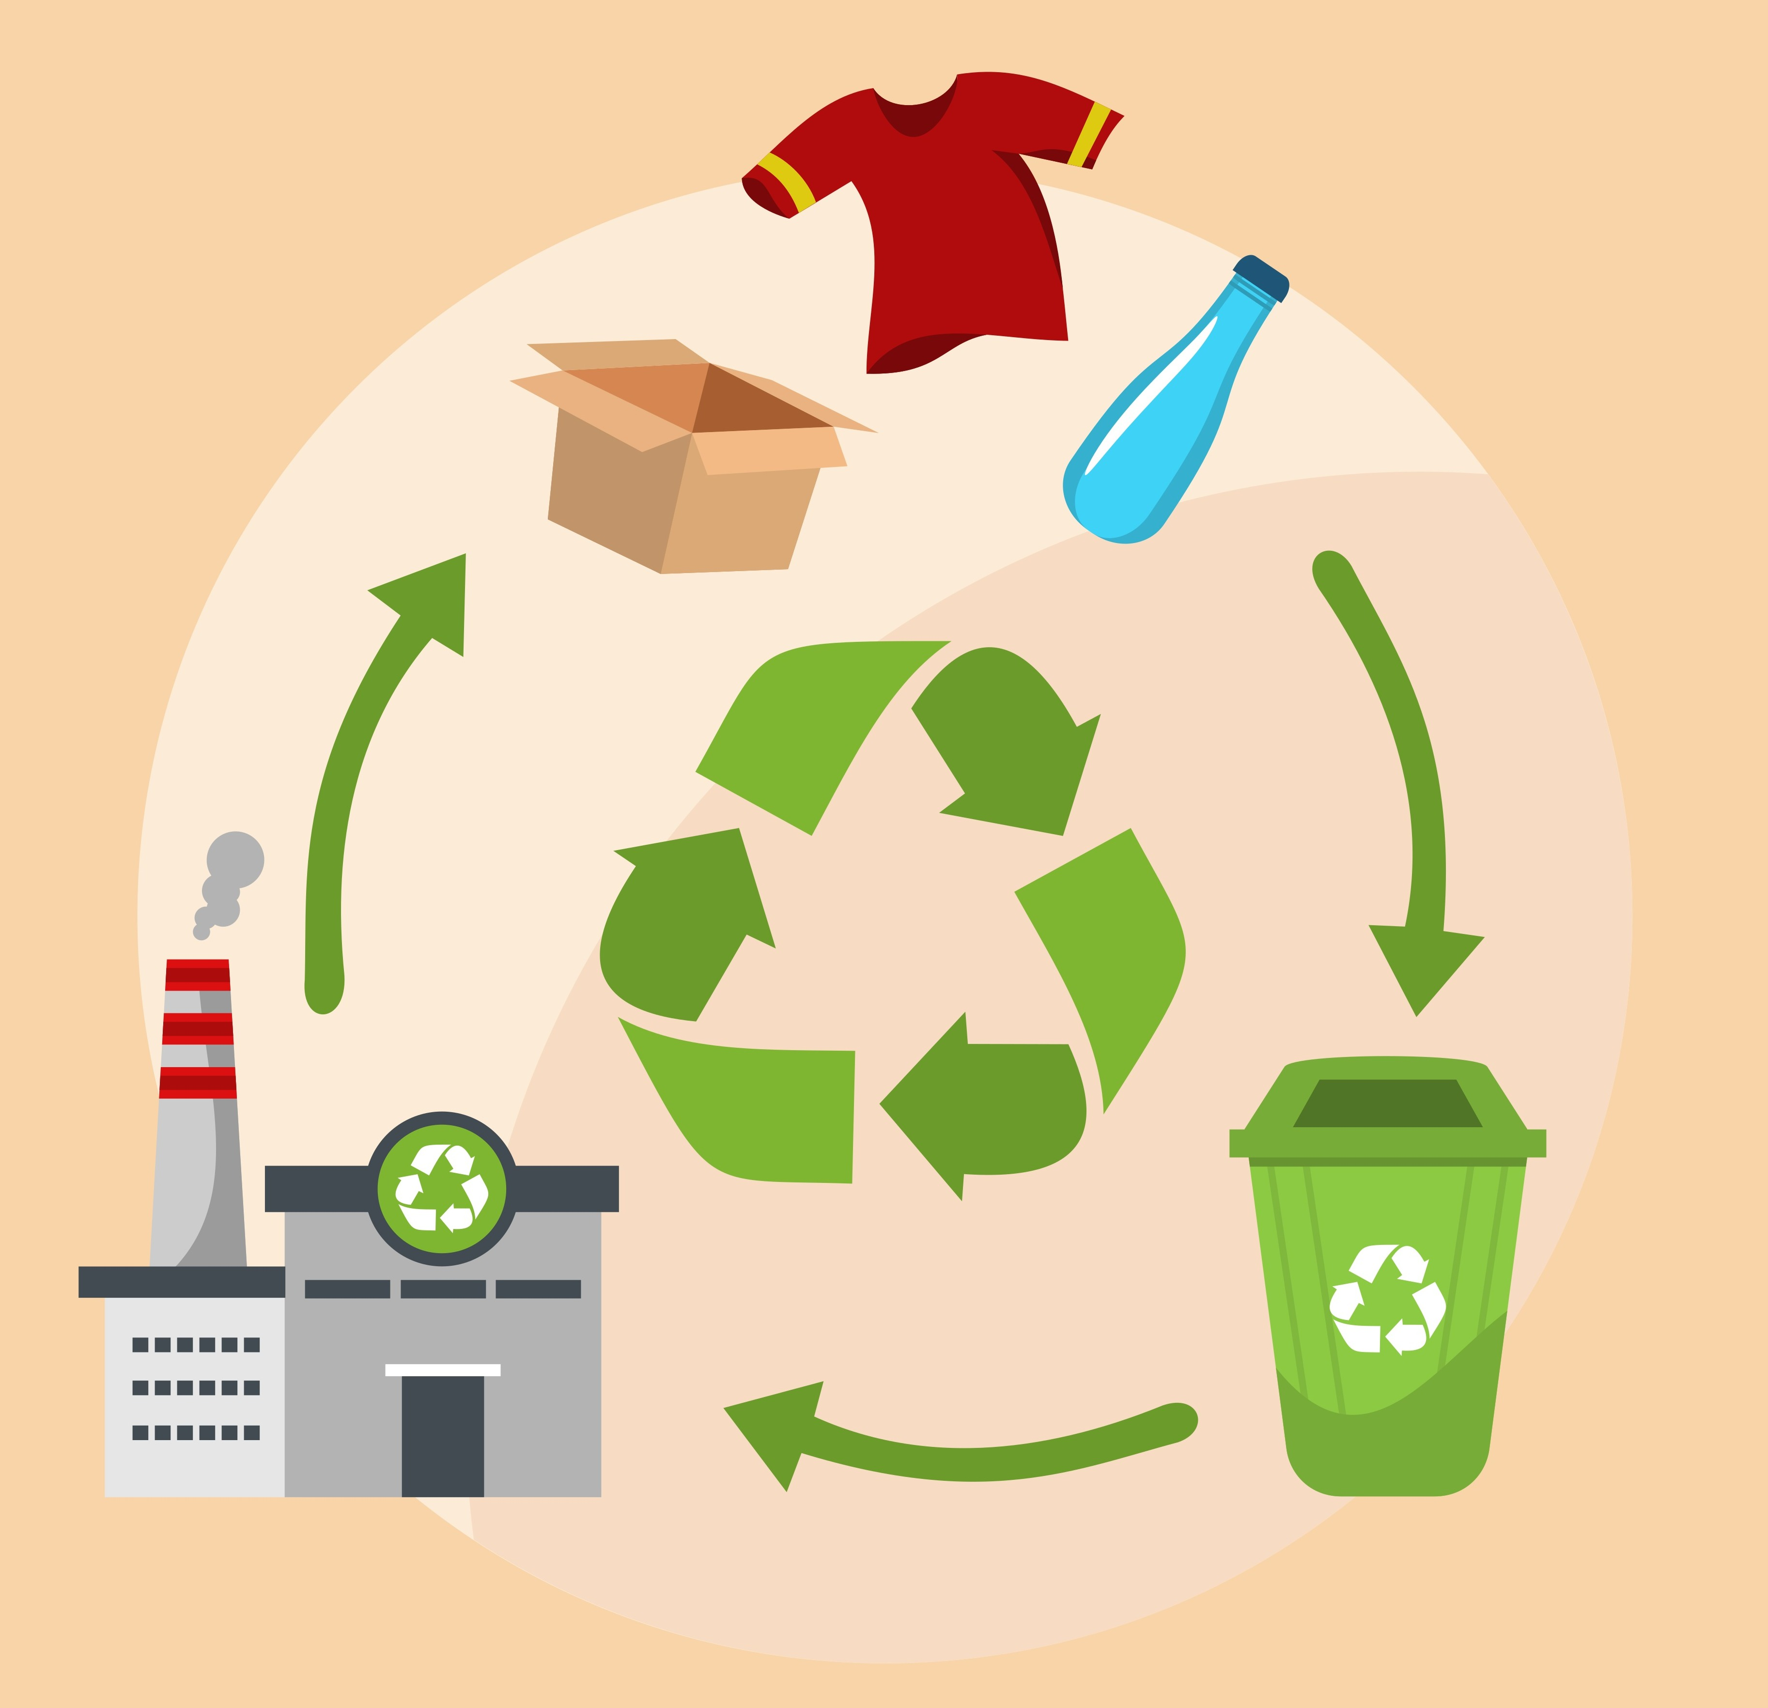
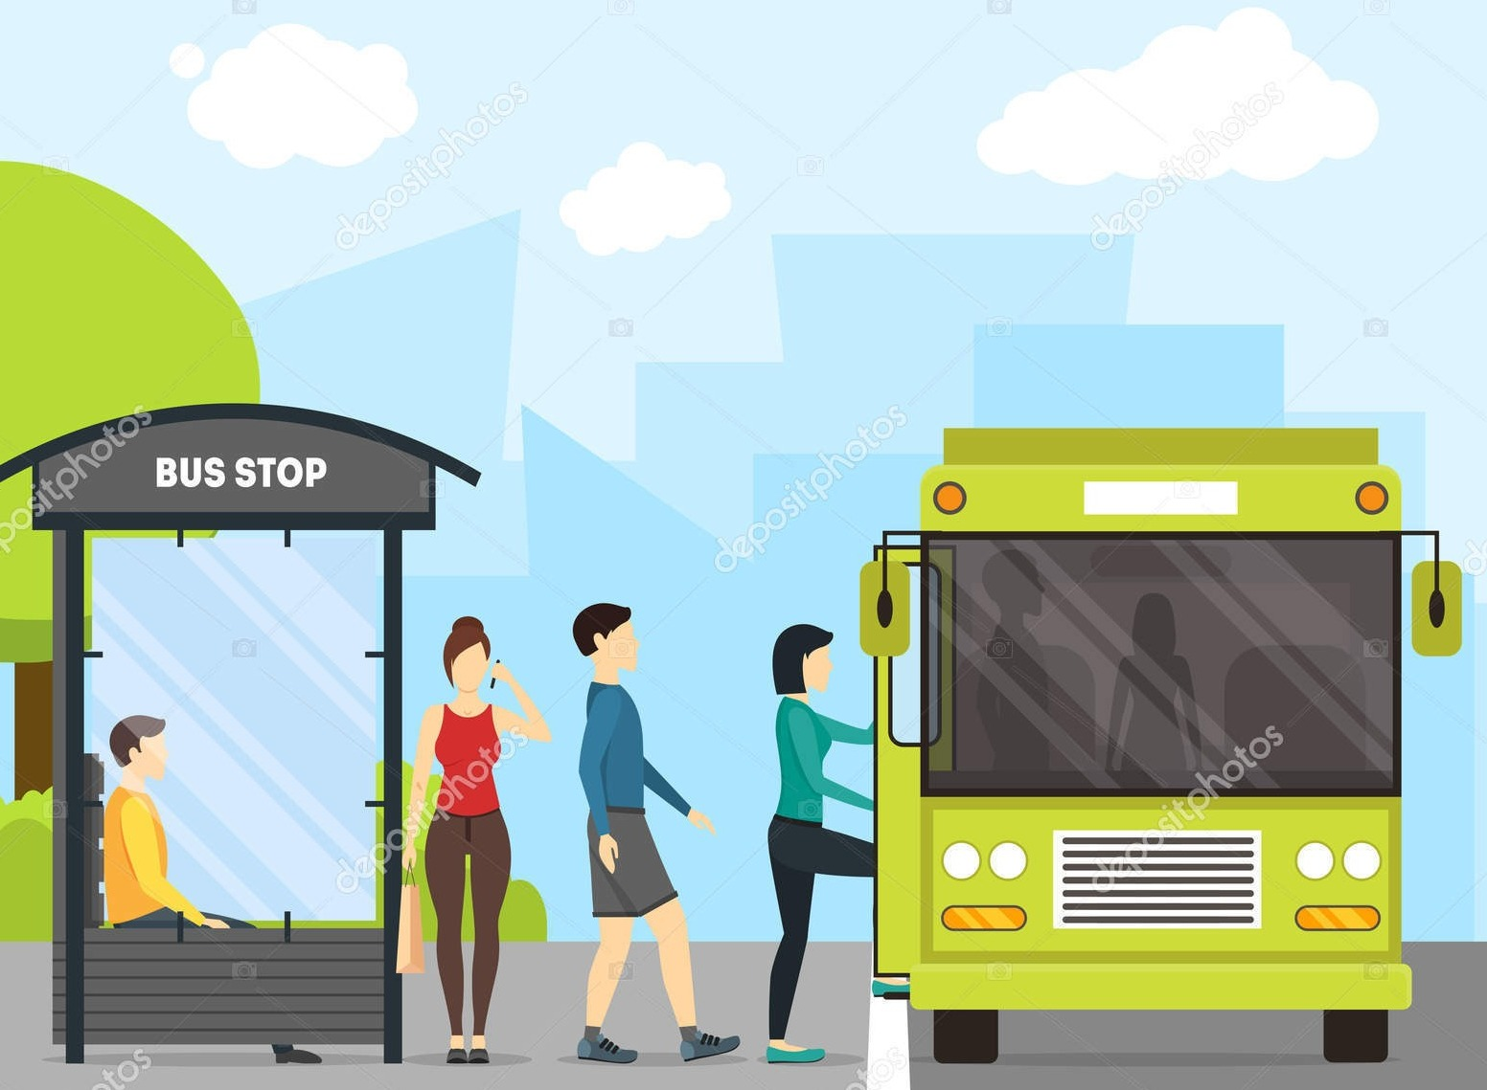
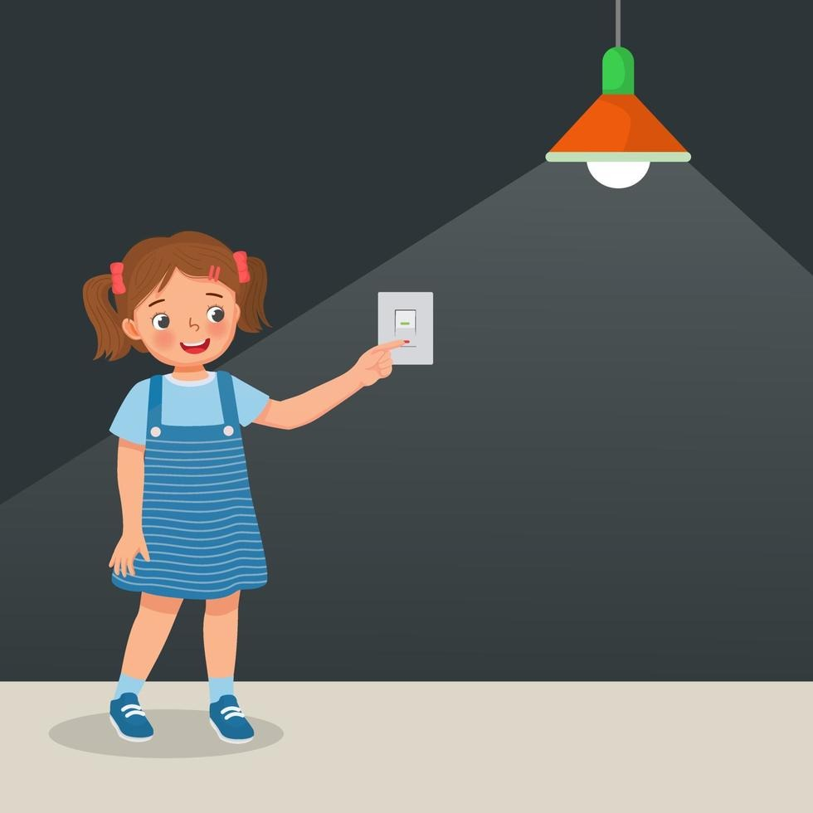
What should we do to protect the environment?
Plant trees
Pick up litter
Recycle
Use public transport
Turn off
the light

Slide 3




UNIT 2: HUMANS AND THE ENVIRONMENT
LESSON 3: READING

Slide 4

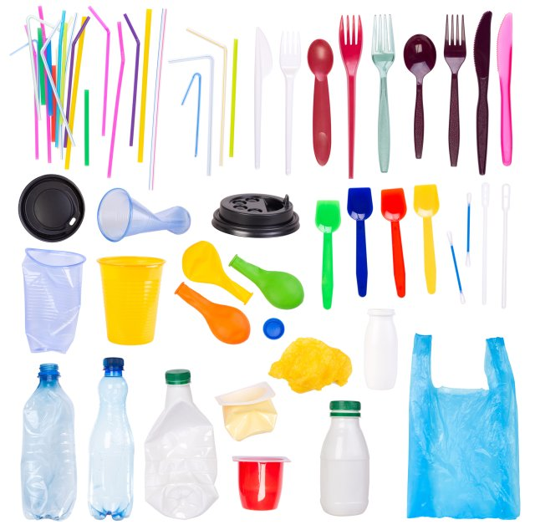
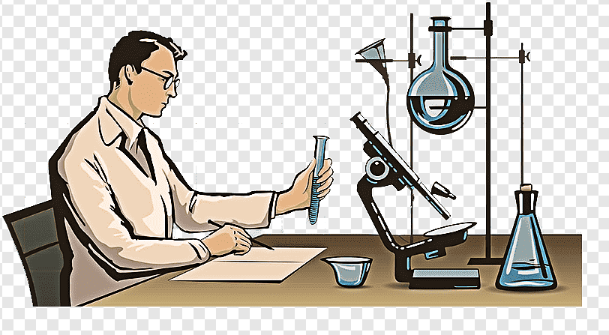
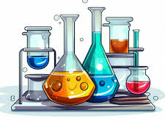
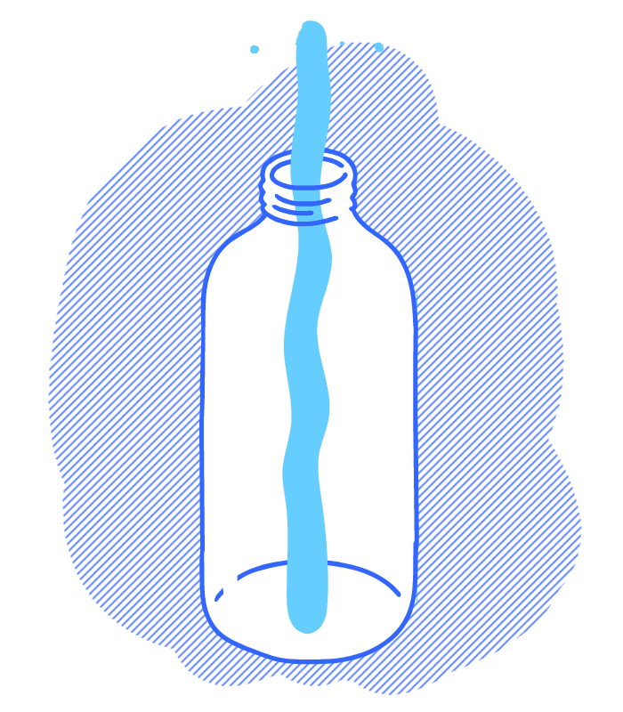


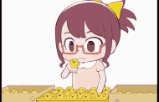
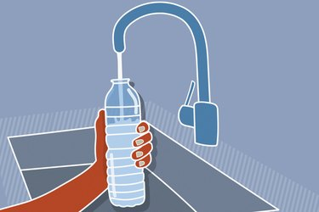
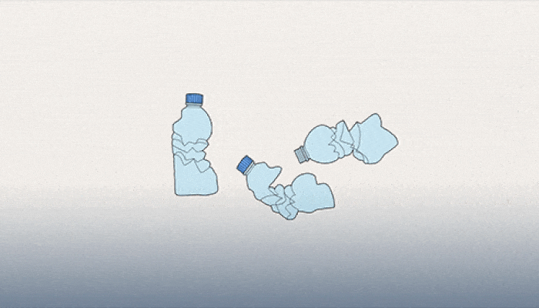
VOCABULARY
- explosion /ɪkˈspləʊʒn/ (n)
: vụ nổ
- method /ˈmeθəd/ (n)
: phương pháp
A sudden and loud noise, with fire, smoke, and damage
- chemical /ˈkemɪkl/ (n)
: hóa chất
A way of doing something
- plastic /ˈplæstɪk/ (n)
: nhựa
- refillable /ˌriːˈfɪləbl/ (a)
: có thể làm đầy lại
: nguyên liệu thô
- raw material /ˌrɑː məˈtɪəriəl/ (n.phr)
That can be filled again after being empty
: phân loại
- sort /sɔːrt/ (v)
- compulsory /kəmˈpʌlsəri/ (a)
: bắt buộc
Have to do something
- break down /breɪk daʊn/ (phr.v):
: phân hủy

Slide 5

Refillable

Slide 6
Method

Slide 7
explosion

Slide 8
Raw materials

Slide 9
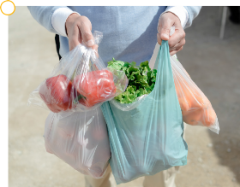
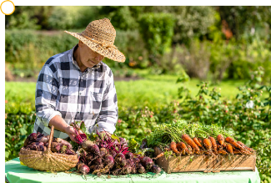
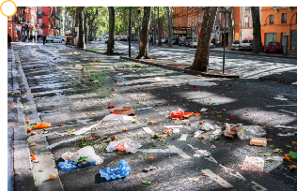
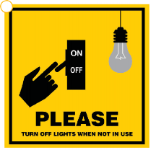
PRE-READING
1
Work in groups. Look at the pictures and answer the questions.
Which pictures show a green lifestyle? Why?
a
b
c
d

Slide 10
PRE-READING
1
Work in groups. Look at the pictures and answer the questions.
Does this picture show a green lifestyle? Why?
The man uses many plastic bags.
- Plastic bags are bad for environment.
→This picture doesn’t show a green lifestyle.
a

Slide 11
PRE-READING
1
Work in groups. Look at the pictures and answer the questions.
Does this picture show a green lifestyle? Why?
The man is using fresh vegetables.
- Fresh vegetables are good for health.
→This picture shows a green lifestyle.
b

Slide 12
PRE-READING
1
Work in groups. Look at the pictures and answer the questions.
Does this picture show a green lifestyle? Why?
There is a lot of litter on the street.
- It makes the street dirty and pollutes the environment.
→This picture doesn’t show a green lifestyle.
c

Slide 13
PRE-READING
1
Work in groups. Look at the pictures and answer the questions.
Does this picture show a green lifestyle? Why?
Turn off lights when not in use.
- It saves electricity.
→This picture shows a green lifestyle.
d

Slide 14
WHILE-READING
2
Read the following text and choose the best title for it.
It is a choice we make to change to a greener and more sustainable lifestyle.
Turning off your appliances when they are not in use
This is one of the easiest ways to save energy and reduce your carbon footprint. It also helps reduce energy bills and prevent any dangerous situations such as a fire or an explosion.
Buying products that are grown using more natural organic methods
This helps reduce the use of harmful chemicals in food. Organic food is better for us because it is safer and healthier. It also tastes better.
Cutting down on plastic use
This really helps the environment because it takes many years for plastic waste to break down into small pieces. Bring a reusable bag when you go shopping, and your own refillable bottle instead of buying bottled water.
Recycling as much as possible
This prevents pollution because it reduces the need to collect new raw materials and protects natural resources such as water and trees. So don't throw away your used household items, but sort and recycle them.
More and more people adopt a green lifestyle.
There are many things
Green living
Green issues
Green products
you can do to become an eco-friendly person. Here are some of them.
Tips
When you choose the best title, you should:
Read through the whole text.
Pay attention to the opening paragraph
Choose the title that best represents the idea of the whole text, not just part of it.

Slide 15
WHILE-READING
3
Circle the correct meanings of the highlighted words and phrases in the text.
It is a choice we make to change to a greener and more sustainable lifestyle.
Turning off your appliances when they are not in use
This is one of the easiest ways to save energy and reduce your carbon footprint. It also helps reduce energy bills and prevent any dangerous situations such as a fire or an explosion.
Buying products that are grown using more natural organic methods
This helps reduce the use of harmful chemicals in food. Organic food is better for us because it is safer and healthier. It also tastes better.
Cutting down on plastic use
This really helps the environment because it takes many years for plastic waste to break down into small pieces. Bring a reusable bag when you go shopping, and your own refillable bottle instead of buying bottled water.
Recycling as much as possible
This prevents pollution because it reduces the need to collect new raw materials and protects natural resources such as water and trees. So don't throw away your used household items, but sort and recycle them.
1. sustainable
a. causing little or no damage to the environment
b. bringing no benefits to the environment
More and more people adopt a green lifestyle.
There are many things
you can do to become an eco-friendly person. Here are some of them.
2. organic
a. without the use of animal organs
b. without the use of chemicals
3. cutting down on
a. reducing
b. reusing
4. natural resources
a. materials supporting life
b. materials harmful to life

Slide 16
WHILE-READING
4
Read the text again and decide whether the following statements are true (T) or false (F).
 | T | F
1. Green living is now compulsory for many people.
2. Turn off electrical appliances when not in use is an easy way to save energy.
3. It takes a long time for plastic waste to break down.
4. The use of refillable water bottles is not encouraged.

Slide 17



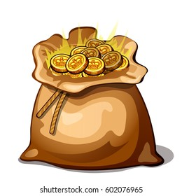




1
2
+5
:2
3
4
+4
+1
5
6
+3
x2
Notes:
GV chia lớp thành 2 đội và lần lượt trả lời câu hỏi. Với mỗi đáp án đúng, học sinh được chọn một ô cửa trên tàu và nhận số điểm tương tứng với hình đã chọn.

Slide 18

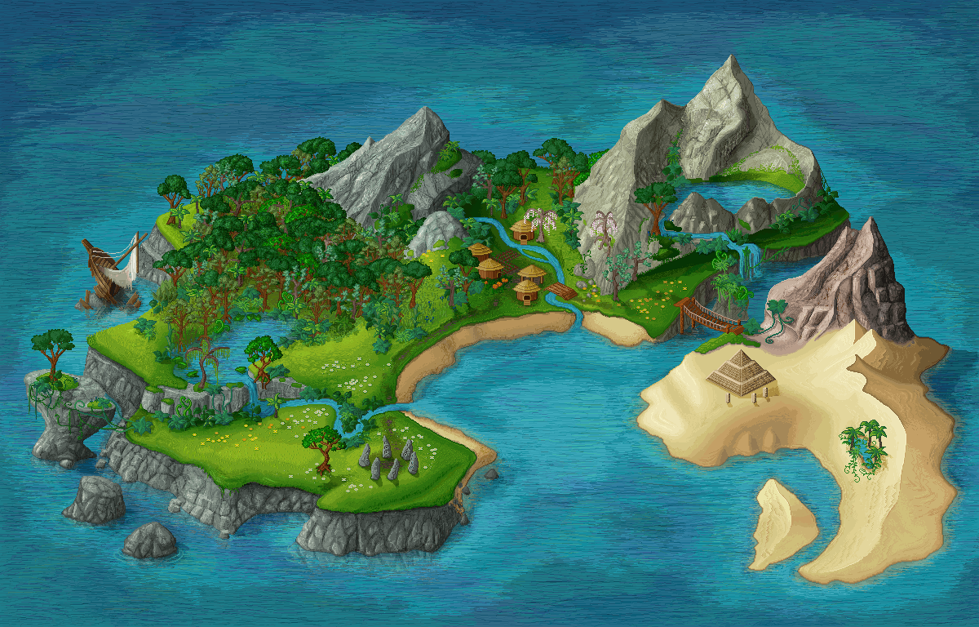



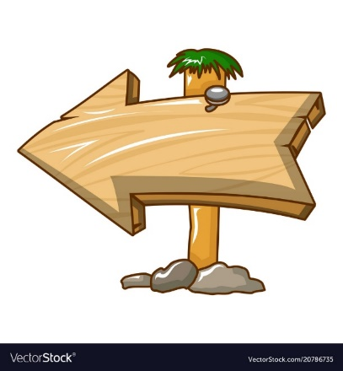
Green living is now compulsory for many people.
More and more people adopt a green lifestyle. It is a choice we make to change to a greener and more sustainable lifestyle.
True
False
There are many things you can do to become an eco-friendly person. Here are some of them.
Turning off your appliances when they are not in use
This is one of the easiest ways to save energy and reduce your carbon footprint. It also helps reduce energy bills and prevent any dangerous situations such as a fire or an explosion.
Buying products that are grown using more natural organic methods
This helps reduce the use of harmful chemicals in food. Organic food is better for us because it is safer and healthier. It also tastes better.
Cutting down on plastic use
This really helps the environment because it takes many years for plastic waste to break down into small pieces. Bring a reusable bag when you go shopping, and your own refillable bottle instead of buying bottled water.
Recycling as much as possible
This prevents pollution because it reduces the need to collect new raw materials and protects natural resources such as water and trees. So don't throw away your used household items, but sort and recycle them.
NEXT

Slide 19


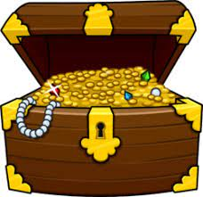
What are on the ship?
Let’s choose one window!
A
B
C

Slide 20
Turning off electrical appliances when not in use is an easy way to save energy.
More and more people adopt a green lifestyle. It is a choice we make to change to a greener and more sustainable lifestyle.
True
There are many things you can do to become an eco-friendly person. Here are some of them.
and reduce your carbon footprint. It also helps reduce energy bills and prevent any dangerous situations such as a fire or an explosion.
Buying products that are grown using more natural organic methods
This helps reduce the use of harmful chemicals in food. Organic food is better for us because it is safer and healthier. It also tastes better.
Cutting down on plastic use
This really helps the environment because it takes many years for plastic waste to break down into small pieces. Bring a reusable bag when you go shopping, and your own refillable bottle instead of buying bottled water.
Recycling as much as possible
This prevents pollution because it reduces the need to collect new raw materials and protects natural resources such as water and trees. So don't throw away your used household items, but sort and recycle them.
False
Turning off your appliances when they are not in use
This is one of the easiest ways to save energy
NEXT

Slide 21

What are on the ship?
Let’s choose one window!
A
B
C

Slide 22
LUCKY NUMBER!
NEXT

Slide 23
What are on the ship?
Let’s choose one window!
A
B
C

Slide 24
LUCKY NUMBER!
NEXT

Slide 25
What are on the ship?
Let’s choose one window!
A
B
C

Slide 26

It takes a long time for plastic waste to break down.
More and more people adopt a green lifestyle. It is a choice we make to change to a greener and more sustainable lifestyle.
True
False
There are many things you can do to become an eco-friendly person. Here are some of them.
Turning off your appliances when they are not in use
This is one of the easiest ways to save energy and reduce your carbon footprint. It also helps reduce energy bills and prevent any dangerous situations such as a fire or an explosion.
Buying products that are grown using more natural organic methods
This helps reduce the use of harmful chemicals in food. Organic food is better for us because it is safer and healthier. It also tastes better.
Cutting down on plastic use
This really helps the environment
Bring a reusable bag when you go shopping, and your own refillable bottle instead of buying bottled water.
Recycling as much as possible
This prevents pollution because it reduces the need to collect new raw materials and protects natural resources such as water and trees. So don't throw away your used household items, but sort and recycle them.
NEXT
NEXT
because it takes many years for plastic waste to break down into small pieces.

Slide 27
What are on the ship?
Let’s choose one window!
A
Bb
Cc

Slide 28
The use of refillable water bottles is not encouraged.
More and more people adopt a green lifestyle. It is a choice we make to change to a greener and more sustainable lifestyle.
There are many things you can do to become an eco-friendly person. Here are some of them.
Turning off your appliances when they are not in use
This is one of the easiest ways to save energy and reduce your carbon footprint. It also helps reduce energy bills and prevent any dangerous situations such as a fire or an explosion.
Buying products that are grown using more natural organic methods
This helps reduce the use of harmful chemicals in food. Organic food is better for us because it is safer and healthier. It also tastes better.
Cutting down on plastic use
This really helps the environment because it takes many years for plastic waste to break down into small pieces.
Recycling as much as possible
This prevents pollution because it reduces the need to collect new raw materials and protects natural resources such as water and trees. So don't throw away your used household items, but sort and recycle them.
True
False
NEXT
Bring a reusable bag when you go shopping, and your own refillable bottle instead of buying bottled water.

Slide 29
What are on the ship?
Let’s choose one window!
A
B
C

Slide 30
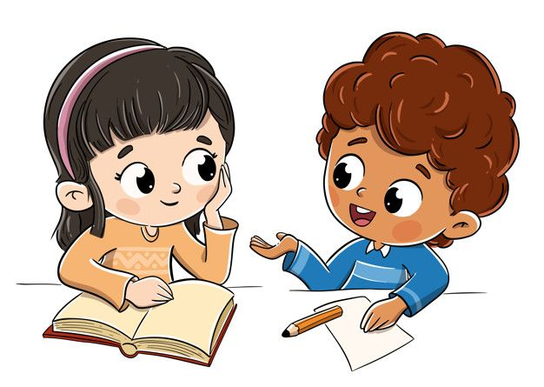
POST-READING
5
Work in pairs. Discuss the following questions.
In your opinion, which of the suggestions in the text is the easiest way to live green?
Turning off appliances when not in use
Buying natural and organic products
Live green
Cutting down plastic use
Recycling

