Slide 1


Slide 2



WARMLY WELCOME TEACHERS!

Slide 3

Unit
1
1
FAMILY LIFE
Family Life
Unit
OBJECTIVES
Gain an overview about the topic Inventions for education.
Memorize vocabulary to talk about inventions for education.

Slide 4
LESSON 1
GETTING STARTED
Unit
GETTING STARTED
Guessing game
WARM-UP
Vocabulary
PRESENTATION
Activity 1: Listen and read.
Activity 2: Read the conversation again and answer the following questions.
Activity 3: Find three nouns and three adjectives in the conversation in activity 1 to talk about inventions. Follow the example.
Activity 4: Fill in the gap in the summary of the conversation with ONE word from activity 1.
PRACTICE
CONSOLIDATION
Wrap-up
Home work

Slide 5
WARM-UP
Act.1: Guessing Game: What invention is it?
3 cues/ an answer
-the 1st cue → give correct answer → get 3 candies.
-the 2nd cue → give correct answer → get 2 candies.
-the 3rd cue → give correct answer → get 1 candy.

Slide 6
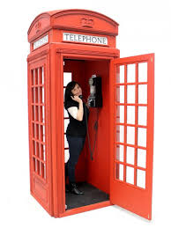


What is it?
1. We can use it to make calls.
2. It is portable.
3. It can be used for surfing the Internet.

Slide 7
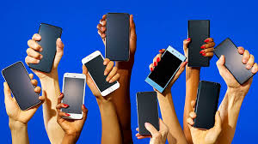
a smartphone

Slide 8
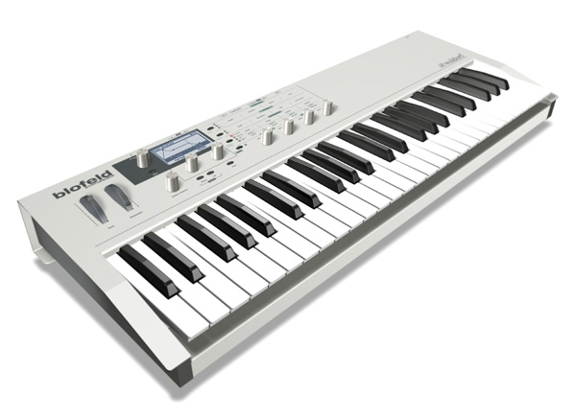
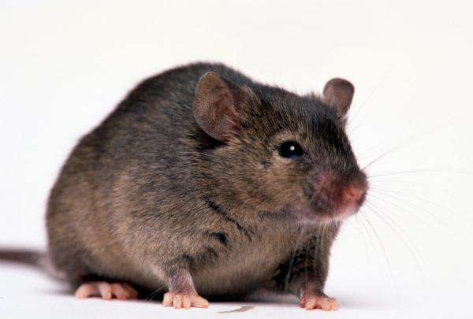
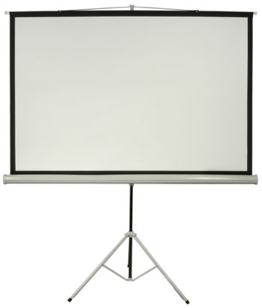
What is it?
1. It has a keyboard.
2. It has a mouse.
3. It has a screen.

Slide 9
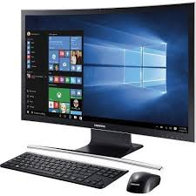
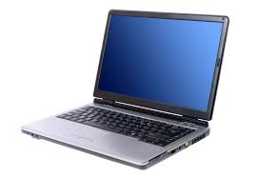
a computer system
a laptop

Slide 10
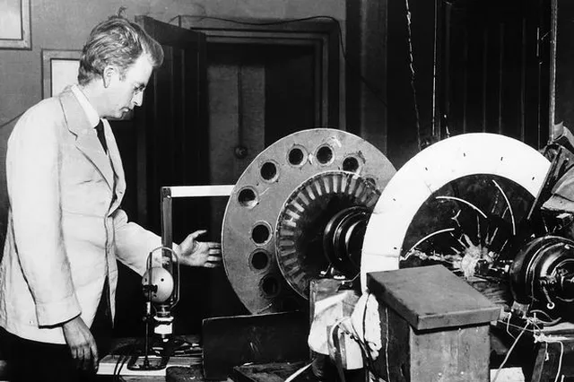
What is it?
It was first introduced in 1928
by John Logie Baird.
2. It has a speaker, a big green, a remote control
3. People watch news, documentary and film on it everyday

Slide 11
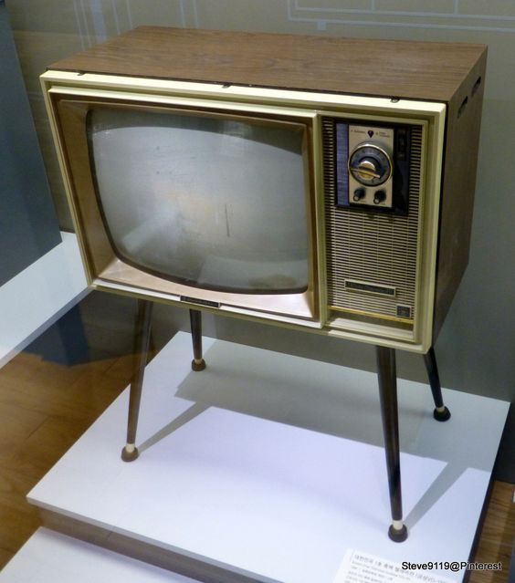
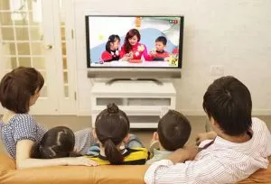
A television

Slide 12

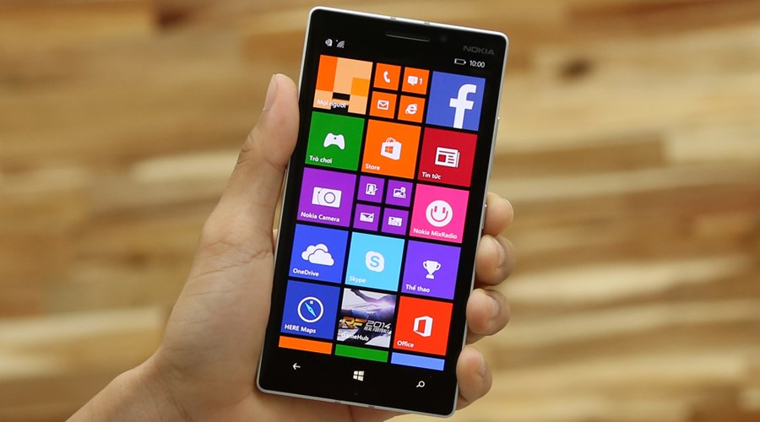
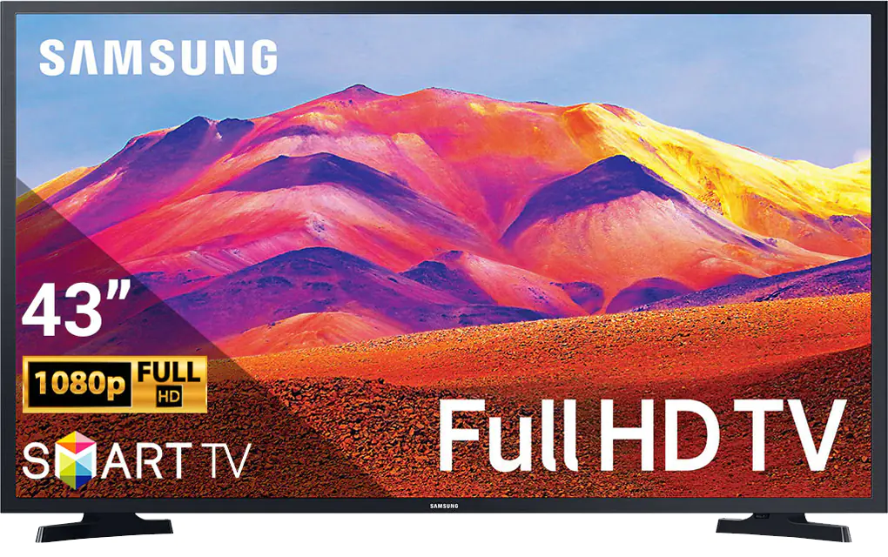
Among three devices, which one is useful for your learning? Why (not)?

Slide 13
UNIT 5
INVENTIONS
Lesson 1: GETTING STARTED
INVENTIONS FOR EDUCATION

Slide 14
Vocabulary

Slide 15

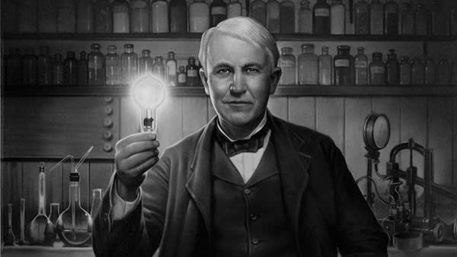

Unit
5
1
Unit
FAMILY LIFE
Unit
5
II. PRESENTATION
INVENTIONS
1
FAMILY LIFE
1. Vocabulary
⋅ invent (v)
/ɪnˈvent/
⋅ invention (n)
⋅ inventor (n)
to produce or design something that has not existed before
PRESENTATION
INVENTIONS

Slide 16

Unit
5
II. PRESENTATION
INVENTIONS
1
Unit
FAMILY LIFE
1. Vocabulary
⋅ improve (v)
/ɪmˈpru:v/
⋅ improvement (n)
to become better than before

Slide 17

VOCABULARY
3. Suitable (a)
/ˈsuːtəbl/
right or appropriate for a particular purpose or occasion

Slide 18
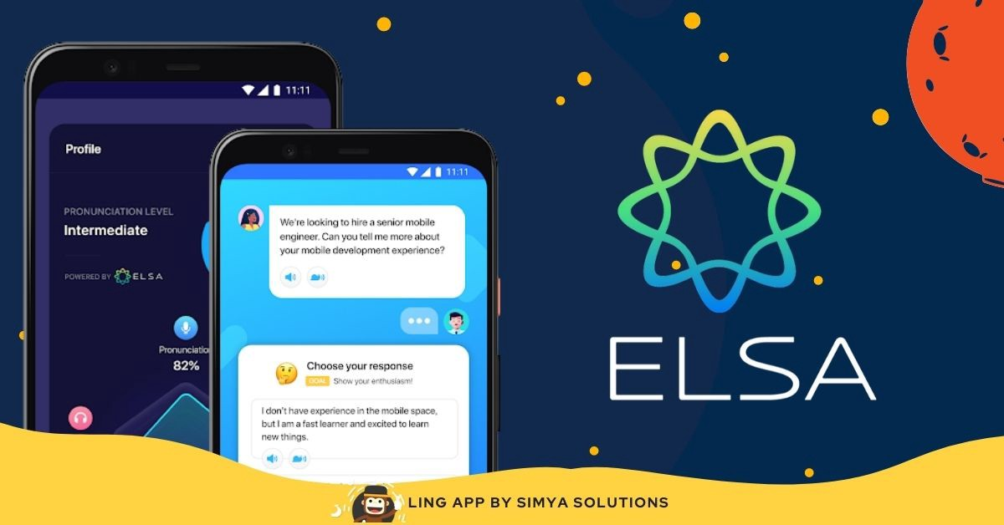
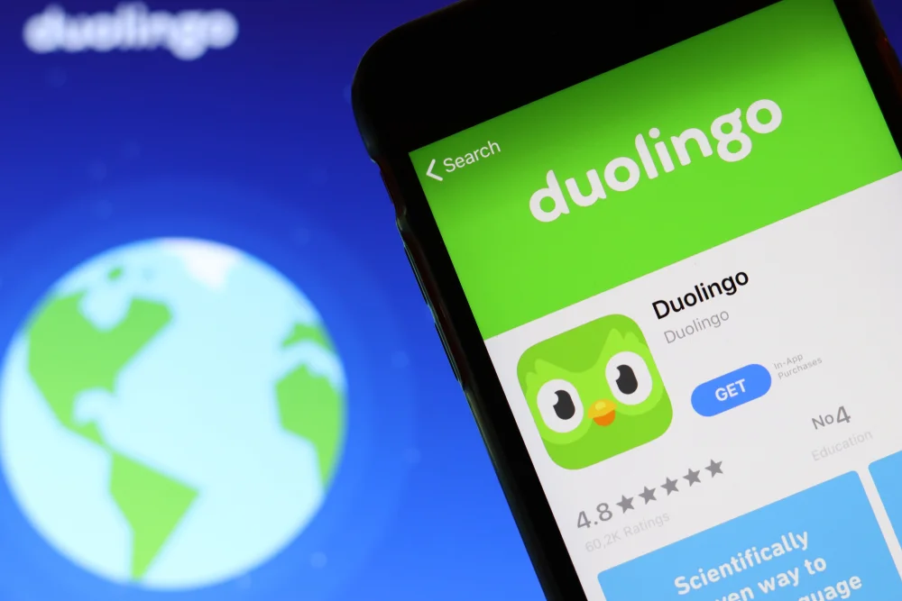

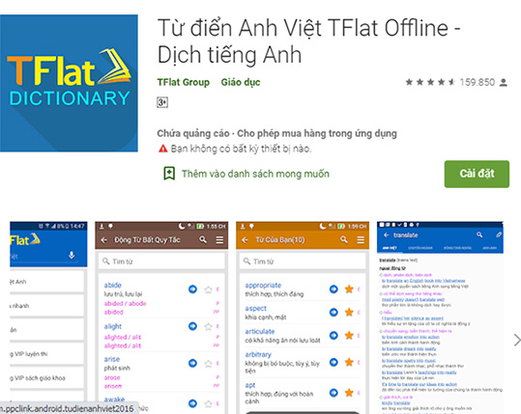
VOCABULARY
4. App (n)
/æp/
a piece of software that you can download to a device such as a smartphone or tablet

Slide 19

VOCABULARY
5. Convenient (a)
/kənˈviːniənt/
⋅ Convenience (n)
Ex: By using smartphone, we can buy many things online without going to the supermarket, so it is very convenient.

Slide 20
VOCABULARY
New words | Pronunciation | Meaning
1. invent (v) | /ɪnˈvent/ | phát minh
2. improve (v) | /ɪmˈpruːv/ | ​cải thiện
3. suitable (a) | /ˈsuːtəbl/ or /ˈsjuːtəbl/ | phù hợp
4. app (n) | /æp/ | ứng dụng
5. convenient (a) | /kənˈviːniənt/ | tiện lợi, thuận tiện

Slide 21


Slide 22


Inventions
for education

Slide 23


Fill in the blank
app
It’s a piece of software that you can download .

Slide 24

Fill in the blank
convenient
It’s an adjective. Being useful, easy or quick to do.

Slide 25
Fill in the blank
improve
Becoming better than before;

Slide 26

Fill in the blank
invent
Producing something that has not existed before

Slide 27
Fill in the blank
suitable
It’s right or appropriate for a particular purpose .

Slide 28
LESSON 1
GETTING STARTED
Unit
GETTING STARTED
WARM-UP
Guessing game
PRESENTATION
Vocabulary
Activity 1: Listen and read.
Activity 2: Read the conversation again and answer the following questions.
Activity 3: Find three nouns and three adjectives in the conversation in activity 1 to talk about inventions. Follow the example.
Activity 4: Fill in the gap in the summary of the conversation with ONE word from activity 1.
PRACTICE

Slide 29
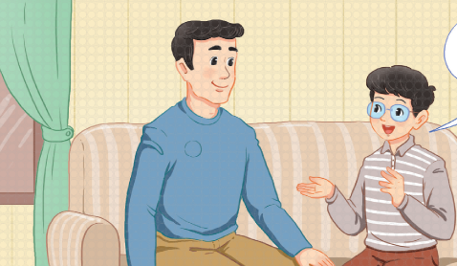
PRACTICE
1
Listen and read.
Inventions for education

Slide 30
PRACTICE
1
Listen and read.
Inventions for education
Phong: Dad, I’ve saved some money since Tet holiday. I think I’ll buy something new for my studies.
Dad: Good idea, Phong. What do you want to buy?
Phong: I’m not sure. It’s hard to choose between a smartphone and a laptop. They’re both useful and I’ve wanted either of them for a long time. What do you think, Dad?
Dad: Perhaps a laptop is a better choice. Since laptops were invented, they’ve allowed us to study better and work faster. They’ve completely changed our lives in the last 20 years.
Phong: That’s true, Dad. But smartphones have also improved the way we work and study.

Slide 31
PRACTICE
1
Listen and read.
Inventions for education
Dad: Really? I didn’t know smartphones were suitable for learning.
Phong: Well, it’s actually a lot of fun to learn with educational apps. It’s also very convenient for learners to use them. Some of my classmates love using them on their smartphones. The apps allow them to communicate and learn at the same time.
Dad: I didn’t know that! There have been so many valuable inventions. Hmm … Perhaps you should ask your teacher. She may be able to help you decide.

Slide 32
Task 2: Read the conversation again and answer the following questions
PRACTICE
1. What inventions are Phong and his dad talking about?
-> ………………………................................................................
2. When did Phong start saving money?
-> ………………………................................................................
3. Is it hard for Phong to choose between a laptop and a smartphone?
-> ………………………................................................................
4. How useful are laptops?
-> ………………………................................................................
5. Why is it fun and convenient to learn with educational apps on smartphones?
-> ………………………................................................................

Slide 33
PRACTICE
PRACTICE
2
Read the conversation again and answer the following questions.
GAME: LUCKY NUMBER
1
2
3
4
5
6

Slide 34

PRACTICE
PRACTICE
2
Read the conversation again and answer the following questions.
GAME: LUCKY NUMBER
2. When did Phong start saving money?
A. Since Tet holiday
B. Since summer holiday
A
10

Slide 35

PRACTICE
PRACTICE
2
Read the conversation again and answer the following questions.
GAME: LUCKY NUMBER
4. How useful are laptops?
A. They’ve allowed us to study better and work faster
B. They’ve allowed us to travel and surf the internet faster.
A
15

Slide 36

PRACTICE
PRACTICE
2
Read the conversation again and answer the following questions.
GAME: LUCKY NUMBER
5. Why is it fun and convenient to learn with educational apps on smartphone?
A. The apps allow students to talk and learn at the same time.
B. The apps allow students to communicates and learn at the same time.
B
5

Slide 37
PRACTICE
PRACTICE
2
Read the conversation again and answer the following questions.
GAME: LUCKY NUMBER
1. What inventions are Phong and his dad talking about?
A. Smartphone
B. Smartphone and laptop
B
10

Slide 38
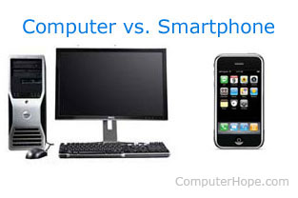
PRACTICE
PRACTICE
2
Read the conversation again and answer the following questions.
GAME: LUCKY NUMBER
3. Is it hard for Phong to choose between a laptop and a smartphone?
A. Yes, it is.
B. No, it isn’t.
A
5

Slide 39

PRACTICE
PRACTICE
2
Read the conversation again and answer the following questions.
GAME: LUCKY NUMBER
15

Slide 40
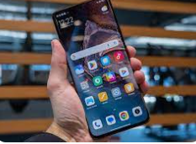



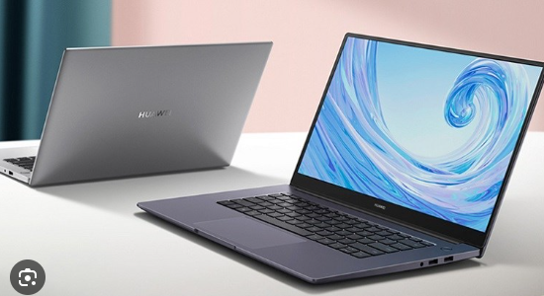

PRACTICE
3
Find out a suitable word for the picture. Follow the example.
Useful
Smartphone
Suitable
Laptop
Apps
Valuable

Slide 41
PRACTICE
3
Find out a suitable word for the picture. Follow the example.
Useful
Smartphone
Suitable
Laptop
Apps
Valuable
Smartphone

Slide 42
PRACTICE
3
Find out a suitable word for the picture. Follow the example.
Useful
Smartphone
Suitable
Laptop
Apps
Valuable
Valuable

Slide 43
PRACTICE
3
Find out a suitable word for the picture. Follow the example.
Useful
Useful
Smartphone
Suitable
Laptop
Apps
Valuable
Useful

Slide 44
PRACTICE
3
Find out a suitable word for the picture. Follow the example.
Useful
Smartphone
Suitable
Laptop
Apps
Valuable
Apps

Slide 45
PRACTICE
3
Find out a suitable word for the picture. Follow the example.
Useful
Smartphone
Suitable
Laptop
Apps
Valuable
Laptop

Slide 46
PRACTICE
3
Find out a suitable word for the picture. Follow the example.
Useful
Smartphone
Suitable
Laptop
Apps
Valuable
Suitable

Slide 47
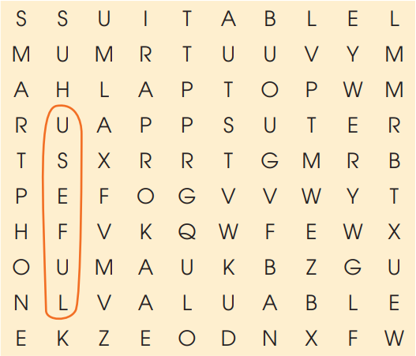
PRACTICE
3
Find three nouns and three adjectives in the conversation in activity 1 to talk about inventions. Follow the example.
Useful
Smartphone
Suitable
Laptop
Apps
Valuable

Slide 48
Task 4:
Fill in the gap in the summary of the conversation with ONE word from activity 1.
Phong and his father are discussing what to buy for his studies. Phong has wanted a laptop or a smartphone (1) _______ a long time because they are both very useful. Laptops (2) _________ completely changed our lives since their invention, but smartphones have also (3) _________ they way we work and study. For example, it’s fun (4) _________ study with educational apps on smartphones. They allow students (5) _________ (6) _________ and communicate at the same time. It’s really difficult for Phong to choose between the two.
for
have
changed
to
to
learn

Slide 49
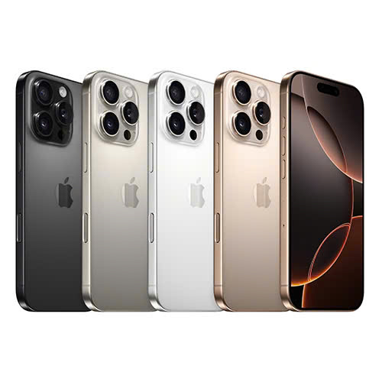

Unit
5
INVENTIONS
II. PRESENTATION
1
III. PRACTICE
FAMILY LIFE
5
Discussion: Which one would you like to choose? Why?

Slide 50
Which one would you like to choose? Why?
1/ Do you think a smartphone or a laptop helps you a lot in your study?
Why? / Why not
2/ Have you ever downloaded an app for learning English in your smartphone? What is it?
3/ How do you learning English with a smartphone or a laptop?

Slide 51
Unit
5
II. PRESENTATION
III. PRACTICE
INVENTIONS
IV. CONSOLIDATION
1
Unit
FAMILY LIFE
1
Wrap-up
• Memorize vocabulary to talk about Inventions.
2
Homework
• Do exercises in the workbook.
• Prepare for the next lesson. (LANGUAGE)

Slide 52
SEE YOU NEXT TIME !!

