Slide 1






Good afternoom!
Welcome to our class

Slide 2
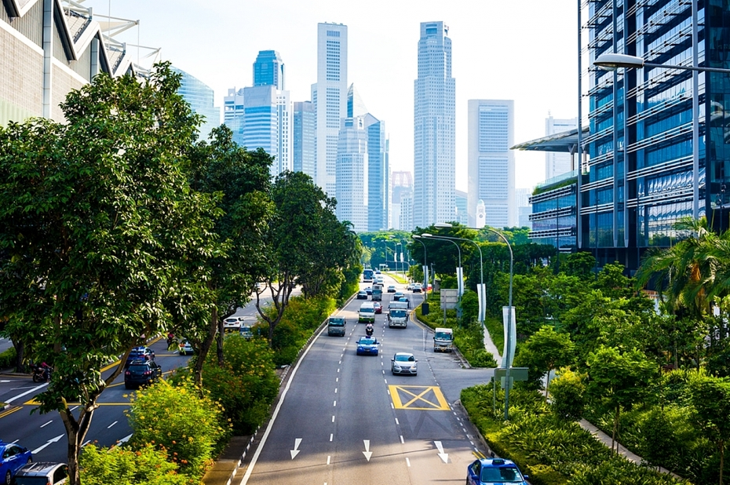
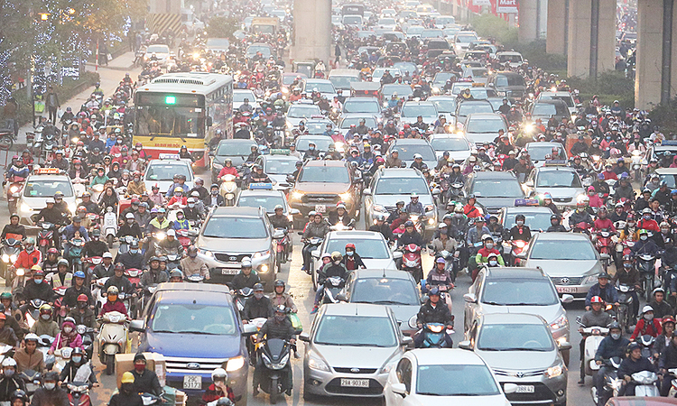
Which of two cities below would you like to live in?
Why?
1
2
If given a choice, what lifestyle would you choose?
Green lifestyle
I’ d like to live in the first city
because it’s clean, with lots of trees and fresh air, living there people will be healthier
The second city has a lot of traffic, so it has noise pollution, air pollution, it affects human health

Slide 3

Unit
2
1
Unit
FAMILY LIFE
HUMANS AND THE ENVIRONMENT
LESSON 3
READING

Slide 4
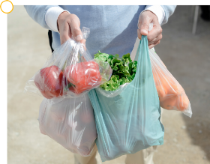
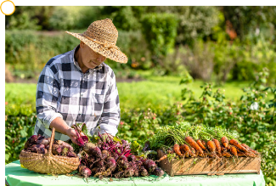
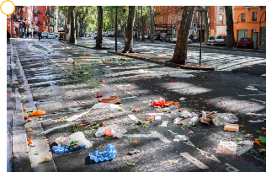
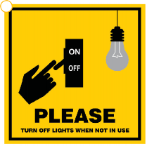
1
Work in groups. Look at the pictures and answer the questions.
Which pictures show a green lifestyle? Why?
a
b
c
d

Slide 5
1
Work in groups. Look at the pictures and answer the questions.
a
In this picture, a man goes shopping with lots of plastic bags. It doesn’t show a green lifestyle. Plastic bags pollute the environment since they take time to decay.

Slide 6
1
Work in groups. Look at the pictures and answer the questions.
b
In this picture, we can see fresh food, which looks organic and is better for our health.
It shows a green lifestyle.

Slide 7
1
Work in groups. Look at the pictures and answer the questions.
c
In this picture, we can see a lot of litter on the ground. Dropping litter makes the streets very dirty and pollutes the air and water. It doesn’t show a green lifestyle.

Slide 8
1
Work in groups. Look at the pictures and answer the questions.
d
In this picture, the sign advises people to turn off lights when they are not in use. This can save electricity and shows a green lifestyle.

Slide 9
2. Read the following text and choose the best title for it.
Green living
B. Green issues
C. Green products
More and more people adopt a green lifestyle. It is a choice we make to change to a greener and more sustainable lifestyle. There are many things you can do to become an eco-friendly person. Here are some of them.
Turning off your appliances when they are not in use
This is one of the easiest ways to save energy and reduce your carbon footprint. It also helps reduce energy bills and prevent any dangerous situations such as a fire or an explosion.
Buying products that are grown using more natural organic methods
This helps reduce the use of harmful chemicals in food. Organic food is better for us because it is safer and healthier. It also tastes better.
Cutting down on plastic use
This really helps the environment because it takes many years for plastic waste to break down into small pieces. Bring a reusable bag when you go shopping, and your own refillable bottle instead of buying bottled water.
Recycling as much as possible
This prevents pollution because it reduces the need to collect new raw materials and protects natural resources such as water and trees. So don't throw away your used household items, but sort and recycle them.

Slide 10


VOCABULARY
explosion (n)
/ɪkˈspləʊʒn/
A violent burst, often with a loud noise
Vụ nổ

Slide 11
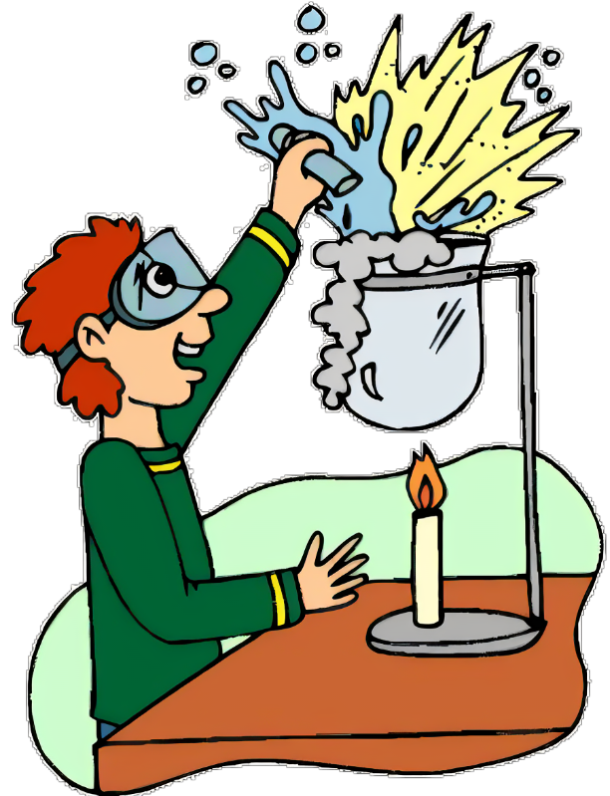
VOCABULARY
method (n)
/ˈmeθəd/
a way of doing st
phương pháp

Slide 12
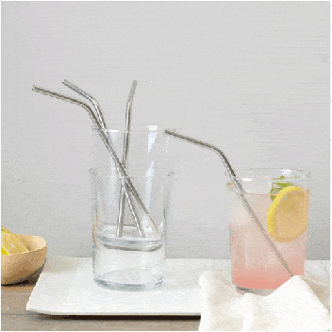
VOCABULARY
refillable (adj)
/ˌriːˈfɪləbl/
that can be filled again after being empty
có thể làm đầy lại

Slide 13
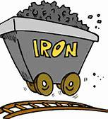
VOCABULARY
raw material (n.phr.)
/ˌrɑː məˈtɪəriəl/
any material, such as oil, cotton, or sugar in its natural condition, before it has been processed for use
nguyên liệu thô

Slide 14
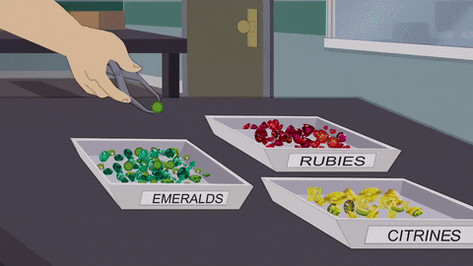
VOCABULARY
sort (v)
/sɔːt/
put a number of things in an order or to separate them into groups
phân loại

Slide 15
VOCABULARY
New words | Pronunciation | Meaning
explosion (n) | /ɪkˈspləʊʒn/ | a violent burst, often with a loud noise a bomb/nuclear/gas explosion
method (n) | /ˈmeθəd/ | a way of doing something
refillable (adj) | /ˌriːˈfɪləbl/ | that can be filled again after being empty
raw material (n.phr.) | /ˌrɔː məˈtɪəriəl/ | any material, such as oil, cotton or sugar in its natural condition, before it has been processed for use
sort (v) | /sɔːt/ | put a number of things in an order or to separate them into groups

Slide 16
2. Read the following text and choose the best title for it.
Green living
B. Green issues
C. Green products
More and more people adopt a green lifestyle. It is a choice we make to change to a greener and more sustainable lifestyle. There are many things you can do to become an eco-friendly person. Here are some of them.
Turning off your appliances when they are not in use
This is one of the easiest ways to save energy and reduce your carbon footprint. It also helps reduce energy bills and prevent any dangerous situations such as a fire or an explosion.
Buying products that are grown using more natural organic methods
This helps reduce the use of harmful chemicals in food. Organic food is better for us because it is safer and healthier. It also tastes better.
Cutting down on plastic use
This really helps the environment because it takes many years for plastic waste to break down into small pieces. Bring a reusable bag when you go shopping, and your own refillable bottle instead of buying bottled water.
Recycling as much as possible
This prevents pollution because it reduces the need to collect new raw materials and protects natural resources such as water and trees. So don't throw away your used household items, but sort and recycle them.

Slide 17
3
Circle the correct meanings of the highlighted words and phrases in the text.
1. sustainable
a. causing little or no damage to the environment
b. bringing no benefits to the environment
2. organic
a. without the use of animal organs
b. without the use of chemicals
3. cutting down on
a. reducing
b. reusing
4. natural resources
a. materials supporting life
b. materials harmful to life

Slide 18
4
Read the text again and decide whether the following statements are true (T) or false (F).
T
F
1. Green living is now compulsory for many people.
2. Turning off electrical appliances is an easy way to save energy.
3. It takes a long time for plastic waste to break down.
4. The use of refillable water bottle is not encouraged.
P1
More and more people adopt a green lifestyle. It is a choice we make …
P2
This is one of the easiest way to save energy ….
P4
because it takes many years for plastic waste to break down
P4
Bring a reusable bag when you go shopping, and your own refillable bottle instead of buying bottled water

Slide 19
PRACTICE
5
Work in pairs. Discuss the following question.
In your opinion, which of the suggestions in the text is the easiest way to live green?
In my opinion, turning off household appliances when they are not in use is the easiest way to live green because we can do this thing at home. We don’t need any training for this.

Slide 20
1. WHAT HAVE WE LEARNT TODAY?

Slide 21
1. WHAT HAVE WE LEARNT TODAY?
- The ways to live green.

Slide 22
1. WHAT HAVE WE LEARNT TODAY?
- The ways to live green.
2. Homework
- Search for more ways to live green on the Internet, take note some and post them on the Facebook/Zalo of your class.
- Prepare for Speaking lesson.

Slide 23


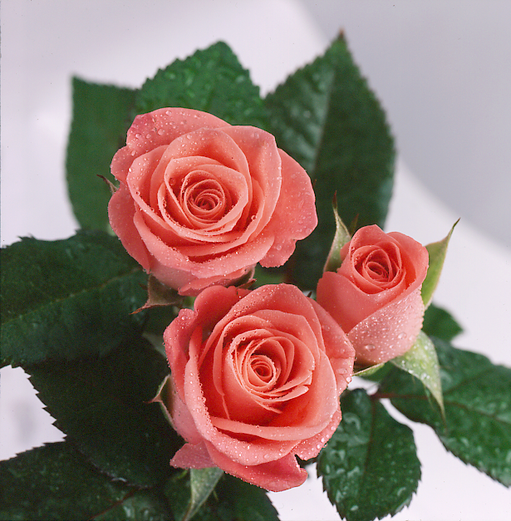
Thank you for your attendance

