Slide 1


To our class

Slide 2



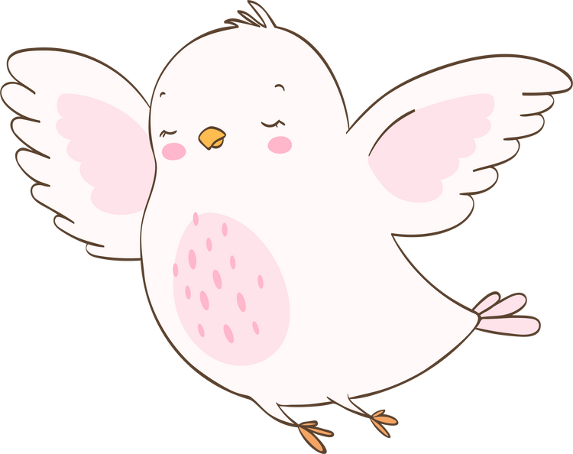
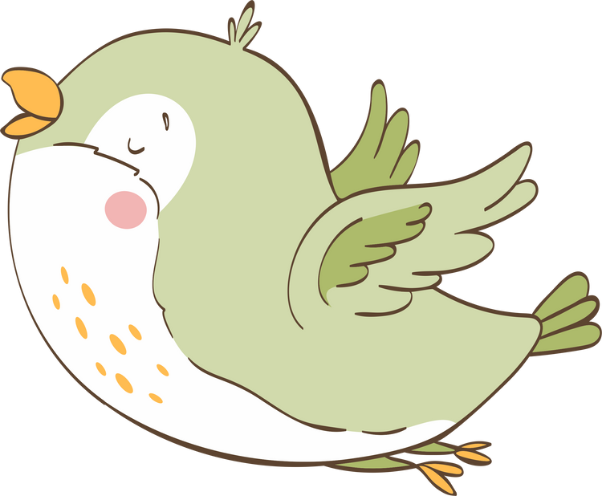
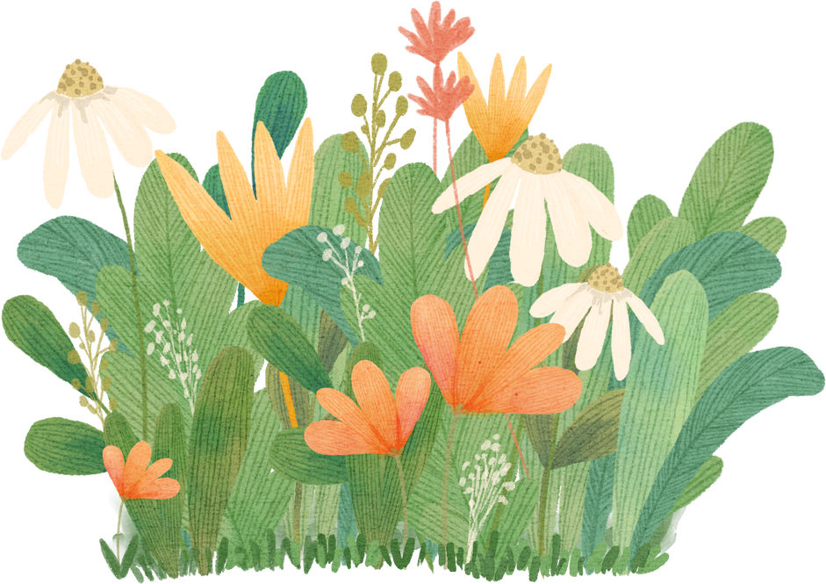
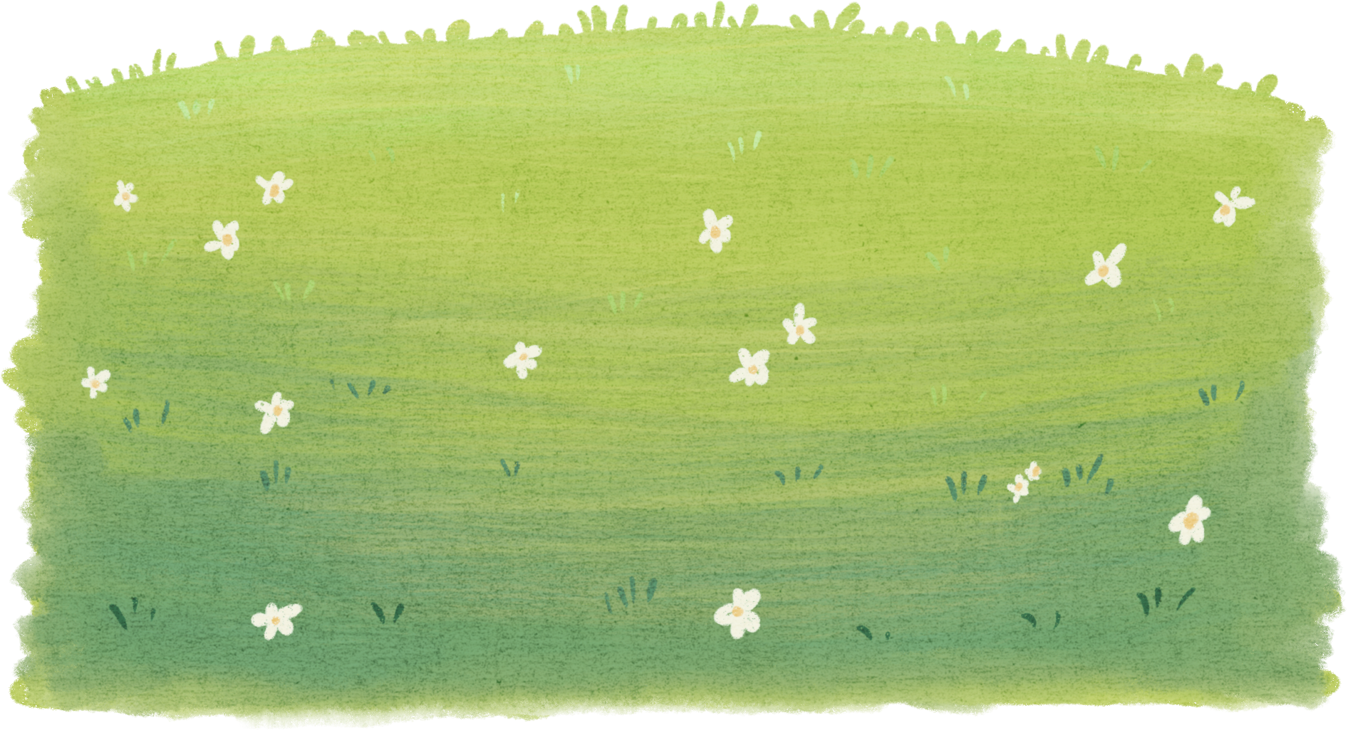
LOOK AT THE PICTURES AND SAY “SHOULD” OR “ SHOULDN’T”

Slide 3
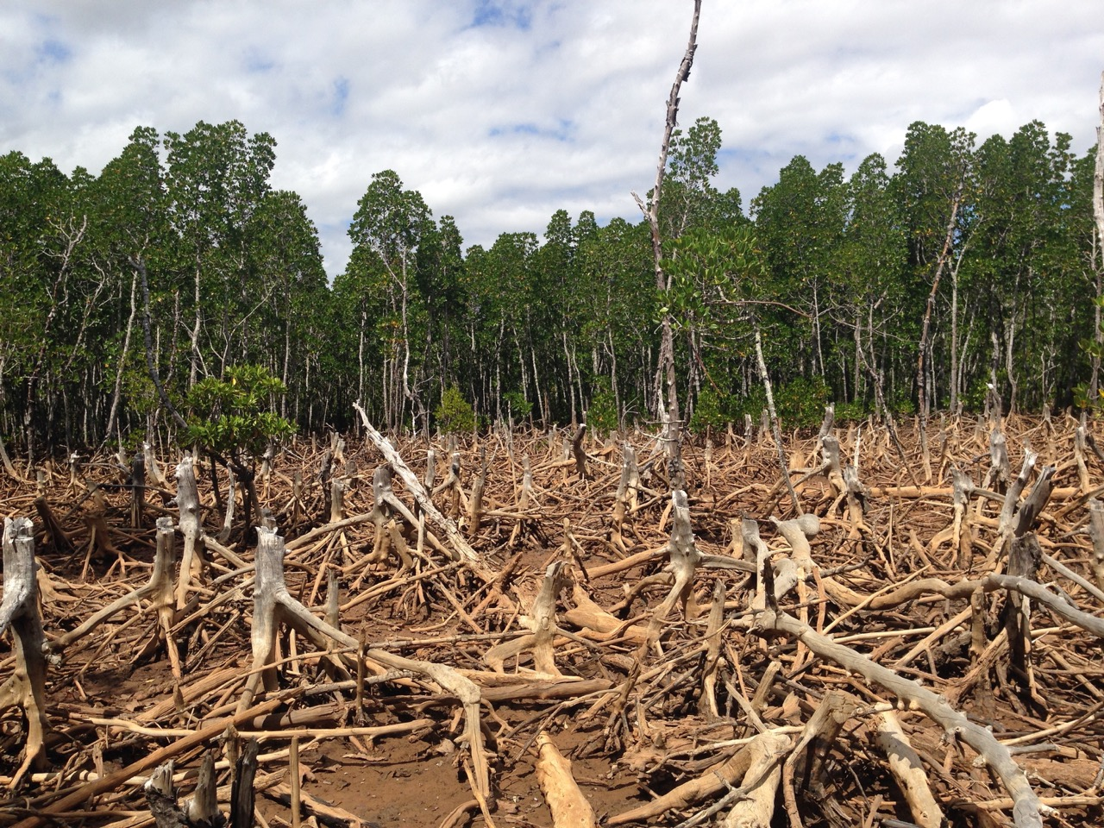


Should
Shouldn’t

Slide 4
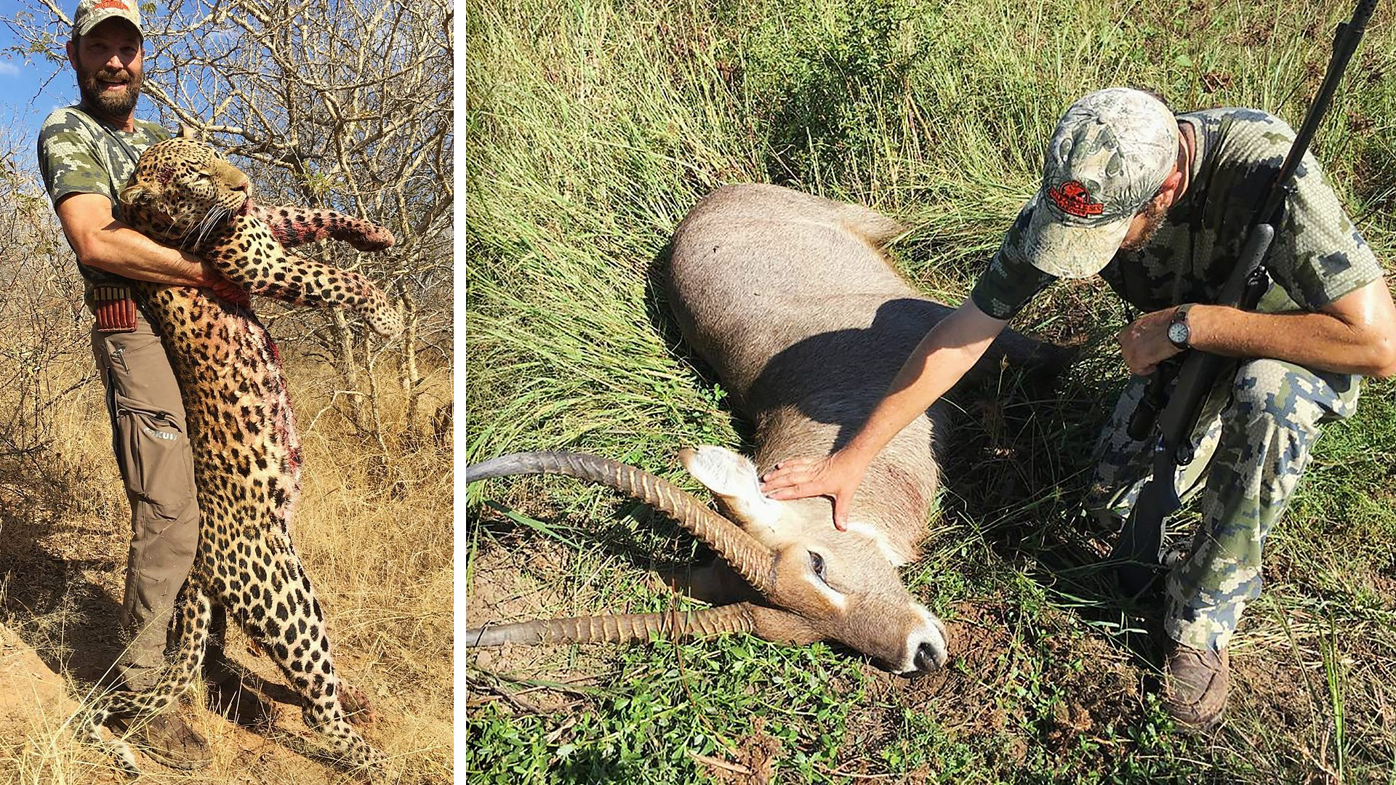
Should
Shouldn’t

Slide 5
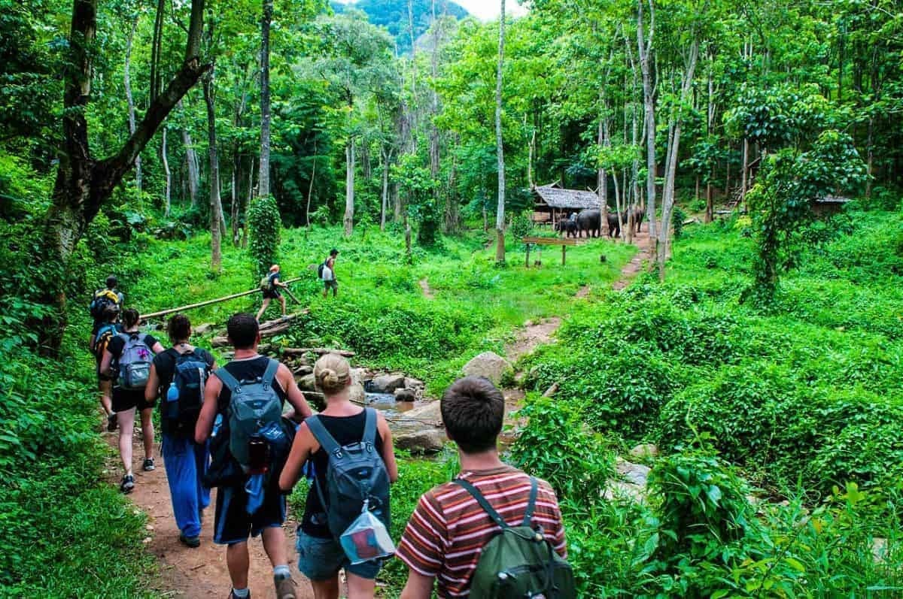
Should
Shouldn’t

Slide 6
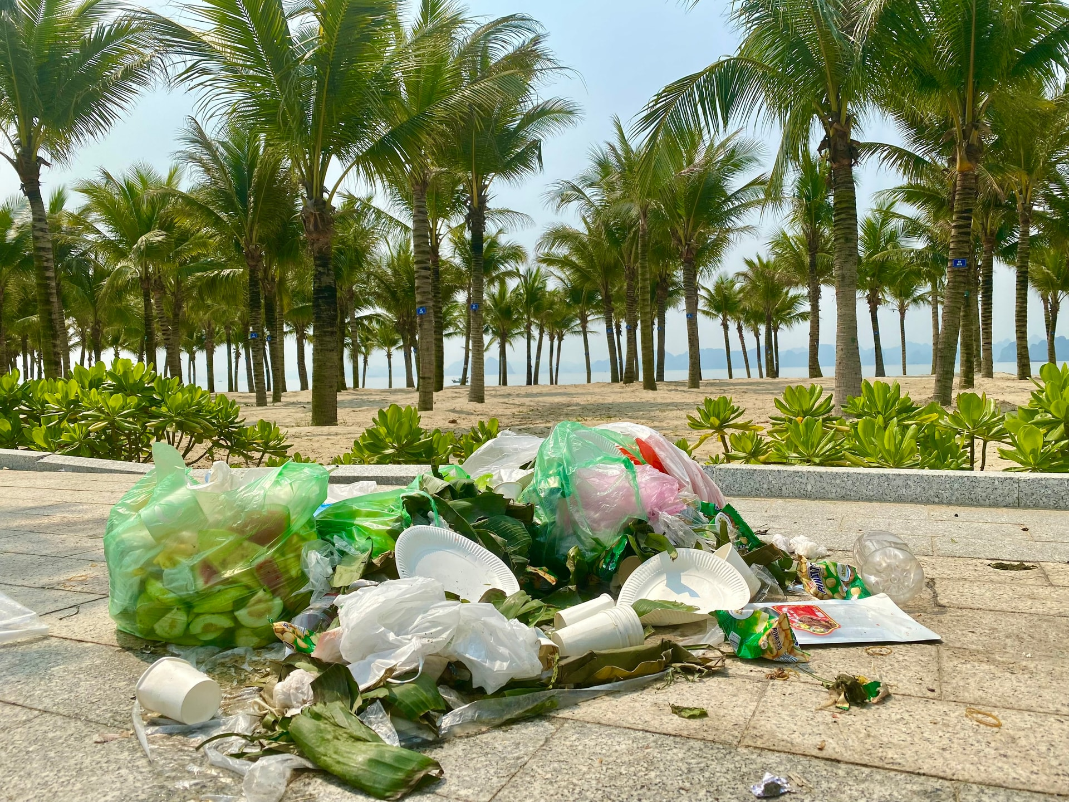
Should
Shouldn’t

Slide 7
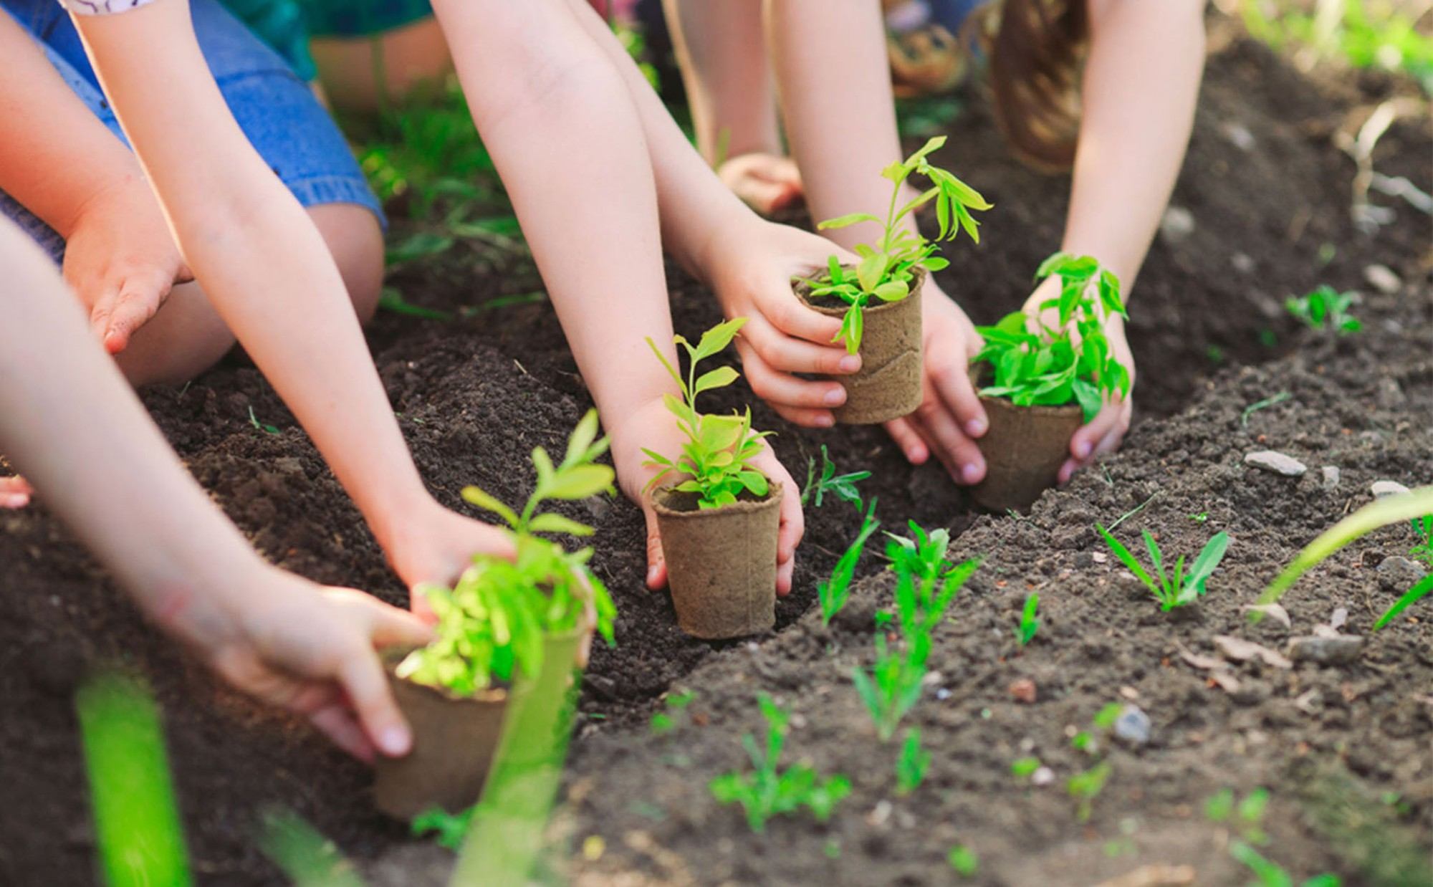
Should
Shouldn’t

Slide 8
Unit 10
SPEAKING
Ways to protect local biodiversity

Slide 9


1
Which of the followings are ways to protect local biodiversity. Tick the correct boxes.
1. banning the hunting of wild animals
2. planting local trees, flowers, and other plants
3. promoting mass tourism
4. educating people about the importance of biodiversity
5. increasing your carbon footprint

Slide 10
2
Work in pairs. Choose a way to protect local biodiversity from the list in Task 1, and tell your partner about it.
Why is it important? How will it help protect local biodiversity? What can you do to help?
Example:
A: I will choose planting local trees, flowers, and other plants
B: Why is it important?
A: Plants play an important role in ecosystems. They provide food and shelter for many animal species.
B: How will it help protect local biodiversity?
A: Each plant supports the ecosystem and biodiversity of the local area.
B: What can you do to help?
A: We can help by researching the local flora, and planting more native plants.

Slide 11


Slide 12


SPEAKING TIME

Slide 13

3
Work in groups. Your class is on a field trip to a national park. Read the situations below and
Think of some possible responses. Provide reasons for each answer.
Create a slogan

Slide 14
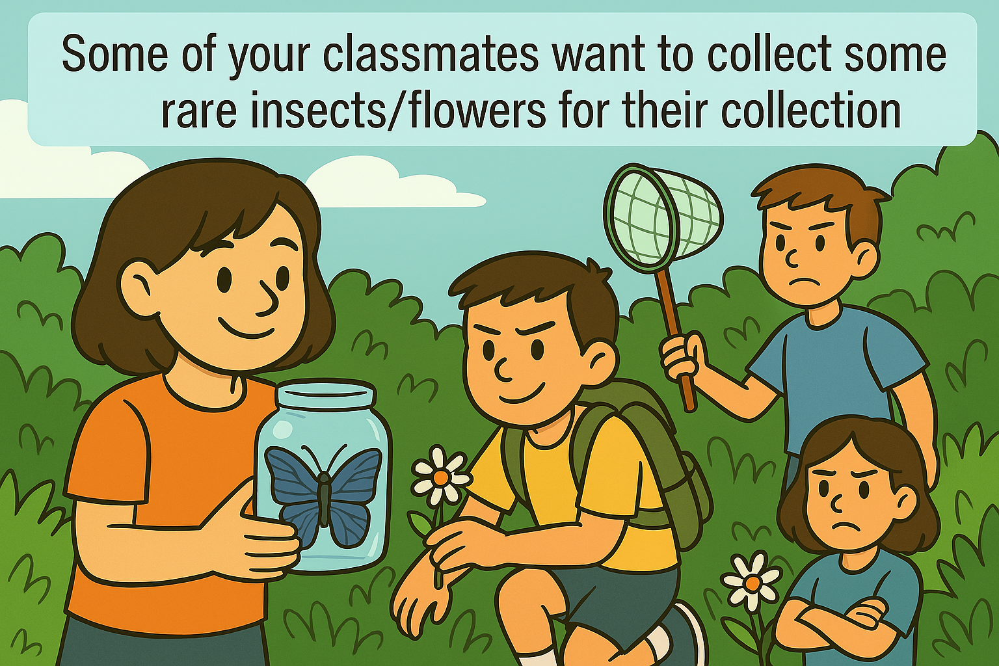
GROUP 1

Slide 15
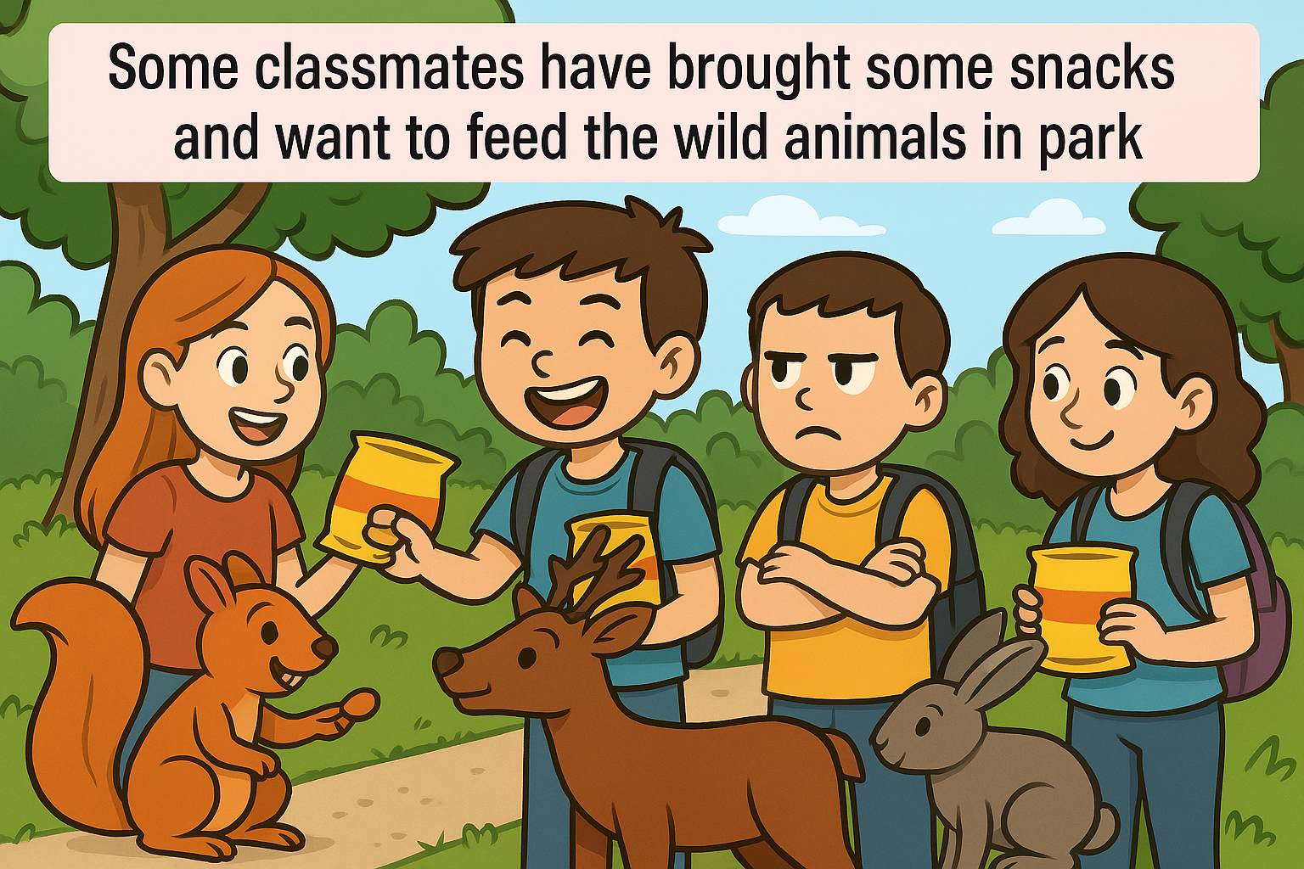
GROUP 2

Slide 16
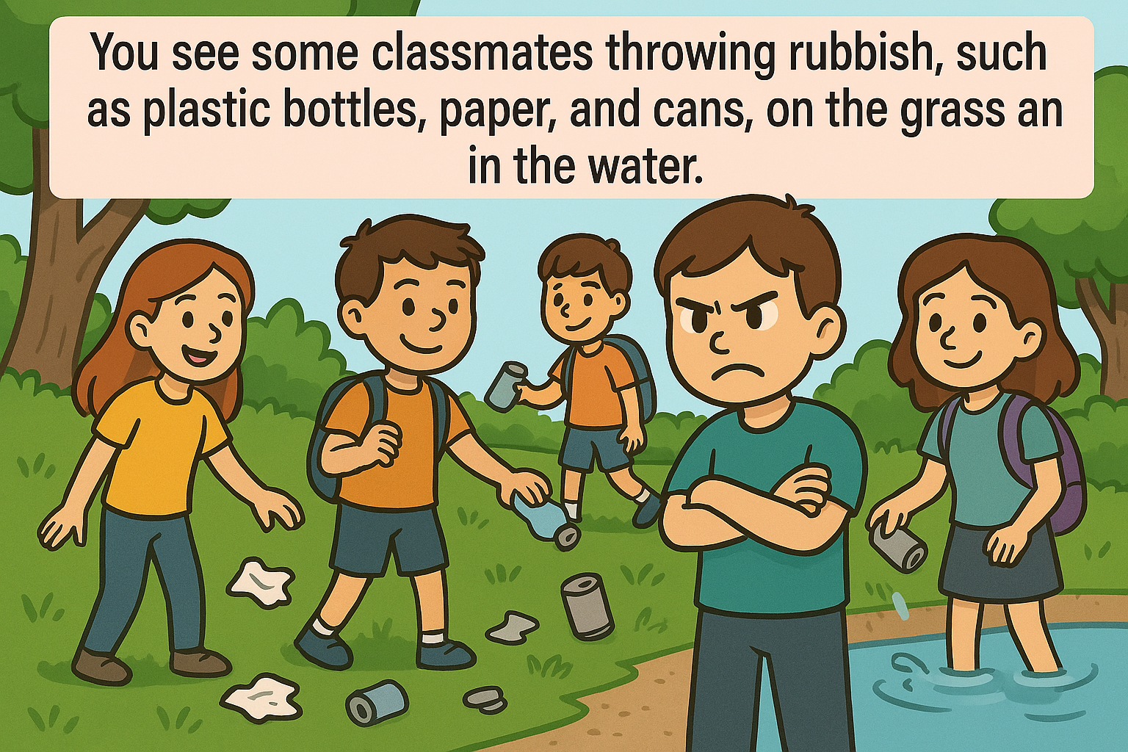
d
GROUP 3

Slide 17
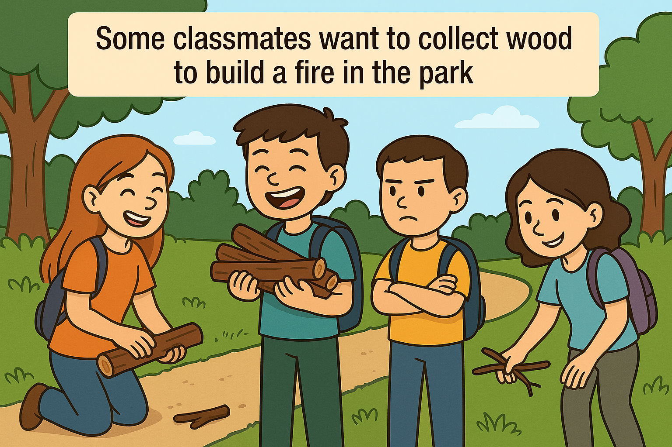
GROUP 4

Slide 18
Example: ‘You shouldn’t do that for several reasons. First, rare plant and animal species are endangered. Second, if people start killing or collecting them, they will soon disappear. Finally, this will harm local biodiversity and have a serious effect on the balance of the local ecosystem.’
Slogan: "Look, Love, Leave Them Safe!"

Slide 19
GROUP 1
GROUP 2
GROUP 3
GROUP 4

Slide 21


Slide 22
SPEAKING TIME

Slide 23


Vote for the best answer
Evaluation criteria
Creative and interesting ideas
Use a variety of vocabulary
2
Speak clearly and naturally
Correct stress and intonation
Speak smoothly
Eyes contact

Slide 24

Vote for the best answer

Slide 25







Slide 26
CONSOLIDATION
1
Wrap-up
What have you learnt today?
How to protect local biodiversity;
Vocabulary to talk about how to protect local biodiversity.

Slide 27
CONSOLIDATION
2
Homework
Do the exercises in the workbook.
Prepare for Listening-Unit 10.

Slide 28
THANK
YOU

