Slide 1
WELCOME TO OUR CLASS

Slide 2

Unit 3
GREEN LIVING
Watch the video and write the things we can reduce, reuse or recycle

Slide 3

Unit 3
GREEN LIVING
Watch the video and check

Slide 4
Plastic, paper, cardboard, wood, metal, textiles, stones, glass
Aluminum, bricks, wires, compost, copper, steel, brass
Plastic bottles, old tin cans, garden waste, magazines, old sweet wrappers, old T-shirts

Slide 5
Unit 3
GREEN LIVING
LESSON 4
SPEAKING
Paper: Reduce, Reuse, and Recycle!

Slide 6

Save paper, save _ _ _ _ _, save our _ _ _ _
t r e e s
life

Slide 7
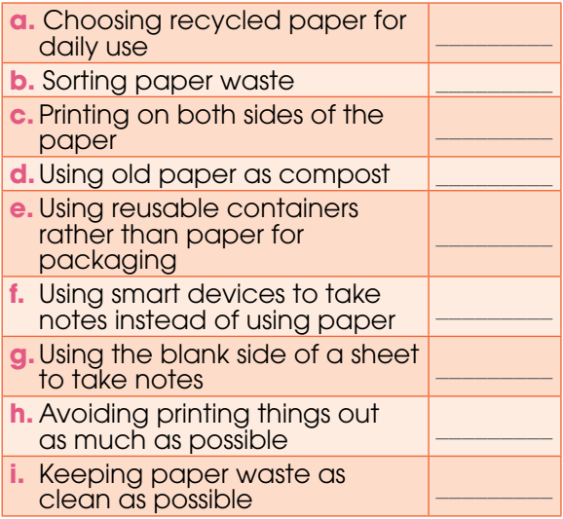
1
Sort these activities into Reduce, Reuse, and Recycle activities.
reduce
recycle
reduce
reuse
reduce
reduce
reuse
reduce
recycle

Slide 8
2
Pairwork. Talk about how to reduce, reuse, and recycle paper.
1. Which of the activities (a–i) above are you doing?
→ I’m sorting paper waste.
2. Can you suggest more ideas?
→I suggest donating second-hand books to school library.

Slide 9
Group 1 . After a club meeting, you notice that there are a lot of leaflets left, and they are only printed on one side. Your friend is asking you to help throw them away.
Group 2. You are asked to make something from old newspapers .
Group 3. Your group is preparing for a presentation, and everyone has found a lot of useful online material. A group member is asking you to print out about 50 pages of information for the group to read.
Group 4. Your club is organising a meeting, including a game in which people should write down something about themselves to share with others. The club president is asking you to buy a lot of Post-it notes for the game.

Slide 10
Homework
Do exercises in the workbook.
Write a paragraph about what you have done to save the environment.

Slide 11
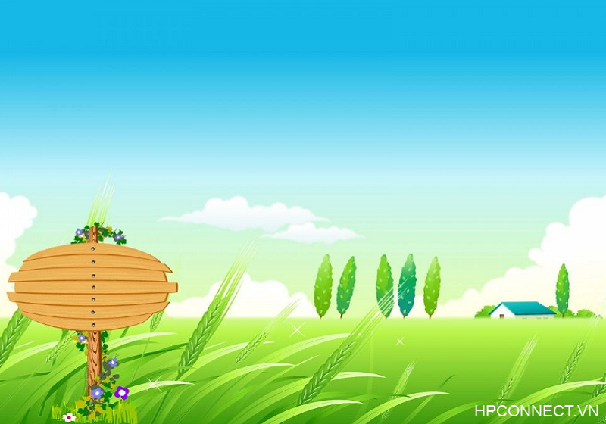
THANKS FOR ATTENDING OUR CLASS

